Slide 1
Cleaning Data
Sean McMinn
Northwestern University

Slide 2
Data stories?

Slide 3
Steps to a data story
Find data
Clean data
Analyze data
Present data

Slide 4
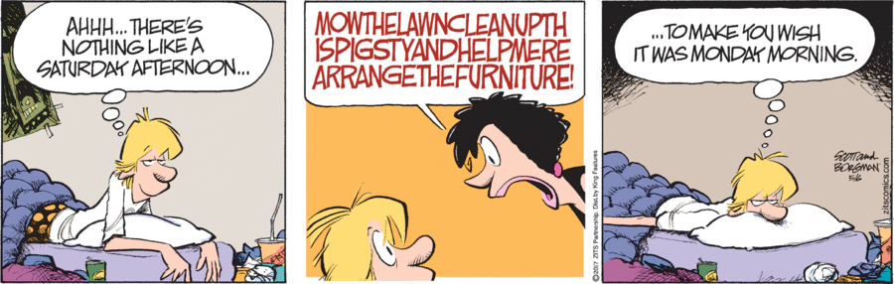
Data cleaning

Slide 5
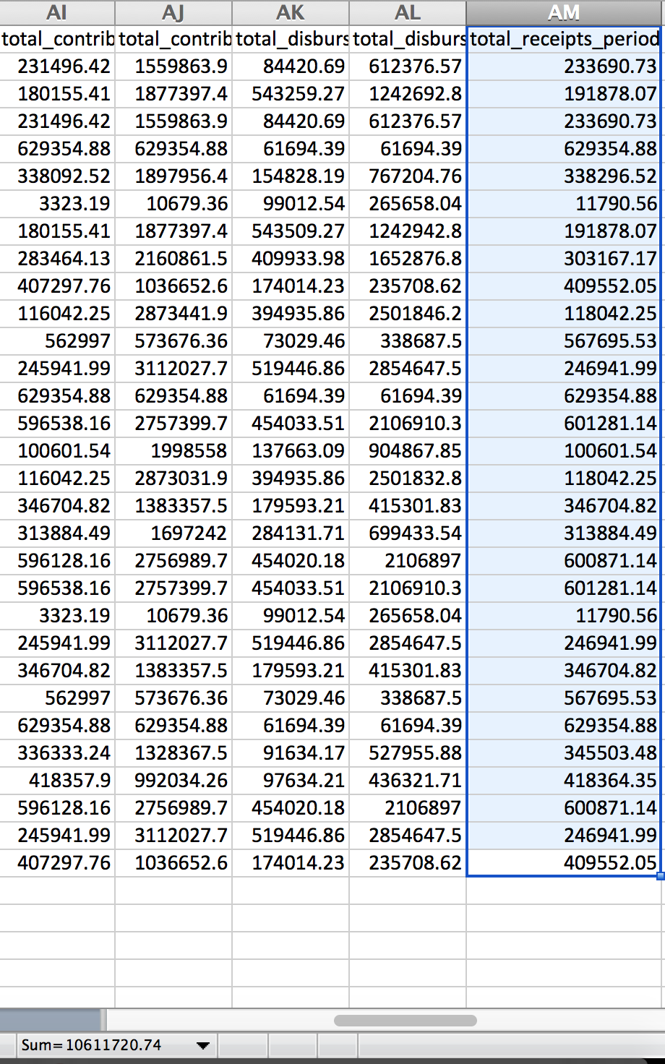
Data cleaning
How you can (read: I did) mess up if you don’t clean

Slide 6
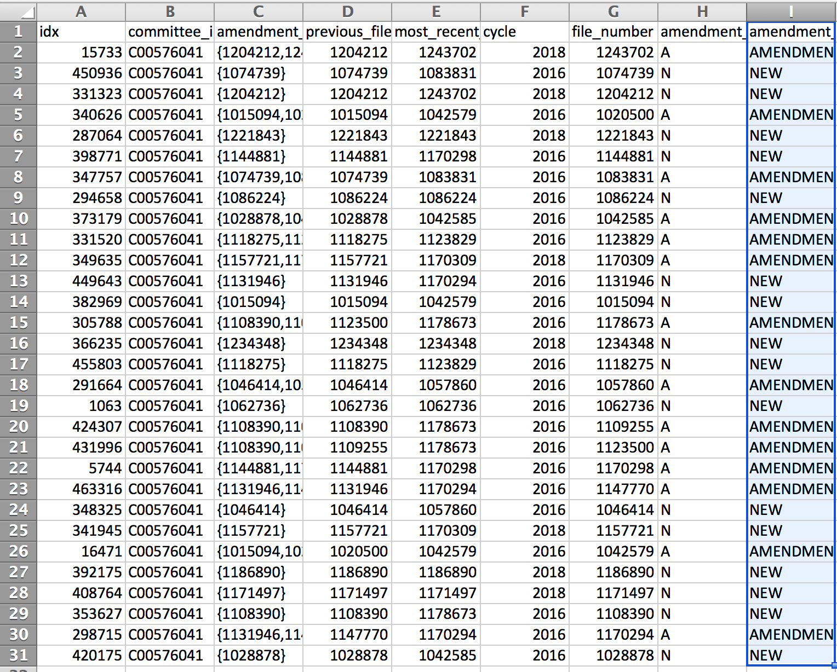
Data cleaning
How you can (read: I did) mess up if you don’t clean

Slide 7
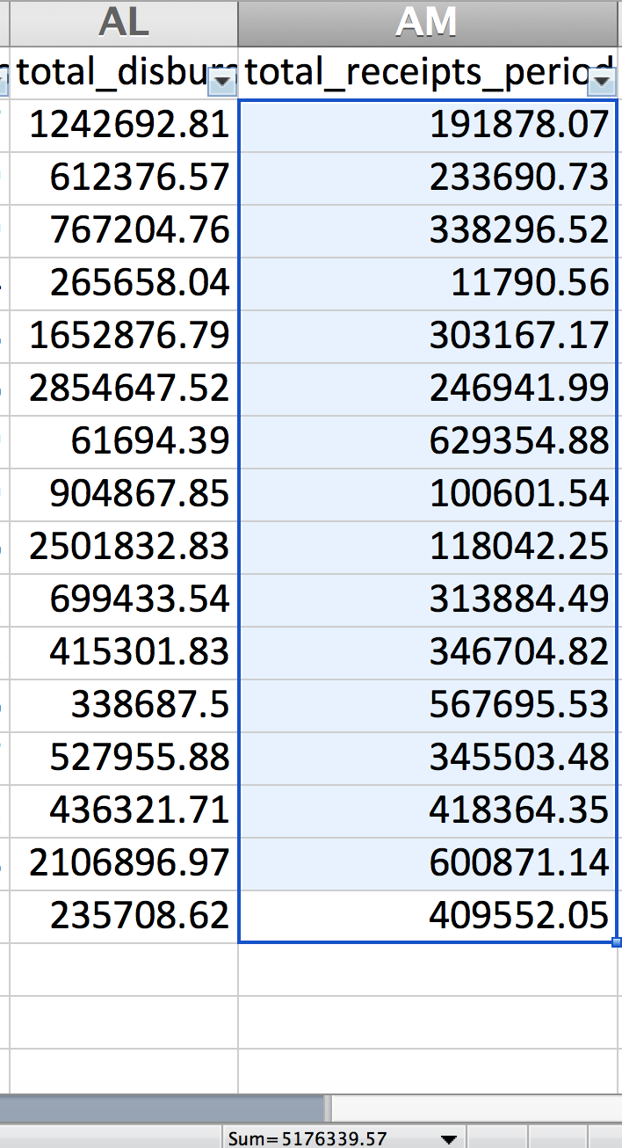
Data cleaning
How you can (read: I did) mess up if you don’t clean

Slide 8
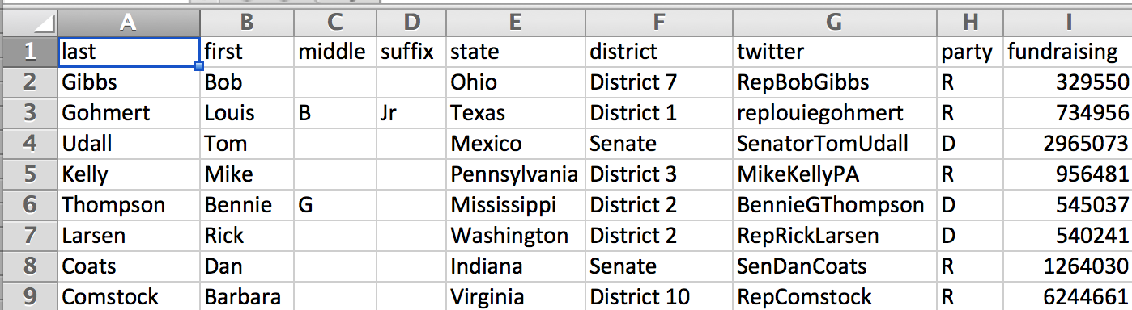
Data examples
“Good” (slash very fake) fundraising data

Slide 9
Data examples
“Good” (slash very fake) fundraising data
Separate fields in separate columns

Slide 10
Data examples
“Good” (slash very fake) fundraising data
Separate fields in separate columns
States and districts formatted the same

Slide 11
Data examples
“Good” (slash very fake) fundraising data
Clean numbers (no commas, $ signs)
Separate fields in separate columns
States and districts formatted the same

Slide 12
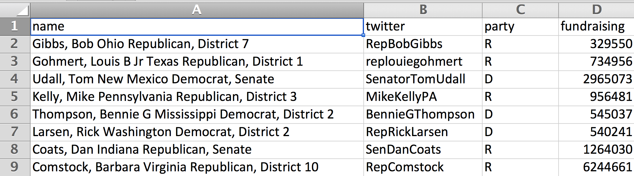
Data examples
How that data started out
Lots mashed together for each data point
Redundant column

Slide 13
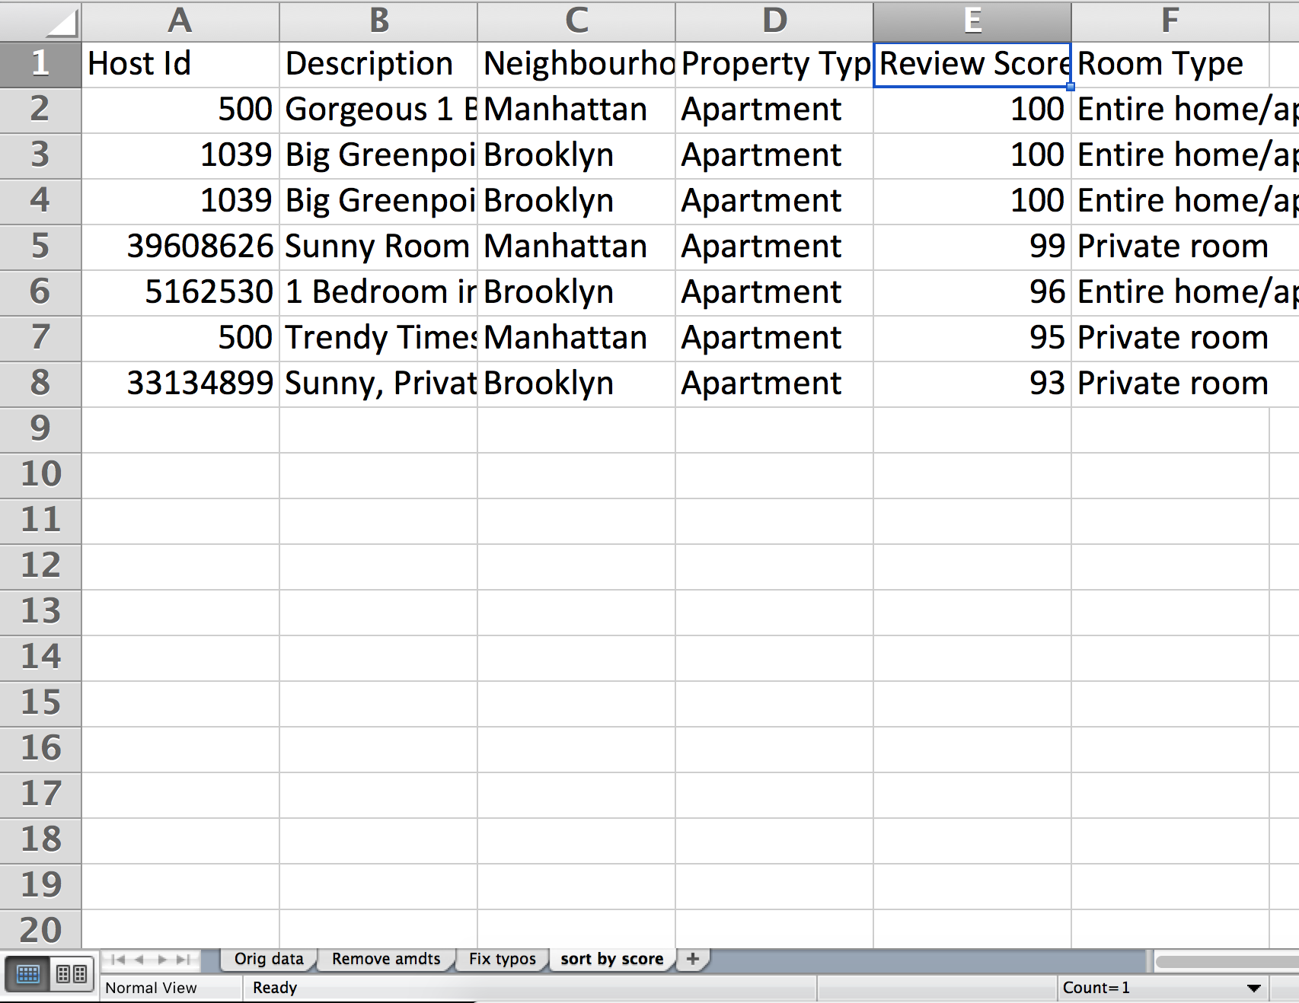
First, a word
Always work on a COPY of your data!
Always keep a RECORD of what you’re doing to your data
Example:

Slide 14
First, a word
Always work on a COPY of your data!
Always keep a RECORD of what you’re doing to your data
Example:

Slide 15
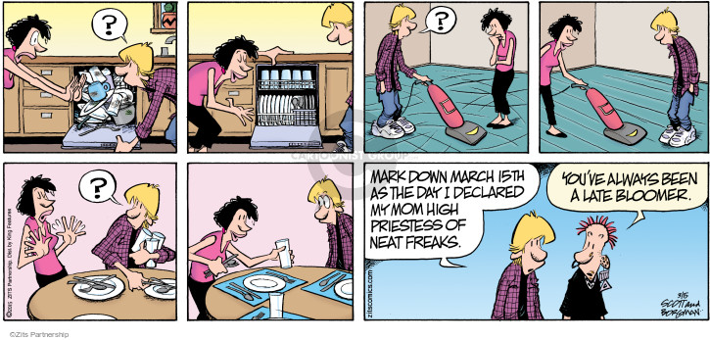
Cleaning techniques

Slide 16
Cleaning techniques
You can do everything by hand, one at a time, but UGH

Slide 17
Cleaning techniques
Filter then change
Marijuana lobbying data:
Org ➔ Organization
Marijuana-lobby-namechange.csv

Slide 18
Cleaning techniques
Find and replace
Marijuana lobbying data:
Org ➔ Organization
Marijuana-lobby-namechange.csv

Slide 19
Cleaning techniques
ADVANCED find and replace
a.k.a. regular expressions
a.k.a. regex
a.k.a. misleadingly intimidating pile of garbage
^".*" or \n[A-Za-z]*\t or : "\d* "

