Slide 1

Land Cover Classification from Satellite Imagery
Using CNN and U-Net Architectures
Daniil Khrestianovskii · Mariia Shmeleva
Peter the Great St. Petersburg Polytechnic University
Institute of Cybersecurity and Computer Science
Supervisor: Mohamad Khalil
2026
Notes:
[~1:00]
Good morning, everyone. My name is [your name], and I am presenting our project "Land Cover Classification from Satellite Imagery Using CNN and U-Net Architectures." This work was carried out at Peter the Great St. Petersburg Polytechnic University, Institute of Cybersecurity and Computer Science, under the supervision of Mohamad Khalil. Our goal was to train two deep learning models — a simple baseline CNN and a U-Net-based classifier — that automatically determine what type of land cover appears in a 64×64 satellite image patch from the EuroSAT dataset. The talk will take 20 to 25 minutes, after which we are happy to take questions.

Slide 2
Outline
1. Introduction & Problem Statement
2. State of the Art & Motivation
3. EuroSAT Dataset
4. Data Preparation
5. Reading the Dataset (code)
6. Model Architectures — SimpleCNN & U-Net Classifier
7. Model Characteristics
8. Training Techniques & Hyperparameters
9. Testing Protocol & Evaluation Metrics
10. Results & Hyperparameter Analysis
11. Conclusion
12. References
Land Cover Classification · SPbPU · 2026
Notes:
[~0:30]
Let me walk you through what we will cover. We start with the problem statement and motivation, move to related work and our contribution, then describe the EuroSAT dataset in detail. After that we look at data preparation and how it is loaded in code. The bulk of the talk covers the two model architectures, how they were trained, tested, and how the results compare. We close with conclusions and references.

Slide 3
State of the Art — Aim of the Work
Why do we need automatic land cover classification?
The Problem
Project Objective
▸ Cities expand rapidly; land use changes constantly
▸ Decision-makers need up-to-date, accurate land maps
▸ Sentinel-2 revisit time: every 5 days over Europe
▸ Volume of imagery: impossible to label manually
▸ Scale demands automation
▸ Design & train two deep learning architectures
▸ SimpleCNN — lightweight 3-block baseline
▸ U-Net Classifier — encoder-decoder with skip connections
▸ Classify 10 land cover types from satellite RGB images
▸ Compare models on identical data split & metrics
▸ Ensure full reproducibility (fixed seed, Docker)
Land Cover Classification · SPbPU · 2026
Notes:
[~1:30]
Why do we need automatic land cover classification? The scale of modern Earth observation makes manual labeling impractical. Sentinel-2 covers the entire European continent every five days — one week of imagery would take a team of analysts months to review by hand. Decision-makers in urban planning, agriculture, and environmental monitoring need frequent, accurate land use maps. Our objective is clear: design and fairly compare two architectures — a lightweight SimpleCNN baseline and a U-Net repurposed for scene-level classification — trained entirely from scratch on EuroSAT RGB imagery, with no ImageNet pre-training.

Slide 4
EuroSAT Dataset — Overview
eurosat-api.com · Sentinel-2 Satellite (ESA Copernicus)
27,000
64 × 64 px
10
13 (RGB used)
Total Images
Image Size
Land Classes
Spectral Bands
Dataset source: EuroSAT — derived from the Sentinel-2 satellite constellation (ESA Copernicus programme)
Spatial resolution: 10 – 60 m per pixel | Revisit time: every 5 days over Europe
Spectral bands: 13 bands available; we use RGB (3 bands) for direct comparability with published benchmarks
Normalisation: ImageNet statistics: mean [0.485, 0.456, 0.406] · std [0.229, 0.224, 0.225]
Class balance: AnnualCrop, Forest, Residential: 3,000 samples each | Pasture: 2,000 | others: 2,500
Link: https://github.com/phelber/EuroSAT
Land Cover Classification · SPbPU · 2026
Notes:
[~1:30]
The EuroSAT dataset comes from the Sentinel-2 satellite constellation, part of ESA's Copernicus programme. It contains 27,000 image patches, each 64×64 pixels, across 10 land cover classes. Although Sentinel-2 provides 13 spectral bands at resolutions from 10 to 60 meters per pixel, we use only the RGB version — the three visible bands. This makes our results directly comparable with published benchmarks. Before feeding images into the network, we normalize each channel using ImageNet statistics: mean [0.485, 0.456, 0.406] and standard deviation [0.229, 0.224, 0.225]. This is standard practice for RGB CNNs. The class distribution is slightly imbalanced: Forest, AnnualCrop, and Residential each have 3,000 samples, while Pasture has only 2,000. This mild imbalance is worth keeping in mind when looking at per-class results.

Slide 5
EuroSAT Dataset — 10 Land Cover Classes
Each 64×64 patch is labelled with exactly one class
AnnualCrop
Pasture
3,000
2,000
Seasonal agricultural fields
Grazing land (smallest class)
Forest
PermanentCrop
3,000
2,500
Dense tree cover
Orchards & vineyards
HerbaceousVegetation
Residential
3,000
3,000
Grassland & meadows
Urban housing areas
Highway
River
2,500
2,500
Major roads & motorways
Waterways & streams
Industrial
SeaLake
2,500
3,000
Factories, warehouses
Large open water bodies
images
Land Cover Classification · SPbPU · 2026
Notes:
[~1:00]
Here are the 10 land cover classes. Notice the variation in sample counts — Pasture has the fewest images at 2,000, which makes it potentially the hardest class to learn. The classes span a wide range of visual appearances: from dense Forest and open SeaLake — which are visually distinctive — to HerbaceousVegetation and PermanentCrop, which are difficult to separate even for a human expert at this resolution. This diversity is what makes EuroSAT a meaningful benchmark.

Slide 6
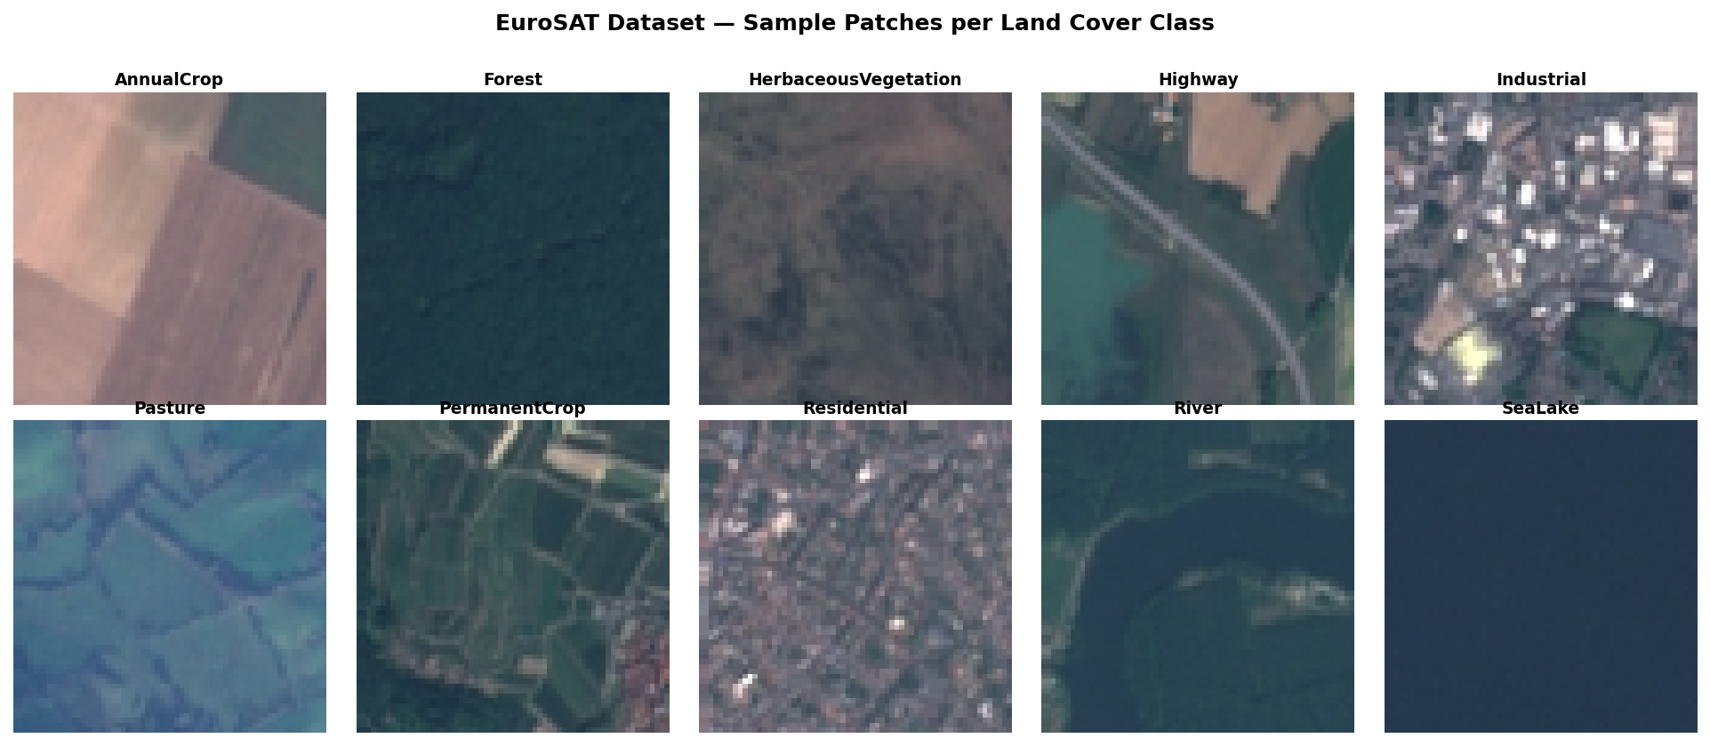
EuroSAT Dataset — Sample Patches
One representative 64×64 RGB patch per class
Land Cover Classification · SPbPU · 2026
Notes:
[~0:45]
Here you can see one sample patch for each of the 10 classes. Notice how Forest looks dark and textured, SeaLake is uniformly dark blue, and Residential shows the regular grid of streets and rooftops. The hardest pairs are immediately apparent: HerbaceousVegetation and Pasture look almost identical; PermanentCrop and AnnualCrop share similar textures. At 64×64 pixels and 10 meters per pixel, these distinctions are genuinely challenging.

Slide 7
Preparing the Dataset — Folder Structure
torchvision.datasets.ImageFolder-compatible layout
EuroSAT/
└── 2750/
├── AnnualCrop/
│ ├── AnnualCrop_00001.jpg
│ └── ... (3 000 images)
├── Forest/
│ └── ... (3 000 images)
├── HerbaceousVegetation/
├── Highway/
├── Industrial/
├── Pasture/
├── PermanentCrop/
├── Residential/
├── River/
└── SeaLake/
ImageFolder convention
Each sub-directory name becomes the class label.
The folder index determines the integer class ID (0-9 alphabetically).
How PyTorch reads it
datasets.ImageFolder(root='EuroSAT/2750')
→ discovers 10 classes automatically
→ returns (image_tensor, class_idx) pairs
Key benefit
No manual CSV or annotation file needed.
Adding a new class = adding a new sub-folder.
Land Cover Classification · SPbPU · 2026
Notes:
[~1:00]
The dataset lives on disk in an ImageFolder-compatible layout: one sub-directory per class, images inside. This is the format expected by torchvision's ImageFolder class. The class integer ID is assigned alphabetically — AnnualCrop gets index 0, Forest gets 1, and so on up to SeaLake at index 9. No annotation files, no CSV — the directory structure is the label. The key benefit is simplicity: adding a new class means adding a new folder.

Slide 8
Preparing the Dataset — Train / Val / Test Split
Fixed random seed = 42 for full reproducibility
TRAIN 70 % 18,900 images
VAL
15 %
4,050
TEST
15 %
4,050
Split method
torch.utils.data.random_split
Random seed
torch.Generator().manual_seed(42)
Training set
Gradient updates only — never inspected by hand
Validation set
One purpose: select the best epoch (lowest val_loss)
Test set
Touched exactly once, at the end — reports final metrics
Leakage prevention
No hyperparameter tuning uses test set information
Land Cover Classification · SPbPU · 2026
Notes:
[~1:00]
We split the 27,000 images 70 / 15 / 15 using torch.utils.data.random_split with a fixed generator seed of 42. That gives 18,900 training images, 4,050 for validation, and 4,050 for the test set. The roles are strictly separated. Training set: gradient updates only. Validation set: one purpose — choose which epoch's checkpoint to save. Test set: touched exactly once at the end to report final metrics. This strict separation is the foundation of our unbiased evaluation.

Slide 9
Reading the Dataset — data_utils.py
Transforms · DataLoaders · Class discovery
from torchvision import datasets, transforms
from torch.utils.data import DataLoader, random_split
transform = transforms.Compose([
transforms.ToTensor(),
transforms.Normalize(mean=[0.485, 0.456, 0.406],
std= [0.229, 0.224, 0.225])
])
full_dataset = datasets.ImageFolder(root='EuroSAT/2750', transform=transform)
# classes: ['AnnualCrop', 'Forest', ..., 'SeaLake'] (10 total)
train_dataset, val_dataset, test_dataset = random_split(
full_dataset, [18900, 4050, 4050],
generator=torch.Generator().manual_seed(42)
)
train_loader = DataLoader(train_dataset, batch_size=64, shuffle=True)
▸ ToTensor() — converts PIL image [0,255] → float tensor [0.0, 1.0]
▸ Normalize() — subtracts ImageNet channel mean, divides by channel std
▸ ImageFolder — auto-discovers classes from sub-directory names
▸ batch_size=64 — good balance between gradient noise and memory
Land Cover Classification · SPbPU · 2026
Notes:
[~1:00]
Here is the actual code from data_utils.py. Notice the transform pipeline: ToTensor converts a PIL image from uint8 [0,255] to float [0.0,1.0], then Normalize subtracts the ImageNet per-channel mean and divides by the standard deviation. ImageFolder discovers all 10 classes automatically from the directory names. random_split with the fixed seed produces the same three disjoint subsets on every run — this is what makes our experiments reproducible. Batch size 64 feeds the DataLoader: large enough for stable gradient estimates, small enough to fit comfortably in GPU memory.

Slide 10
Creating the CNN — SimpleCNN Architecture
Lightweight 3-block convolutional baseline · ~4.5 M parameters
Conv Block 1
3→32 ch
64→32 px
BN+ReLU+Pool
Conv Block 2
32→64 ch
32→16 px
BN+ReLU+Pool
Conv Block 3
64→128 ch
16→8 px
BN+ReLU+Pool
FC 8192→512
Dropout 0.5
ReLU
Input
3×64×64
Flatten
8192
FC 512→10
Softmax
→
→
→
→
→
→
Spatial: 64 → 32 → 16 → 8 Channels: 3 → 32 → 64 → 128
▸ 3×3 conv, padding=1 (preserves spatial size before pooling)
▸ 2×2 MaxPool halves spatial dimensions at each stage
▸ Dropout p=0.5 in FC head prevents overfitting
Land Cover Classification · SPbPU · 2026
Notes:
[~1:45]
SimpleCNN is our baseline. It has three convolutional blocks, each with a 3×3 convolution with padding=1 — which preserves spatial size before pooling — followed by Batch Normalization, ReLU activation, and 2×2 MaxPool that halves spatial dimensions. The channel depth grows: 3 → 32 → 64 → 128. After three pools, the 8×8 feature map is flattened to a vector of 8,192 elements. Two fully connected layers follow: 8192→512 with Dropout 0.5 to prevent overfitting, then 512→10 for the class logits. Total: ~4.5 million parameters. Batch Normalization proved critical — removing it reduced accuracy by ~3 percentage points in our preliminary experiments.

Slide 11
Creating the CNN — U-Net Classifier Architecture
Encoder-decoder with skip connections · ~8.1 M parameters
ENCODER
DECODER
CLASSIFICATION HEAD
Input 3ch 64×64
DoubleConv 64ch
TransConv 256ch
skip ─────▶
AdaptiveAvgPool2d
(1×1)
Pool + DC 128ch
cat+DC 256ch
skip ─────▶
Pool + DC 256ch
TransConv 128ch
Flatten → 64-dim
skip ─────▶
Pool + DC 512ch 8×8
cat+DC 128ch
Linear 64 → 10
TransConv 64ch
Class Logits
cat+DC 64ch
Key adaptation: segmentation head replaced by GlobalAvgPool + Linear → one label per image
Land Cover Classification · SPbPU · 2026
Notes:
[~1:45]
The U-Net Classifier has an encoder path of four DoubleConv blocks — two 3×3 convolutions per stage, each with BatchNorm and ReLU — interspersed with MaxPool operations. Channels grow: 3→64→128→256→512, while spatial size shrinks from 64×64 down to 8×8. The decoder mirrors this with transposed convolutions that upsample back to full resolution. The key innovation is skip connections: before each DoubleConv in the decoder, we concatenate the upsampled feature map with the matching encoder feature map, preserving fine spatial detail that would otherwise be lost during downsampling. Our adaptation for classification: instead of the original 1×1 segmentation head, we attach an AdaptiveAvgPool that collapses the spatial map to a single 64-dimensional vector, followed by a Linear layer to 10 classes. Total: ~8.1 million parameters.

Slide 12
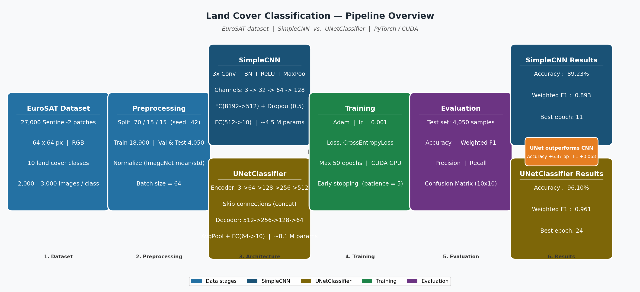
Architecture Overview — Pipeline
EuroSAT → Preprocessing → Model → Training → Evaluation
Land Cover Classification · SPbPU · 2024
Notes:
[~1:00]
This workflow diagram summarizes the full pipeline. On the left: the EuroSAT dataset. Then preprocessing: 70/15/15 split, ImageNet normalization. The two models are trained in parallel under identical conditions. Finally evaluation on the shared test set. The diagram also shows the key characteristics of each model side by side — you can already see the accuracy gap: 89.23% for SimpleCNN versus 96.10% for U-Net.

Slide 13
Model Characteristics — SimpleCNN
Layer-by-layer parameter breakdown
Layer
Output shape
Parameters
Conv2d 3→32
32×64×64
896
BatchNorm2d 32
32×64×64
64
MaxPool2d 2×2
32×32×32
0
Conv2d 32→64
64×32×32
18,496
BatchNorm2d 64
64×32×32
128
MaxPool2d 2×2
64×16×16
0
Conv2d 64→128
128×16×16
73,856
BatchNorm2d 128
128×16×16
256
MaxPool2d 2×2
128×8×8
0
Flatten
8,192
0
Linear 8192→512
512
4,194,816
Dropout 0.5
512
0
4.5 M
17.2 MB
11
89.23 %
Linear 512→10
10
5,130
Total Parameters
Model Size
Trained (best epoch)
Test Accuracy
TOTAL
~4.5 M
Land Cover Classification · SPbPU · 2024
Notes:
[~1:15]
SimpleCNN in numbers. The layer table shows that the dominant cost is the first fully connected layer: 8,192 × 512 = ~4.2 million parameters out of 4.5 million total. This is why Dropout at that layer is so important — without it, that many free parameters on 18,900 training images would overfit quickly. The convolutional layers themselves are lightweight: the three conv blocks together account for fewer than 100K parameters. The model fits in 17.2 MB and trains to its best checkpoint in just 11 epochs.

Slide 14
Model Characteristics — U-Net Classifier
Encoder · Decoder · Classification Head breakdown
Block
Output shape
Approx. params
DoubleConv 3→64 (inc)
64×64×64
~38 K
MaxPool + DoubleConv 64→128
128×32×32
~221 K
MaxPool + DoubleConv 128→256
256×16×16
~885 K
MaxPool + DoubleConv 256→512
512×8×8
~3.5 M
ConvTranspose 512→256
256×16×16
~524 K
DoubleConv 512→256 (skip)
256×16×16
~1.2 M
ConvTranspose 256→128
128×32×32
~131 K
DoubleConv 256→128 (skip)
128×32×32
~590 K
ConvTranspose 128→64
64×64×64
~32 K
DoubleConv 128→64 (skip)
64×64×64
~148 K
AdaptiveAvgPool + Linear
10
650
TOTAL
~8.1 M
8.1 M
30.9 MB
24
96.10 %
Total Parameters
Model Size
Trained (best epoch)
Test Accuracy
Land Cover Classification · SPbPU · 2024
Notes:
[~1:15]
U-Net Classifier in numbers. The parameter count is distributed much more evenly across the network. The encoder bottleneck — the 256→512 DoubleConv — accounts for ~3.5M parameters. The decoder adds another ~2M in upsampling and DoubleConv blocks. The classification head — AdaptiveAvgPool plus a single linear layer of 64×10 = 640 weights — is almost negligible. Total ~8.1M, model size 30.9 MB — 1.8× larger than SimpleCNN. Best epoch 24, test accuracy 96.10%.

Slide 15
Training Techniques & Hyperparameters
Identical conditions for both models — fair comparison
Optimizer
Adam (lr = 0.001) — stable convergence for both models
Loss function
CrossEntropyLoss — standard multi-class classification
Batch size
64 — balances gradient noise vs. GPU memory
Max epochs
50 — upper bound; early stopping usually triggers earlier
Early stopping
Patience = 5 epochs; min_delta = 0.001 (CNN) / 0.0 (U-Net)
Checkpoint
Best model saved when val_loss improves; used for final eval
Random seed
42 for both data split and weight init — full reproducibility
Device
CUDA GPU if available, else CPU
Early stopping saved 34 epochs for SimpleCNN · 21 epochs for U-Net — protects against overfitting by selecting best validation checkpoint
Land Cover Classification · SPbPU · 2024
Notes:
[~1:30]
Both models share identical training conditions — this is essential for a fair comparison. Adam optimizer with learning rate 0.001 proved the most stable; lr=0.01 caused oscillation in early epochs. CrossEntropyLoss is the standard multi-class objective. Batch size 64 balances gradient noise and memory. The early stopping mechanism checks validation loss every epoch: if it improves by more than min_delta, save a checkpoint and reset the patience counter; if no improvement for 5 consecutive epochs, stop training and load the best saved checkpoint. The min_delta differs: 0.001 for SimpleCNN (noisier curve) and 0.0 for U-Net (smoother curve). Early stopping saved 34 unnecessary epochs for SimpleCNN and 21 for U-Net.

Slide 16
Testing Protocol & Evaluation Metrics
4,050 held-out images · never seen during training or tuning
Accuracy
Weighted F1
Weighted
Precision
Weighted
Recall
Fraction of correctly classified images
(all 4,050 test samples)
Harmonic mean of precision & recall
weighted by class frequency
TP / (TP + FP) per class
weighted by class frequency
TP / (TP + FN) per class
weighted by class frequency
Why weighted averaging?
Class sizes differ (Pasture: 2,000 · Forest: 3,000). Weighted metrics reflect the real class distribution, giving a more realistic picture of deployment performance than macro averaging.
Confusion matrix (10 × 10)
Each cell [i, j] shows how many test images of true class i were predicted as class j.
Diagonal = correct predictions. Off-diagonal = errors. Used to identify the hardest class pairs.
Checkpoint selection rule: evaluate.py loads the checkpoint with the lowest validation loss (not the last epoch). Validation loss is a more sensitive signal than accuracy: it degrades before accuracy does, giving earlier warning of overfitting.
Test set is used EXACTLY ONCE — after all hyperparameter choices are final
Land Cover Classification · SPbPU · 2024
Notes:
[~1:00]
Our test protocol uses the 4,050 held-out images seen at no point during training or hyperparameter selection. We report four metrics: accuracy, weighted F1, weighted precision, and weighted recall. Weighted averaging weights each class's score by its frequency in the test set — correct for a mildly imbalanced dataset. We also inspect the full 10×10 confusion matrix, which reveals which class pairs are most often confused. The checkpoint used is always the one with the lowest validation loss — not the last epoch — because validation loss starts degrading before accuracy does, giving an earlier and more reliable signal.

Slide 17
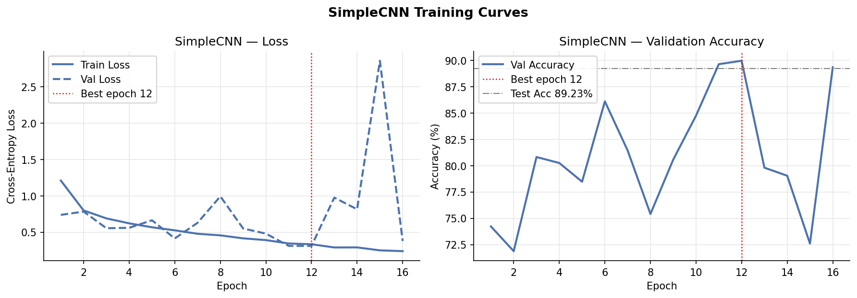
Results — SimpleCNN
Test set · 4,050 images · best checkpoint at epoch 11
89.23 %
0.8930
0.8963
0.8923
Test Accuracy
Weighted F1
Precision
Recall
Per-Class F1 Highlights
Best classes
Forest: 0.954
SeaLake: 0.948
Residential: 0.939
Hardest classes
HerbaceousVegetation: 0.821 ← visually similar to Pasture
PermanentCrop: 0.833 ← texture overlap with AnnualCrop
River: 0.836 ← thin strip, confused with Highway
Land Cover Classification · SPbPU · 2024
Notes:
[~1:45]
SimpleCNN results. The training curves on the left show loss and accuracy over 16 epochs, with the best checkpoint at epoch 11 marked by a vertical line. Validation loss at best epoch: 0.3105. On the test set: accuracy 89.23%, weighted F1 0.8930. Looking at per-class results, the model handles visually distinctive classes well — Forest 0.954, SeaLake 0.948, Residential 0.939. The hardest classes are HerbaceousVegetation at 0.821, PermanentCrop at 0.833, and River at 0.836. These failures are predictable: at 10 meters per pixel, a river is a thin strip easily confused with a highway or surrounding fields; herbaceous vegetation and pastures look nearly identical.

Slide 18
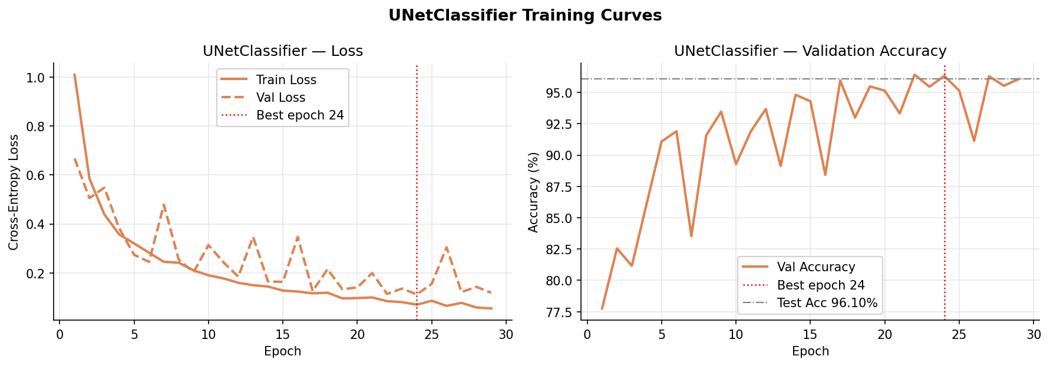
Results — U-Net Classifier
Test set · 4,050 images · best checkpoint at epoch 24
96.10 %
0.9610
0.9613
0.9610
Test Accuracy
Weighted F1
Precision
Recall
Gains over SimpleCNN
River: 0.836 → 0.951 (+0.115)
PermanentCrop: 0.833 → 0.940 (+0.107)
HerbaceousVeg.: 0.821 → 0.939 (+0.118)
Highway: 0.848 → 0.978 (+0.130)
Residential: 0.939 → 0.986 (+0.047)
SeaLake: 0.948 → 0.979 (+0.031)
Improvement is consistent across ALL classes,
not limited to easy ones → systematic architectural gain
Land Cover Classification · SPbPU · 2024
Notes:
[~1:45]
U-Net Classifier results. Best validation loss: 0.1116 at epoch 24. On the test set: accuracy 96.10%, weighted F1 0.9610 — a 6.87 percentage point improvement over SimpleCNN. What is most striking is that the gains are consistent across all classes. River jumps from 0.836 to 0.951 — a gain of +0.115 from one architectural change. PermanentCrop: +0.107. HerbaceousVegetation: +0.118. Even the already-strong classes improve: Highway from 0.848 to 0.978, Residential from 0.939 to 0.986. Why? Skip connections allow the network to simultaneously access fine spatial detail from shallow encoder layers and abstract semantic features from deep layers. For distinguishing visually similar land types, this dual access to local and global context is the key advantage.

Slide 19
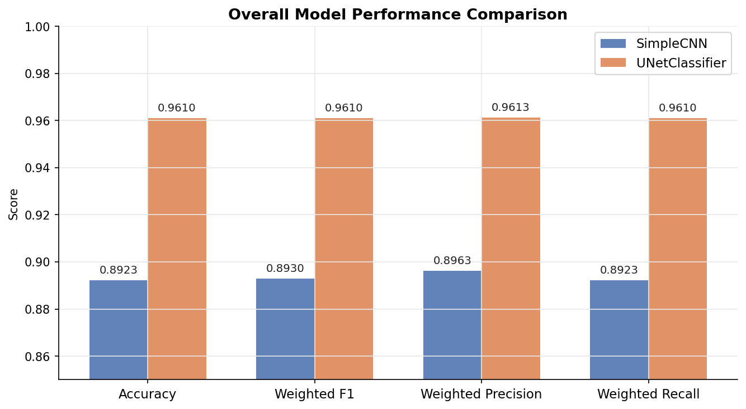
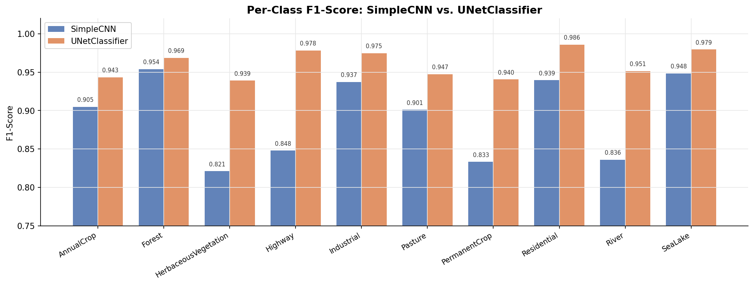
Results — Model Comparison
SimpleCNN vs. U-Net Classifier · same test set · same metrics
Metric
SimpleCNN
U-Net Classifier
Δ
Test Accuracy
89.23 %
96.10 %
+6.87 pp
Weighted F1
0.8930
0.9610
+0.068
Weighted Precision
0.8963
0.9613
+0.065
Weighted Recall
0.8923
0.9610
+0.069
Best Val Loss
0.3105
0.1116
−64 %
Best Epoch
11
24
×2.2
Parameters
~4.5 M
~8.1 M
×1.8
Model size
17.2 MB
30.9 MB
×1.8
Worst-class F1
0.821
0.939
+0.118
Land Cover Classification · SPbPU · 2024
Notes:
[~1:30]
The comparison table summarizes everything. Accuracy improves 6.87 pp. Weighted F1 up 0.068. Best validation loss drops 64%. U-Net takes twice as many epochs and is 1.8× larger — but the worst-class F1 improves by 0.118. The bar charts confirm: every single metric improves, and every single class improves. The cost — 1.8× more parameters, 2× more training epochs, 13 extra MB of storage — is clearly justified. In any real deployment scenario where accuracy matters, U-Net is the better choice.

Slide 20
Conclusion
SimpleCNN
▸ 89.23 % accuracy · F1 = 0.893
▸ Converges in 11 epochs · 4.5 M params
▸ Fast, lightweight, practical baseline
▸
U-Net Classifier
▸ 96.10 % accuracy · F1 = 0.961
▸ Converges in 24 epochs · 8.1 M params
▸ +6.87 pp over SimpleCNN across all classes
Key Lessons
▸ Skip connections + hierarchical reuse = best architectural choice for satellite imagery
▸ U-Net naturally combines local texture and global context
▸ Batch Normalization critical: +3 pp accuracy, faster convergence
▸ Early stopping + fixed seed → reproducible, robust evaluation
Future Work
▸ Use all 13 Sentinel-2 bands (NIR/SWIR boost vegetation classes)
▸ Data augmentation (flips, rotation) especially for Pasture
▸ Transfer learning: ResNet/EfficientNet backbone fine-tuning
▸ Temporal fusion: multi-date stack for seasonal dynamics
Land Cover Classification · SPbPU · 2024
Notes:
[~1:15]
To summarize: we designed, trained, and evaluated two architectures. SimpleCNN gives 89.23% accuracy with 4.5M parameters in 11 epochs — a strong and practical lightweight baseline. U-Net Classifier gives 96.10% with 8.1M parameters in 24 epochs — a systematic +6.87 pp across all classes. The central lesson: skip connections and hierarchical feature reuse, the defining properties of U-Net, are highly effective for satellite imagery because they allow the model to exploit both local texture and global context simultaneously. From an engineering standpoint, fixed seed, Docker, and the modular pipeline ensure full reproducibility. Looking ahead, the most promising directions are using all 13 Sentinel-2 bands, adding data augmentation, and fine-tuning a pre-trained backbone.

Slide 21
References
[1] P. Helber, B. Bischke, A. Dengel, D. Borth. "EuroSAT: A Novel Dataset and Deep Learning Benchmark for Land Use and Land Cover Classification." IEEE JSTARS, 2019.
[2] O. Ronneberger, P. Fischer, T. Brox. "U-Net: Convolutional Networks for Biomedical Image Segmentation." MICCAI, 2015.
[3] K. He, X. Zhang, S. Ren, J. Sun. "Deep Residual Learning for Image Recognition." CVPR, 2016.
[4] E. Maggiori, Y. Tarabalka, G. Charpiat, P. Alliez. "Convolutional Neural Networks for Large-Scale Remote-Sensing Image Classification." IEEE TGRS, 2017.
[5] K. S. Nogueira et al. "Exploiting EfficientNet and Transfer Learning for Land Use Classification." Remote Sensing, 2019.
[6] Y. Li et al. "Deep Learning for Remote Sensing Image Classification: A Survey." Wiley WIREs Data Mining, 2018.
[7] S. Ioffe, C. Szegedy. "Batch Normalization: Accelerating Deep Network Training." ICML, 2015.
[8] D. P. Kingma, J. Ba. "Adam: A Method for Stochastic Optimization." ICLR, 2015.
Land Cover Classification · SPbPU · 2024
Notes:
[~0:30]
Here are the references we cited throughout the presentation. The key papers are Helber et al. for EuroSAT, Ronneberger et al. for U-Net, and He et al. for ResNet. Thank you very much for your attention — we are happy to take any questions.

