Slide 1
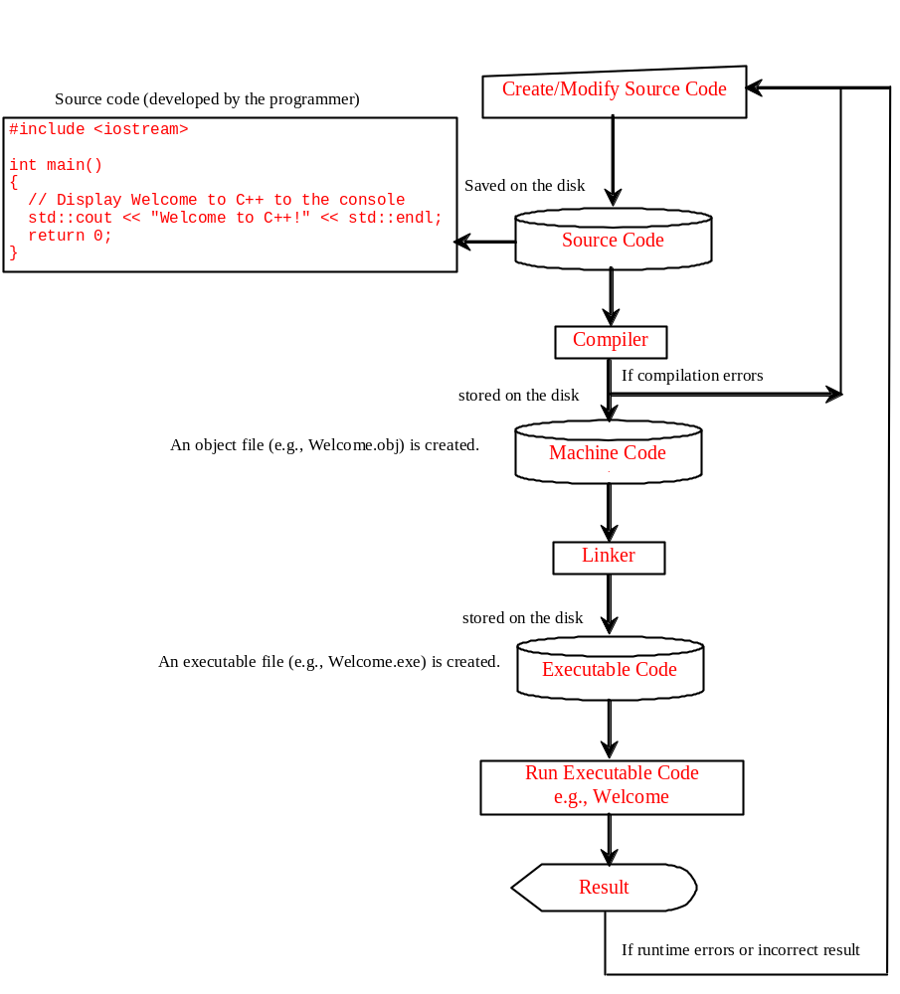
Program running process
Creating, Compiling, and Running Programs

Slide 2
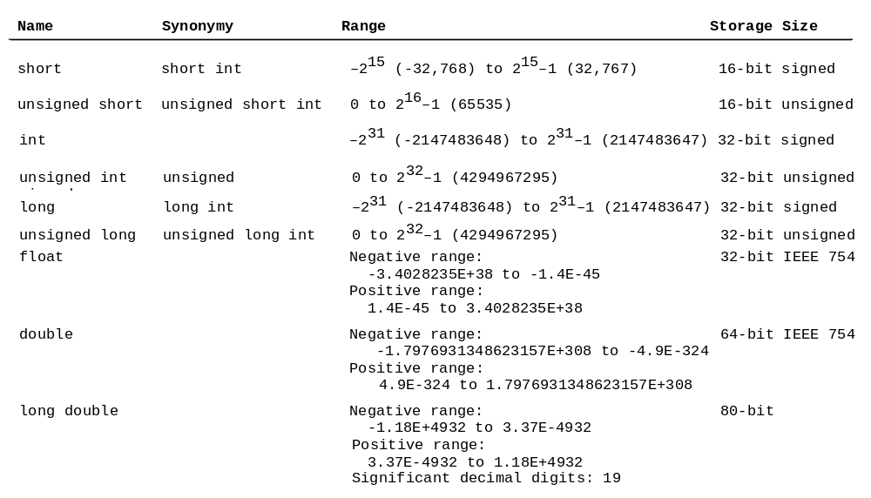
Numerical Data Types and Operations

