Slide 1

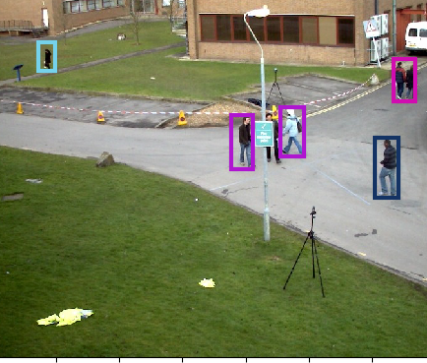
Video Processing Using
Kalman-Filter
Eliran Shmila
Guy Frenkel

Slide 2
Intro (1/2)
In many tracking problems, we often use a model of a tracker that correlates detections and tracks.
The correlation process (or the matching stage) is sometimes done by applying the Hungarian Algorithm.
In our case, the detections are objects that are called bbox, and the tracks are abstract objects that save the recent-most bbox that has correlated to them.
(this kind of problem is known as a ‘MoT’ problem).

Slide 3
Intro (2/2)
Our implementation is mostly based on the article: “Simple Online and Realtime Tracking“ by Bewley et al.
We were given a ‘skeleton’ of the implementation and had to fill the methods and fix some of the purposely broken logic of this piece of code.

Slide 4
BBOX
A bbox is a 4-value vector -
[x1, y1, x2, y2] where:
(x1,y1)
(x2,y2)

Slide 5
The Tracking Model
The state vector is structured as detailed in the article; [u,v,s,r,u’,v’,s’]
Where (u,v) is the center-point of the bbox, s – is the surface area of the bbox, and r is aspect-ratio.

Slide 6
The Tracking model
Tracker per track
The main Tracker (the Sort tracker) uses and generates the relevant list of trackers for each frame (there are multiple frames for each video)

Slide 7
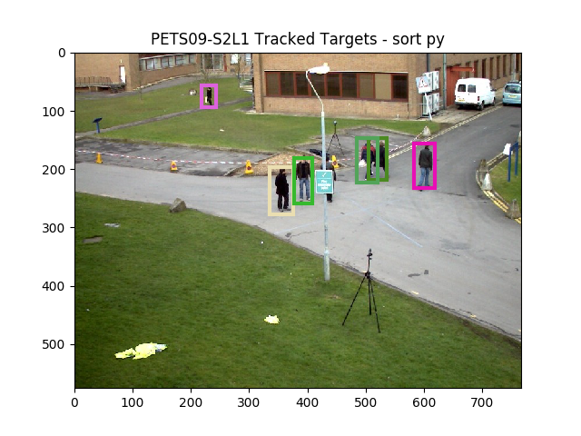
tracks’ most recent bbox
detection

Slide 8
Problems
Only 3 Trackers
Unnecessary Trackers creation
Display Trackers which are unstable

Slide 9
Our solution
At first there were two main misbehaviors of the main Tracker:
We used the Hungarian algorithm to match between pairs of detection → track
We ‘cleaned’ out tracks that their correlation score didn’t pass the threshold (IOU)
For every unstable track (consequent predict-only iterations with no update stage) → we waited until they got stable (3 or more hit strikes) and only then → displayed them.

