Slide 1

Department of Computer Science & Engineering SOUTHEAST UNIVERSITY
Project Title : “ANTI SLEEP ALARM” USING EYE BLINK SENSOR & ARDUINO
Course Title: Embedded System Lab
Course Code: CSE3028

Slide 2
Submitted By: Submitted T0:
Md Asif Rahman Mr. Ovishake Sen
2017200000031
Sazid Hasan Milon
2017200000012
Utpal Roy Shishir
2017200000022
Lecturer
Department of CSE Southeast University

Slide 3
Introduction
Because of the tremendous increase in traffic day by day road accidents are increasing at a huge scale. Accidents due to driver drowsiness can be prevented using eye blink sensors. There are two main components here in this project.
First is Arduino Nano which is the heart of the project , and second is the eye blink sensor. The driver has to wear the eye blink sensor frame throughout the course of driving and the eye blink has to be for some particular amount of seconds to detect drowsiness or sleep.

Slide 4
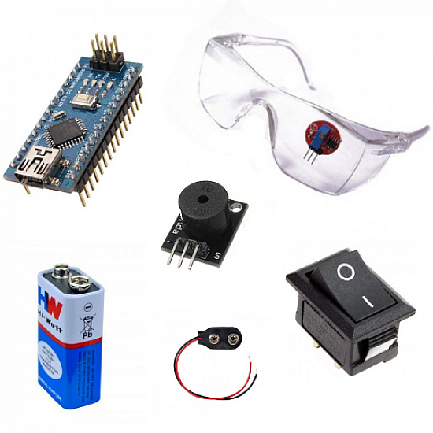
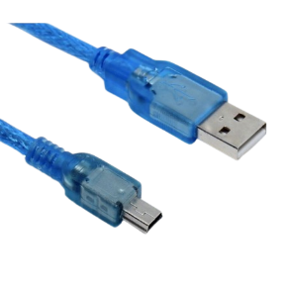
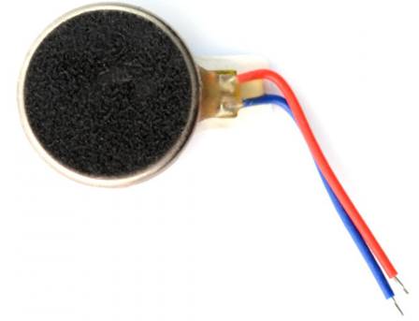
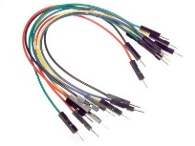
Components used / Material Required
Eye blink sensor with Goggles
Arduino Nano
Vibration Sensor
Buzzer
SPST switch
9V Battery
Mini USB Cable
Wire

Slide 5
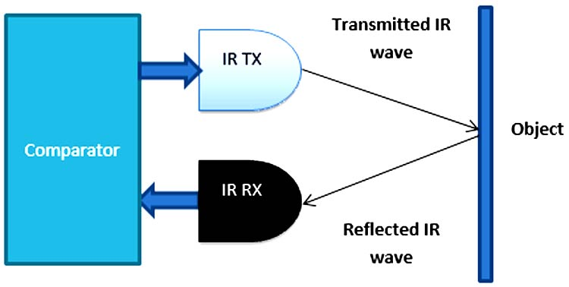
Working Principle of Eye Blink senor

Slide 6
Working Principle of Eye Blink senor
An infrared sensor includes two parts, the emitter (transmitter) & the receiver (receiver), so this is jointly called an optocoupler or a photo-coupler. Here, IR LED is used as a transmitter whereas the IR photodiode is used as a receiver for reflected IR radiations.
There are two types of IR sensors, active and passive. Passive IR sensors have only the IR receiver, not the Transmitter. But active have both transmitter and receiver. Here we are using an active IR sensor.

Slide 7
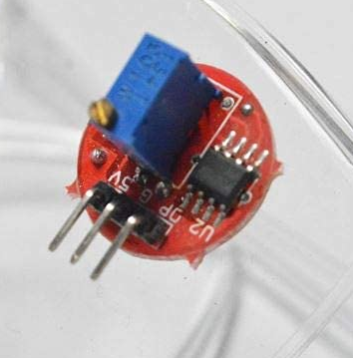
Eye Blink Sensor
5v VCC
Ground (GND
Open (OP)

Slide 8
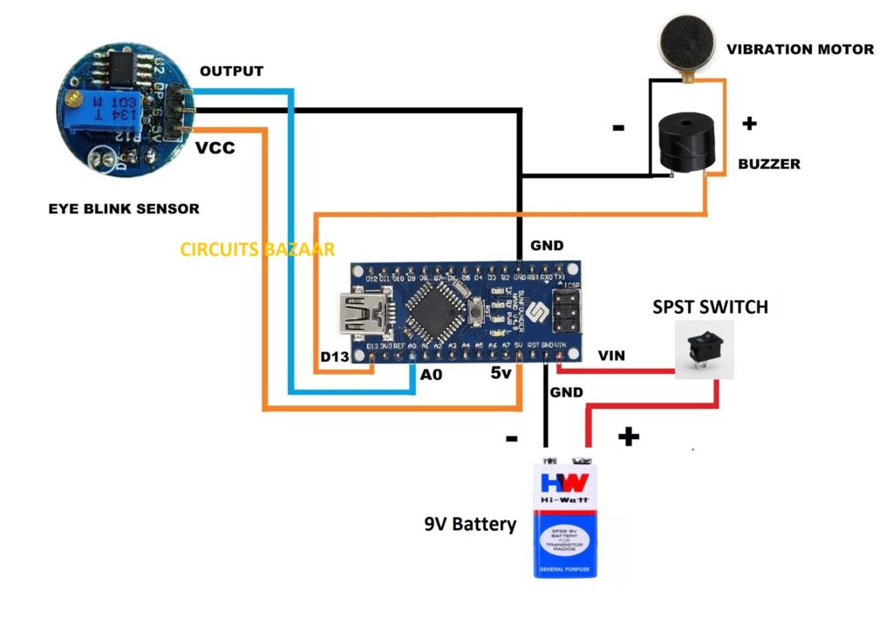
Circuit Diagram of Anti-Sleep Alarm Project

Slide 9
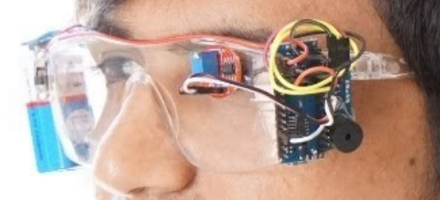
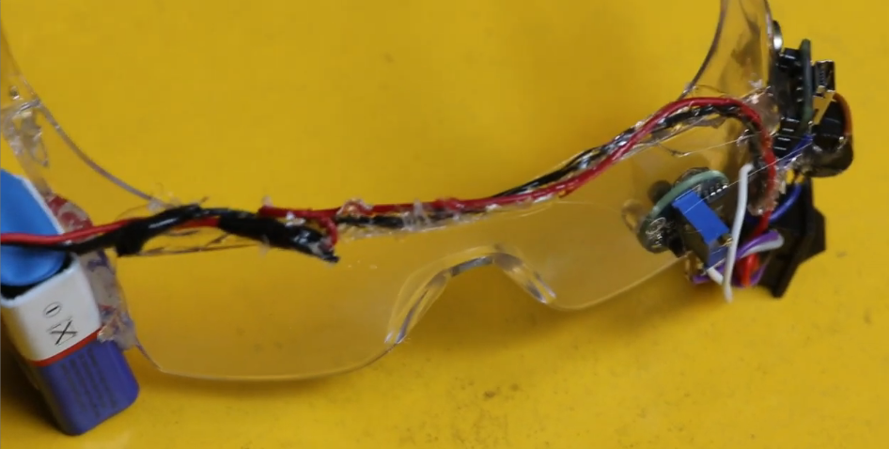
Final Assembled Face

Slide 10
Code of the project
//Code of Anti Sleep Alarm Project
define SENSE A0 // for eye blink sensor output
void setup()
{
pinMode(SENSE, INPUT);
pinMode(2, OUTPUT);
pinMode(LED_BUILTIN, OUTPUT); // Pin number 13 of Arduino
}
void loop()
{
if(digitalRead(SENSE))
{
digitalWrite(LED_BUILTIN, LOW);
pinMode(2, LOW);
}

Slide 11
else
{
delay (2000);
if(digitalRead(SENSE))
{
digitalWrite(LED_BUILTIN, LOW);
pinMode(2, LOW); }
else
digitalWrite(LED_BUILTIN, HIGH);
pinMode(2, HIGH);
}
}

Slide 12
Why Should Use This Device
Many drivers fall asleep while driving, which occurs to accidents. To avoid all these accidents, this device should be used. So, that they can wake up even if they fall asleep while driving.

Slide 13
Thank You

