Slide 1

Active disturbance rejection control for a quadrotor
Cascade ESO and TD3-tuned tanh-ADRC, simulated in MATLAB and Python
Based on Benyahia et al. (2025) and Cai et al. (2026, Drones 10:110)
Notes:
This project simulates a quadrotor drone flown by five different controllers, all built from active disturbance rejection control (ADRC). Two research papers drive it: Benyahia et al. 2025, which proposes a cascade extended state observer (CESO), and Cai et al. 2026, which proposes a tanh-based nonlinear ADRC whose gains are retuned online by a TD3 reinforcement-learning agent. The same equations are implemented twice, in MATLAB and in Python/NumPy, so each implementation checks the other.

Slide 2
What the project does
Builds one quadrotor model and flies it along four paths: hover, circle, figure-eight and waypoints
Compares five controllers under gusts, sensor noise and model error
Trains a TD3 agent to retune the tanh-ADRC gains while flying
Builds everything twice, in MATLAB and Python, so each version checks the other
5
4
controllers: PID, ESO, CESO, tanh-ADRC, TD3-ADRC
flight paths: hover, circle, figure-eight, waypoints
30 s
1e-11
per flight, with two gust windows
largest MATLAB/Python difference (CESO, 30 s)
Notes:
In short: one plant model, five controllers, four trajectories, two implementations. Every flight lasts 30 seconds and includes two wind gusts (9 to 13 s and 18 to 23 s) plus measurement noise. MATLAB and Python implement the same equations and the same pseudo-random noise, so their outputs agree to about 1e-11, which proves both implementations are the same model.

Slide 3
The idea behind ADRC
01
Estimate everything you do not know as one signal, then cancel it

Slide 4
ADRC lumps every unknown into one disturbance and cancels it
Plant as the controller sees it
ÿ = f* + u
Extended state observer
estimates y, ẏ and f*
Control law
u = u₀ − f̂*
f* is the total disturbance: unknown mass, drag, wind gusts, coupling between axes and model error, all combined into one signal.
The observer treats f* as an extra state. With gains 3ω₀, 3ω₀², ω₀³ it tracks y, ẏ and f* from the measurement alone.
After cancelling f̂*, the drone behaves like a pure double integrator ÿ ≈ u₀, which a simple PD law u₀ = ωc²e + 2ωc ė controls with bandwidth ωc.
Notes:
ADRC's central trick: write each axis as a double integrator plus one unknown term f*, the total disturbance. The extended state observer (ESO) estimates position, velocity and f* at the same time, using only the measured output and the control input. The controller then subtracts the estimate, so what remains is a clean double integrator, and a PD law with bandwidth omega_c finishes the job. omega_o (observer bandwidth) sets how fast the disturbance estimate reacts; omega_c sets how aggressively the drone tracks. In this project position uses omega_c = 1.5 to 1.8 rad/s and attitude 7, 7, 5 rad/s; observer bandwidths are 10 to 12 and 28 to 36 rad/s.

Slide 5


Two papers, two upgrades to the basic observer
Cascade ESO (CESO)
tanh-ADRC tuned by TD3
Benyahia et al., 2025
Cai et al., 2026 (Drones 10:110)
Chains two observers: the second one estimates what the first one missed
Stage bandwidths ω₀ᵢ = α^(i−p)·ω₀, here p = 2 and α = 2
Goal: the same disturbance rejection with less noise reaching the motors
Tracking differentiator, tanh-ESO and a nonlinear tanh feedback law
A TD3 reinforcement-learning agent changes the attitude gains online
Goal: gains that adapt to the flight instead of one fixed setting
This project implements both on the same drone, fixes the TD3 training setup, and checks every result in two independent implementations.
Notes:
Benyahia et al. 2025 keep linear ADRC but cascade the observer: the first stage runs at half the bandwidth and the second stage, at full bandwidth, estimates the residual that the first missed. The total disturbance estimate is the sum of both stages. Cai et al. 2026 go nonlinear: a tracking differentiator smooths the reference, a tanh-shaped ESO and a tanh feedback law replace the linear terms, and a TD3 agent picks the feedback bandwidths in real time. This project implements both and compares them on the same drone.

Slide 6
Simulation model and controllers
02
One plant, one control structure, five ways to fill it in

Slide 7
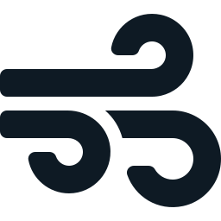
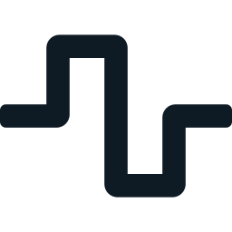


A 17-state quadrotor with motor lag, drag, gusts and noise
State vector
2.52 kg
Position
3
Velocity
3
Quaternion
4
Body rates
3
Motor thrusts
4
mass
Gusts
Up to 3 N of force and 0.04 N·m of torque, from 9 to 13 s and 18 to 23 s
0.23 m
Sensor noise
4 mm on position and 0.0015 rad on attitude, the same seeded stream in MATLAB and Python
arm length
2 ms
Model mismatch
Optional: real mass +15 %, inertia ×[1.12, 0.90, 1.10] that the controller does not know
RK4 step (500 Hz)
Motors and drag
First-order motor lag of 20 ms, linear and angular drag
Notes:
The plant has 17 states: position, velocity, an orientation quaternion (no gimbal lock in the plant), body angular rates and the actual thrust of each of the four motors. Motors respond with a 20 ms first-order lag, so commanded thrust is not instant. Drag acts on both linear and angular velocity. The simulation integrates with fourth-order Runge-Kutta at 2 ms. Two gust windows push the drone sideways and twist it; measurement noise is added to position and attitude; and model mismatch makes the real drone heavier with different inertia than the controller assumes. The drone is generic, not a calibrated real airframe.

Slide 8
Every controller runs inside the same cascade
Reference
path
Position
loop
Thrust
direction
+ yaw
Attitude
loop
Motor
mixer
Quadrotor
plant
position
acceleration
roll, pitch,
yaw
torques
4 thrusts
noisy position and attitude measurements
Only the two orange blocks change between controllers. Limits keep every controller honest: tilt ≤ 30°, horizontal and vertical acceleration ≤ 4 m/s², Euler acceleration ≤ 30, 30, 20 rad/s², and thrust per motor ≤ 2.2 × weight / 4.
Notes:
Quadrotors are underactuated: they can only push along their own z axis, so control is a cascade. The position loop outputs a desired acceleration; that is converted into a thrust direction which, together with the desired yaw, gives desired roll and pitch angles. The attitude loop then outputs angular accelerations, converted to torques, and the mixer turns total thrust plus three torques into four motor thrusts. Each loop is where a controller lives: PID, ESO, CESO, tanh-ADRC or TD3-ADRC. Everything else, including the saturation limits, is shared, so the comparison is fair.

Slide 9
Five controllers, from baseline to learned
PID
ESO
CESO
tanh-ADRC
TD3-ADRC
Baseline
Linear ADRC
Cascade ADRC
Nonlinear ADRC
Learned gains
Filtered derivative and a clamped integral that stops while motors saturate
One third-order observer per axis, gains 3ω₀, 3ω₀², ω₀³
Two observer stages at ω₀/2 and ω₀; disturbance estimates add up
Tracking differentiator, tanh-ESO and tanh feedback law (NLSEF)
tanh-ADRC whose attitude bandwidth ωc is chosen by a TD3 agent every 50 ms
0.309 m
0.058 m
0.035 m
0.140 m
0.142 m
figure-eight position RMSE
figure-eight position RMSE
figure-eight position RMSE
figure-eight position RMSE
figure-eight position RMSE
Notes:
PID is the classical baseline, with a low-pass-filtered derivative and anti-windup (the integral freezes while any motor is saturated). ESO is standard linear ADRC from Han and Gao. CESO is the Benyahia et al. cascade. tanh-ADRC is the nonlinear structure from Cai et al. TD3-ADRC is the same tanh-ADRC, except a neural network chooses the three attitude feedback bandwidths (roll, pitch, yaw) between 1 and 20 rad/s. The colours on this slide are used for each controller in every chart that follows.

Slide 10
CESO: a second observer estimates what the first one missed
Stage 1 ω₀/2
Measured
error e
f̂* = f̂₁ + f̂₂
u = u₀ − f̂*
stage-1 estimates
Stage 2 ω₀
18 / 36
554 N
0.035 m
rad/s roll stages (ω₀ = 36, α = 2)
rotor variation on the figure-eight, the lowest of all five
position RMSE on the figure-eight, the best of all five
Notes:
CESO runs two ESOs in series. Stage 1 runs at half the bandwidth and is fed the measured error. Stage 2, at full bandwidth, tracks stage 1's estimate and treats stage 1's disturbance estimate as already known, so its own disturbance state picks up only what stage 1 missed. The controller uses stage 2's position and velocity estimates, and the two disturbance estimates add to give the total f*. Each stage is a linear system, discretised exactly with a matrix exponential (expm in MATLAB, a scaling-and-squaring Taylor series in NumPy). On the figure-eight with gusts, CESO gives the best position tracking (0.035 m RMSE) and the smoothest motor commands (554 N total thrust variation).

Slide 11
tanh-ADRC swaps the linear terms for saturating tanh functions
Tracking differentiator
tanh-ESO
Nonlinear feedback (NLSEF)
Smooths the reference into v₁ and its rate v₂
Observer with tanh error injection
u₀ = β₀₁·tanh(e₁) + β₀₂·tanh(e₂)
speed r = 30 (position), 60 (attitude)
β₀ = 3ω₀, β₁ = 3ω₀²/k₀, β₂ = ω₀³/k₀
β₀₁ = ωc²/k₁, β₀₂ = 2ωc/k₂
tanh(e) = tanh(α·ln(1/δ)·e)
α = 0.6, δ = 0.01, so kᵢ = α·ln(1/δ) ≈ 2.76. This equals the paper's Eq. 16 form, checked numerically.
Why not the paper's Table 2 gains?
They break the paper's own stability condition β₀β₁ − β₂ > 0. The gains here are matched to the linear bandwidths instead, so the comparison with ESO and CESO is fair.
Notes:
The tracking differentiator (Eq. 21 of Cai et al.) produces a smoothed reference and its derivative, avoiding a derivative kick when the setpoint jumps. The tanh-ESO (Eq. 24) is an observer whose error correction passes through tanh, so large errors are saturated. The NLSEF (Eq. 30) is the feedback law: tanh of the position error plus tanh of the rate error. The paper's tanh function, written with powers of delta, simplifies exactly to tanh(alpha times ln(1/delta) times e). The gains are chosen so that for small errors tanh-ADRC behaves like linear ADRC with the same omega_o and omega_c. One limitation: Eq. 30 has no reference-acceleration term, so on curved paths tanh-ADRC lags; an optional feedforward flag (tanh_acceleration_feedforward) adds it.

Slide 12
Learning the gains with TD3
03
A neural network picks the attitude bandwidth while the drone flies

Slide 13
A TD3 agent retunes the attitude bandwidth while flying
Observation (15)
attitude error, its integral,
rate error, angle, current ωc
Actor network
15 → 64 → 64 → 3
ωc for roll,
pitch, yaw
1 to 20 rad/s
tanh-ADRC
flies the
drone
every 50 ms, with the change limited to 20 rad/s per second
Reward each step (higher is better)
The first two lines are the paper's Eq. 35. The yellow terms were added here to stop the agent from flicking gains and shaking the motors.
−( |e| + 0.2·|∫e| + 0.05·|ė| ) in degrees
+ 0.5 when no attitude command saturates
− 0.01·|Δωc|/dt − 0.02·|Δthrust|/dt
Notes:
TD3 (Twin Delayed Deep Deterministic policy gradient) is an actor-critic reinforcement learning method for continuous actions. The actor maps the observation to an action; two critics estimate how good each action is, and taking the smaller of the two curbs over-optimism. The actor is updated only every second critic update (the 'delayed' part), and noise is added to target actions for smoothing. Here the observation is 15 numbers: for roll, pitch and yaw, the attitude error, its integral, the rate error from the tracking differentiator, the measured angle, and the bandwidth currently applied. The action is three bandwidths. Everything, including back-propagation and the Adam optimiser, is written in plain NumPy and gradient-checked. The reward follows the paper's Eq. 35 plus two penalties added in this project.

Slide 14
The fixes turned bang-bang gains into smooth ones
Setting | Paper variant | Improved variant (default)
Agent decision period | 10 ms | 50 ms
Gain rate limit | none | 20 rad/s per second
Episode length | 15 s (misses the 2nd gust) | 30 s (both gusts)
Replay buffer | 10,000 samples | 200,000 samples
Gain-change / rotor penalty | 0 / 0 | 0.01 / 0.02
Sees its own gains | no | yes
Training time (500 episodes) | ≈ 37 min | ≈ 72 min
Result in 30 s flights | crashes on hover and circle | no crashes anywhere
Notes:
The first training run used the paper's Table 3 settings. The agent learned a bang-bang policy: each bandwidth swung across the whole 1 to 20 range about every 10 ms. That chatter shook the motors (rotor variation around 1500 N against 700 for fixed gains) and the drone crashed on the hover and circle paths in 30-second runs. Three causes: no penalty on switching gains or on motor activity; 15-second episodes that never see the second gust; and a buffer holding only about 7 episodes. The improved variant holds each action for 50 ms, rate-limits it, lets the agent see the gains it already applied, adds the two penalties, and uses 30-second episodes with a 200,000-sample buffer. The paper variant is kept in config.json for comparison.

Slide 15
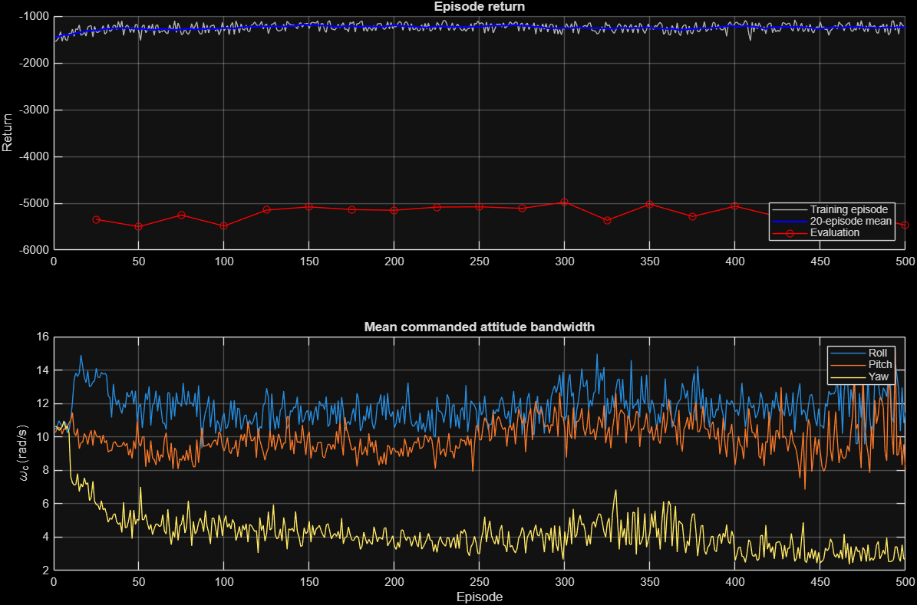
Training levelled off after about 150 episodes
300
episode of the saved actor (best crash-free evaluation)
12 / 10 / 3
average roll / pitch / yaw ωc in rad/s
0
crashes in training or evaluation
Notes:
Top panel: grey is each training episode's return, blue its 20-episode mean, red the evaluation score every 25 episodes (the sum over all four trajectories, so it sits lower). Returns improve over the first hundred or so episodes and then hold. The best crash-free evaluation came at episode 300, and that actor is the shipped policy (policies/td3_improved_actor.json). Bottom panel: the agent learned to fly with a high roll bandwidth (around 12 rad/s), slightly lower pitch (around 10) and a much softer yaw (around 3), whereas the fixed design uses 7, 7, 5.

Slide 16
Results
04
30-second flights with gusts and noise

Slide 17
Figure-eight: CESO tracks best, TD3 holds attitude best
tanh-ADRC and TD3 lag on curved paths because the paper's control law has no reference-acceleration term. Adding it gave 0.062 m but 2342 N of rotor variation.
Notes:
Same 30-second figure-eight, same gusts and noise for every controller. Position: CESO is best (0.035 m), plain ESO next (0.059), the tanh-based pair around 0.14, PID worst at 0.31. Attitude: TD3-ADRC is best (0.686 degrees). Rotor thrust variation measures how much the motors are jerked around (sum of sample-to-sample changes); CESO is smoothest at 554 N and PID roughest at 2634 N. No motor saturated in any run. Why do tanh-ADRC and TD3 trail ESO on position? ESO and CESO work on the error, so the reference acceleration is folded into the disturbance estimate; the paper's Eq. 30 law has no such term and lags curves. None of these numbers are performance claims from either paper, and no controller went through a systematic tuning study.

Slide 18
TD3 cuts attitude error by 15–24 % versus fixed gains
−15 to −24 %
attitude error, on every path
−7 to −12 %
rotor activity, on 3 of 4 paths
±1.5 %
position error, essentially unchanged
Notes:
This is the fair test of the learning part: same tanh-ADRC, fixed gains versus TD3-scheduled gains, on all four paths. Attitude error drops 15 to 24 percent everywhere. Motor activity drops 7 to 12 percent on hover, circle and figure-eight; on waypoints it is 1.7 percent higher (709 against 697 N). Position error barely moves, because the position loop is untouched and its lag comes from the missing acceleration term, not from attitude.

Slide 19
It still scores lower on reward, because changing gains costs points
Reward term (figure-eight) | Fixed ωc = 7 | TD3
Attitude error | −571.5 | −539.2
Error integral | −70.0 | −69.9
Error rate | −378.5 | −385.6
No-saturation bonus | +300.0 | +300.0
Gain-change penalty | −0.4 | −278.4
Rotor-activity penalty | −337.3 | −258.9
Total | −1057.8 | −1232.1
The whole gap is one term.
A constant gain never pays the gain-change penalty. TD3 pays 278 points for scheduling and wins back points on attitude and motors.
A lighter penalty was tried.
At 0.002 the agent tied fixed gains on reward (−4199 vs −4184) but flew worse, with roll ωc swinging from 1.3 to 20 rad/s. The 0.01 agent was kept.
Notes:
Over the four evaluation flights TD3 scores −4977 against −4185 for fixed gains, which looks like a loss. The breakdown for one figure-eight shows why: TD3 is better on attitude error and much better on rotor activity, but pays 278 points of gain-change penalty, which a fixed gain never pays. So in flight terms TD3 is the better controller; the reward just charges it for adapting. A second agent trained with a five-times-smaller penalty tied on reward but flew worse on attitude on every path, because it moved its gains far more.

Slide 20

Validation: what is checked on every change
24 flight cases
Hover equilibrium
5 controllers plus the paper TD3 agent on 4 paths: finite states, unit quaternion, tilt < 45°, RMSE < 0.5 m
No noise, no gusts: drift below 1e-10 m for all five controllers
Model mismatch
Timestep halving
CESO with +15 % mass: RMSE 0.037 to 0.048 m
dt = 2 ms vs 1 ms: at most 0.21 mm apart
MATLAB vs Python
Unit checks
CESO 1.1e-11 and tanh-ADRC 7.2e-12 over 30 s; TD3 5.6e-9 over 5 s
Mixer round trip, rotation orthogonality, matrix exponential, Eq. 16 tanh, disturbance estimation
Notes:
validate_matlab runs the 24 thirty-second cases with assertions, the equilibrium test, the mismatch stress test and the timestep-halving convergence test, and writes the CSV logs and figures. python/validate_reference.py runs the unit checks and compares its own logs to MATLAB's. The paper TD3 agent is reported but not asserted, because it leaves the envelope on hover and circle. TD3 parity is checked over 5 seconds only: the gain-scheduling feedback amplifies 1e-12 rounding differences about ten-fold every 2 seconds, so the two runs are both valid but not bit-identical over 30 seconds.

Slide 21
Code and how to run it
05
Two languages, one config file

Slide 22
Where everything lives
config.json | Every parameter: drone, gains, limits, both TD3 variants
python/quadsim/ | Python package: plant, observers, five controllers, simulation, TD3 networks
python/simulate.py | Command line: fly one case and print its metrics
python/td3_train.py | TD3 training loop and reward
python/validate_reference.py | Unit checks and MATLAB/Python parity report
matlab/quad_simulate.m | MATLAB twin of quadsim: same plant and controllers
matlab/run_quadcopter_demo.m | Interactive dashboard: run, compare, export
matlab/validate_matlab.m | All validation cases, CSVs and figures
matlab/quad_*.m, plot_*.m | Reference paths, gusts, maths helpers, export and plots
Notes:
config.json holds every number, so MATLAB and Python always read identical parameters. The Python side is a small package, quadsim, with one module per job: maths (rotations and the motor mixer), scenario (reference paths, gusts and seeded noise), observers (the ESO/CESO bank and tanh-ADRC), controller (the five controllers and the TD3 actor), plant (dynamics and the RK4 step), simulation (the loop, metrics and CSV export) and td3 (networks, replay buffer and agent). simulate.py, td3_train.py and validate_reference.py are the scripts you run. quad_simulate.m is the MATLAB twin, split into the same steps as local functions. When the code was restructured, old and new versions were run side by side and gave bit-identical results.

Slide 23
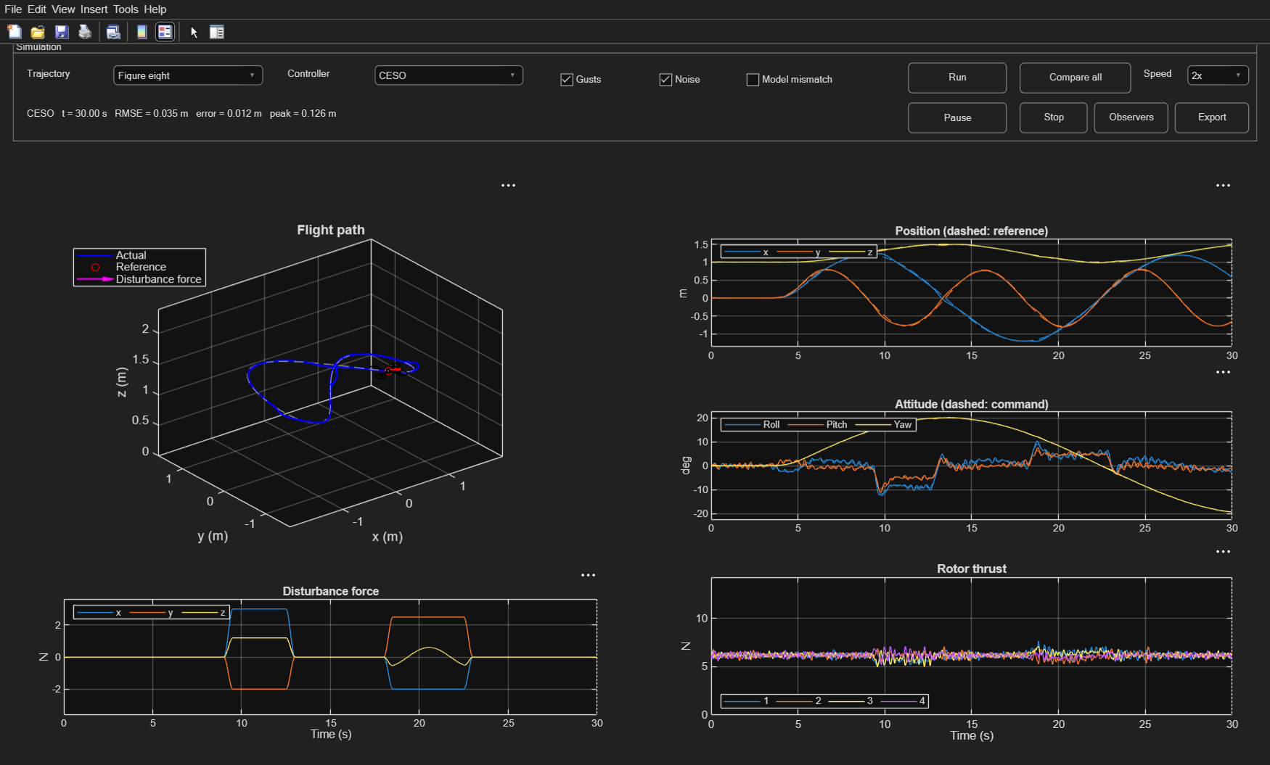
Running it
MATLAB
START_MATLAB
validate_matlab
Python
python python\simulate.py --controller td3
python python\validate_reference.py
python python\td3_train.py --variant improved
MATLAB dashboard: choose a path and controller, then Run or Compare all
Notes:
In MATLAB, run START_MATLAB from the project folder to open the dashboard, and validate_matlab to regenerate every result. In Python, simulate.py flies one case and prints its metrics; flags include --trajectory, --no-noise, --no-disturbance, --mismatch and --td3-variant. Retraining takes about 72 minutes and overwrites the shipped policy, so only do it on purpose.

Slide 24

Conclusions and limitations
CESO is the best all-rounder
Not covered yet
Best position tracking (0.035 m) and the smoothest motors (554 N) on the figure-eight
Generic drone, not a calibrated airframe
No systematic gain-tuning study
tanh-ADRC has no acceleration feedforward by default
Flights start airborne: no takeoff or landing
No hardware test
TD3 makes tanh-ADRC better
15–24 % lower attitude error than fixed gains, once gain switching is penalised
Two implementations agree
MATLAB and Python match to 1e-11; the paper's raw TD3 settings do not survive 30 s flights
Next steps
Gain-tuning study for all five controllers
tanh-ADRC feedforward with a rotor penalty
Hardware-in-the-loop test
Notes:
Takeaways. One: the cascade observer delivers what Benyahia et al. claim, best tracking with the least motor activity. Two: the TD3 agent improves its tanh-ADRC base, but only after fixing the training setup; the paper's settings produce a chattering policy that crashes in longer flights. Three: the results are not an artefact of one implementation, because MATLAB and Python agree to about 1e-11. Limitations are listed on the right; natural next steps are a tuning study, adding feedforward to tanh-ADRC with a rotor-activity penalty, and hardware-in-the-loop testing.

Slide 25

Likely questions
Why does tanh-ADRC track position worse than CESO?
Why does TD3 score lower on reward if it flies better?
The paper's control law (Eq. 30) has no reference-acceleration term, so it lags on curves. Adding one gave 0.062 m, but 2342 N of rotor variation.
The whole gap is the gain-change penalty (−278 on the figure-eight). A fixed gain never pays it; TD3 wins on attitude and motors.
Why check TD3 parity over only 5 s?
Why NumPy instead of PyTorch?
The gain feedback amplifies 1e-12 rounding differences about ten-fold every 2 s. Both runs are valid; they just stop being bit-identical.
No extra dependencies, exact reproducibility, and MATLAB can run the same trained network from its JSON file.
Is this a real drone?
Why a quaternion plant but an Euler-angle controller?
No. It is a generic 2.52 kg quadrotor, not a calibrated airframe, and there is no hardware test yet.
Quaternions keep the plant free of singularities. The controller uses Euler angles like the papers, stays below 30° tilt, and stops if pitch nears 81°.
Notes:
Backup slide for questions. Tracking: ESO and CESO work on the tracking error, so the reference acceleration ends up inside the disturbance estimate and gets cancelled; the paper's NLSEF law (Eq. 30) works on the smoothed reference without that term, so it lags on curves. The optional tanh_acceleration_feedforward flag adds the term: position RMSE drops to 0.062 m but rotor variation rises to 2342 N. Reward: over four evaluation flights TD3 scores -4977 against -4185 for fixed gains; on one figure-eight it is better on attitude error (-539 vs -572) and rotor activity (-259 vs -337) but pays -278 in gain-change penalty. A run with a five-times-smaller penalty tied on reward but flew worse. Parity: with fixed gains MATLAB and Python agree to about 1e-11 over 30 s; with the trained actor, the gain feedback grows rounding differences from 1e-12 at 0.15 s to 1e-6 at 9 s and 1e-2 at 19 s. NumPy: the networks are small (two hidden layers of 64), so hand-written back-propagation and Adam are enough; they were checked against numerical gradients, and the exported JSON actor runs unchanged in MATLAB. Real drone: the parameters are generic, so the results compare controllers on one model rather than predict a specific airframe. Euler angles: the attitude controller works in roll, pitch and yaw like both papers; the tilt limit is 30 degrees, and the rate map raises an error if the cosine of pitch drops below 0.15.

