Slide 1
FlightLog Black Box
CA3 · SOFTWARE AUTOMATION LAB · PROJECT 29
Healthy
all available checks passed
Warning
Every ArduPilot flight log checked automatically: a verdict, the reasons and what to fix, in the team's inbox within a minute.
fly, but fix this soon
Critical
ground the drone until fixed
Aarushi Rudra · Zahra Modi · Harsh Narain
Notes:
FlightLog Black Box takes the flight log our drone writes on every flight and turns it into one of three verdicts, with the reasons and the fixes, emailed to the team. Nobody has to open a graph.

Slide 2
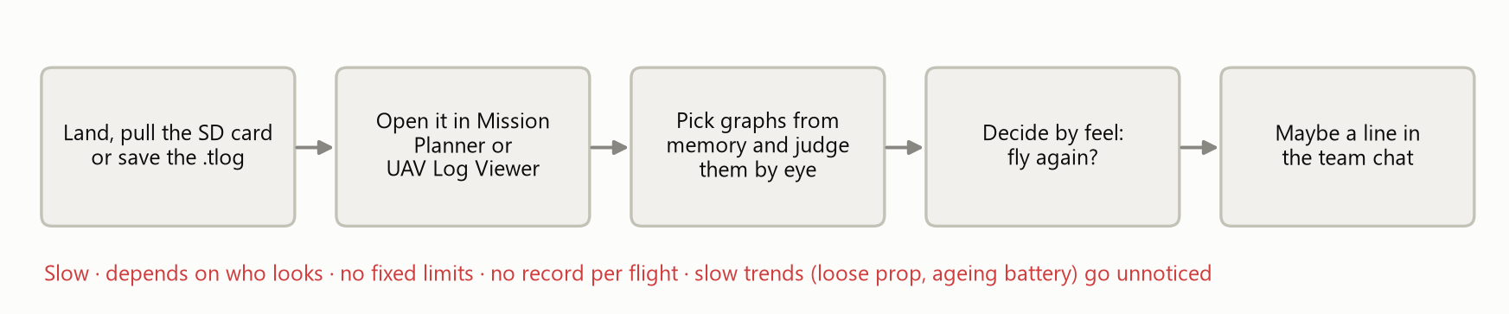
Today, someone eyeballs every log by hand
1
Slow
2
Inconsistent
3
No record
4
Trends missed
Each graph opened and read by hand, after every flight
No fixed limits: the verdict depends on who looks
Nothing is written down per flight, so flights can't be compared
A loosening prop or an ageing battery builds up unseen
Notes:
This is the existing process. After landing, someone copies the log, opens it in Mission Planner or UAV Log Viewer, picks graphs from memory and decides by eye. There are no fixed limits, nothing is recorded, and slow problems such as an ageing battery are only noticed when something goes wrong.

Slide 3
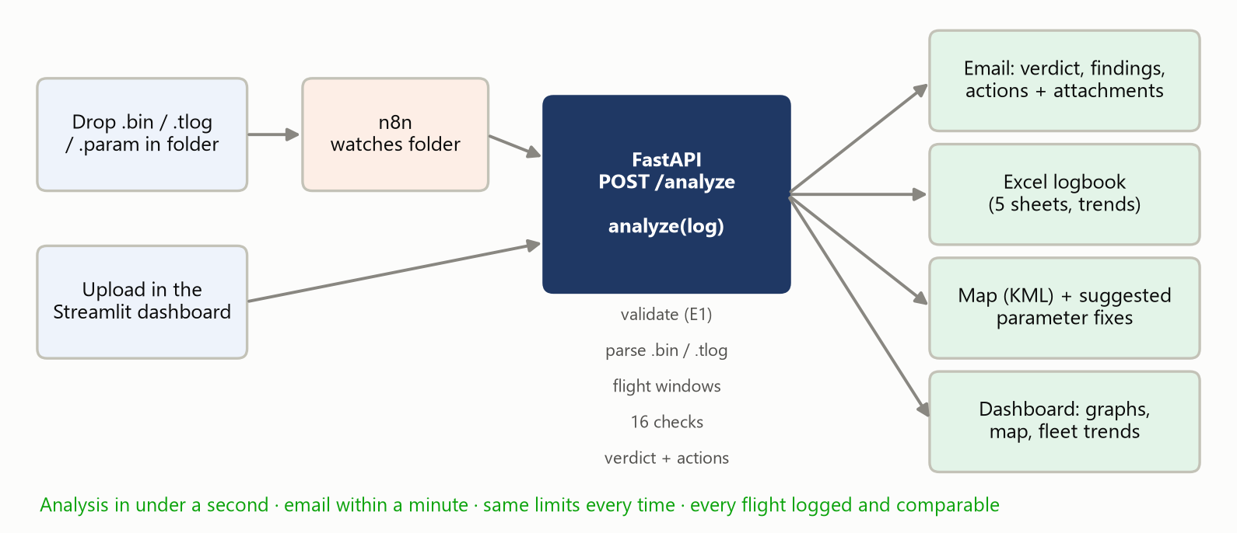
The automation: drop a log, get a verdict
< 1 s
to analyse a log (measured on our real .bin and .tlog files)
16
health checks on every flight, with limits from one YAML file
0
graphs opened by hand; a person steps in only when a flight is flagged
Notes:
The new process: drop the log in a folder, or upload it in the dashboard. n8n notices the file and posts it to our FastAPI service, which runs one Python function, analyze. Out come the email, the Excel logbook, a map and suggested parameter fixes, and the dashboard shows the same result.

Slide 4
One analyze() function, two ways to call it
Trigger and delivery
n8n 2.43 (self-hosted, npx): watches the folder, posts the file, emails the team over Gmail SMTP
Why one function?
Web front end
Streamlit dashboard: upload a log, see graphs and map, browse the fleet logbook
n8n and the dashboard both call analyze(log), so a folder drop and an upload always give the same verdict.
No UiPath: parsing binary logs and running numerical checks needs Python libraries; n8n does the orchestration an RPA bot would do.
API
FastAPI + uvicorn: POST /analyze, GET /files, /logbook, /ledger
Core
Python, pymavlink, pandas, numpy: validate, parse, flight windows, 16 checks, verdict, actions
Outputs
openpyxl Excel logbook, HTML email, KML flight map, Mission Planner .param fixes
Config and tests
thresholds.yaml holds every limit; pytest runs 88 tests on synthetic and real logs
Notes:
The stack in layers. The core is plain Python. FastAPI wraps it as a web service. n8n and Streamlit are two ways of calling it. All limits live in thresholds.yaml, so tuning needs no code change.

Slide 5
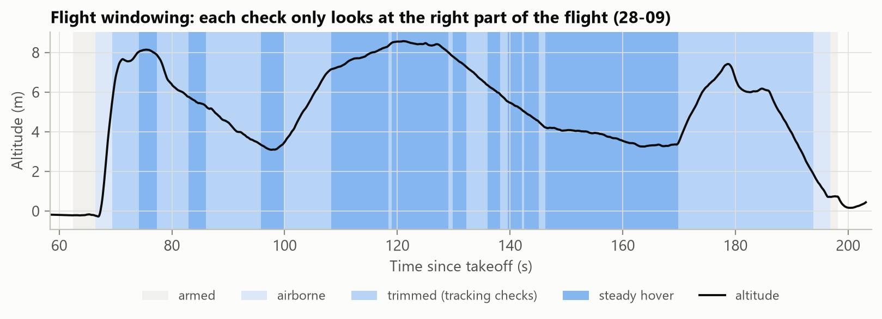
Inside analyze(): validate, parse, window, check
1
Validate
2
Parse
3
Windows
4
16 checks
5
Verdict
6
Actions
File type from its bytes, not its name (E1)
.bin via pymavlink; .tlog mapped to the same tables
Armed, airborne, steady hover, takeoff trimmed
Each runs only in its window, per sensor
Any Critical → Critical, any Warning → Warning
Linked causes, fixes, map, logbook entry
Notes:
Validation looks at the bytes, so a renamed photo is rejected and a .bin saved without its extension still works. The key idea is flight windowing: bench time before arming and the takeoff and landing transients would otherwise cause false alarms, so each check only looks at its part of the flight.

Slide 6
16 checks, every limit in one YAML file
# | Check | Warning / Critical
1 | Vibration | > 30 / > 60 m/s²
2 | Accelerometer clipping | > 0 / > 100
3 | Cell voltage under load | < 3.5 / < 3.3 V
4 | Voltage sag | > 0.3 / > 0.5 V
5 | Board supply | < 4.8 / < 4.5 V
6 | Hover throttle | > 0.60 / > 0.75
7 | Altitude hold (p95 error) | > 0.3 / > 0.6 m
8 | Attitude tracking (p95) | > 5 / > 10°
# | Check | Warning / Critical
9 | Estimator (EKF ratio, 1 s) | > 0.8 / > 1.0
10 | Motor balance | > 100 / > 200 µs
11 | Hard landing | > 3 g, 1 m/s / > 5 g, 2 m/s
12 | Errors and failsafes | any / crash, EKF, thrust loss
13 | External navigation gaps | > 0.2 / > 0.5 s
14 | Configuration (battery params) | mismatch → Warning
15 | Vibration spectrum (FFT) | peak outside notch
16 | Compass interference | > 30 / > 60 %
Shaded: checks 13 to 16 were added beyond the project plan's 12. A check whose data is missing shows "Not available" and names the logging to switch on (E3).
Notes:
Vibration and EKF limits come from the ArduPilot documentation; the rest are team-set starting values in thresholds.yaml. We added four checks beyond the plan: external navigation, configuration, vibration spectrum and compass interference.

Slide 7
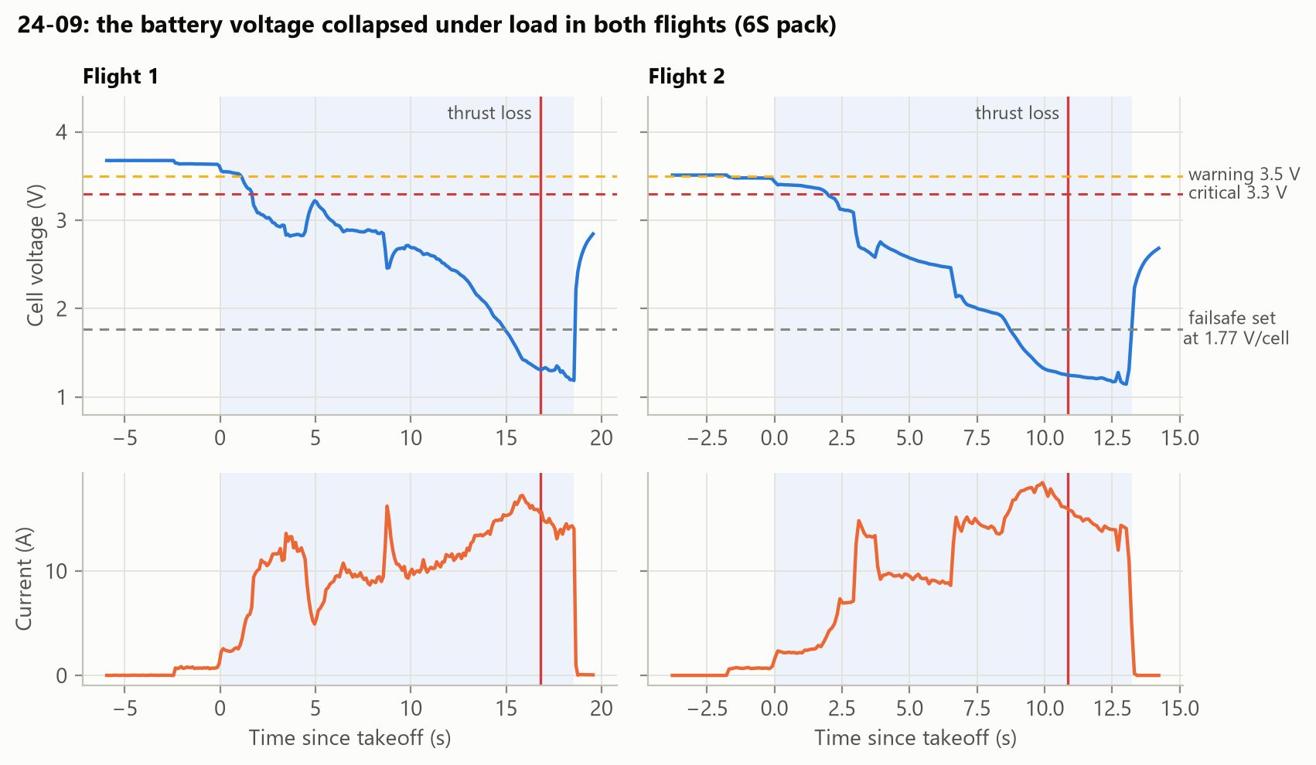
24-09: the battery collapsed, then thrust was lost
1.18 V
lowest cell voltage under load (limit 3.3 V)
1.77 V
per cell: where the low-battery failsafe was set, too low to ever fire
2×
"potential thrust loss" errors, one in each flight
Notes:
This is a real log from 24 September. In both flights the pack voltage fell from 3.6 to about 1.2 volts per cell under 15 to 18 amps, the motors went to full output and the flight controller logged potential thrust loss. The low-battery failsafe was set at 10.6 V on a 6S pack, 1.77 V per cell, so it could never have triggered. The verdict is Critical, and the tool links cell voltage, sag, thrust loss and the hard landing into one cause: the battery.

Slide 8
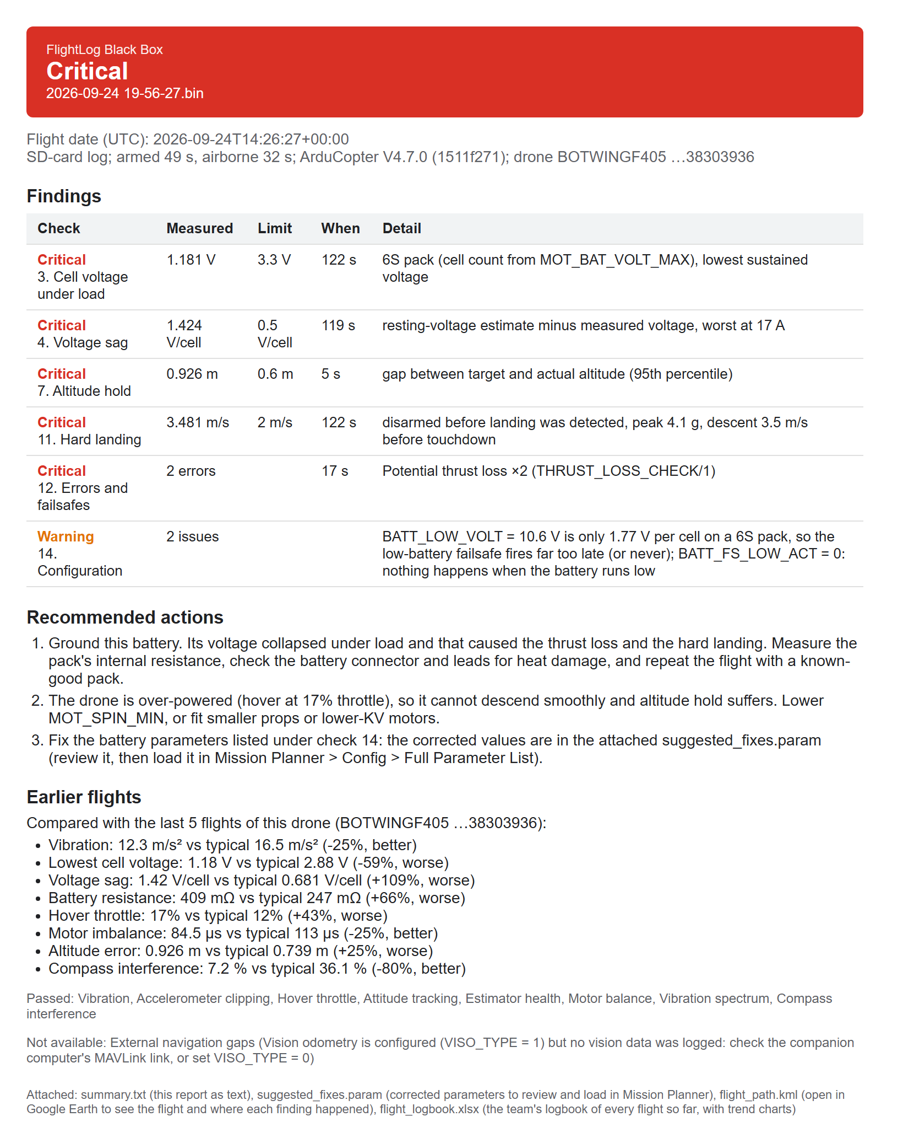
The email says what happened and what to do
Attached to every email
1
summary.txt the same report as plain text
2
suggested_fixes.param corrected parameters to review and load in Mission Planner
3
flight_path.kml the flight in Google Earth, each finding pinned where it happened
4
flight_logbook.xlsx the team's logbook of every flight so far
Pre-flight GO / NO-GO
Drop the drone's .param file before flying. Run on the 24-09 settings, it says NO-GO: the battery failsafe can never fire. That crash would have been caught on the ground.
Notes:
The email starts with the verdict, then the findings with measured value, limit and time, then recommended actions. Actions are rules: linked causes first, so the team fixes the battery instead of three symptoms. The pre-flight check runs the same battery rules on a parameter file before the drone flies.

Slide 9
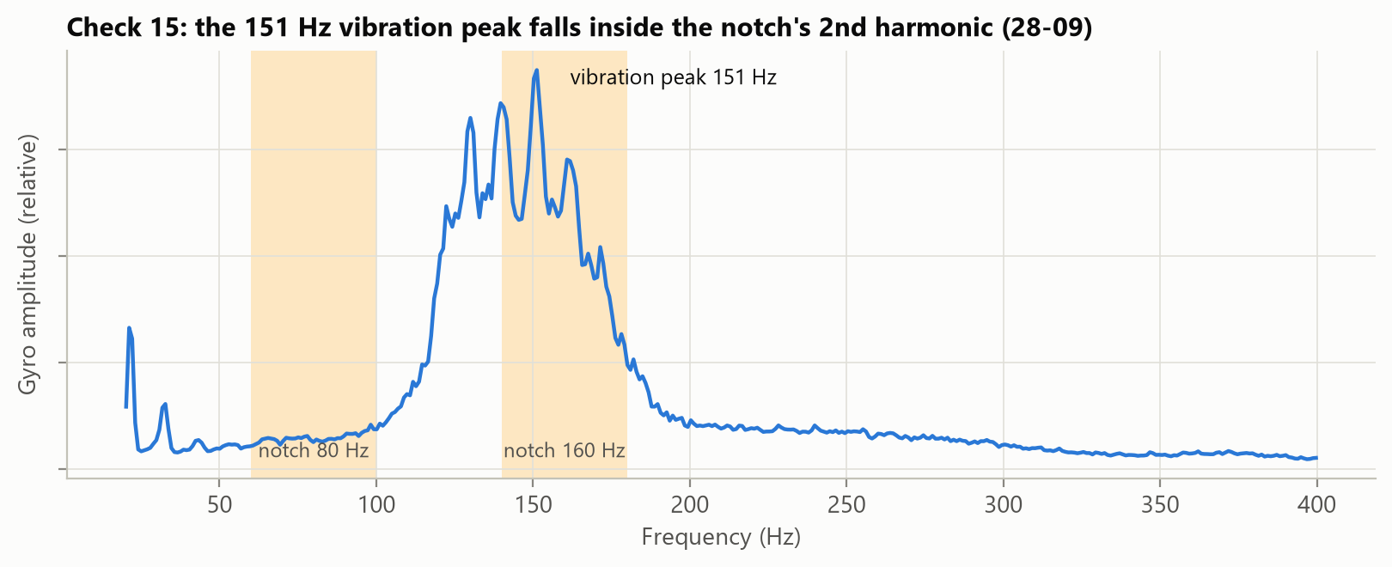
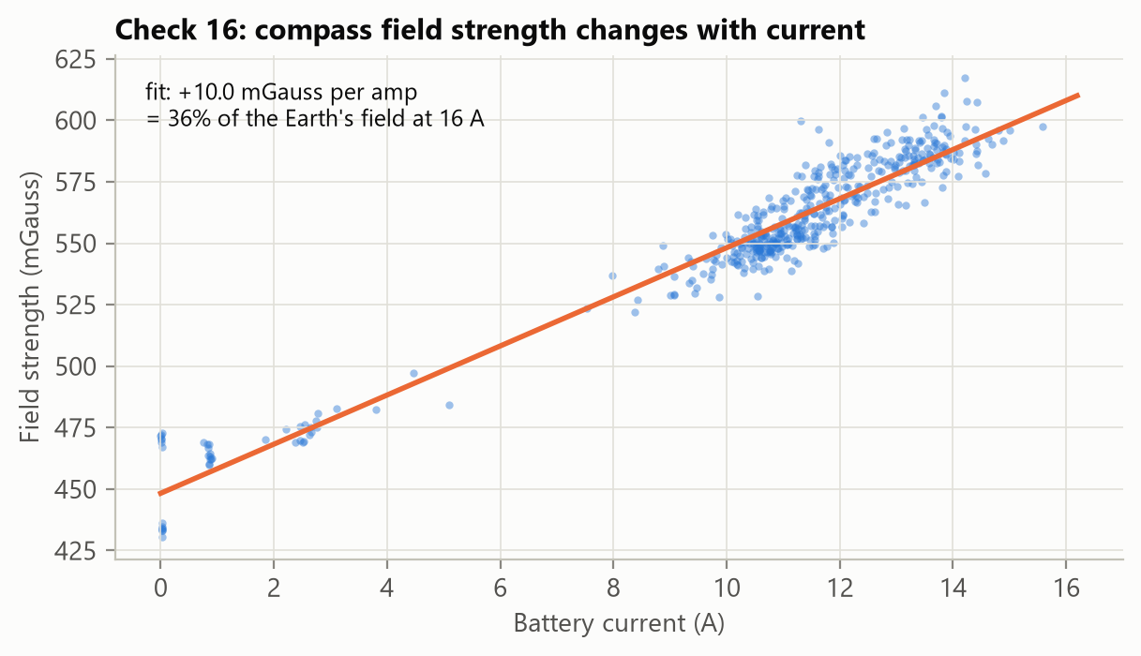
Checks 15 and 16 look for causes, not symptoms
Vibration spectrum
Compass interference
An FFT of the IMU's raw samples puts the vibration peak at 151 Hz, inside the notch's 160 Hz harmonic, so it passes. The report still warns that throttle tracking is off (INS_HNTCH_REF = 0).
The field grows 10 mGauss per amp: 36% of the Earth's field at full current, above the 30% limit. Fix: CompassMot calibration, twisted leads.
Notes:
Two checks go beyond pass or fail. The spectrum check runs a Fourier transform on the IMU's batch samples and compares the peak with the harmonic notch filter; here the notch covers it, so it passes. The compass check fits field strength against current: the Earth's field doesn't change with current, so any slope is interference from the power wiring.

Slide 10
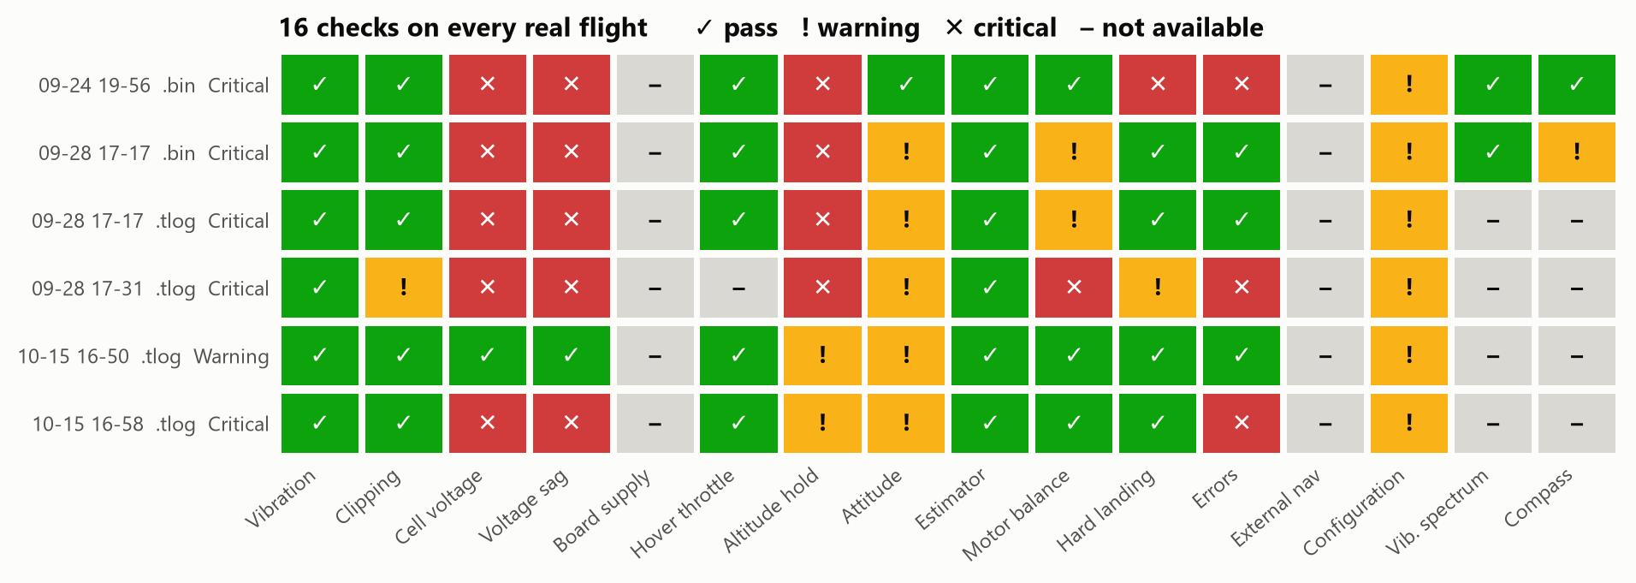
Every real flight came back Critical or Warning
28
6
9
12
real files tested (.bin, .tlog, .rlog)
flight logs analysed: 5 Critical, 1 Warning
ground sessions classed No flight (E5)
.rlog files rejected, with what to upload instead
Notes:
We ran every file the team had. The six flight logs cover five flights: 28-09 17:17 was recorded both as a .bin and a .tlog. All have real problems, mainly the battery: cell voltage and sag are Critical in five of six. Configuration is flagged on all of them because the low-battery failsafe is set far too low for the pack. Telemetry logs show fewer checks because they carry less data.

Slide 11
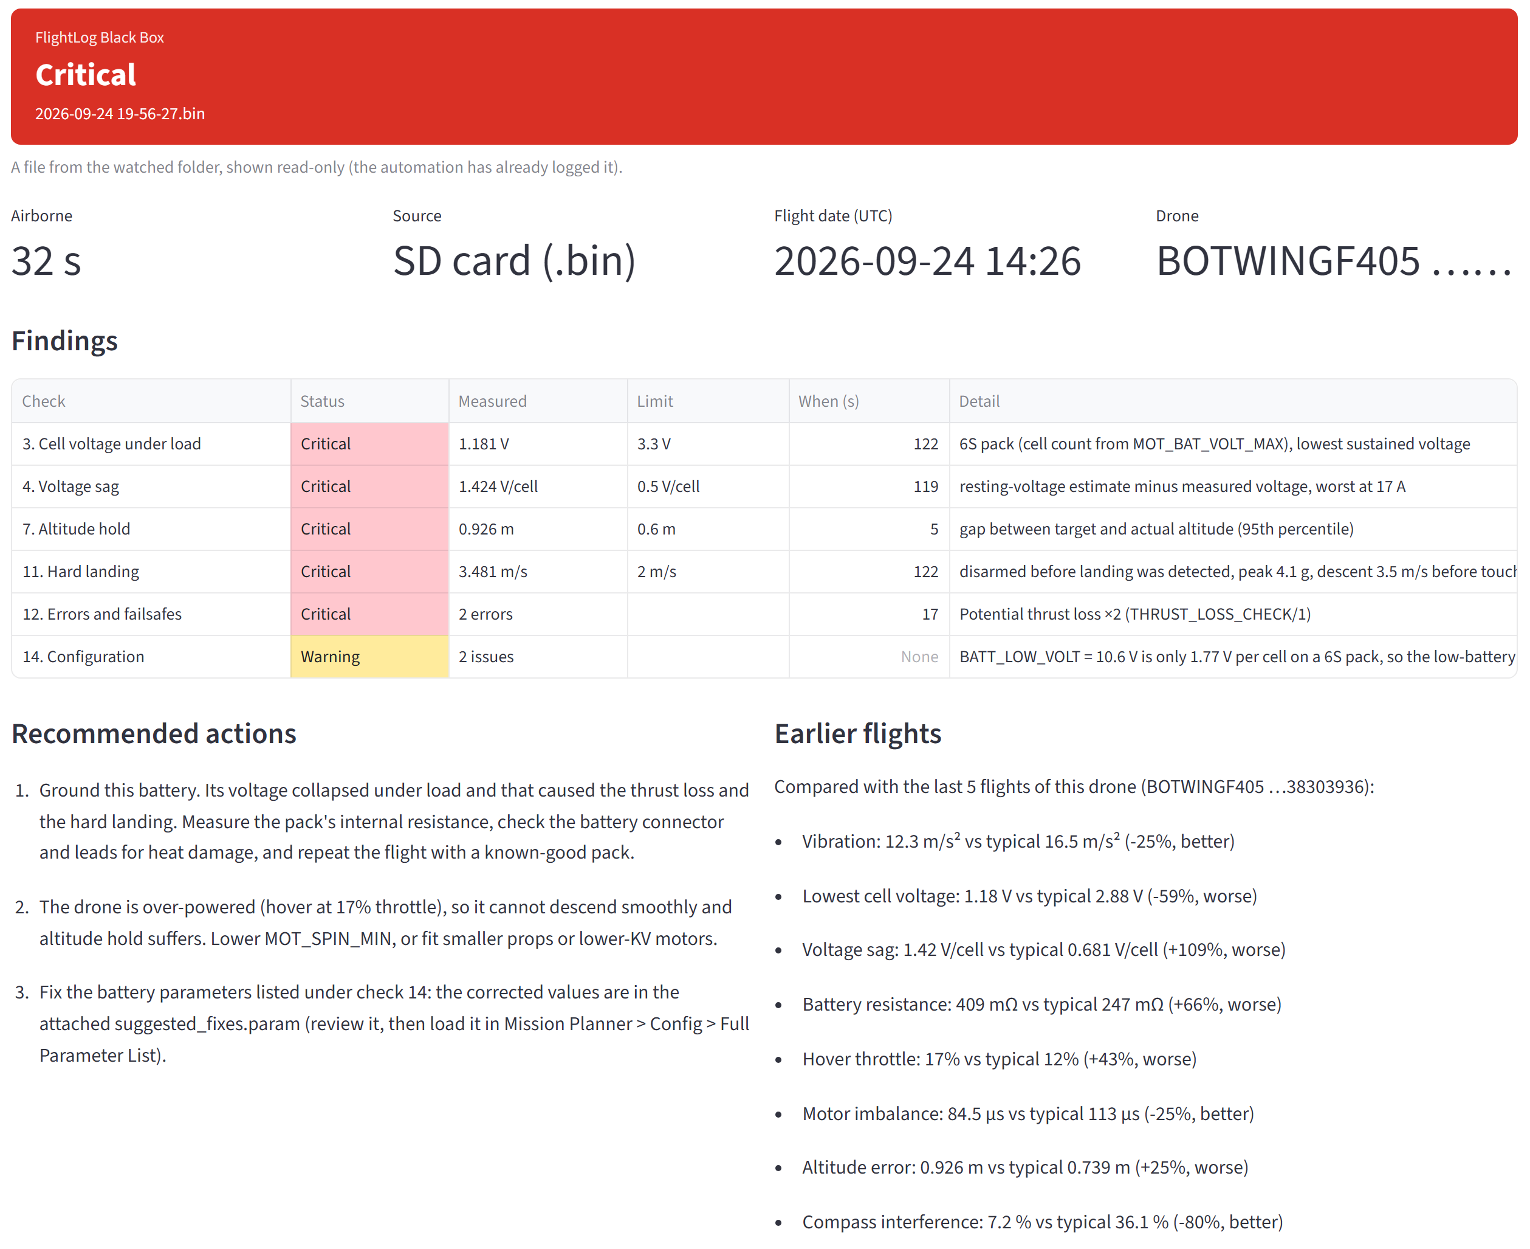
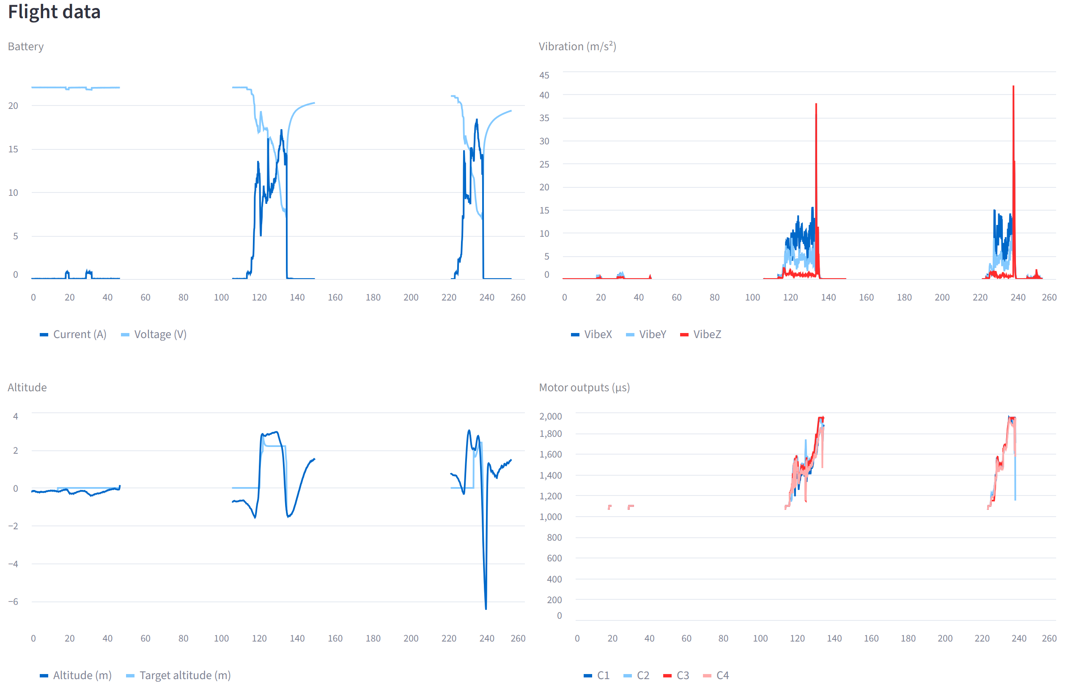
Dashboard: analyse one flight
Upload a .bin, .tlog or .param, or pick a file from the watched folder.
Uploads are saved into the watched folder, so n8n logs and emails them like any dropped file.
Notes:
The first tab analyses one log. Here it is the 24-09 crash: the verdict banner, the findings with value, limit and time, the actions, the comparison with this drone's earlier flights, and the raw graphs.

Slide 12
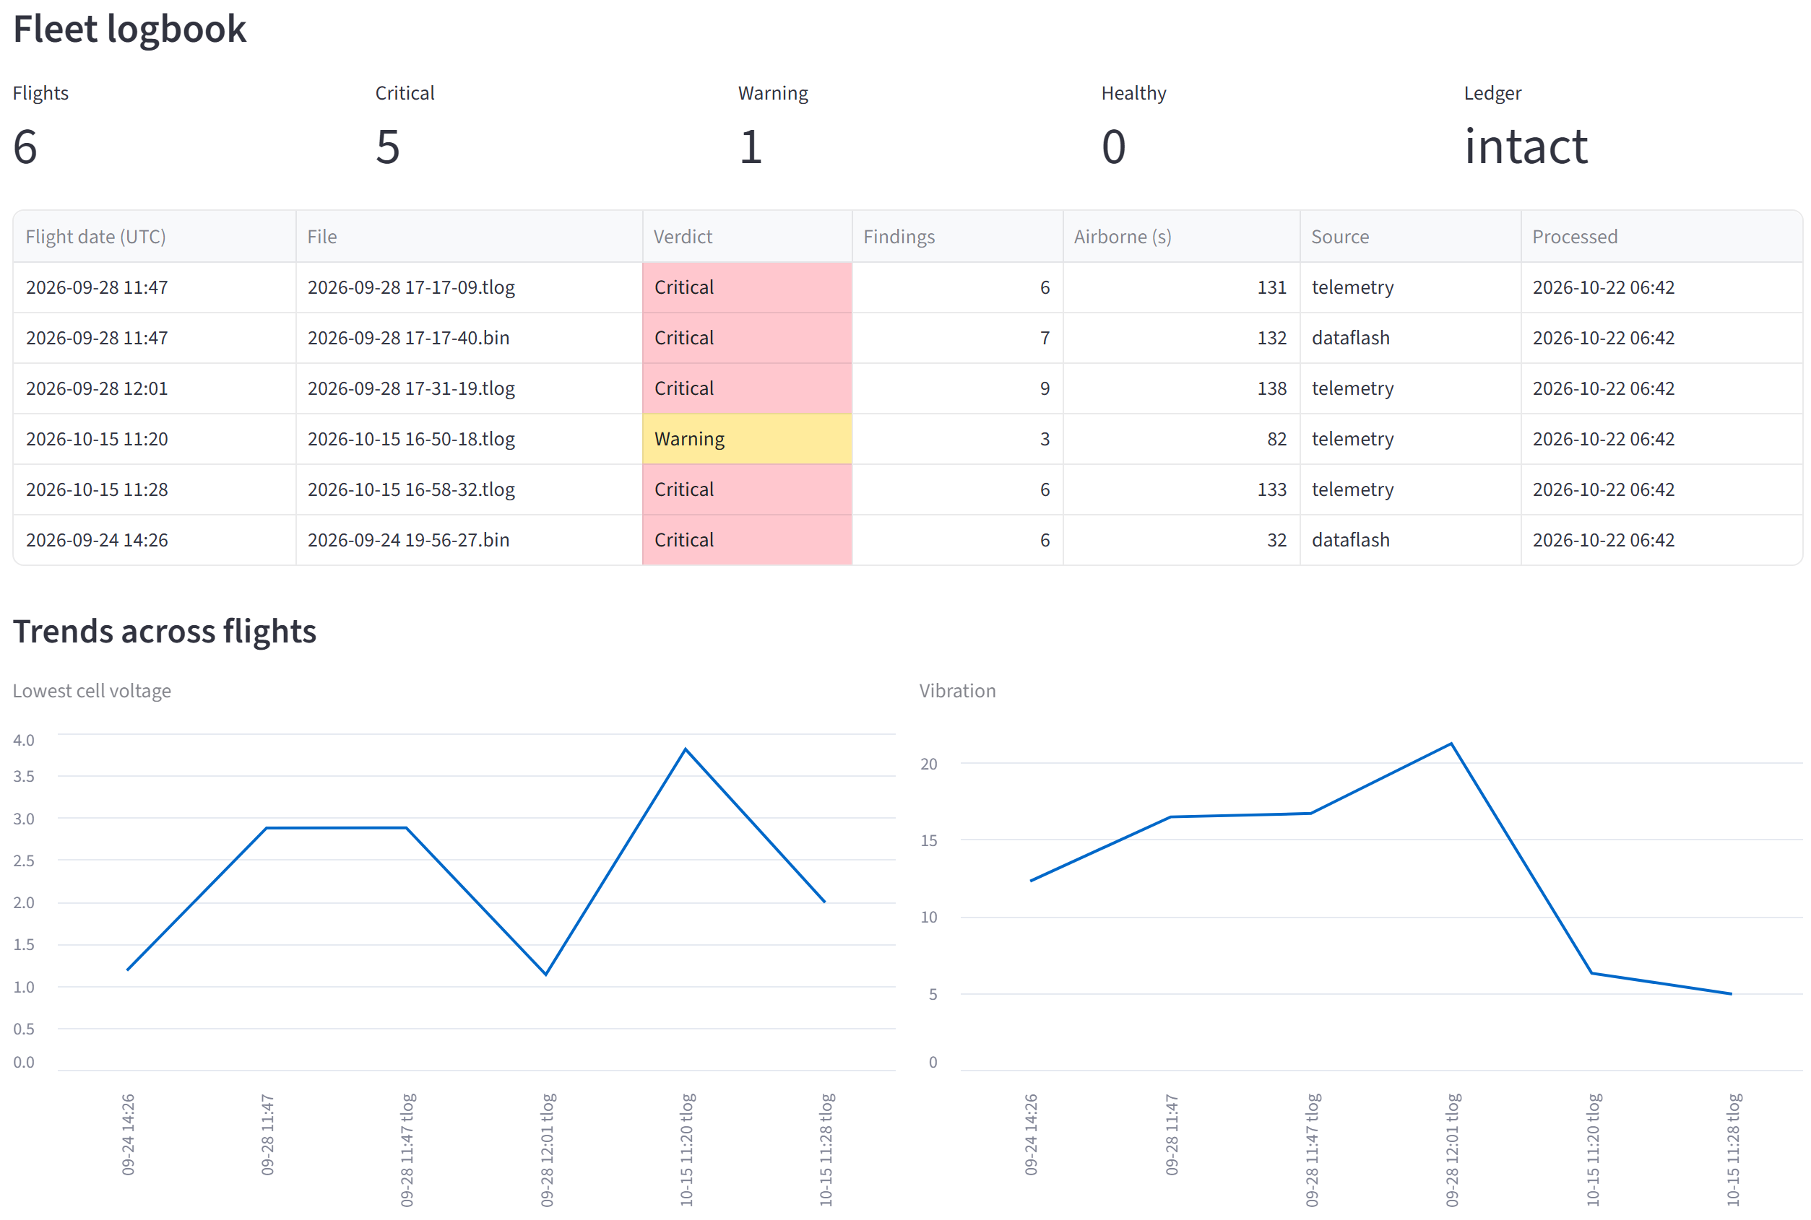
Dashboard: the whole fleet at a glance
1
Verdict counts
how many flights were Critical, Warning or Healthy
2
Ledger check
recomputes the hash chain; any edited entry shows as broken
3
Trends
cell voltage, vibration, battery resistance and motor imbalance across flights
4
Exceptions and pre-flight
every rejected file and every GO / NO-GO check
Notes:
The second tab is the fleet view, read from the same logbook as the Excel file. The ledger check recomputes the SHA-256 chain over all processed files, so quietly editing a past verdict is detected.

Slide 13
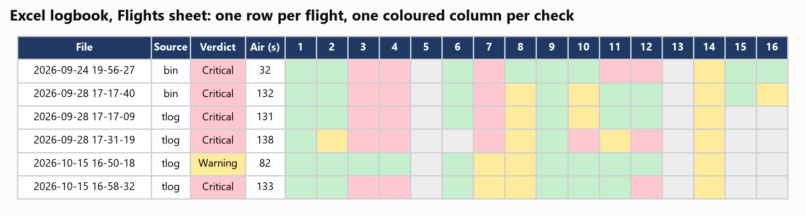
The Excel logbook records every flight
Flights
Findings
Exceptions
Pre-flight
Trends
one row per flight, one coloured column per check
every Warning and Critical, with value, limit and time
rejected, bench, incomplete and repeat uploads
GO / NO-GO results of .param files
key numbers per flight, with four line charts
Notes:
The workbook is rebuilt from a JSON-lines record after every file, because openpyxl drops charts when it edits a workbook. If someone has it open in Excel, the save is tried three times, 10 seconds apart, and then written to a pending copy, which is exception E6.

Slide 14
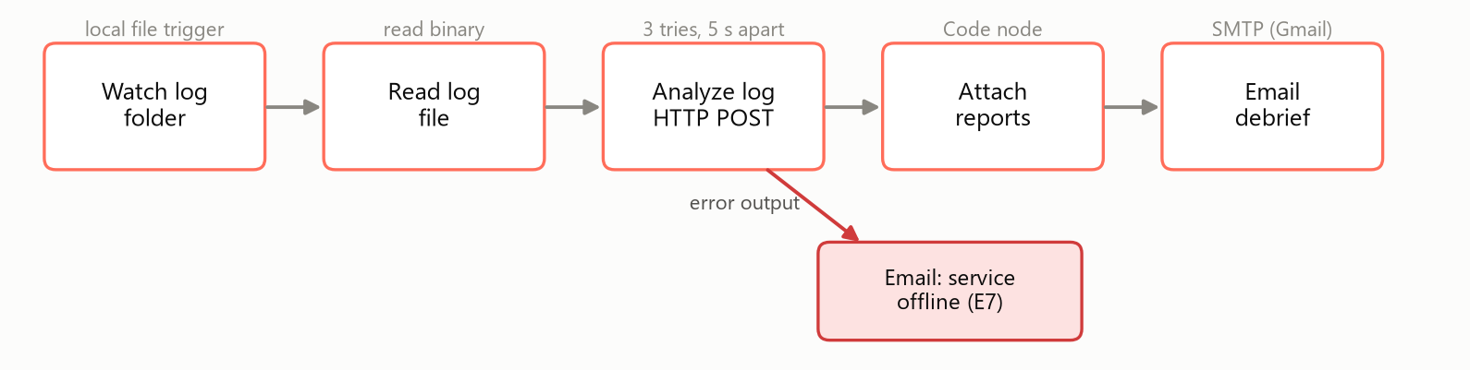
n8n runs it hands-free
Trigger
Resilience
Setup
Local folder watch with polling, so a file still being copied by Windows Explorer is not read half-written.
The HTTP node tries 3 times, 5 s apart. If the API is still down, the error branch emails "service offline" (E7).
One script imports the workflow and stores the Gmail App Password inside n8n, encrypted. It is never written to the repository.
Notes:
We first planned a Google Drive trigger, but Google OAuth setup was heavy for a lab project, so the workflow watches a local folder and sends mail over Gmail SMTP with an App Password. Each file runs as its own execution, and the API's file lock processes them one at a time.

Slide 15
Seven exception cases, all handled
 | Scenario | Detected by | What happens
E1 | Not a flight log (renamed photo) | Content check of the first bytes | Rejected, email explains why
E2 | Corrupt or truncated log | Parser stops early, log ends armed | Analysed and marked Incomplete; under 30 s rejected
E3 | Message types missing | Needed table is empty | Check shows Not available + logging to enable
E4 | Same file uploaded again | SHA-256 in the hash-chained ledger | Analysed again with a note, counted once
E5 | Bench log, never armed | No arming event | Classed No flight, no verdict
E6 | Logbook open in Excel | PermissionError on save | 3 tries, then flight_logbook_pending.xlsx
E7 | Analysis service down | n8n HTTP request fails | 3 tries, then "service offline" email
Notes:
The brief asks for two exception cases; we handle seven, and every one ends up in the logbook's Exceptions sheet. Duplicates were first skipped, but the team only had a few logs, so a repeat is now analysed again with a note and still counted once.

Slide 16
88 automated tests, plus every real log
 | Scenario | Expected and observed
T1 | Clean flight | ✓ Healthy
T2 | High vibration | ✓ Warning / Critical on 1–2
T3 | Low battery and sag | ✓ Critical on 3–4
T4 | Motor failure, crash | ✓ Critical on 10–12
T5 | Truncated log | ✓ Incomplete (E2)
T6 | Not a log | ✓ Rejected (E1)
T7 | Duplicate upload | ✓ Note, counted once (E4)
T8 | Bench log | ✓ No flight (E5)
T9 | Logbook open in Excel | ✓ Pending copy (E6)
T10 | Service down | ✓ Offline email (E7)
83 pass
on synthetic logs; 5 more run when real logs are placed in tests/data
0 drones
crashed for testing: a synthetic log writer builds each fault scenario
Also tested: the n8n Code node runs on a real API reply, the dashboard renders, two copies uploaded at once are counted once, and an edited ledger entry is detected.
Notes:
Each scenario from the test plan is a pytest case. Instead of crashing a drone or setting up the simulator, a small writer produces DataFlash logs with injected faults. The real logs are the end-to-end check.

Slide 17
Limits and what comes next
Limits
Next
ArduPilot logs only (.bin and .tlog)
Team-set limits need tuning on 2–3 clean flights of each airframe
Rules flag symptoms; they link only the causes we wrote rules for
.tlog arrives at 2–4 Hz, so short spikes can be missed
PowerPoint debrief per flight (planned, not built yet)
ESC telemetry checks once our logs carry ESC data
Anomaly detection once there are enough healthy flights
PX4 .ulg support and limit profiles per airframe
What the real logs taught us
The plan assumed one drone and clean files. Real logs had a 6S setting on a 3S pack, aborted arms, bench time with 0 V batteries and radio failsafes, and Windows file locks. Testing on them early changed the design: flight windowing, cell count from the voltage, and content-based file detection.
Notes:
Be honest about the limits: it only reads ArduPilot logs, the team-set limits still need tuning, and the advice is rule-based. The next steps build on the logbook we now keep.

Slide 18
What we built
1
Automatic
16
health checks
Folder or dashboard in, verdict and fixes out, no graphs opened by hand
2
Explained
7
exception cases
Every finding has a measured value, a limit, a time and an action
3
Recorded
88
automated tests
Every flight in the logbook and a tamper-evident ledger, comparable over time
Thank you. Questions?
github.com/shmizi/flightlog-blackbox
Notes:
Three things to remember: it is automatic, every finding is explained with a value, a limit and an action, and every flight is recorded so problems that build up across flights become visible.

