Slide 1
Alignment to Genome, Visualizing alignments
&
Gene Counts
Jessica Kirkpatrick

Slide 2
Outline
Review last class
Discuss alignment and downstream methods for various scenarios
Align trimmed data using STAR
Visualize aligned data using IGV
Get gene counts using featureCounts

Slide 3
Review of last class
  Sequencing Technology
  File formats
  Transferring data using FileZilla (FTP server)
  Un”tar”ring of compressed files
  Running FastQC and assessing results
  Trimming data for adaptors and based on quality
  Discuss alignment and downstream methods for various scenarios

Slide 4
STAR
Underlying algorithm allows it to outperform other aligners in speed by more than 50x
Splice-aware - can discover de novo splice junctions
Coded in C++, free, open-source
Paper: http://bioinformatics.oxfordjournals.org/content/early/2012/10/25/bioinformatics.bts635
Manuals
  2.3.0.1 :https://code.google.com/p/rna-star/downloads/detail?name=STARmanual_2.3.0.1.pdf
  2.4.0.1 : https://github.com/alexdobin/STAR/tree/master/doc

Slide 5
STAR
STAR prefers GTF feature format
  Can use GFF3 but must provide extra arguments, make sure id names match what it is manual (this can vary from UCSC vs Ensembl)
FASTQ can’t be compressed
If you don’t have access to one, will need to make indexed genome reference

Slide 6
STAR genome index script - Example
#!/bin/bash
#PBS -l walltime=36:00:00
#PBS -l nodes=1:ppn=2,mem=10gb
#PBS -q classroom
#PBS -N index_STAR
#PBS -m ae
#PBS -j oe
#PBS -M emailaddress
cd ~
module load STAR/2.4.0i
STAR --runThreadN $PBS_NUM_PPN \
--runMode genomeGenerate \
--genomeDir ~/starIndex \
--genomeFastaFiles /home/mirrors/igenome/Saccharomyces_cerevisiae/Ensembl/R64-1-1/Sequence/WholeGenomeFasta/genome.fa \
--sjdbGTFfile /home/mirrors/igenome/Saccharomyces_cerevisiae/Ensembl/R64-1-1/Annotation/Genes/genes.gtf \
--sjdbOverhang 99

Slide 7
Prepare input files for STAR alignment
qsub -I -q classroom
mkdir ~/star-runs
cd trimming/
gunzip yeast_1_50K.trimmed.fastq.gz
gunzip yeast_12_50K.trimmed.fastq.gz
cd ~/script_templates
cp /home/classroom/hpcbio/sp15-rnaseq/script_templates/align_yeast_1_50K-TEMPLATE.sh .

Slide 8
STAR alignment script
/home/classroom/hpcbio/sp15-rnaseq/script_templates/align_yeast_1_50K-TEMPLATE.sh
#!/bin/bash
#PBS -l walltime=36:00:00
#PBS -l nodes=1:ppn=2,mem=4gb
#PBS -q classroom
#PBS -N align_STAR
#PBS -m ae
#PBS -j oe
#PBS -M emailaddress
cd ~/star-runs/
module load STAR
STAR --runThreadN $PBS_NUM_PPN \
--genomeDir /home/classroom/hpcbio/sp15-rnaseq/starIndex \
--readFilesIn ../trimming/yeast_1_50K.trimmed.fastq \
--sjdbGTFfile /home/mirrors/igenome/Saccharomyces_cerevisiae/Ensembl/R64-1-1/Annotation/Genes/genes.gtf \
--outFileNamePrefix yeast_1_50K_star_ \
--outSAMtype BAM SortedByCoordinate

Slide 9
STAR alignment
$ qsub align_yeast_1_50K-TEMPLATE.sh
$ cd ~/star-runs/
$ ll
$ less yeast_1_50K_star_Log.final.out

Slide 10
Exercise
Make a copy of your alignment script, edit it, and run alignment on yeast_12_50K.trimmed.fastq

Slide 11
Location of data on biocluster
S. cerevisiae genome STAR index:
/home/classroom/hpcbio/sp15-rnaseq/starIndex/
Normally this would be found in: /home/mirrors/igenome/Saccharomyces_cerevisiae/Ensembl/R64-1-1/Sequence/
  Does not exist there yet
  Can always make your own STAR index
S. cerevisiae genome annotation file:
/home/mirrors/igenome/Saccharomyces_cerevisiae/Ensembl/R64-1-1/Annotation/Genes/genes.gtf

Slide 12
Outline
Review last class
Discuss alignment and downstream methods for various scenarios
Align trimmed data using STAR
Visualize aligned data using IGV
Get gene counts using featureCounts

Slide 13
Important steps after completion of STAR runs
Index all the BAM files using:
$ qsub -I -q classroom
$ cd star-runs/
$ module load samtools
$ samtools index yeast_1_50K_star_Aligned.sortedByCoord.out.bam
$ samtools index yeast_12_50K_star_Aligned.sortedByCoord.out.bam
This will create a new index file (.bai) that is required for visualization

Slide 14
Data visualization with IGV
Using FileZilla, copy over the following files to the Desktop:
  From /home/classroom/hpcbio/sp15-rnaseq/R64-1-1_info/
    R64-1-1.genes.gtf
    R64-1-1.genome.fa
    R64-1-1.genome.fa.fai
  &
  The BAM and BAI files you just made
    yeast_1_50K_star_Aligned.sortedByCoord.out.bam
    yeast_12_50K_star_Aligned.sortedByCoord.out.bam
    yeast_1_50K_star_Aligned.sortedByCoord.out.bam.bai
    yeast_12_50K_star_Aligned.sortedByCoord.out.bam.bai

Slide 15
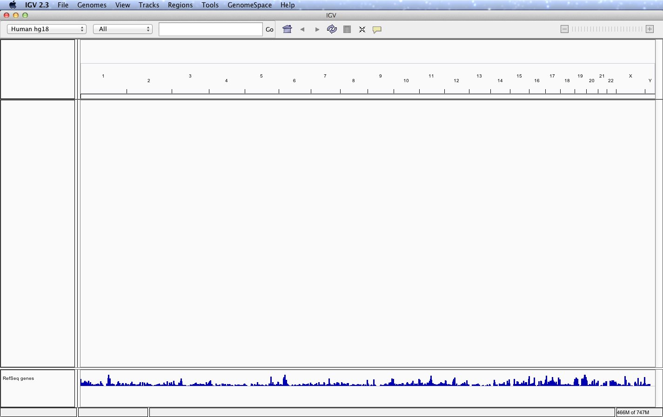
IGV
Does the genome pull down menu on the top left have the S. cerevisiae genome version we used, R64-1-1?

Slide 16
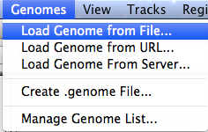
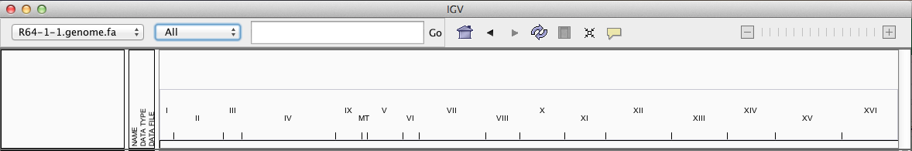
IGV
Click on “Load Genome from File” in the “Genomes” pull down menu
Select the R64-1-1.genome.fa file from the “Desktop”

Slide 17
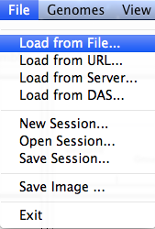
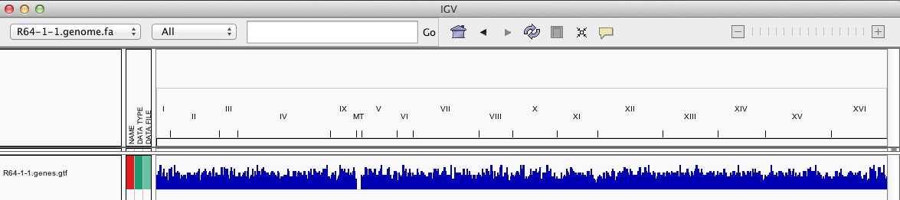
IGV
Click on “Load from File” in the “File” pull down menu
Select the “R64-1-1.genes.gtf” file from the “Desktop”

Slide 18
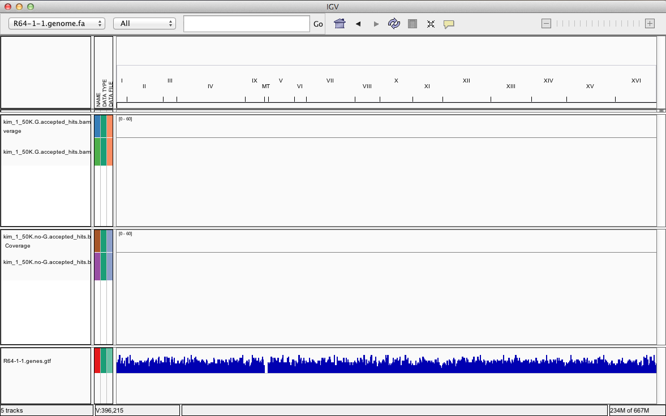
IGV
Click on “Load from File” in the “File” pull down menu
Select one of the downloaded bam file (NOT the .bai)

Slide 19
IGV
Click on “Load from File” in the “File” pull down menu
Select the second downloaded bam file (NOT the .bai)

Slide 20
IGV
Type in YER117W in the circled box and press Go

Slide 21
Outline
Review last class
Discuss alignment and downstream methods for various scenarios
Align trimmed data using STAR
Visualize aligned data using IGV
Get gene counts using featureCounts

Slide 22
featureCounts runs
  mkdir ~/featureCounts
  cd ~/script_templates
  cp /home/classroom/hpcbio/sp15-rnaseq/script_templates/featureCounts_yeast_1_50K-TEMPLATE.sh .
  Manual: http://bioinf.wehi.edu.au/subread-package/SubreadUsersGuide.pdf
    Skip to Chapter 6

Slide 23
Script to run featureCounts
/home/classroom/hpcbio/sp15-rnaseq/script-templates/featureCounts_yeast_1_50K-TEMPLATE.sh
#!/bin/bash
#PBS -l walltime=36:00:00
#PBS -l mem=8gb
#PBS -l nodes=1:ppn=1
#PBS -q classroom
#PBS -j oe
#PBS -N yeast_1_featCounts
#PBS -M emailaddress
#PBS -m ae
module load subread
cd ~/featureCounts/
featureCounts -T 1 -s 2 -g gene_id -t exon -o yeast_1_50K_featCounts.txt
-a /home/mirrors/igenome/Saccharomyces_cerevisiae/Ensembl/R64-1-1/Annotation/Genes/genes.gtf ../star-runs/yeast_1_50K_star_Aligned.sortedByCoord.out.bam

Slide 24
  $ qsub featureCounts_yeast_1_50K-TEMPLATE.sh

Slide 25
Exercise
Copy featureCounts script and edit for the 2nd BAM file:
yeast_12_50K_star_Aligned.sortedByCoord.out.bam
Run this script

Slide 26
Collate STAR final.out files
R script: collateSTARlogs.R
On worker node, in directory with STAR output files:
$ module load R/experimental
$ R CMD BATCH ../script_templates/collateSTARlogs.R
This will collate all the information and write it out to a file called “collated_STARlogs.txt”
Use FileZilla to transfer to your computer and use Excel to open.
Transfer the #input reads (column F), #uniquely mapped (I) and #multi mapped reads (X) to the SampleInfo.xlsx file
WARNING: Check the order of the samples!!!

Slide 27
Collate featureCounts .summary files
R script: collateFCsummaries.R
On worker node, in directory with featureCounts output files:
$ module load R/experimental
$ R CMD BATCH ../script_templates/collateFCsummaries.R
This will collate all the information and write it out to a file called “collated_featureCountSummaries.txt”
Use FileZilla to transfer to your computer and use Excel to open.
Transfer the #Assigned (column B), #Ambiguous (C) and #NoFeatures (E) to the SampleInfo.xlsx file
WARNING: Check the order of the samples!!!

Slide 28
Warning about reads mapped to >1 location
featureCounts (and htseq) do give a number for “MultiMapping” reads.
This is not the unique number of reads but the total number of mapping locations
Instead, use the number of “MultiMapping” reads from STAR log files (or tophat).

