Slide 1
Zillow Dataset: Assessed Tax Value Modeling
OMCDS MOD 3
Peter Shmorhun, Nowrin Mustary, and Matt Gurgiolo

Slide 2
Executive Summary
Result:
A reliable and interpretable model that can support homeowners, real estate investors, and tax authorities with property valuations.
This project is aimed at producing accurate predictions for tax-assessed value of homes based on the Zillow Housing Dataset.
Includes features like square footage, location, bed/bathrooms, and more
Performed cleaning, preprocessing, and feature engineering on the data
Decided on Gradient Boosting Regressor after testing a number of different models

Slide 3

Introduction
In today’s data-driven real estate market, accurate property valuation models are essential for improving transparency and fairness in tax assessments. By developing a model that enhances Zillow’s existing valuation pipeline, we aim to benefit a broad range of stakeholders—including homeowners, investors, tax authorities, and real estate professionals—by improving the accuracy, interpretability, and fairness of automated property tax assessments.
How do we accomplish this?
Robust data cleaning and reduction
Development of new features
How do we measure success?
RMSE, MAE, and R² on unseen data
Generalization power and interpretability

Slide 4
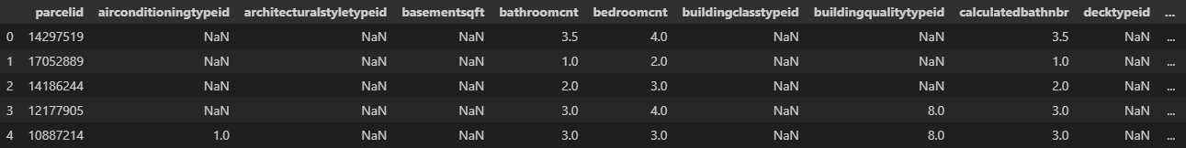
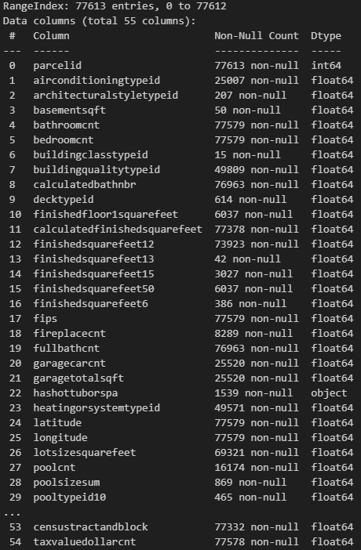
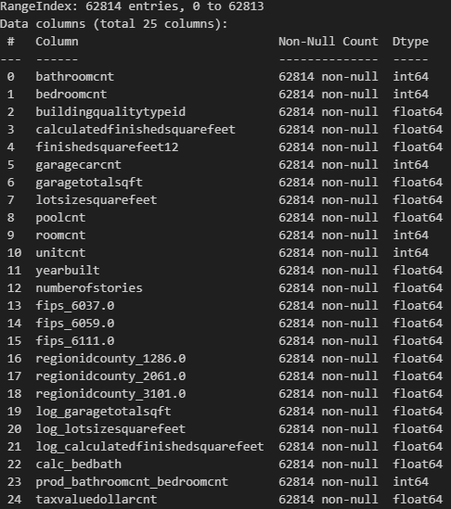
The Data
The 2016 Zillow Property Dataset:
3 million property records
Various U.S. regions
home characteristics, geographic identifiers, and administrative data.
Key characteristics:
Size: ~77,000 rows before filtering; reduced to ~63,000,000 after cleaning
Target Variable: taxvaluedollarcnt — the Zillow-assessed property tax value
Feature Types: Numerical categorical and string-based
Missing Values: Some >80%, so we applied strict thresholds to retain only well-populated features.
Redundancy: Location-based features were streamlined to avoid duplication.
After Cleaning and Engineering

Slide 5

Methodology

Slide 6
Analytical Framework
RMSE (Root Mean Squared Error) was chosen for its sensitivity to large errors, aligning with the business goal of accurate high-value home assessments.
We used cross-validation to assess generalization, particularly KFold and RepeatedKFold, to ensure stability across multiple data splits.
We explored linear models, tree-based models, and ensemble techniques to cover a range of complexities and interpretabilities.
Initially, RandomizedSearchCV was used for efficient exploration. GridSearchCV was later removed due to marginal performance gains and high computational cost.
Error Metric
Validation
Model Selection
Hyperparameter Tuning

Slide 7
Cleaning and Preprocessing
Step | Method
1: Initial Cleanup | Dropping columns with no predictive power or high redundancy
2: Handling Missing Data | Dropped columns with 80% null and rows with 25% null
3: Remove Outliers | Reduced the dataset by 20% by trimming according to the IQR
4: Imputation | Median fill for numeric columns and most common value for categorical
5: Final | One-Hot Encoding, Rounding count columns, and X/y split
5 Steps

Slide 8
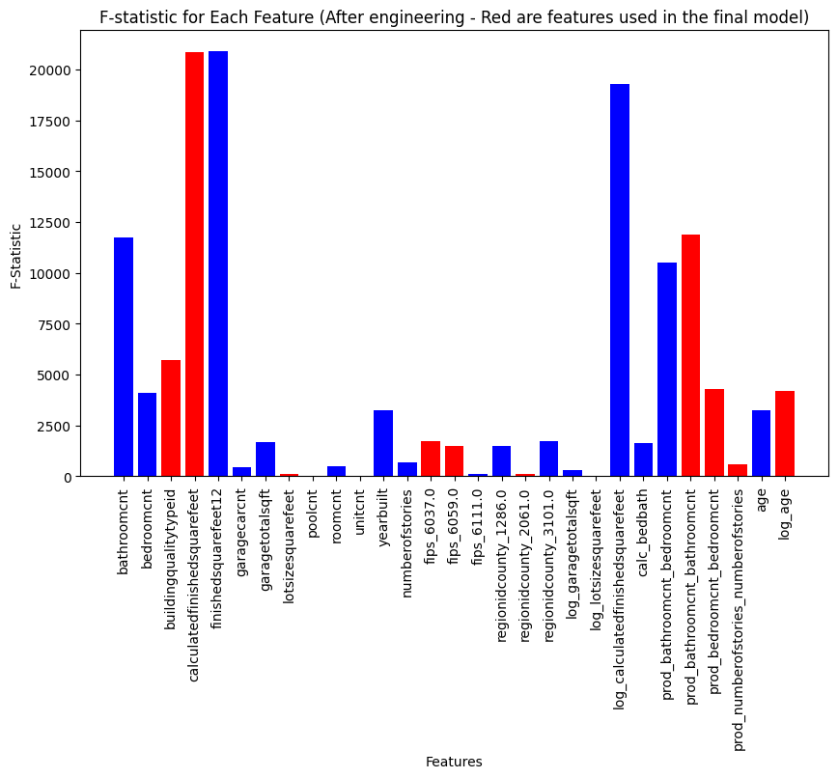
Feature Engineering
Bed-to-Bath Ratio: bedroomcnt / (bathroomcnt + 1)
Bed-to-Bath Product: bathroomcnt * bedroomcnt
Age Feature: Formula: 2025 - yearbuilt
Polynomial Features: Squares of various features to increase their variance on the higher end
Log Transformations: Logarithms to eliminate right-skewed features’ effects

Slide 9
Model Evaluation Approach
Plot validation curves to monitor overfitting or underfitting under various hyperparameter configurations
Track performance across multiple metrics (RMSE, R², training time).

Slide 10
Model Selection: GradientBoostingRegressor
Category | Model(s) | Best
Linear | Linear Regression, Ridge, Lasso | Ridge
Tree | DecisionTreeRegressor, RandomForestRegressor | RF
Ensemble | GradientBoostingRegressor | GBR

Slide 11
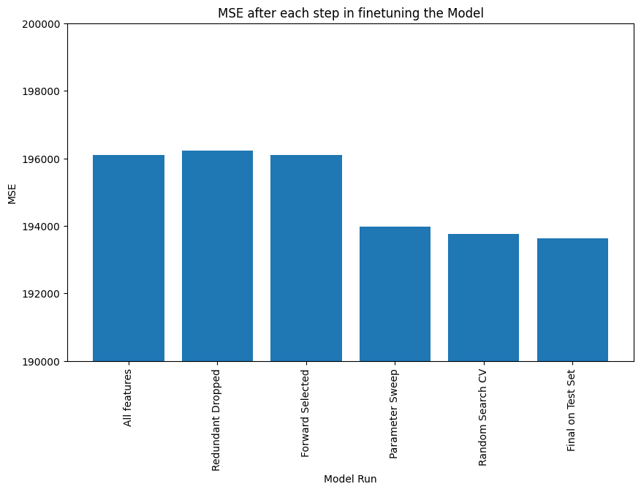
Results and Evaluation
We selected the GradientBoostingRegressor (GBR) as our final model based on its strong overall performance, generalization capability, and ability to model non-linear relationships.
Train RMSE: 189,200.81
Test RMSE: 193,634.37
Cross-Validated RMSE: 193,744.46
CV RMSE Std Dev: 502,332.56
Test R² Score ~0.43–0.48 (est.)
Although Ridge Regression remained a strong contender (offering faster training and reasonably good test performance), it consistently underperformed the GBR in final runs by a measurable margin.

Slide 12
Error Analysis
Outliers: Many high-value homes were harder to predict — likely due to missing luxury indicators not captured in the dataset.
Feature Sensitivity: GBR leveraged engineered features like Bed-to-Bath ratio and Age more effectively than simpler models.
Overfitting Risk: Controlled by early stopping and regularization in GBR, with validation curves confirming minimal overfit.

Slide 13
Conclusions
Findings:
The importance of rigorous cleaning and engineering
Ensemble models advantages with nonlinear data
Our model can support fair and quick tax assessments for a range of stakeholders
Limitations:
The lack of certain key features (e.g., renovation, neighborhood amenities)
High value homes remain difficult to value
Future:
Incorporate more datasets
Experiment with XGBoost for faster training
Develop a lightweight version for web integration

Slide 14
THANK YOU

