Slide 1
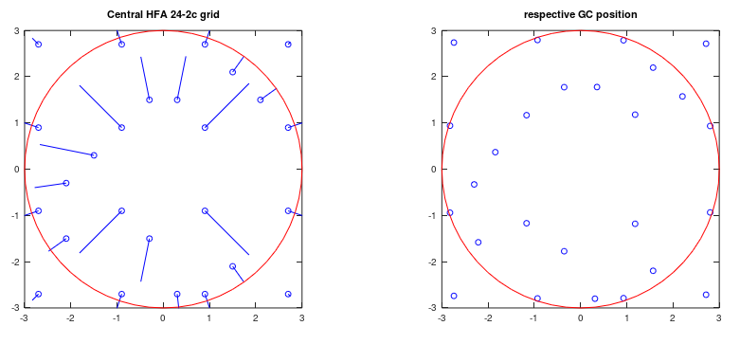
Drasdo et al [4] results applied to 24-2c VF test pattern

Slide 2
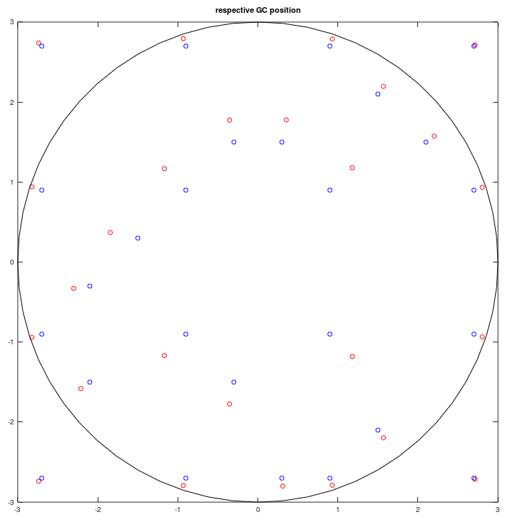

Slide 3
