Slide 1
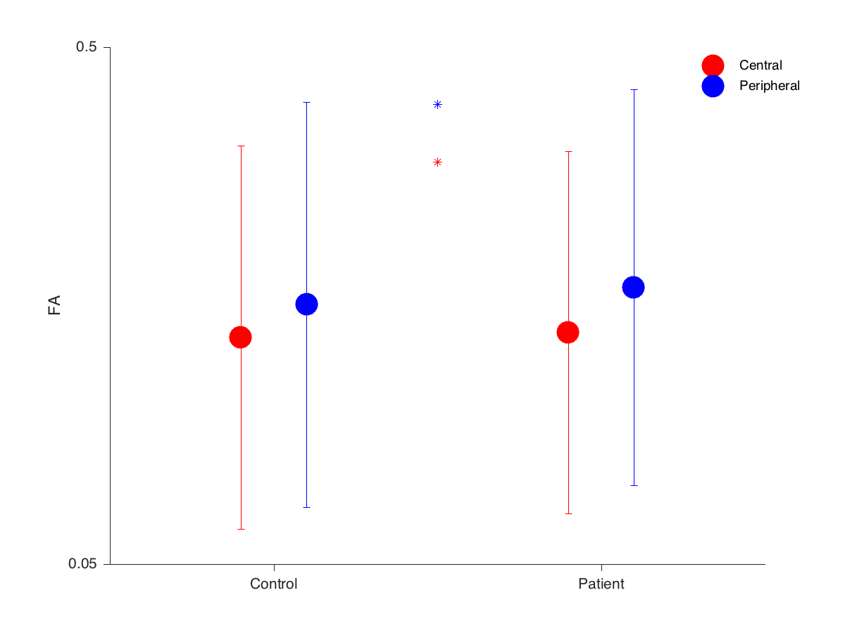
OR voxel wise comparison FA

Slide 2
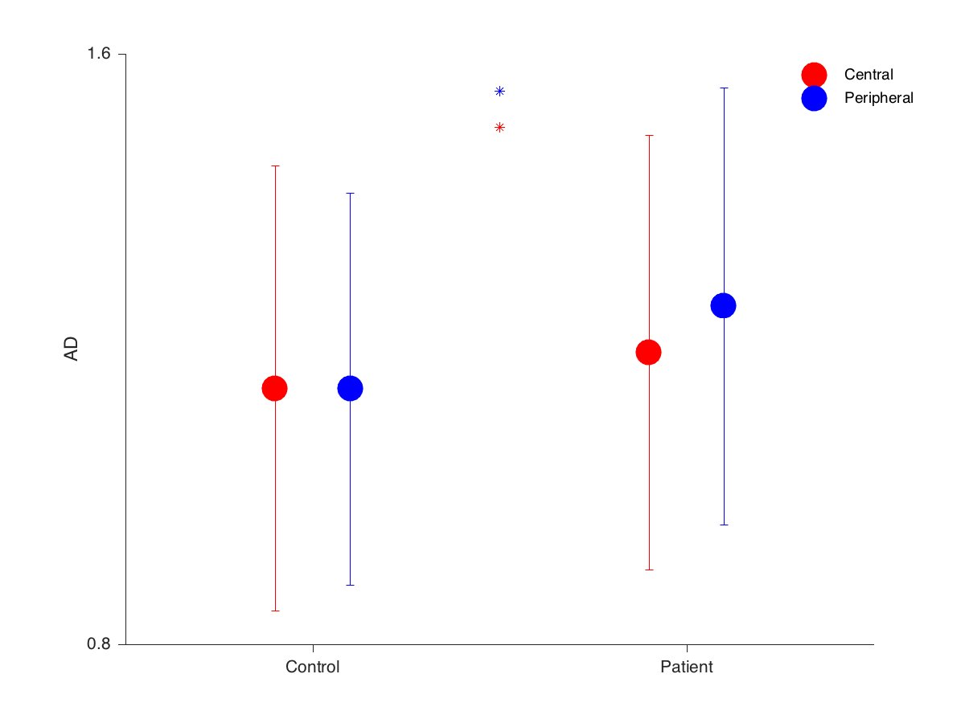
OR voxel wise comparison AD

Slide 3
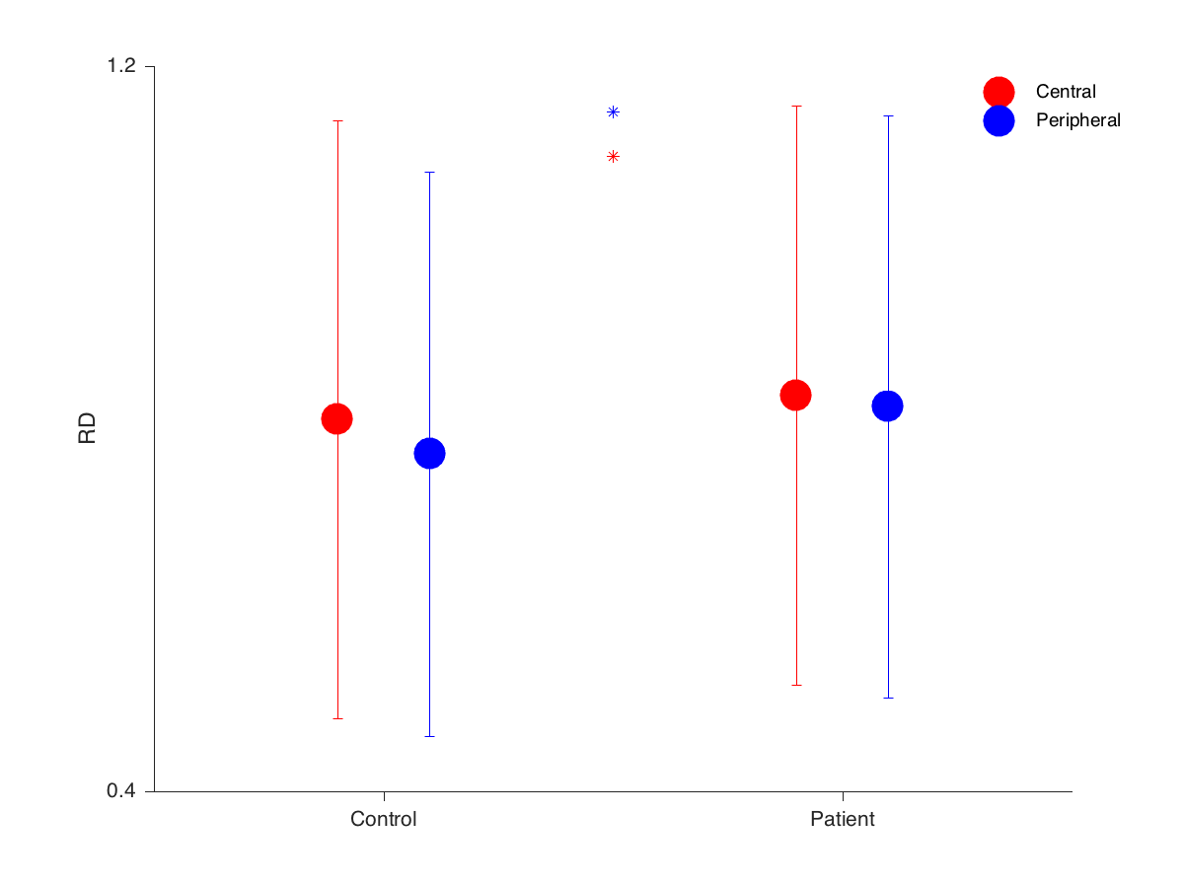
OR voxel wise comparison RD

Slide 4
Diffusivity change in both central and peripheral portion is significant. But we can not see the eccentricity effect.

