Slide 1
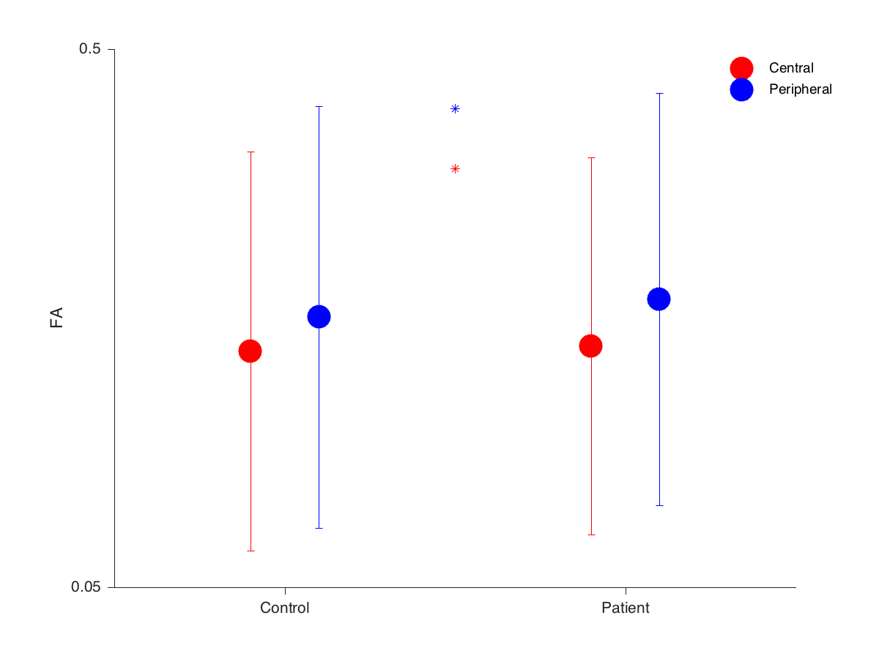
OR voxel wise comparison FA

Slide 2
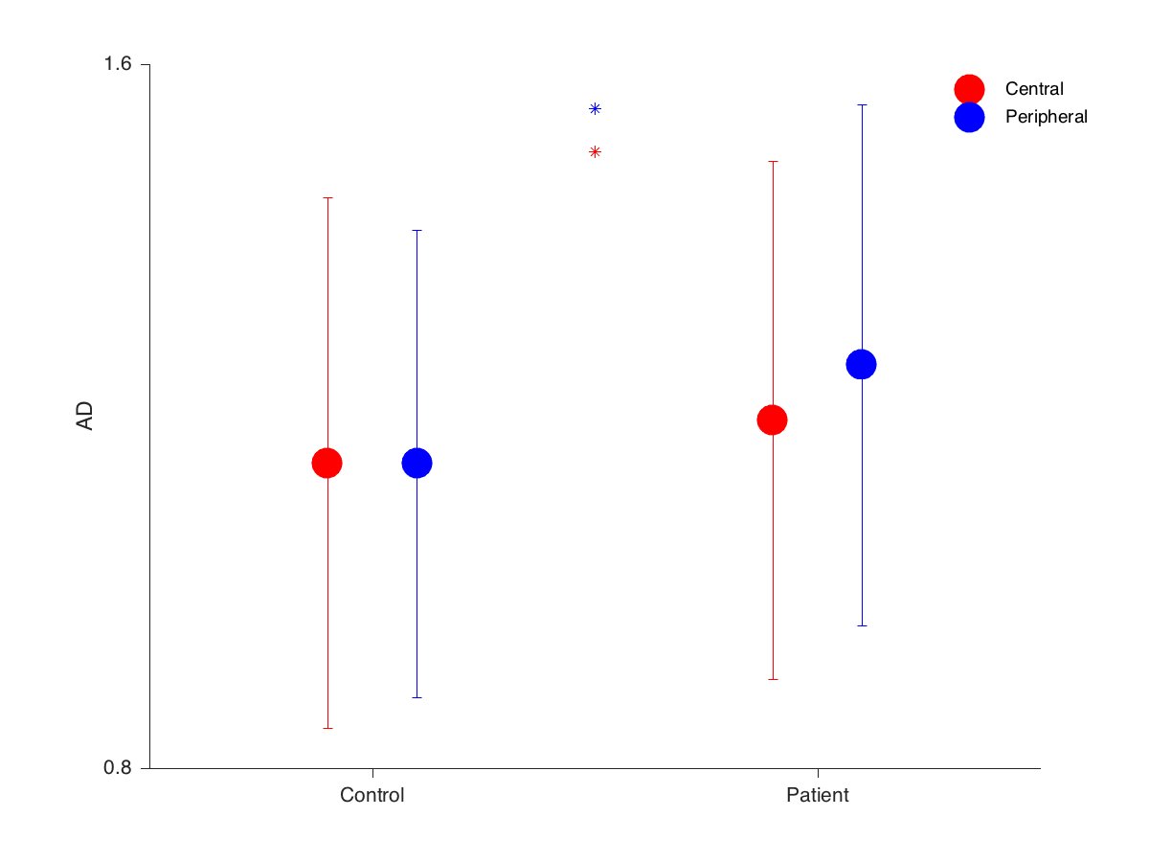
OR voxel wise comparison AD

Slide 3
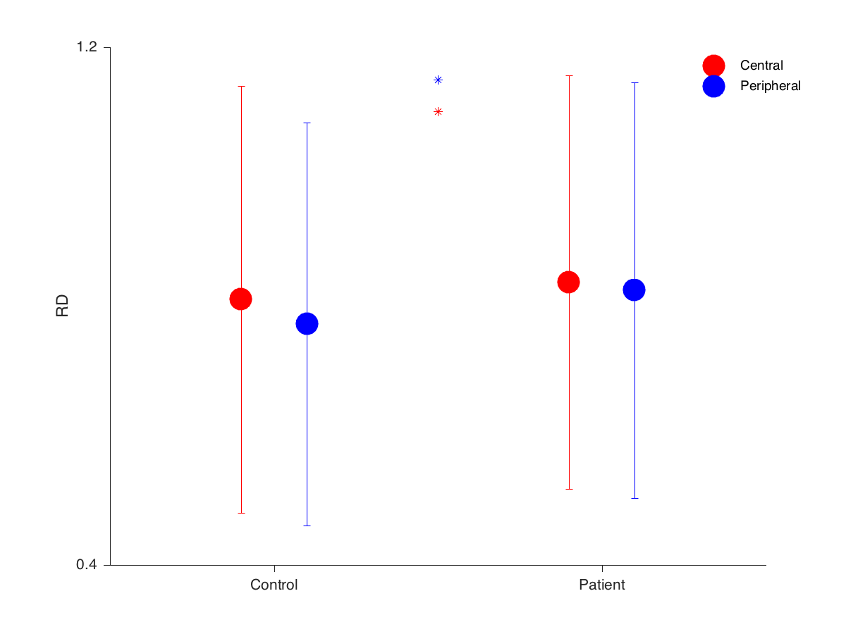
OR voxel wise comparison RD

