Slide 1

COSMOS - Electronic Contracting
Michael Merz
merz@ponton-hamburg.de
Ponton Hamburg

Slide 2
Problems with Contracts on Paper
Contracts are complex
Collaborative editing not supported
No formal validation possible
Difficult to verify signatory/proxy relationships
Media beak: No integration into business processes

Slide 3
Electronic Contracts
An Electronic Contract...
  is a well-structured document
    From the perspective of formatting
    Semantically
  is edited/viewed in different contexts
    Composition, Printing, Visualisation, Signing
  consists of standard elements plus individual extensions
  needs to be exchanged
  may be manipulated in a collaborative session
  is signed by attaching signatures in a standardized way

Slide 4
COSMOS Architecture
Offer
Database
Process
Description
Offer
Selection
Contract
Template
Database
Negotiation
Signing
Offer /
Inquiry
Market Participant
Market Participant

Slide 5
Why XML
Contracts fit well to be represented in XML
Several COSMOS areas require exchange of structured business data
  Profiles
  Offers / Inquiries
  Contracts
  Signatures
  Workflow execution
This data need to be visualized in various forms:
  On-screen vs. printed
  In edit vs. in view mode
  Separated vs. compound

Slide 6
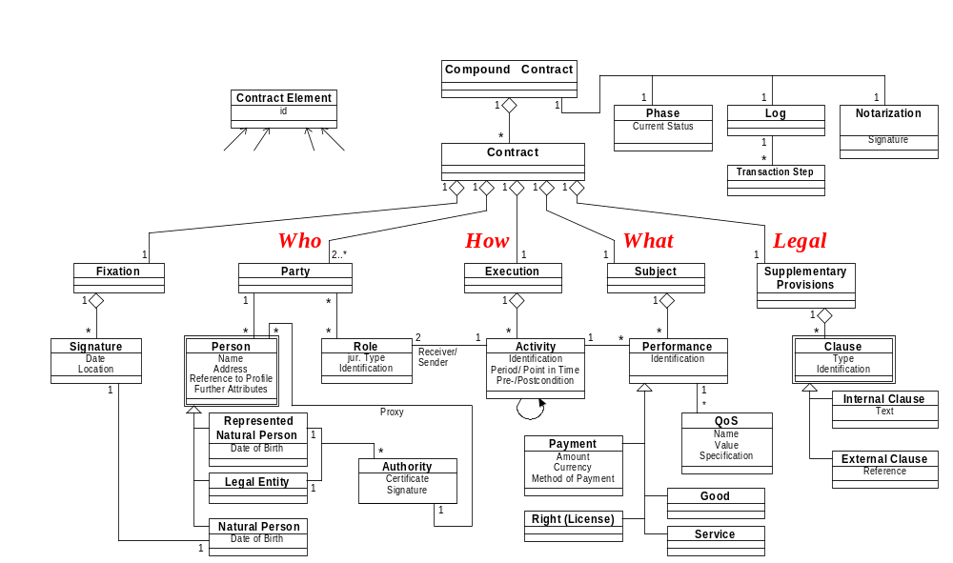
The COSMOS Contract Model

Slide 7
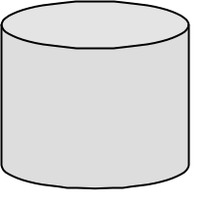

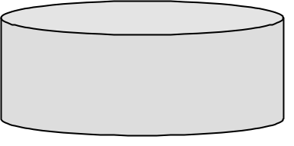
Signing Contracts
Party1 ... Party N
COSMOS Notary
Chamber Of Commerce
Negotiation Phase
I Agree
I Agree
Check Signatories
Please Sign
Please Sign
[ ]
[ ]
Notarisation
Signature, Certificate, Credential
< . . . > + +
Notary‘s Signature
Execution Phase

Slide 8

Modeling, Composition, Visualisation, Signing
(The big picture)
EU
Contract
EU
Contract
Contracts
as such...
WFM
Formalisation
PKI
COSMOS
Contract
Model
(Text)
(Semi
Structured)
COSMOS
DTD
EU
Contract
COSMOS
Contract
Style
Sheet
(UML)
(XML)
(XML)
(XSL)
EU
Contract
(HTML)

Slide 9
Standardization Requirements
General
  Contract DTD
  Contract XSL stylesheets (Print, Screen)
Specific
  Signature DTD
  Certificate DTD
  Product Description DTD
  Attribute Certificates (Signatory, Rating, ...)
  Expressing/verifying complex authority statement
Contract vs. Product Specification
  Embed / refer to document with Product Spec. schema
ToDo: standardizing the vocabulary for assertion statements

