Slide 1

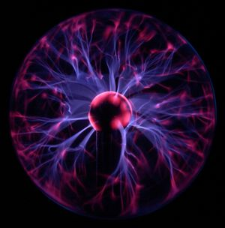
PLASMA HAS POWER!
ESTER KERZNER
IPC HONORS
MRS. K.

Slide 2
INTRODUCTION TO THE STATES OF MATTER
Matter comes in four* states that are distinguished by the strength of the bonds holding the molecules of the matter together.
They are solid, liquid, gas, and plasma.
*Some scientists say that there are more than four states of matter.

Slide 3
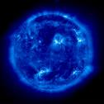
CHARACTERISTICS OF PLASMA
Plasma is usually a conductive assembly of charged particles, neutrals and fields that exhibit collective effects.
Plasma may also carry electrical currents and generate magnetic fields.
Plasma temperatures range from relatively cool to very hot.
Plasma densities range from tenuous to dense.

Slide 4
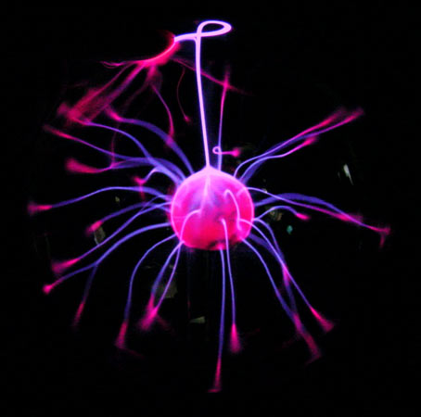
INTERESTING FACTS ABOUT PLASMA
The plasma physics includes basic physics research, industrial plasma processing, controlled fusion experiments, and astrophysical and geophysical plasma research.
It is estimated that roughly 99.5% of the matter in the universe is in the plasma state.
Sir William Crookes, an English physicist, identified plasma as the fourth state of matter in 1879.

Slide 5
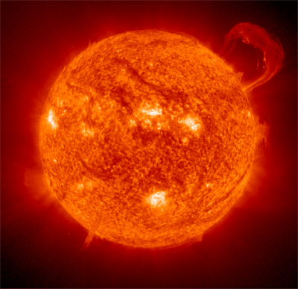
UNIQUENESS OF PLASMA
Plasma is the most common form of matter.
Ordinary solids, liquids, and gases are all electrically neutral and too cool or dense to be identified as plasma.

Slide 6
EVERYDAY APPLICATIONS OF PLASMA
New manufacturing techniques
Consumer products
The prospect of abundant energy
More efficient lighting
Surface cleaning
Waste removal

Slide 7
FUTURE APPLICATIONS OF PLASMA
Nuclear fusion
Prosthetic body parts
Production of artificial skin grafts
Sterilization of food surfaces and medical instruments.

Slide 8

EXAMPLES OF PLASMA
Interplanetary medium
Stellar Interiors
Ionosphere
Electrons in a metal
The gas in an electrical arc
Lightning

Slide 9
UNIVERSITIES/RESEARCH CENTERS WHERE PLASMA RESEARCH IS CONDUCTED IN THE U.S.A.
The University of Illinois
St. John's University
Center for Plasma Material Interactions
University of Rochester

Slide 10
BIBLIOGRAPHY
http://www.plasmas.org/
http://en.wikipedia.org/wiki/Plasma_(physics
http://www.physics.byu.edu/research/plasma/
http://www.cartage.org.lb/en/themes/Sciences/Physics/PlasmaPhysics/Applications/Applications.htm

