Slide 1

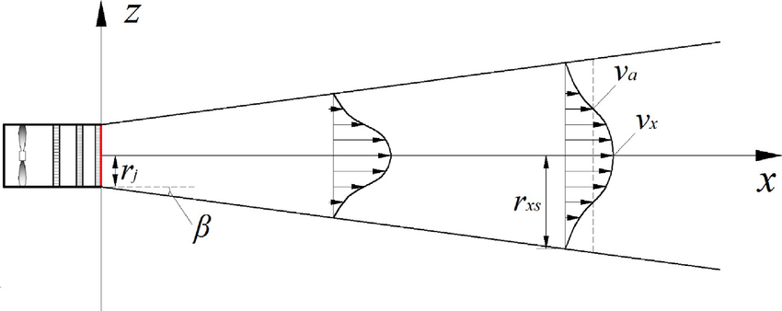
Laser sheet
Free Turbulent jet with aerosols

