Slide 1
(2,4) Trees
What are they?
  They are search Trees (but not binary search trees)
  They are also known as 2-4, 2-3-4 trees

Slide 2
Multi-way Search Trees
Each internal node of a multi-way search tree T:
  has at least two children
  stores a collection of items of the form (k, x), where k is a key and x is an element
  contains d - 1 items, where d is the number of children
  Has pointers to d children
Children of each internal node are “between” items
all keys in the subtree rooted at the child fall between keys of those items.

Slide 3
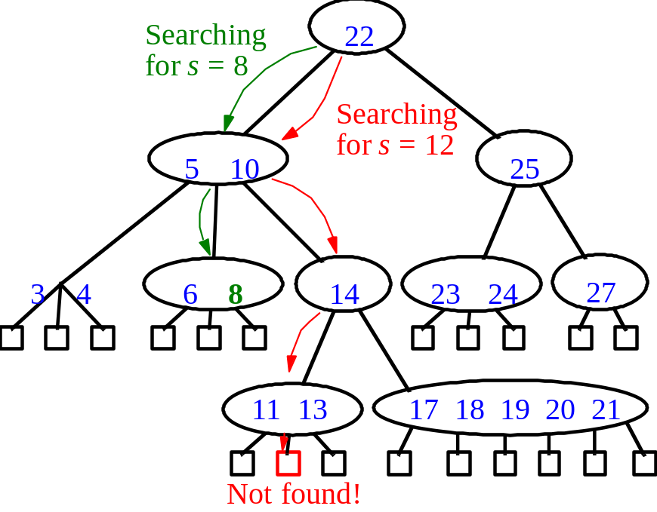


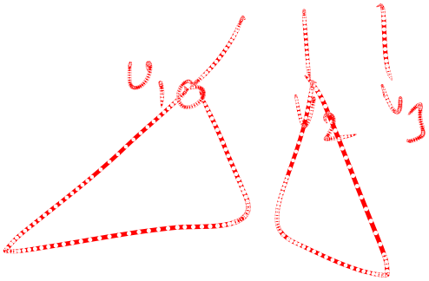

Multi-way Searching
Similar to binary searching
  If search key s<k₁ search the leftmost child
  If s>k_{d-1} , search the rightmost child
That’s it in a binary tree; what about if d>2?
  Find two keys k_{i-1} and k_{i} between which s falls, and search the child v_{i}.
What would an in-order traversal look like?
3 4

Slide 4
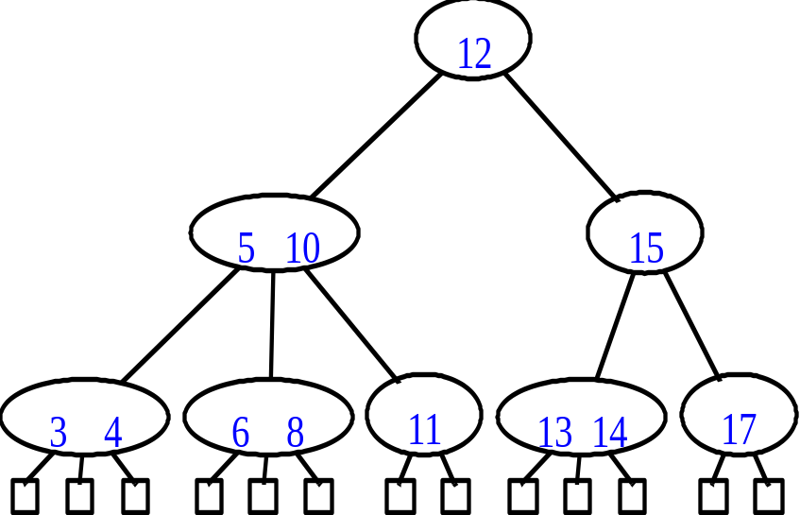
(2,4) Trees
Properties:
  At most 4 children
  All leaf nodes are at the same level.
  Height h of (2,4) tree is at least log₄ n and atmost log₂ n
How is the last fact useful in searching?

Slide 5
Insertion
No problem if the node has empty space
21
23
40
29
7
13
22
32
3
8
10
18
25
35
1
2
4
5
6
9
11
12
14
15
20
24
26
28
30
33
37
39

Slide 6
Insertion(2)
Nodes get split if there is insufficient space.
29
7
13
22
32
3
8
10
18
25
35
1
2
4
5
6
9
11
12
14
15
20
21
23
24
26
28
30
33
37
39
40

Slide 7
Insertion(3)
One key is promoted to parent and inserted in there
7
13
22
32
3
8
10
18
25
35
1
2
4
5
6
9
11
12
14
15
20
21
23
24
33
37
39
40
26
28
29
30

Slide 8
Insertion(4)
If parent node does not have sufficient space then it is split.
In this manner splits can cascade.
13
22
32
3
8
10
18
25
28
35
1
2
9
11
12
14
15
20
21
23
24
33
37
39
40
4
5
6
7
26
29
30

Slide 9
Insertion(5)
Eventually we may have to create a new root.
This increases the height of the tree
5
13
22
32
3
8
10
18
25
28
35
1
2
9
11
12
14
15
20
21
23
24
33
37
39
40
4
6
7
26
29
30

Slide 10
Time for Search and Insertion
A search visits O(log N) nodes
An insertion requires O(log N) node splits
Each node split takes constant time
Hence, operations Search and Insert each take time O(log N)

Slide 11
Deletion
Delete 21.
No problem if key to be deleted is in a leaf with at least 2 keys
13
5
22
3
8
10
18
25
28
1
2
9
11
12
14
15
20
21
23
24
4
6
7
26
29
30

Slide 12
Deletion(2)
If key to be deleted is in an internal node then we swap it with its predecessor (which has to be in a leaf) and then delete it.
Delete 25
13
5
22
3
8
10
18
25
28
1
2
9
11
12
14
15
20
23
24
4
6
7
26
29
30

Slide 13
Deletion(3)
If after deleting a key a leaf(node) becomes empty then we borrow a key from its sibling.
Delete 20
13
5
22
3
8
10
18
24
28
1
2
9
11
12
14
15
20
23
4
6
7
26
29
30

Slide 14
Deletion(4)
If an adjascent sibling has only one key then we merge with it.
The key in the parent node separating these two siblings moves down into the merged node.
Delete 23
13
5
22
3
8
10
15
24
28
1
2
9
11
12
14
18
23
4
6
7
26
29
30

Slide 15
Delete(5)
Moving a key down from the parent corresponds to deletion in the parent node.
The procedure is the same as for a leaf node.
Can lead to a cascade .
Delete 18
13
5
22
3
8
10
15
28
1
2
9
11
12
14
18
4
6
7
24
29
30
26

Slide 16
(2,4) Conclusion
The height of a (2,4) tree is O(log n).
Split, transfer, and merge each take O(1).
Search, insertion and deletion each take O(log n) .
Why are we doing this?
  (2,4) trees are fun! Why else would we do it?
  Well, there’s another reason, too.
  They’re pretty fundamental to the idea of Red-Black trees as well.

