Slide 1
Red-Black Trees
What are they?
Their relation to 2-4 trees
Deletion in red-black trees

Slide 2
Red-Black Trees
A red black tree is a binary search tree in which each node is colored red or black.
The root is colored black.
A red node can have only black children.
If a node of the BST does not have a left and/or right child then we add an external node.
External nodes are not colored.
The black depth of an external node is defined as the number of black ancestors it has.
In a red-black tree every external node has the same black depth.

Slide 3
Examples of red-black trees
Black height of tree is 2
Black height of tree is 2

Slide 4
Trees which are not red-black
Double red
Black height not uniform

Slide 5


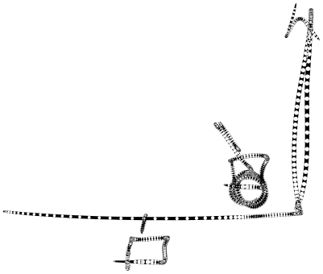






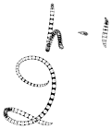
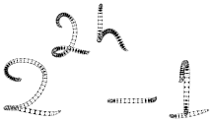








Height of a red-black tree
Let h be the black height of a red-black tree on n nodes.
n is smallest when all nodes are black. In this case tree is a complete binary tree of height h and n=2^{h} -1.
n is largest when alternate levels of tree are red. Then height of tree is 2h and n=2^{2h}-1.
Hence, log₄ n < h < 1+log₂ n

Slide 6
Red-black trees to 2-4 trees
Any red-black tree can be converted into a 2-4 tree.
Take a black node and its red children (at most 2) and combine them into one node of a 2-4 tree.
Each node so formed has at least 1 and at most 3 keys.
Since black height of all external nodes is same, in the resulting 2-4 tree all leaves are at same level.

Slide 7
Example
9
4
13
2
7
11
19
1
3
5
17
4
9
13
1
2
3
5
7
11
17
19

Slide 8
2-4 trees to red-black trees
Any 2-4 tree can be converted into a red-black tree.
We replace a node of the 2-4 tree with one black node and 0/1/2 red nodes which are children of the black node.
The height of the 2-4 tree is the black height of the red-black tree created.
Every red node has a black child.

Slide 9
Example
13
3
8
10
18
1
2
4
5
6
9
11
12
14
15
20
13
8
18
3
10
15
20
2
5
9
12
14
Black height is same as height of 2-4 tree
1
4
6
11

Slide 10
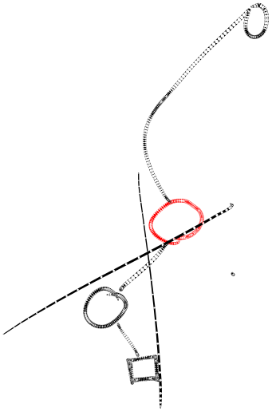
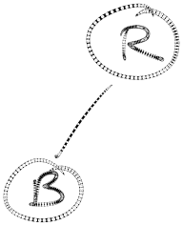

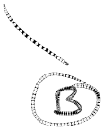


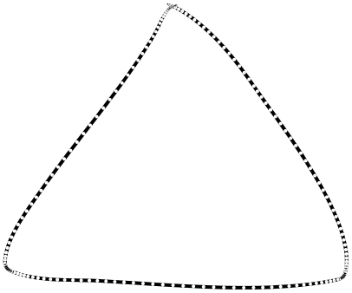
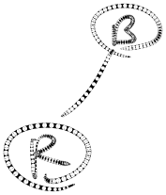
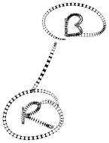
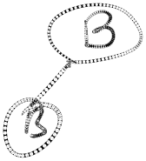


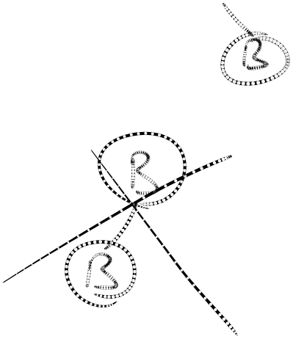
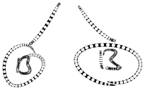

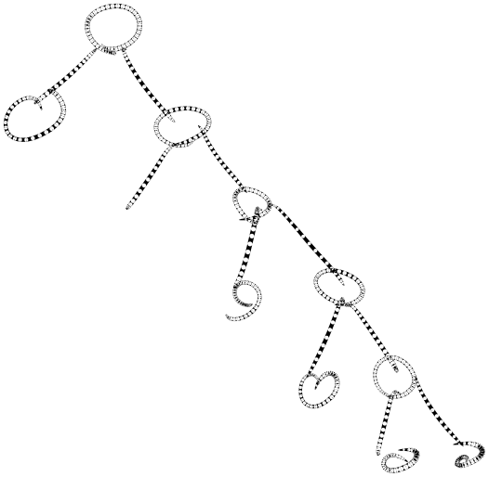

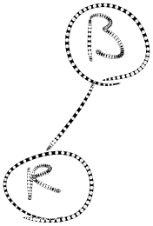




Slide 11

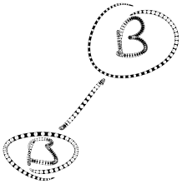
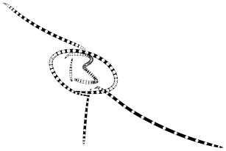
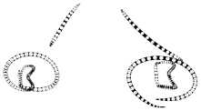
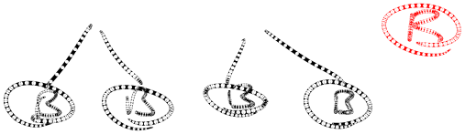

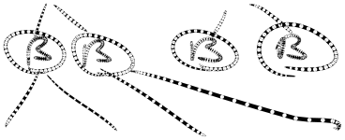




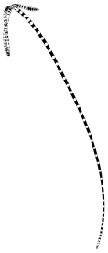


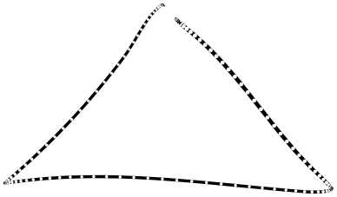
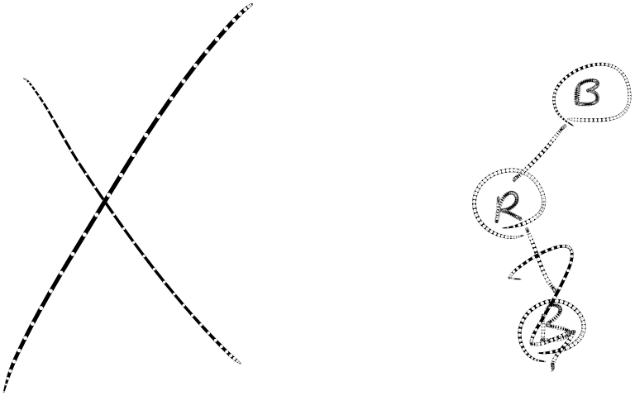

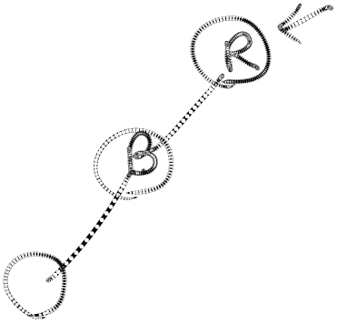





Slide 12
Deletion: preliminaries
To delete a node we proceed as in a BST.
Thus the node which is deleted is always the parent of an external node ( 1 or 2 ) .
Hence it is either a leaf or the parent of a leaf.
Here :
(i). 17 cant be black as else there would be a black height imbalance. H(a or b) = H( c) +1
(ii). 19 and 17 cant swap colours because then also there would be a height imbalance
H(a or b) = H( c) +1
1
11
19
On its deletion , it is equivalent to an empty node in a (2-4) tree . In all the other cases there are atleast two elements in the node from which deletion is being carried out
c
17
a
b
17

Slide 13
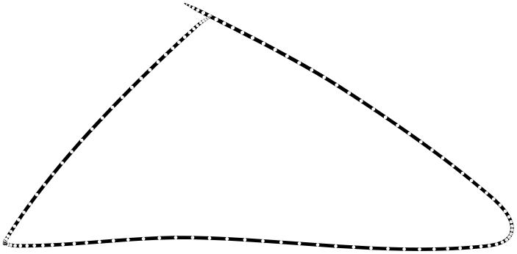

Deletion: preliminaries(2)
Hence we can assume that the node deleted is a black leaf.
Removing this reduces black depth of an external node by 1.
Hence, in a general step, we consider how to reorganize the tree when the black height of some subtree goes down from h to h-1.

Slide 14
Deletion: the cases
a is red
a
a is black
b is red
a
b is black
a
b
a
b
Both c are black
a
Both c are black
c
c
b
b
Both d are black
c
c
c
Some c is red
a
d
d
a
Some c is red
a
b
Some d is red
a
b
b
1.2
a
b
c
a
2.2.2
b
c
2.1.2
c
b
1.1
c
d
2.1.1
2.2.1

Slide 15











Deletion: case1.1
If parent is a red node (a).
Then it has a child (b) which must be black
If b has a red child (c)
a
b
b
c
a
h to h-1
h-1
c
h-1
h-1
h-1
h-1
h-1
h-1
a
b
a
h to h-1
c
h-1
b
c
h-1
h-1

Slide 16
Deletion: case 1.2
If parent is a red node (a).
Then it has a child (b) which must be black
If b has no red child
a
a
b
b
h to h-1
h-1
h-1
h-1
h-1
h-1
a
b
b
a

Slide 17
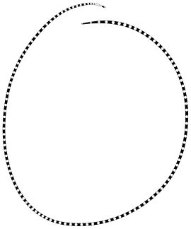
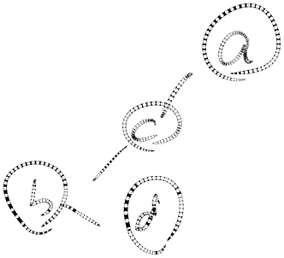
Deletion: case 2.1.1
If parent is a black node (a).
If a has a red child (b)
Consider right child of b (c) which must be black.
If (c) has a red child (d).
c
a
b
a
b
h to h-1
h
c
d
h
h-1
h-1
d
h-1
h-1
h-1
h-1
h-1
b
a
b
c
d
c
d
a

Slide 18
Deletion: case 2.1.2
If parent is a black node (a).
If a has a red child (b)
Consider right child of b (c) which must be black.
If (c) has no red child.
b
a
a
b
h
c
h to h-1
h-1
c
h
h-1
h-1
h-1
h-1
b
a
b
c
c
a

Slide 19
Deletion: case 2.2.1
If parent is a black node (a).
If the child of node a (c) is black.
If (c) has a red child (d)
a
d
c
c
a
h to h-1
h-1
d
h-1
h-1
h-1
h-1
h-1
h-1
a
d
c
d
c
a

Slide 20
Deletion: case 2.2.2
If parent is a black node (a).
If the child of node a (c) is black.
If (c) has no red child.
a
a
c
c
h to h-1
h-1
h-1
h-1
h-1
h-1
a
c
a
c

Slide 21
Deletion: Summary
In all cases, except 2.2.2, deletion can be completed by a simple rotation/recoloring
In case 2.2.2, the height of the subtree reduces and so we need to proceed up the tree.
But in case 2.2.2 we only recolor nodes.
Thus, if we proceed up the tree then we only need to recolor. Eventually we would do a rotation.

