Slide 1
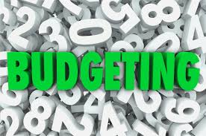

Slide 2

Definitions of budget
1)A budget is a tool for planning, quantifying the plans and controlling costs.
-Finkler, 1984
2) A budget is a plan that uses numerical data to predict the activities of an organization over a period of time and it provides a mechanism for planning each unit’s needs and contributions.
-Carruth and Noto, 2000

Slide 3

Importance of budget
The budget is an essential management tool.
The budget tells you how much money you need to carry out your activities.
The budget forces for rigorous in thinking through the implications of your activity planning.
The budget enables to monitor income & expenditure & identify any problems.
The budget is a basis for financial accountability and transparency.

Slide 4
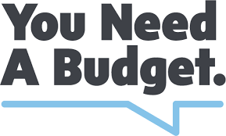
Purposes of Budget
Budget as a tool of financial control, it is exercised at various stages.
Budget is an instrument of organization as policy, fiscal policy. It is device whereby plans and policies are put into action.

Slide 5

Budget is a tool of administration. When planning, co-ordination, control, evaluation, reporting & review are combined in a budgetary system it becomes effective tool of administration management.
Budget is also a tool of accountability.
It has informative roles as it contains valuable information for various activities.

Slide 6
Incremental budget: - It is based on estimated changes in present operations, plus a percentage increase for inflation, all of which is added to the previous year’s budget.
Open ended budget: - It is a financial plan in which each operating manager presents a single cost estimate for optimal activity level for each programme in the unit, without indicating how the budget should be scaled down if less funding available..
Flexible budget: - It is based on the fact that operating conditions rarely conform to expectations. Therefore a flexible budget consists of several financial plans, each for a different level of program activity.

Slide 7
Sales budget:- It is the starting point in a budgetary program, since sales are basic activities which gives shape to all other activities.
Production budget:- It is the budget that aims at securing the economical manufacture of products and maximizing the utilization of production facilities.
Cash budget:- It is prepared by way of projecting the possible cash receipts and payments over the budget period
Zero- based budget:- It requires the manager to justify each cost of every program, both old and new , in every annual budget preparation.

Slide 8
Advantages of Budgeting
It helps plan for detailed program activities
Budgeting compels and motivates management to make an early and timely study of its problems.
Budgeting provides a valuable means of controlling income and expenditure of a business as it is a “plan for spending.”
Budgeting provides a tool through which managerial policies and goals are periodically evaluated.
Budgeting helps in directing capital and other resources into the most profitable channels.

Slide 9
Disadvantages of Budgeting
A budget may become an end in itself instead of the means to achieve an end.
It may gain autocratic control of the organization.
Over-budgeting is a big danger
Forecasting is required but is uncertain
Skill and experience are essential for successful budgetary control
Budgetary planning is expensive and time consuming

