Slide 1
Project Risk Management
Kaustubh Gupta

Slide 2
The Importance of Project Risk Management
Project risk management is the art and science of identifying, assigning, and responding to risk throughout the life of a project and in the best interests of meeting project objectives
Risk management is often overlooked on projects, but it can help improve project success by helping select good projects, determining project scope, and developing realistic estimates
KPMG study found that 55 percent of runaway projects did no risk management at all

Slide 3
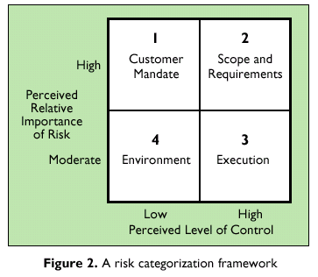
Project Risk Classification

Slide 4
What is Risk?
A dictionary definition of risk is “the possibility of loss or injury”
Project risk involves understanding potential problems that might occur on the project and how they might impede project success
Risk management is like a form of insurance; it is an investment

Slide 5
Risk Utility
Risk utility or risk tolerance is the amount of satisfaction or pleasure received from a potential payoff
Utility rises at a decreasing rate for a person who is risk-averse
Those who are risk-seeking have a higher tolerance for risk and their satisfaction increases when more payoff is at stake
The risk neutral approach achieves a balance between risk and payoff

Slide 6
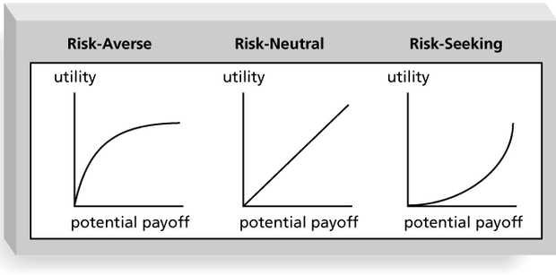
Risk Utility Function and Risk Preference

Slide 7
What is Project Risk Management?
The goal of project risk management is to minimize potential risks while maximizing potential opportunities. Major processes include
Risk management planning: deciding how to approach and plan the risk management activities for the project
Risk identification: determining which risks are likely to affect a project and documenting their characteristics
Qualitative risk analysis: characterizing and analyzing risks and prioritizing their effects on project objectives
Quantitative risk analysis: measuring the probability and consequences of risks

Slide 8
Risk response planning: taking steps to enhance opportunities and reduce threats to meeting project objectives
Risk monitoring and control: monitoring known risks, identifying new risks, reducing risks, and evaluating the effectiveness of risk reduction

Slide 9
Risk Management Planning
The main output of risk management planning is a risk management plan
The project team should review project documents and understand the organization’s and the sponsor’s approach to risk
The level of detail will vary with the needs of the project

Slide 10
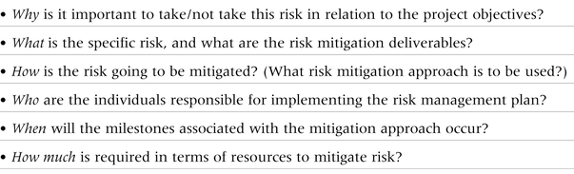
Questions Addressed in a Risk Management Plan

Slide 11
Contingency and Fallback Plans, Contingency Reserves
Contingency plans are predefined actions that the project team will take if an identified risk event occurs
Fallback plans are developed for risks that have a high impact on meeting project objectives
Contingency reserve or allowances are provisions held by the project sponsor that can be used to mitigate cost or schedule risk if changes in scope or quality occur

Slide 12
Other than Project Risk
Market risk: Will the new product be useful to the organization or marketable to others? Will users accept and use the product or service?
Financial risk: Can the organization afford to undertake the project? Is this project the best way to use the company’s financial resources?
Technology risk: Is the project technically feasible? Could the technology be obsolete before a useful product can be produced?

Slide 13
Risk Identification
Risk identification is the process of understanding what potential unsatisfactory outcomes are associated with a particular project
Several risk identification tools and techniques include
Brainstorming
The Delphi technique
Interviewing
SWOT analysis

Slide 14
Quantitative Risk Analysis
Assess the likelihood and impact of identified risks to determine their magnitude and priority
Risk quantification tools and techniques include
Probability/Impact matrixes
The Top 10 Risk Item Tracking technique
Expert judgment

Slide 15
Top 10 Risk Item Tracking
Top 10 Risk Item Tracking is a tool for maintaining an awareness of risk throughout the life of a project
Establish a periodic review of the top 10 project risk items
List the current ranking, previous ranking, number of times the risk appears on the list over a period of time, and a summary of progress made in resolving the risk item

Slide 16
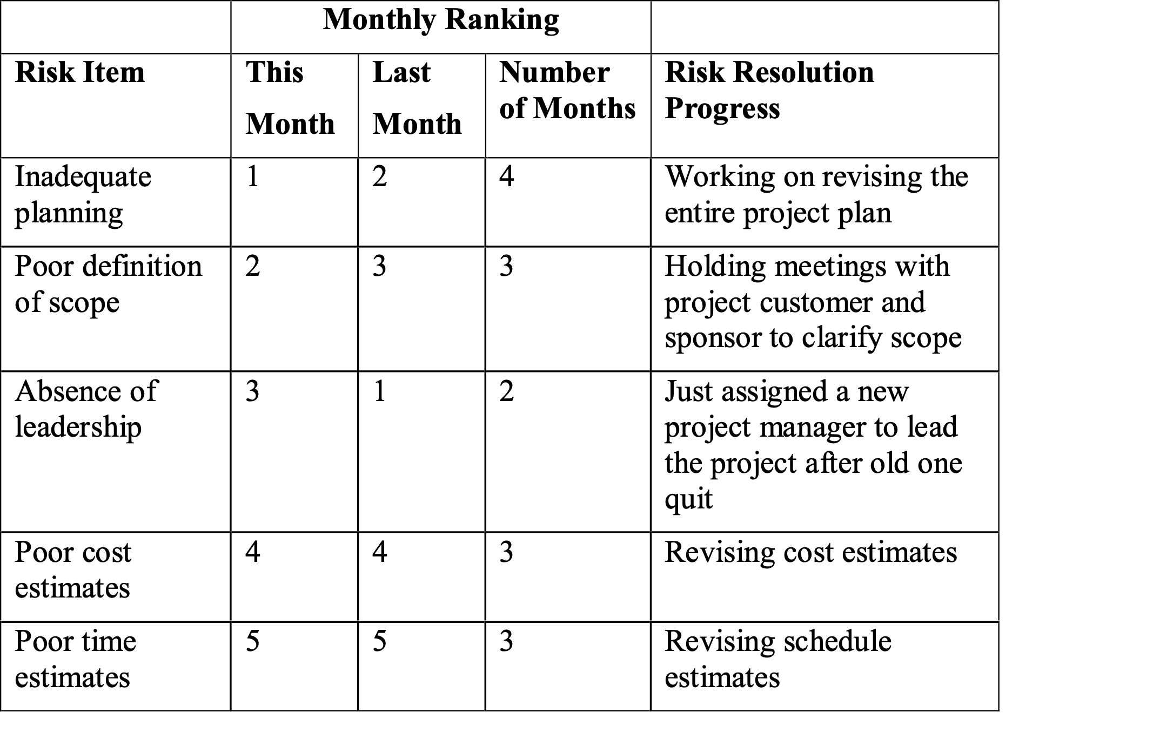
Example of Top 10 Risk Item Tracking

Slide 17
Quantitative Risk Analysis
Often follows qualitative risk analysis, but both can be done together or separately
Large, complex project involving leading edge technologies often require extensive quantitative risk analysis
Main techniques include
Decision tree analysis
simulation

Slide 18
Decision Trees and Expected Monetary Value (EMV)
A decision tree is a diagramming method used to help you select the best course of action in situations in which future outcomes are uncertain
EMV is a type of decision tree where you calculate the expected monetary value of a decision based on its risk event probability and monetary value

Slide 19
Simulation
Simulation uses a representation or model of a system to analyze the expected behavior or performance of the system
Monte Carlo analysis simulates a model’s outcome many time to provide a statistical distribution of the calculated results
To use a Monte Carlo simulation, you must have three estimates (most likely, pessimistic, and optimistic) plus an estimate of the likelihood of the estimate being between the optimistic and most likely values

Slide 20
Risk Response Planning
After identifying and quantifying risk, you must decide how to respond to them
Four main strategies:
Risk avoidance: eliminating a specific threat or risk, usually by eliminating its causes
Risk acceptance: accepting the consequences should a risk occur
Risk transference: shifting the consequence of a risk and responsibility for its management to a third party
Risk mitigation: reducing the impact of a risk event by reducing the probability of its occurrence

Slide 21
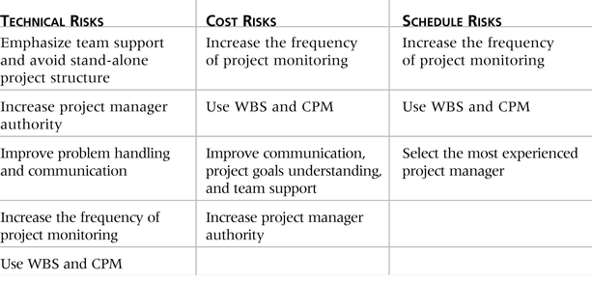
General Risk Mitigation Strategies for Technical, Cost, and Schedule Risks

Slide 22
Risk Monitoring and Control
Monitoring risks involves knowing their status
Controlling risks involves carrying out the risk management plans as risks occur
Workarounds are unplanned responses to risk events that must be done when there are no contingency plans
The main outputs of risk monitoring and control are corrective action, project change requests, and updates to other plans

Slide 23
Risk Response Control
Risk response control involves executing the risk management processes and the risk management plan to respond to risk events
Risks must be monitored based on defined milestones and decisions made regarding risks and mitigation strategies
Sometimes workarounds or unplanned responses to risk events are needed when there are no contingency plans

Slide 24
Results of Good Project Risk Management
Unlike crisis management, good project risk management often goes unnoticed
Well-run projects appear to be almost effortless, but a lot of work goes into running a project well
Project managers should strive to make their jobs look easy to reflect the results of well-run projects

Slide 25
THANK YOU

