Slide 1
NEW PRODUCT DEVELOPMENT PROCESS.

Slide 2

New product.
A product is anything that can be offered to a market to satisfy needs and wants.
A New product is any product which is perceived by the customer as being new.
New product Categories…….
1:New to the world.
2:New to the product lines.
3:Additions to the existing product line.
4:Improvements & revisions of existing products.
5:Repositioning.
6:Cost reductions.

Slide 3
New Product development Process
New Product Development is the development of original products, product improvements, product modifications, and new brands through the firm’s own R & D efforts. This process consist of following steps.
Idea Generation.
Idea Screening.
Concept Development & Testing.
Marketing Strategy Development.
Business Analysis.
Product Development.
Market Testing.
Commercialization.

Slide 4
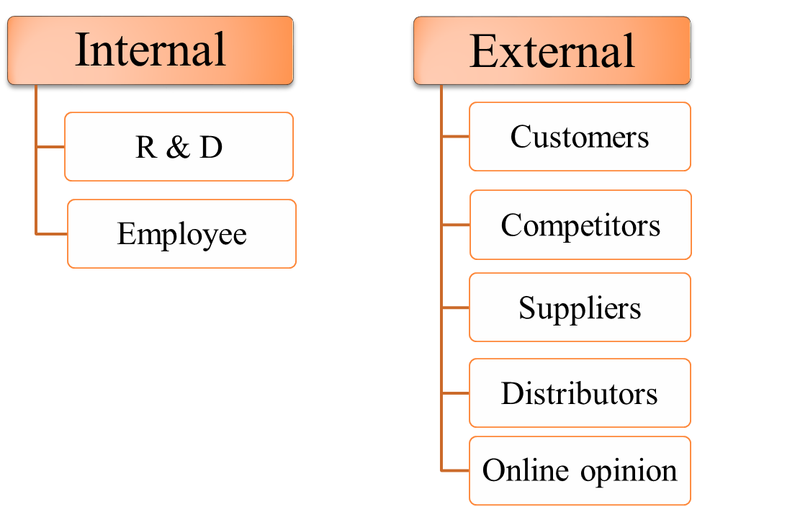

1.Idea Generation .
Idea generation is continuous, systematic search for new product opportunities.
Ideas form using creativity generating techniques and generated through firm’s Internal Sources & external Sources.

Slide 5
2.Idea Screening.
Filtering the ideas to pick out good ones & dropping the poor ones.
It involves a preliminary elimination process in which a large number of product ideas are screened in terms of the organization’s objectives, policies, technical feasibility, and financial viability.
Total ideas are categories into three group. They are, promising ideas, marginal ideas and rejected ideas.

Slide 6
3. Concept Development & Testing.
Here, the Product Idea is converted into product concept.
Product Ideas means Possible product that company may offer to the market.
A product concept is a detailed version of the idea stated in meaningful consumer terms
When developing product concept following criteria should be consider.
Who will use the product.
What primary benefit should this product provide.
When will this product be consumed.
Concept Testing means presenting the product concept to target consumers, physically or symbolically, and getting their reactions.

Slide 7
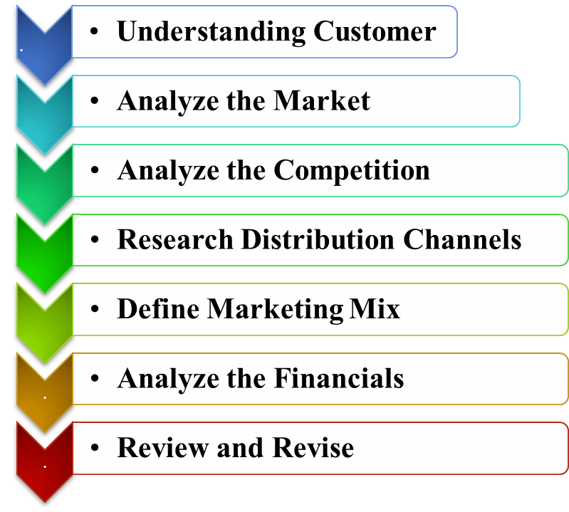
4.Marketing Strategy Development.
After concept testing, for concepts that qualify a preliminary marketing strategy is created to introduce new product into market.

Slide 8
5.Business Analysis.
This stage will decide whether from financial as well as marketing point of view, the project is beneficial or not.
In Business Analysis ,
Estimate likely selling price based upon competition and customer feedback.
Estimate sales volume based upon size of market.
Estimate profitability and break-even point.
If above are match with the company's objectives, then the new product concept moves to product development stage.

Slide 9
6.Product Development.
Up to now, the product has existed only as a word description, a drawing.
The company will now determine whether the product idea can translate into a technically and commercially feasible product.
Produce a
physical prototype
Test the product
Conduct focus group customer
Make adjustment

Slide 10
7. Market Testing.
Now the product is ready to be branded with a name, logo, and packaging and go into a preliminary market testing.
Marketing Testing involves placing a product for sale in one or more selected areas and observing its actual performance under the proposed marketing plan.
Methods for market testing:
Sales wave research.
Simulated test marketing.
Controlled testing marketing.
Test markets.

Slide 11
CONCLUSION.
Every year millions of rupees are being spent on R&D for new products development. Such huge investment is necessary as new products are the only means of survival of a firm.
Product development process include ; Idea Generation, Idea Screening, Concept Development & Testing, Marketing Strategy Development, Business Analysis, Product Development, Market Testing, Commercialization.
New product development provides a number of advantages to the enterprise.
To produce goods & services with best quality.
It helps in providing maximum customer satisfaction.
To replace declining product and take advantage of new technology.
To maintain/increase market share with competitive advantages.
To fill gap in the market.

