Slide 1


Chapter 9:
ANOVA
Instructor: Shirin Nezampour
Department of Management
Fall 2025

Slide 2
Analysis of Variance (ANOVA)
ANOVA is one of the most popular statistical tools of analyzing data.
Does Y (the response) depend on any of the factors?
Factor 1
Y
Factor 2
A Response Variable
Factor 3

Slide 3
ANOVA Examples
Example 1: You are doing a research study on employee performance scores (out of 100) at a company.
Question: What affects performance?
Does Y (the response) depend on any of the factors?
Department?
Sales / HR / IT
Performance
Work Schedule? Onsite / Hybrid / Remote
Education Level?
High School / Bachelor Master / PhD

Slide 4
ANOVA Examples
Example 2: ANOVA in Employee Training Program Evaluation
Research Question: A company's HR manager wants to evaluate the effectiveness of three different employee training programs on improving employee productivity.
Does employee productivity depend on training programs?
Instructor-Led Classroom Training
Productivity
Training program
Online Self-Paced Learning
On-the-Job Shadowing
Response
Factor
Treatments

Slide 5
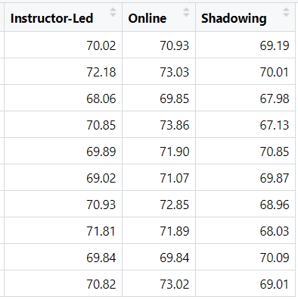







Data: Suppose 10 employees were randomly assigned to each training program. After completion, their productivity was measured using a standardized score.
Objective: Determine if there is a statistically significant difference in the mean productivity scores of employees who participated in the three different training programs. In statistical terms, we write the hypotheses as follows:
Mean:
${\overline{y}}_{1}$=70.34
${\overline{y}}_{2}$= 71.82
${\overline{y}}_{3}$= 69.11
St.D:
$s_{1}=$1.24
$s_{2}=$1.28
$s_{3}=$1.18

Slide 6
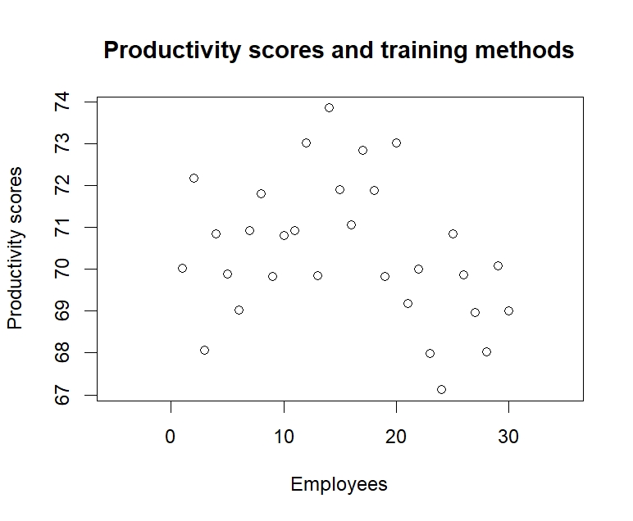
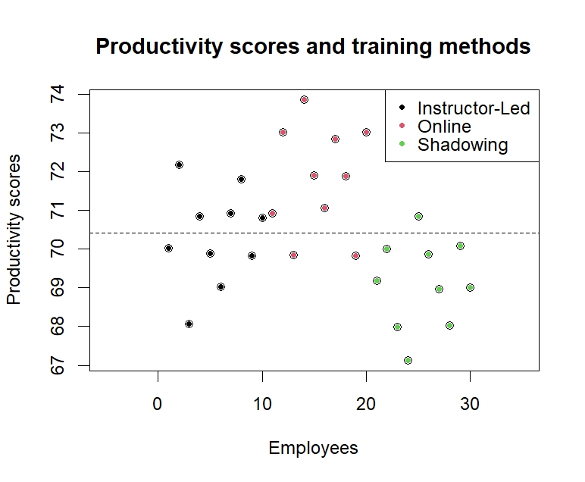
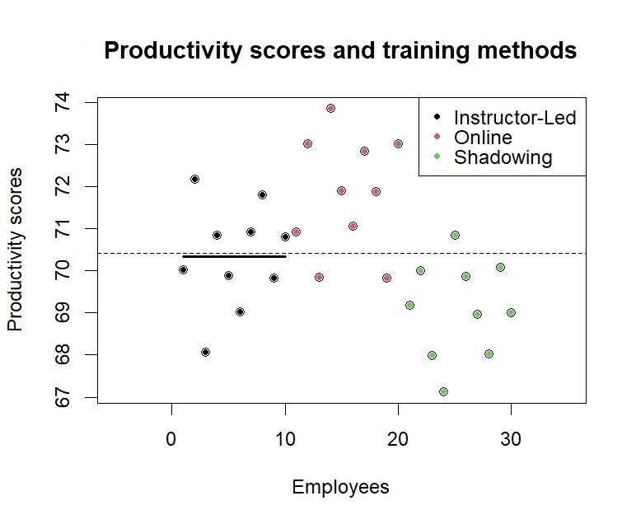
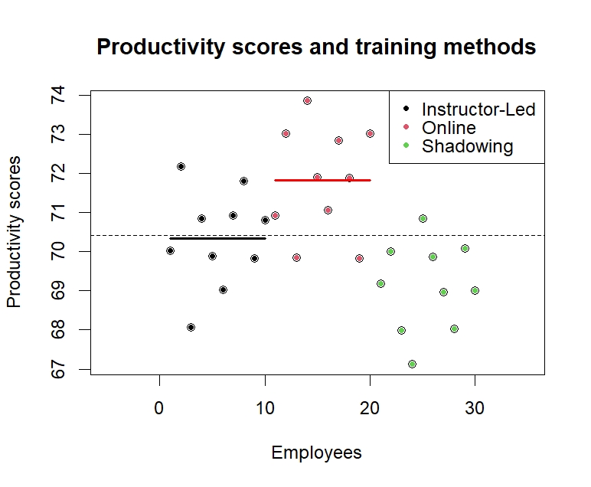
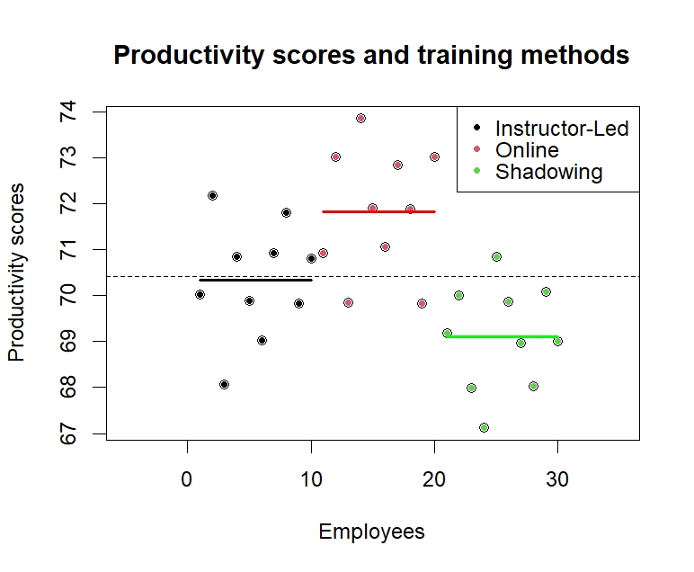
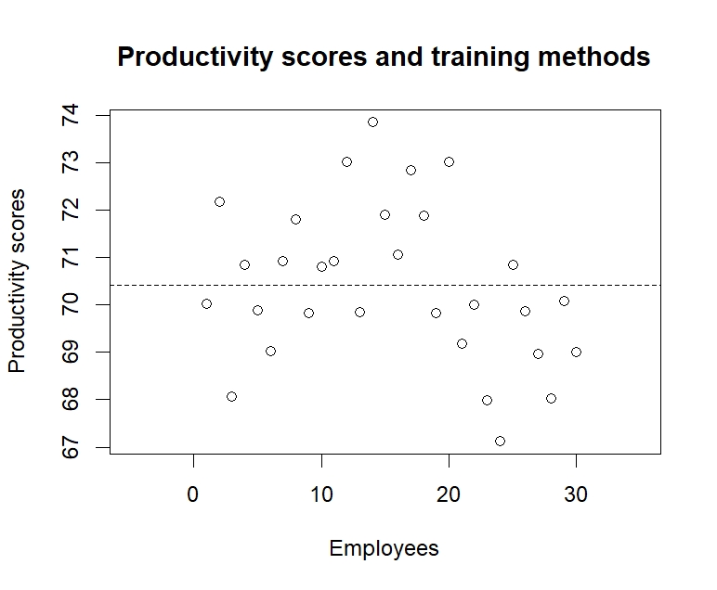
Example Cont’D
The variation in Productivity
some is due to training method
and some is due to error

Slide 7
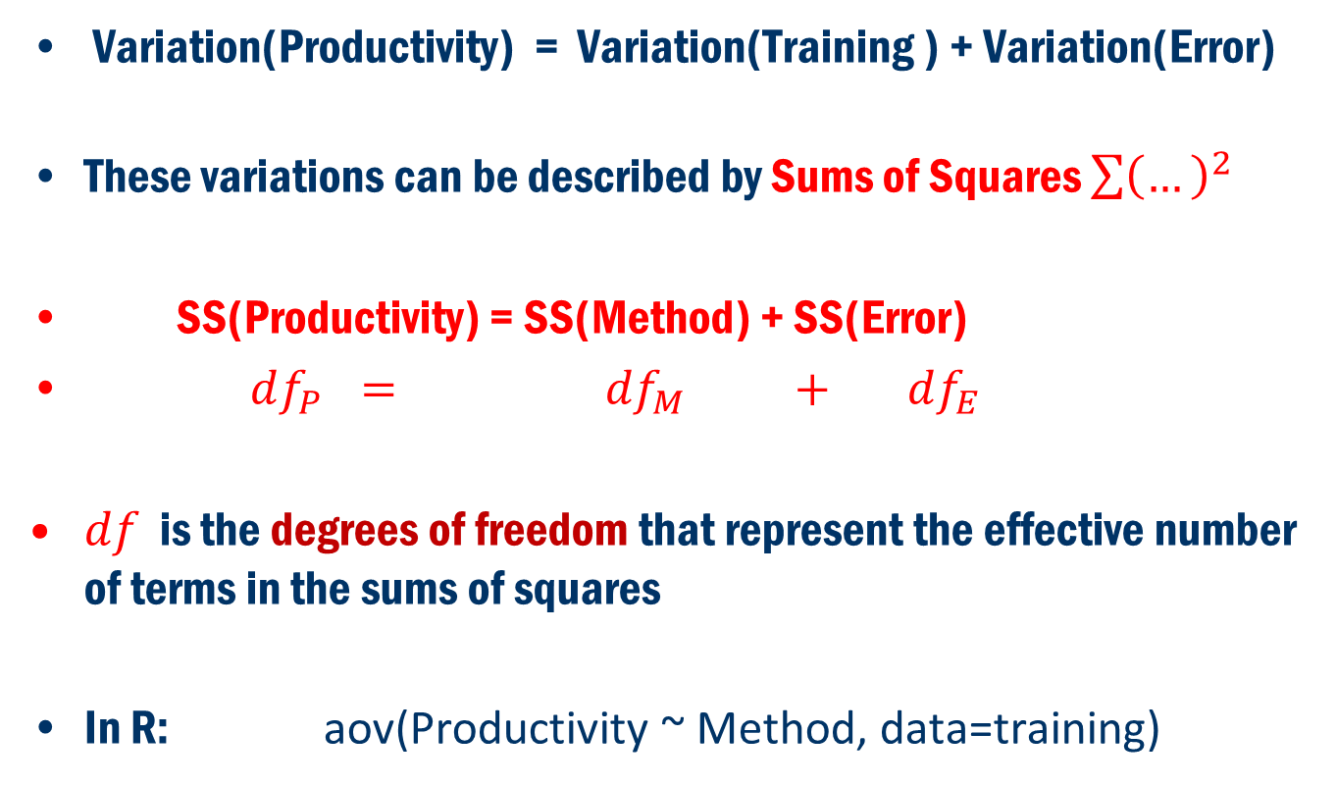
Concept
Variation(Productivity) = Variation(Training ) + Variation(Error)
These variations can be described by Sums of Squares $\sum{{\left(…\right)}^{2}}$
SS(Productivity) = SS(Method) + SS(Error)
$df_{P} = df_{M} + df_{E}$
$df$ is the degrees of freedom that represent the effective number of terms in the sums of squares
In R: aov(Productivity ~ Method, data=training)

Slide 8
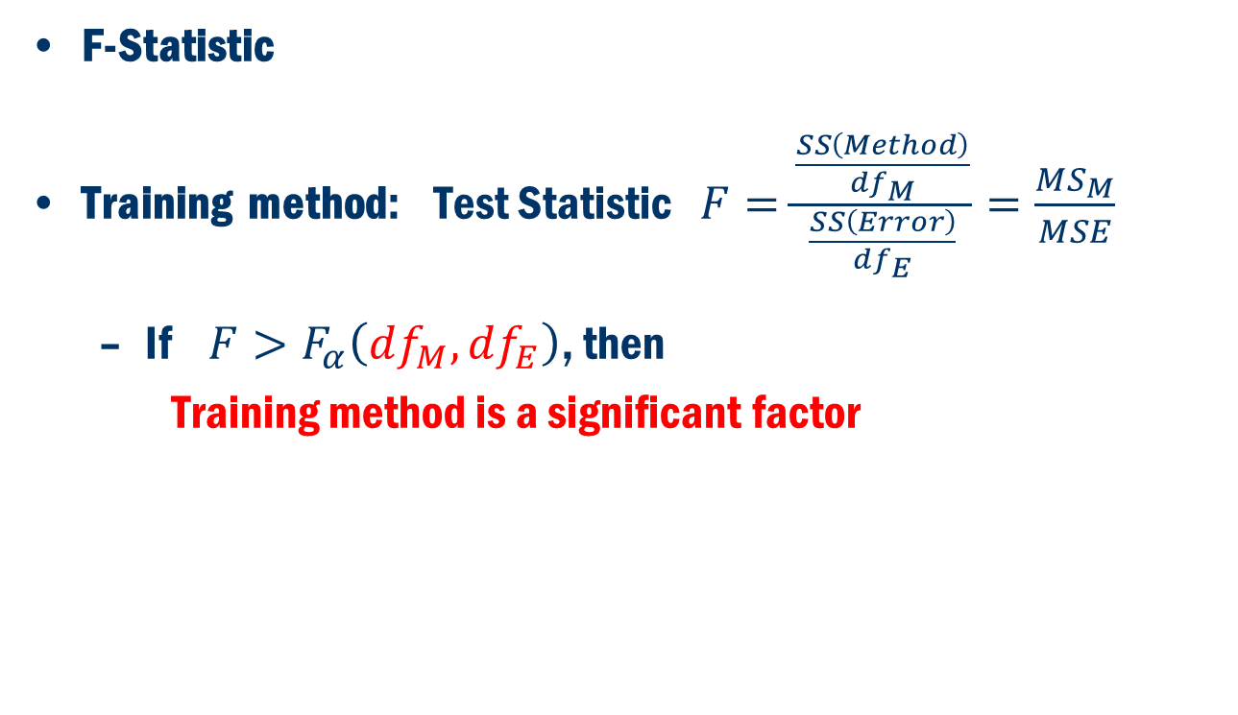
Test Statistics
F-Statistic
Training method: Test Statistic $F=\frac{\frac{SS\left(Method\right)}{df_{M}}}{\frac{SS\left(Error\right)}{df_{E}}}=\frac{MS_{M}}{MSE}$
If $F>F_{α}\left(df_{M},df_{E}\right)$, then
Training method is a significant factor

Slide 9
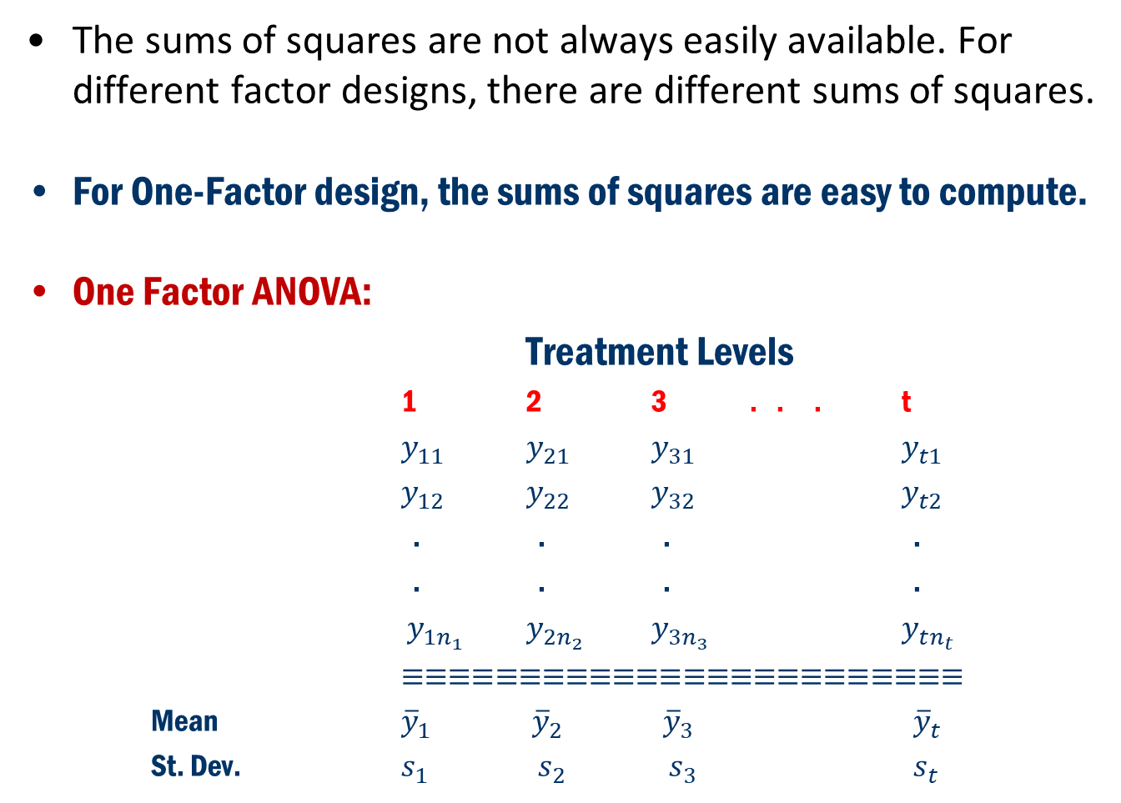
Back to Concept
The sums of squares are not always easily available. For different factor designs, there are different sums of squares.
For One-Factor design, the sums of squares are easy to compute.
One Factor ANOVA:
Treatment Levels
1 2 3 . . . t
$y_{11}$ $y_{21}$ $y_{31}$ $y_{t1}$
$y_{12}$ $y_{22}$ $y_{32}$ $y_{t2}$
. . . .
. . . .
$y_{1n_{1}}$ $y_{2n_{2}}$ $y_{3n_{3}}$ $y_{tn_{t}}$
$≡≡≡≡≡≡≡≡≡≡≡≡≡≡≡≡≡≡≡≡≡≡≡≡$
Mean ${\overline{y}}_{1}$ ${\overline{y}}_{2}$ ${\overline{y}}_{3}$ ${\overline{y}}_{t}$
St. Dev. $s_{1}$ $s_{2}$ $s_{3}$ $s_{t}$

Slide 10
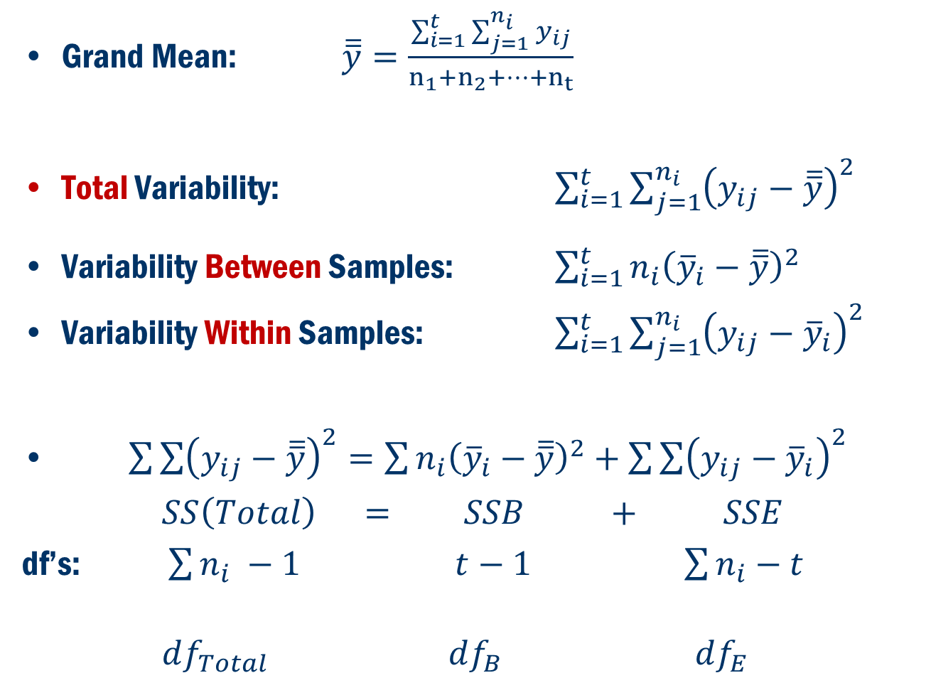
Back To Concept
Grand Mean: $\overline{\overline{y}}=\frac{\sum_{i=1}^{t}{\sum_{j=1}^{n_{i}}{y_{ij}}}}{n_{1}+n_{2}+…+n_{t}}$
Total Variability: $\sum_{i=1}^{t}{\sum_{j=1}^{n_{i}}{{\left(y_{ij}−\overline{\overline{y}}\right)}^{2}}}$
Variability Between Samples: $\sum_{i=1}^{t}{n_{i}{\left({\overline{y}}_{i}−\overline{\overline{y}}\right)}^{2} }$
Variability Within Samples: $\sum_{i=1}^{t}{\sum_{j=1}^{n_{i}}{{\left(y_{ij}−{\overline{y}}_{i}\right)}^{2}}}$
$\sum{\sum{{\left(y_{ij}−\overline{\overline{y}}\right)}^{2}=\sum{n_{i}{\left({\overline{y}}_{i}−\overline{\overline{y}}\right)}^{2}+\sum{\sum{{\left(y_{ij}−{\overline{y}}_{i}\right)}^{2}}}}}}$
$SS\left(Total\right) = SSB + SSE$
df’s: $\sum{n_{i}} −1$ $t−1$ $\sum{n_{i}}−t$
$df_{Total}$ $df_{B}$ $df_{E}$

Slide 11
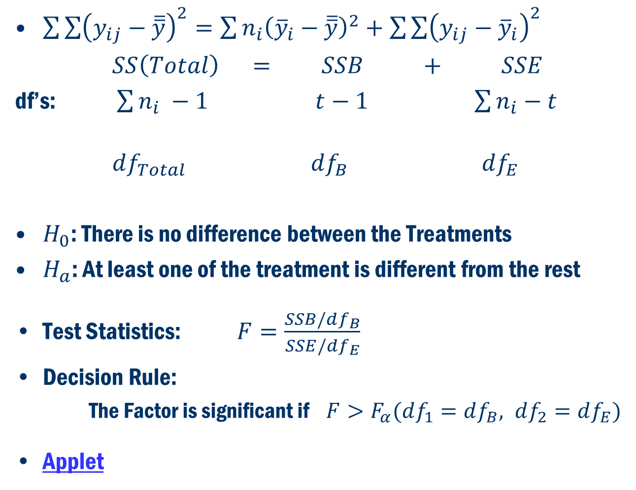
Back to Concept
$\sum{\sum{{\left(y_{ij}−\overline{\overline{y}}\right)}^{2}=\sum{n_{i}{\left({\overline{y}}_{i}−\overline{\overline{y}}\right)}^{2}+\sum{\sum{{\left(y_{ij}−{\overline{y}}_{i}\right)}^{2}}}}}}$
$SS\left(Total\right) = SSB + SSE$
df’s: $\sum{n_{i}} −1$ $t−1$ $\sum{n_{i}}−t$
$df_{Total}$ $df_{B}$ $df_{E}$
$H_{0}$: There is no difference between the Treatments
$H_{a}$: At least one of the treatment is different from the rest
Test Statistics: $F=\frac{SSB/df_{B}}{SSE/df_{E}}$
Decision Rule:
The Factor is significant if $F>F_{α}(df_{1}=df_{B}, df_{2}=df_{E})$
Applet

Slide 12
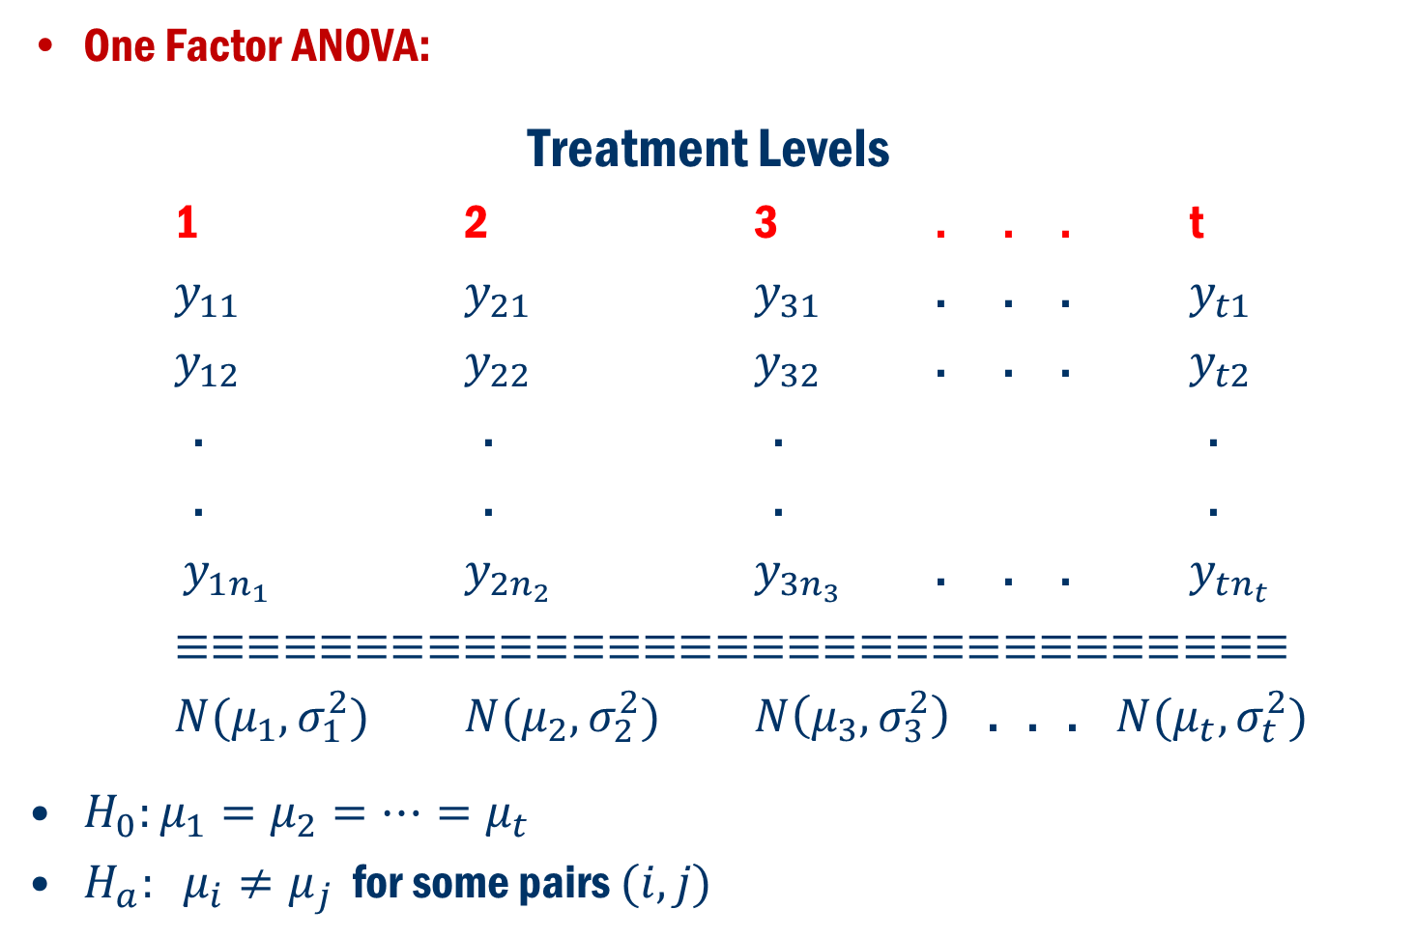
Formulation in terms of Hypothesis Problem
One Factor ANOVA:
Treatment Levels
1 2 3 . . . t
$y_{11}$ $y_{21}$ $y_{31}$ . . . $y_{t1}$
$y_{12}$ $y_{22}$ $y_{32}$ . . . $y_{t2}$
. . . .
. . . .
$y_{1n_{1}}$ $y_{2n_{2}}$ $y_{3n_{3}}$ . . . $y_{tn_{t}}$
$≡≡≡≡≡≡≡≡≡≡≡≡≡≡≡≡≡≡≡≡≡≡≡≡≡≡≡≡≡≡≡$
$N(μ_{1},σ_{1}^{2})$ $N(μ_{2},σ_{2}^{2})$ $N\left(μ_{3},σ_{3}^{2}\right)$ . . . $N(μ_{t},σ_{t}^{2})$
$H_{0}:μ_{1}=μ_{2}=…=μ_{t}$
$H_{a}: μ_{i}≠μ_{j}$ for some pairs $(i, j)$

Slide 13
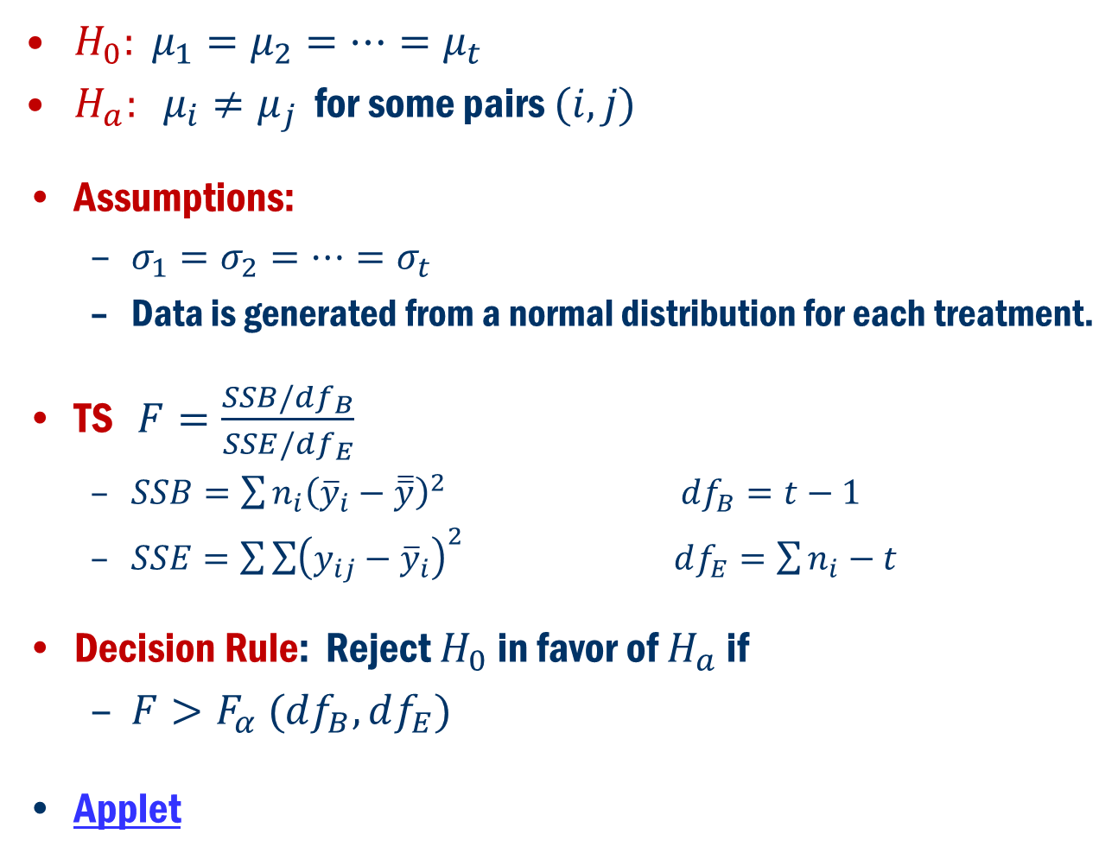
Formulation in terms of Hypothesis Problem Cont’D
$H_{0}: μ_{1}=μ_{2}=…=μ_{t}$
$H_{a}: μ_{i}≠μ_{j}$ for some pairs $(i, j)$
Assumptions:
$σ_{1}=σ_{2}=…=σ_{t}$
Data is generated from a normal distribution for each treatment.
TS $F=\frac{SSB/df_{B}}{SSE/{df}_{E}}$
$SSB=\sum{n_{i}{\left({\overline{y}}_{i}−\overline{\overline{y}}\right)}^{2}}$ $df_{B}=t−1$
$SSE=\sum{\sum{{\left(y_{ij}−{\overline{y}}_{i}\right)}^{2}}}$ $df_{E}=\sum{n_{i}}−t$
Decision Rule: Reject $H_{0}$ in favor of $H_{a}$ if
$F>F_{α} (df_{B}, df_{E})$
Applet

Slide 14

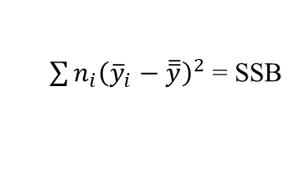


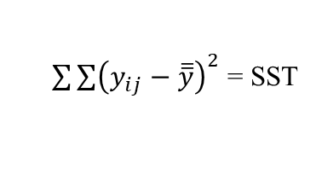



Anova Table
Source of Variation | df | Sum of Squares | Mean Square | F | p-value
Group (Between) | t – 1
Error (Within) | N – t
Total | N – 1
Here:
$N=\sum_{i}^{t}{n_{i}}$
$SST=SSB+SSE$
$\frac{SSB}{{df}_{B}}$ =$MSB$
$${\frac{MSB}{MSE}=F}_{calc}$$
$$Pr⁡(F>F_{calc})$$
$\sum{n_{i}{\left({\overline{y}}_{i}−\overline{\overline{y}}\right)}^{2} }$= SSB
$\sum{\sum{{\left(y_{ij}−{\overline{y}}_{i}\right)}^{2} }}$= SSE
$\frac{SSE}{{df}_{E}}$ =$MS$E
$\sum{\sum{{\left(y_{ij}−\overline{\overline{y}}\right)}^{2} }}$= SST

Slide 15
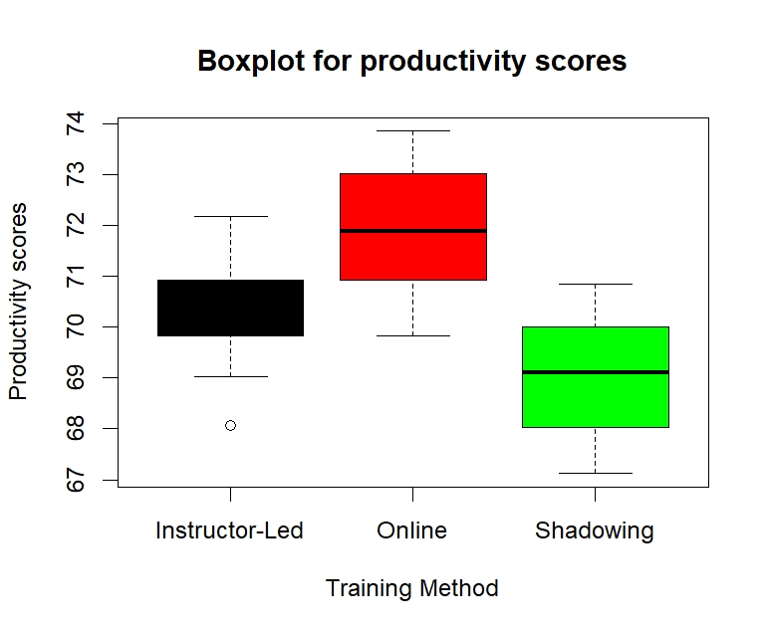
Example 2 CONT’D
ANOVA in Employee Training Program Evaluation

Slide 16
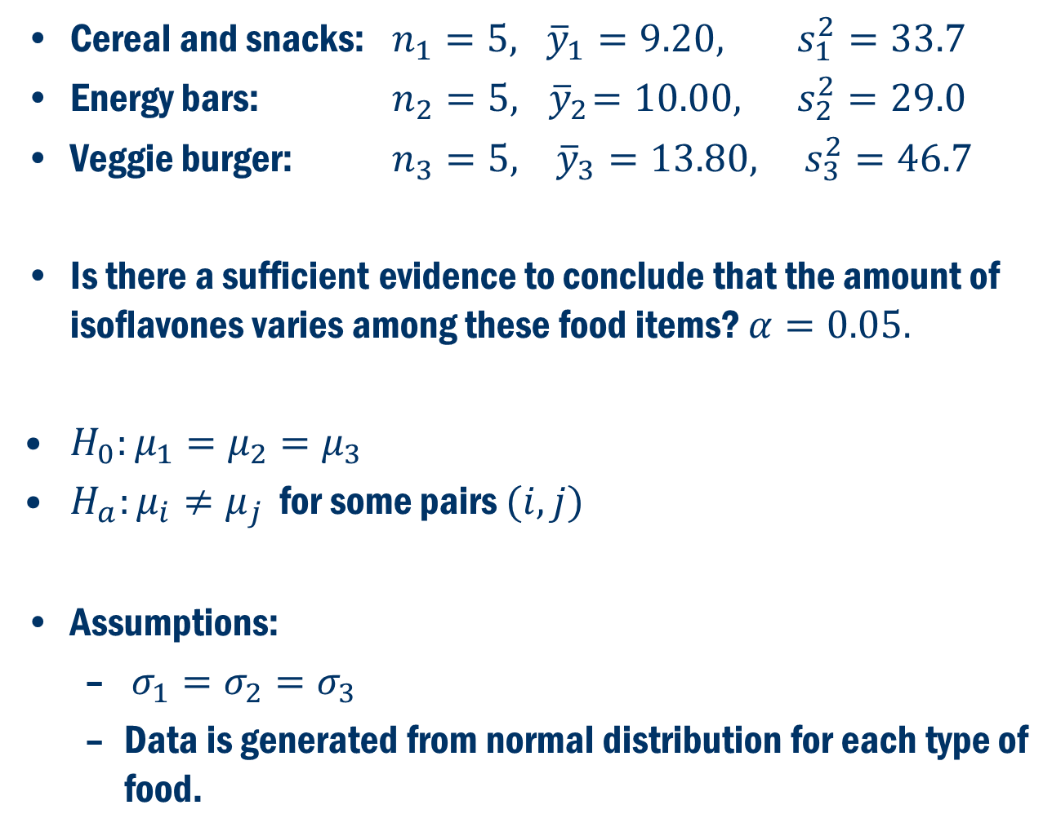
Example 8.1 Cont’D
Cereal and snacks: $n_{1}=5, {\overline{y}}_{1}=9.20, s_{1}^{2}=33.7$
Energy bars: $n_{2}=5, { \overline{y}}_{2}=10.00, s_{2}^{2}=29.0$
Veggie burger: $n_{3}=5, {\overline{y}}_{3}=13.80, s_{3}^{2}=46.7$
Is there a sufficient evidence to conclude that the amount of isoflavones varies among these food items? $α=0.05.$
$H_{0}:μ_{1}=μ_{2}=μ_{3}$
$H_{a}:μ_{i}≠μ_{j}$ for some pairs $(i,j)$
Assumptions:
$σ_{1}=σ_{2}=σ_{3}$
Data is generated from normal distribution for each type of food.

Slide 17
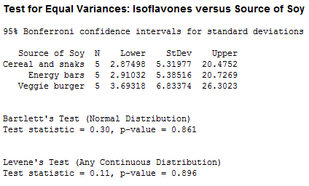
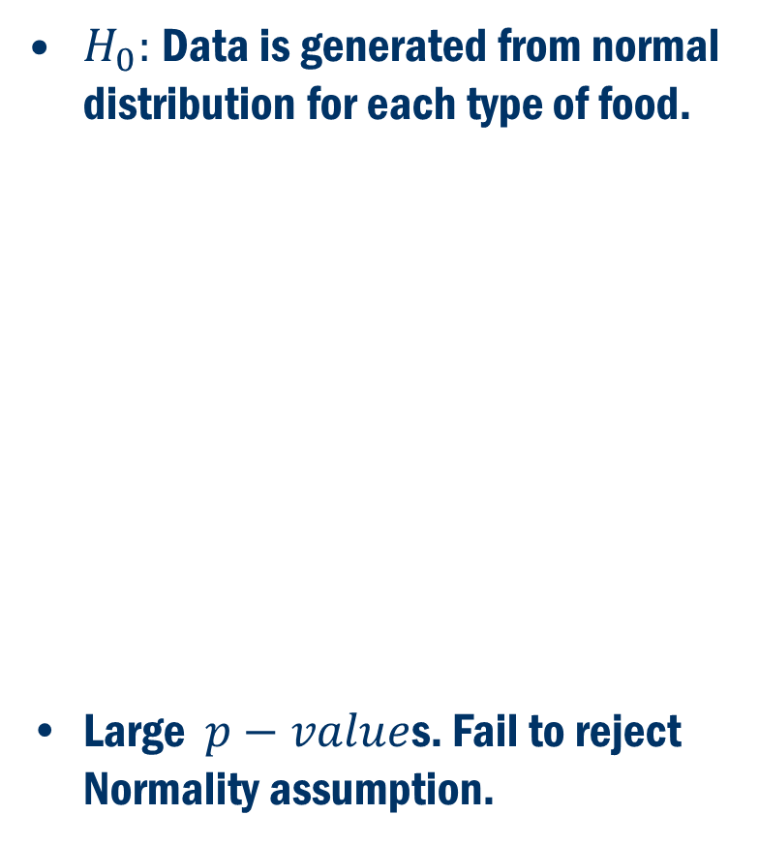
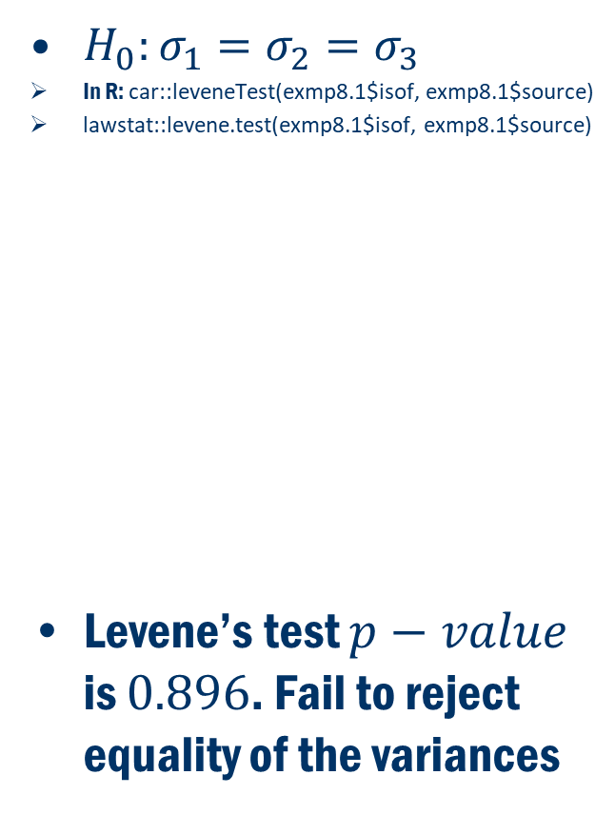
Example 8.1 Assumptions
$H_{0}:σ_{1}=σ_{2}=σ_{3}$
In R: car::leveneTest(exmp8.1$isof, exmp8.1$source)
lawstat::levene.test(exmp8.1$isof, exmp8.1$source)
Levene’s test $p−value$ is $0.896$. Fail to reject equality of the variances
$H_{0}:$Data is generated from normal distribution for each type of food.
Large $p−value$s. Fail to reject Normality assumption.

Slide 18
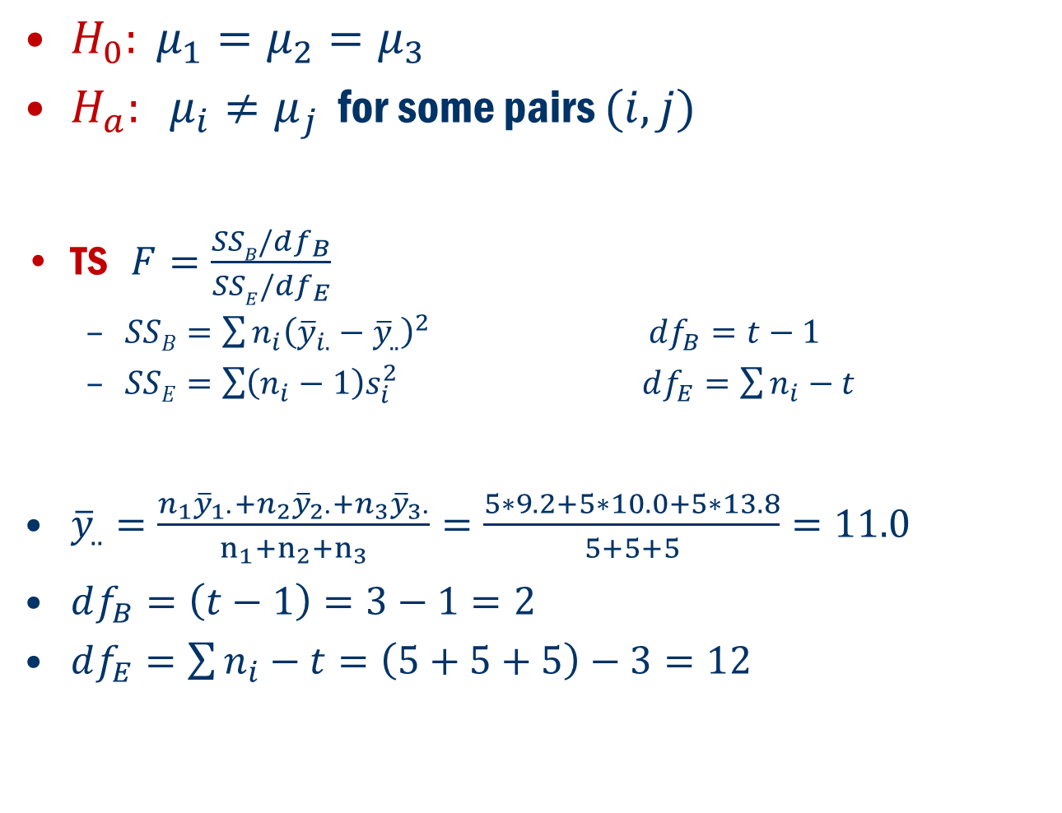
Example 8.1 Cont’D
$H_{0}: μ_{1}=μ_{2}=μ_{3}$
$H_{a}: μ_{i}≠μ_{j}$ for some pairs $(i, j)$
TS $F=\frac{SSB/df_{B}}{SSE/{df}_{E}}$
$SSB=\sum{n_{i}{\left({\overline{y}}_{i.}−{\overline{y}}_{..}\right)}^{2}}$ $df_{B}=t−1$
$SSE=\sum{\left(n_{i}−1\right)s_{i}^{2}}$ $df_{E}=\sum{n_{i}}−t$
${\overline{y}}_{..}=\frac{n_{1}{\overline{y}}_{1∙}+n_{2}{\overline{y}}_{2∙}+n_{3}{\overline{y}}_{3∙}}{n_{1}+n_{2}+n_{3}}=\frac{5∗9.2+5∗10.0+5∗13.8}{5+5+5}=11.0$
$df_{B}=\left(t−1\right)=3−1=2$
$df_{E}=\sum{n_{i}}−t=\left(5+5+5\right)−3=12$

Slide 19
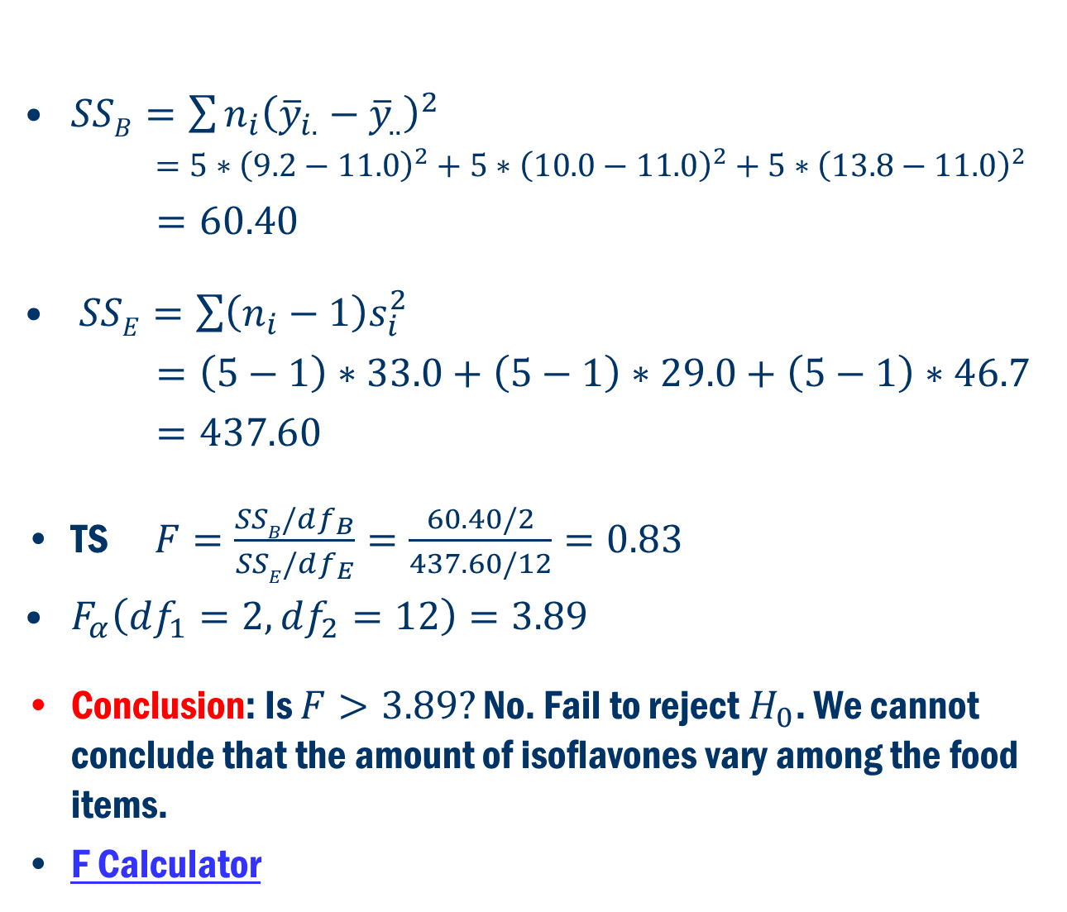
Example 8.1 Cont’D
$SSB=\sum{n_{i}{\left({\overline{y}}_{i.}−{\overline{y}}_{..}\right)}^{2}}$
$=5∗{\left(9.2−11.0\right)}^{2}+5∗{\left(10.0−11.0\right)}^{2}+5∗{\left(13.8−11.0\right)}^{2}$
$=60.40$
$SSE=\sum{\left(n_{i}−1\right)s_{i}^{2}}$
$=\left(5−1\right)∗33.0+\left(5−1\right)∗29.0+\left(5−1\right)∗46.7$
$=437.60$
TS $F=\frac{SSB/df_{B}}{SSE/df_{E}}=\frac{60.40/2}{437.60/12}=0.83$
$F_{α}\left(df_{1}=2, df_{2}=12\right)=3.89$
Conclusion: Is $F>3.89?$ No. Fail to reject $H_{0}$. We cannot conclude that the amount of isoflavones vary among the food items.
F Calculator

Slide 20
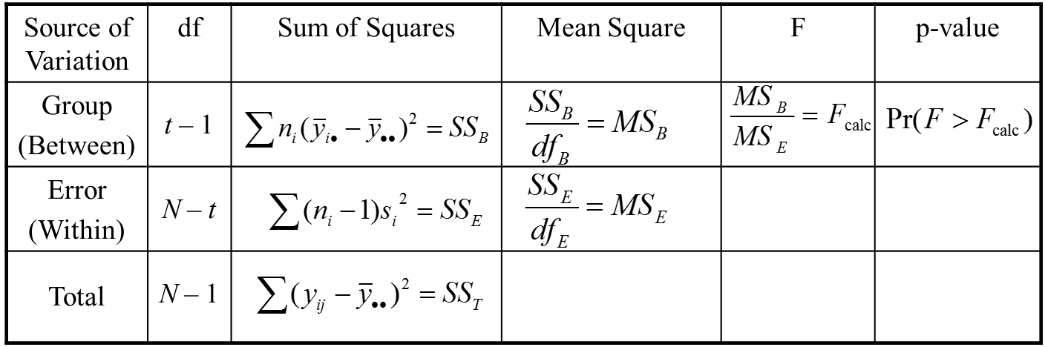
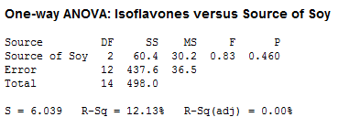
Example 8.1 Anova table
In R
summary(aov(isof ~ source, data=exmp8.1))

Slide 21
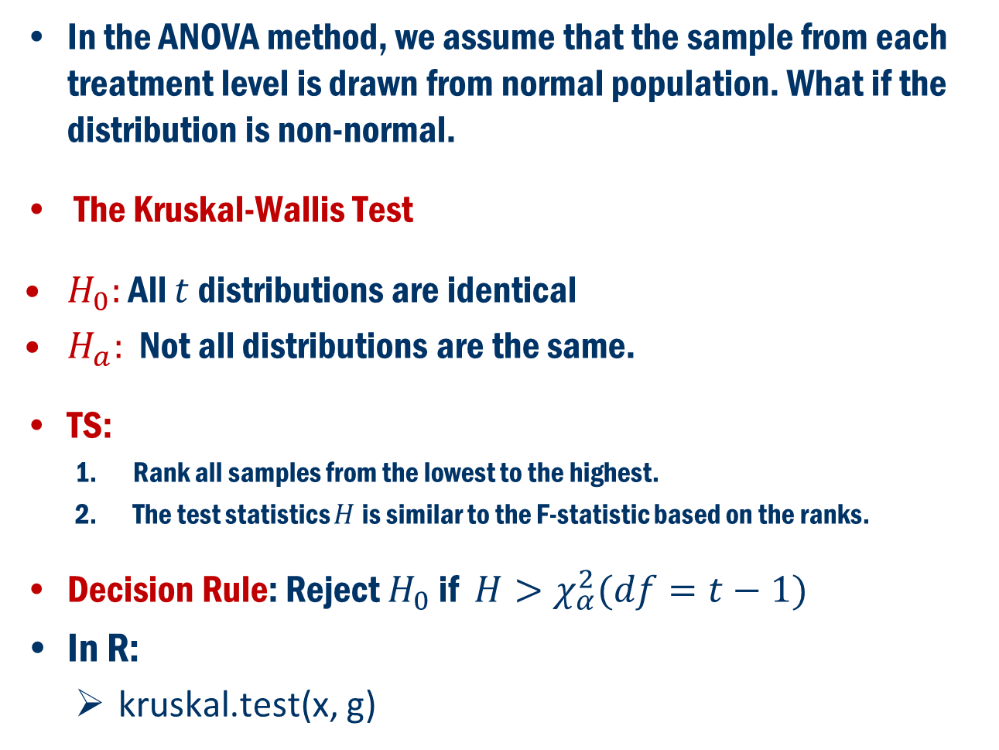
Normality Assumption Fails Non-Parametric Method
In the ANOVA method, we assume that the sample from each treatment level is drawn from normal population. What if the distribution is non-normal.
The Kruskal-Wallis Test
$H_{0}:$ All $t$ distributions are identical
$H_{a}:$ Not all distributions are the same.
TS:
Rank all samples from the lowest to the highest.
The test statistics $H$is similar to the F-statistic based on the ranks.
Decision Rule: Reject $H_{0}$ if $H>χ_{α}^{2}(df=t−1)$
In R:
kruskal.test(x, g)

Slide 22
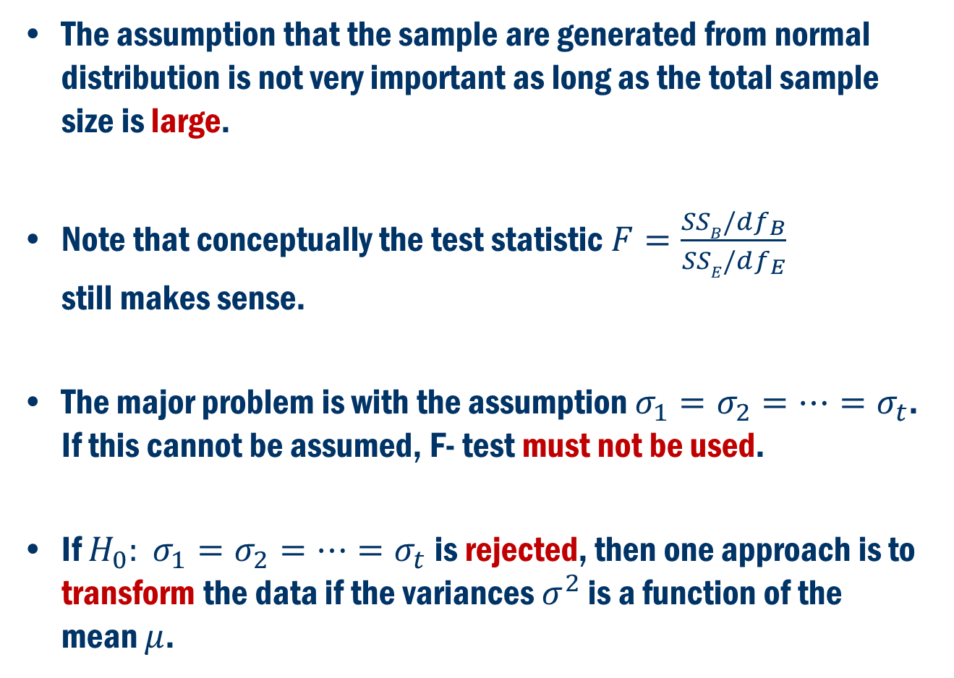
What if Equality of the Variances FAIL?
The assumption that the sample are generated from normal distribution is not very important as long as the total sample size is large.
Note that conceptually the test statistic $F=\frac{SSB/df_{B}}{SSE/df_{E}}$ still makes sense.
The major problem is with the assumption $σ_{1}=σ_{2}=…=σ_{t}$. If this cannot be assumed, F- test must not be used.
If $H_{0}: σ_{1}=σ_{2}=…=σ_{t}$ is rejected, then one approach is to transform the data if the variances $σ^{2}$ is a function of the mean $μ$.

