Slide 1


Accelerated Degree Program (ADP) in Applied Statistics (APST)
Dr. Cheng-Han Yu
Director, Master of Science in Applied Statistics
Mathematical and Statistical Sciences (MSSC)
Marquette University
Dr. Cheng-Han Yu, Mathematical and Statistical Sciences

Slide 2
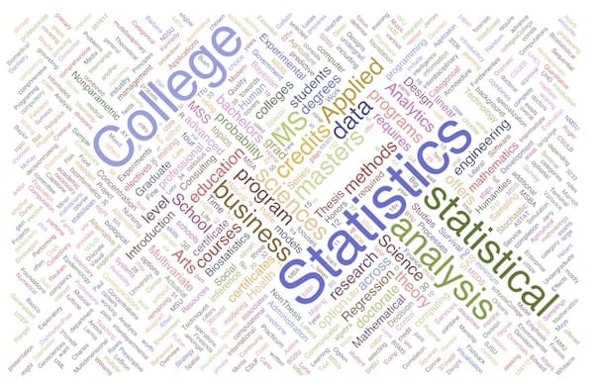


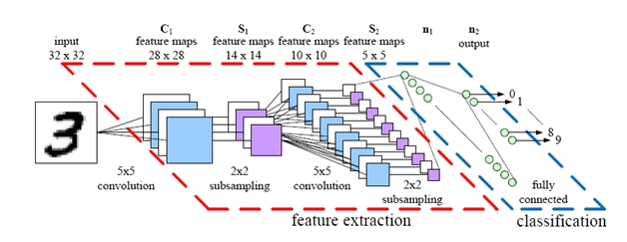
Why ADP?
Earn your BS and MS degrees in 5 years.
+ Starting the senior year, take 5000-level courses to double count 12 credits.
Application fee is waived.
GRE is not required.
Dr. Cheng-Han Yu, Mathematical and Statistical Sciences

Slide 3
Why MU APST-MS?
Detect patterns and perform predictive analytics for big data
Statistical modeling
MSSC 5780 Regression Analysis
MSSC 5760 Time Series Analysis
Machine learning and deep learning algorithms
MSSC 5931 Mathematics of Deep Learning
MSSC 6250 Statistical Machine Learning
Computation skills
MSSC 5750 Statistical Computing
MSSC 6000 Scientific Computing
Dr. Cheng-Han Yu, Mathematical and Statistical Sciences

Slide 4
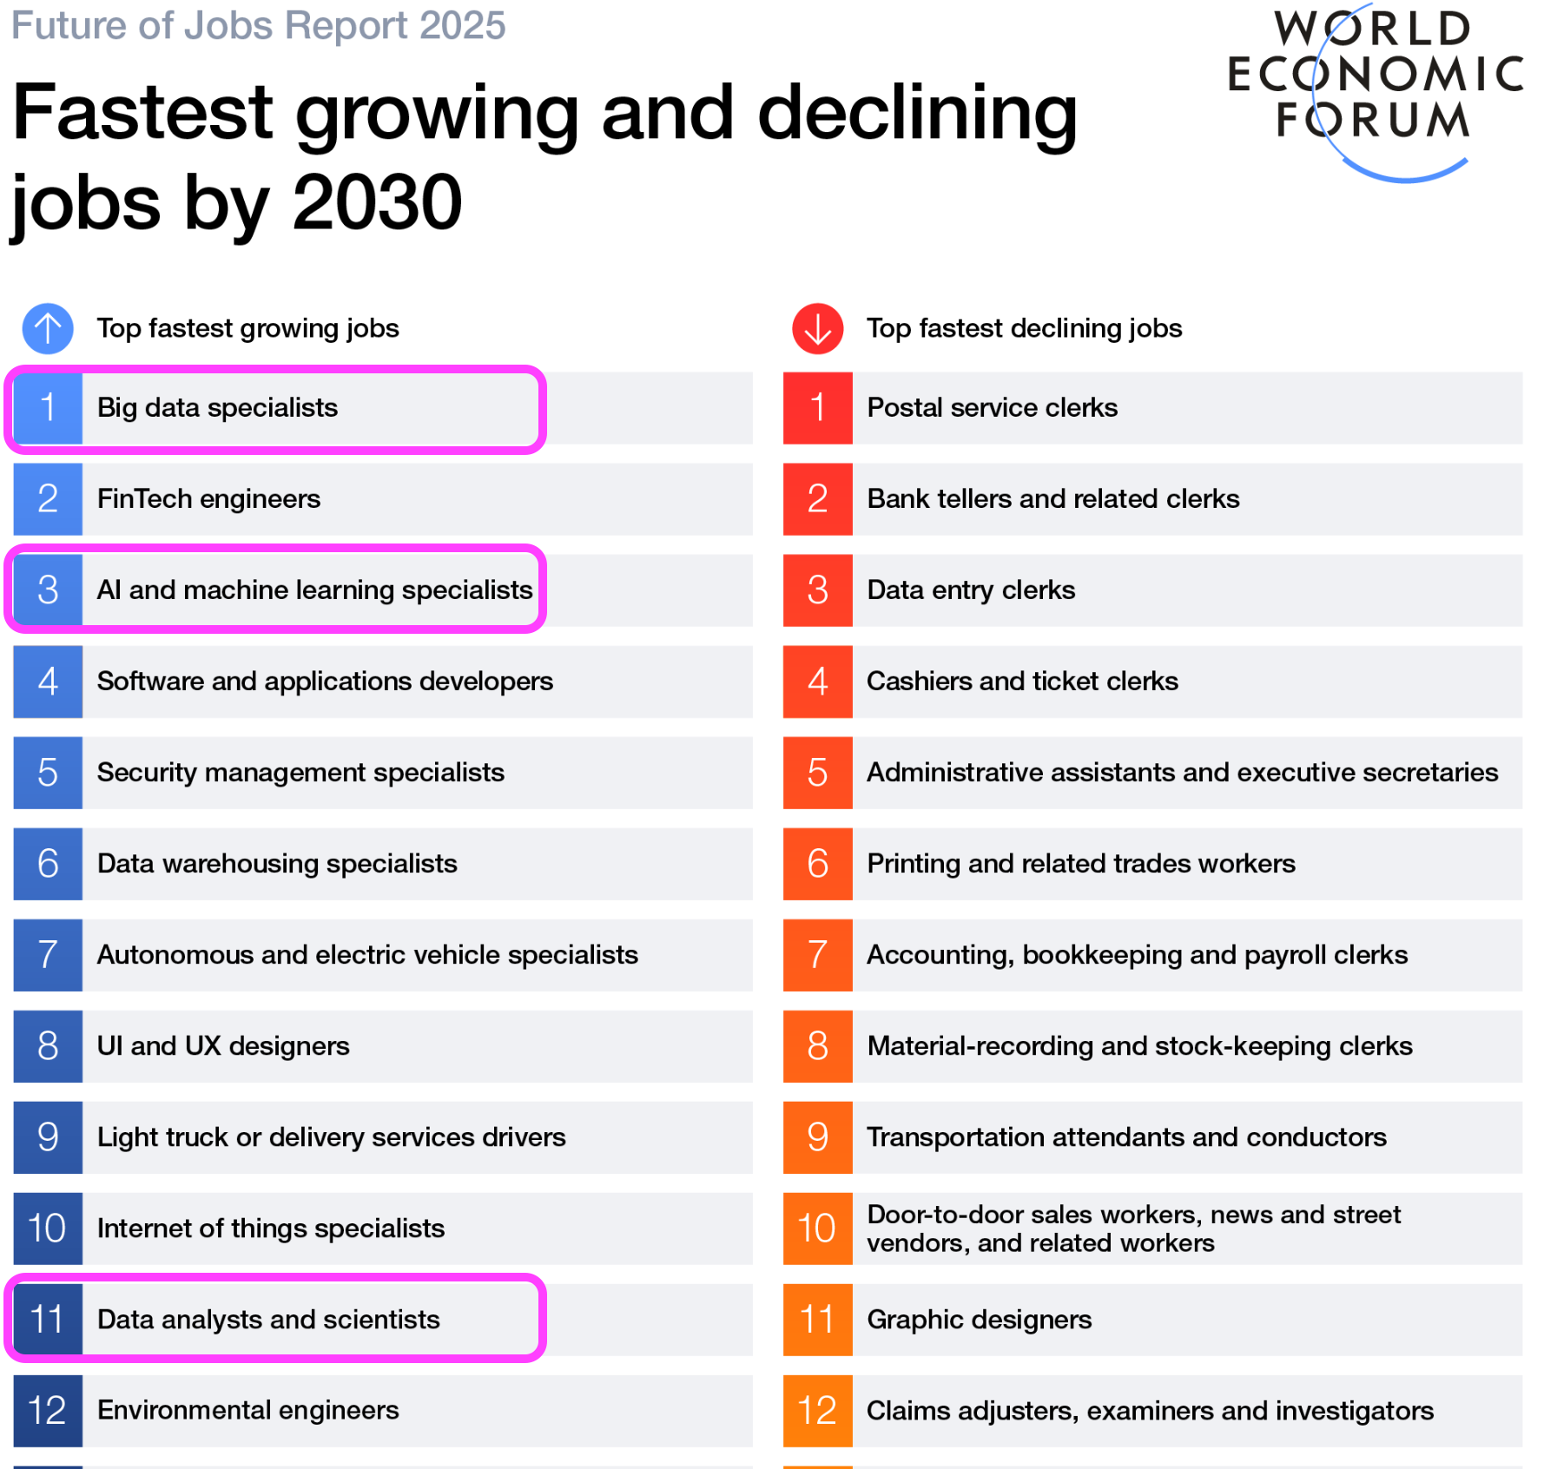
Career Opportunities
Data Scientist
Statistician
Data Analyst
Machine Learning Researcher
AI Engineer
Business Intelligence Analyst
Any jobs dealing with data!
Dr. Cheng-Han Yu, Mathematical and Statistical Sciences

Slide 5
Application Requirements
2 Calculus courses (e.g., MATH 1450, MATH 1455)
1 higher level math-related course (not necessarily in MATH department)
Econometrics in ECON
Algorithms in COSC
GPA 3.00 above
No specific major required
Dr. Cheng-Han Yu, Mathematical and Statistical Sciences

Slide 6


Financial Support
Department tuition scholarship
Northwestern Mutual Data Science Institute Scholarship
Program Flexibility
Electives outside Math/Stats department
MSF 6520 Financial Econometrics
COSC 6060 Distributed and Cloud Computing
Electives outside Marquette
Medical College of Wisconsin
University of Wisconsin-Milwaukee
Dr. Cheng-Han Yu, Mathematical and Statistical Sciences

Slide 7
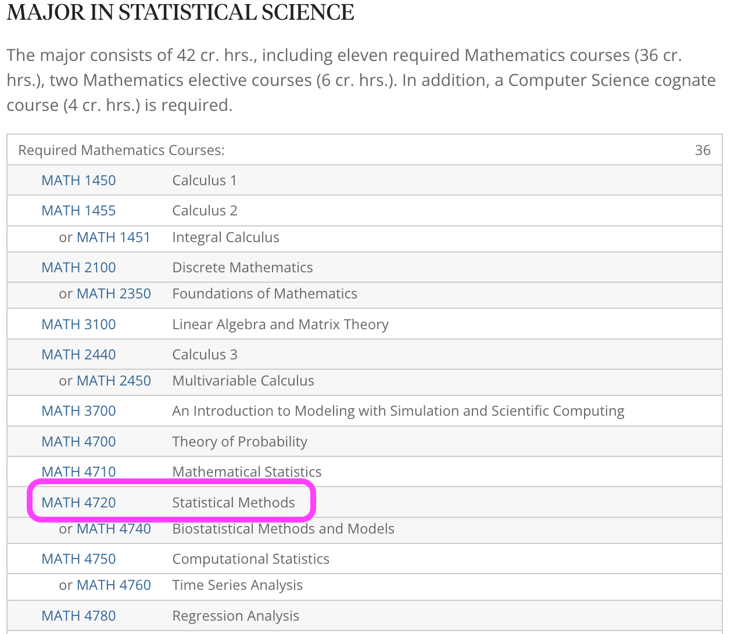
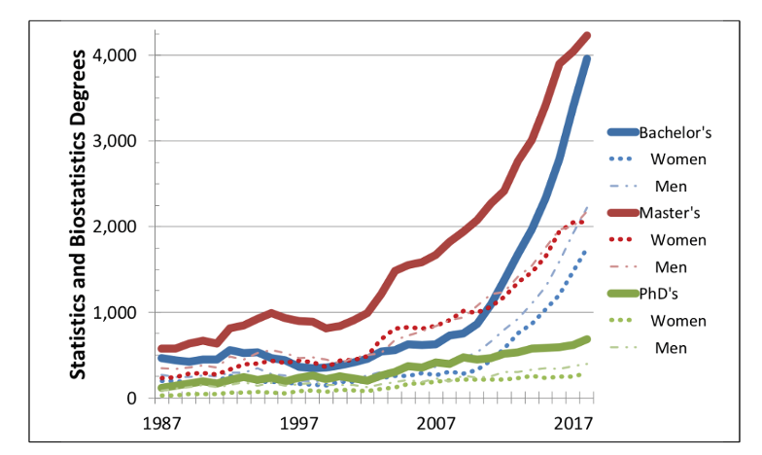
More Statistics?
Statistical Science, BS
Dr. Cheng-Han Yu, Mathematical and Statistical Sciences

Slide 8

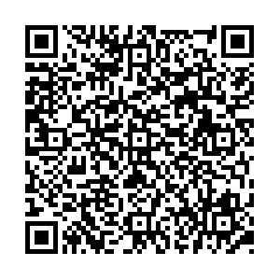
Questions?
Dr. Cheng-Han Yu
Cudahy Hall 353
cheng-han.yu@marquette.edu
QR code for making an appointment!
Dr. Cheng-Han Yu, Mathematical and Statistical Sciences

