Slide 1


Chapter 9:
ANOVA
Instructor: Shirin Nezampour
Department of Management
Fall 2025

Slide 2
Analysis of Variance (ANOVA)
ANOVA is one of the most popular statistical tools of analyzing data.
Does Y (the response) depend on any of the factors?
Factor 1
Y
Factor 2
A Response Variable
Factor 3

Slide 3
ANOVA Examples
Example 1: You are doing a research study on employee performance scores (out of 100) at a company.
Question: What affects performance?
Does Y (the response) depend on any of the factors?
Department?
Sales / HR / IT
Performance
Work Schedule? Onsite / Hybrid / Remote
Education Level?
High School / Bachelor Master / PhD

Slide 4
ANOVA Examples
Example 2: ANOVA in Employee Training Program Evaluation
Research Question: A company's HR manager wants to evaluate the effectiveness of three different employee training programs on improving employee productivity.
Does employee productivity depend on training programs?
Instructor-Led Classroom Training
Productivity
Training program
Online Self-Paced Learning
On-the-Job Shadowing
Response
Factor
Treatments

Slide 5
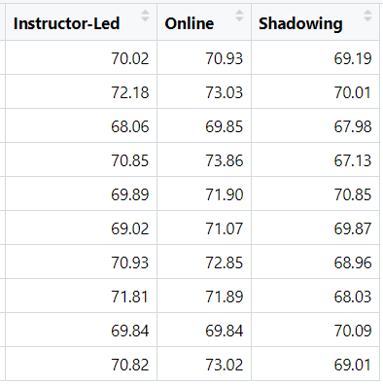







Data: Suppose 10 employees were randomly assigned to each training program. After completion, their productivity was measured using a standardized score.
Objective: Determine if there is a statistically significant difference in the mean productivity scores of employees who participated in the three different training programs. In statistical terms, we write the hypotheses as follows:
Mean:
${\overline{y}}_{1}$=70.34
${\overline{y}}_{2}$= 71.82
${\overline{y}}_{3}$= 69.11
St.D:
$s_{1}=$1.24
$s_{2}=$1.28
$s_{3}=$1.18

Slide 6
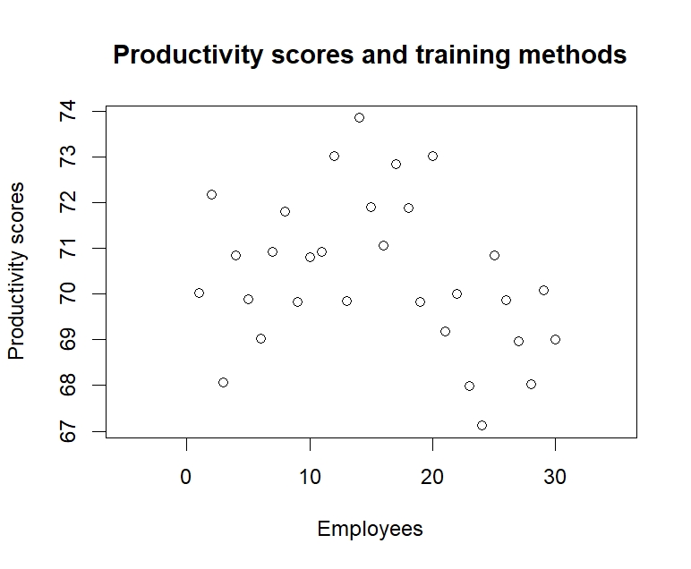
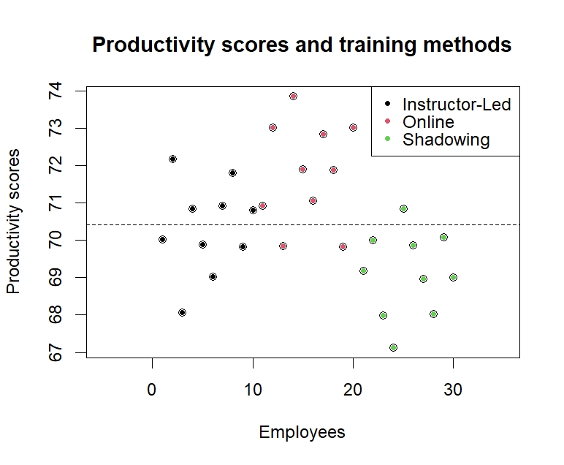
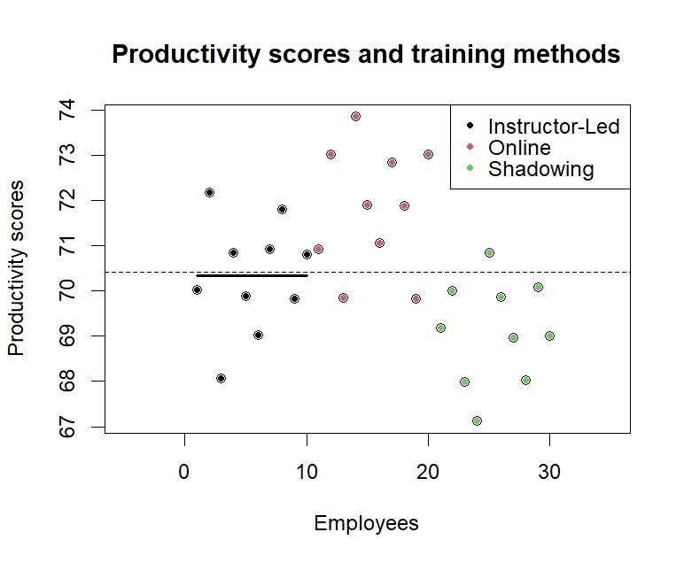
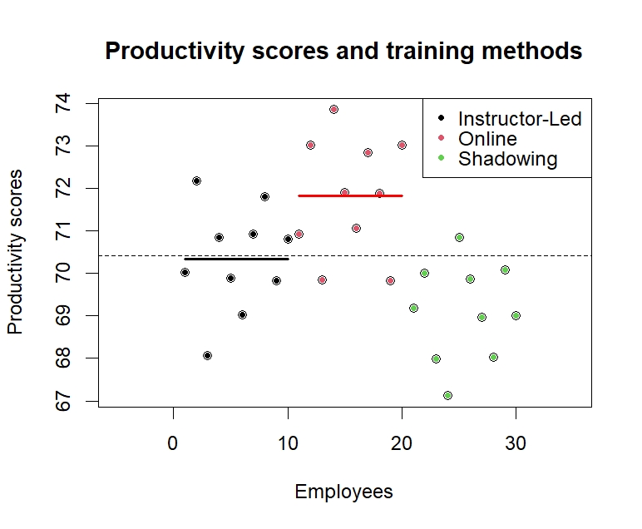
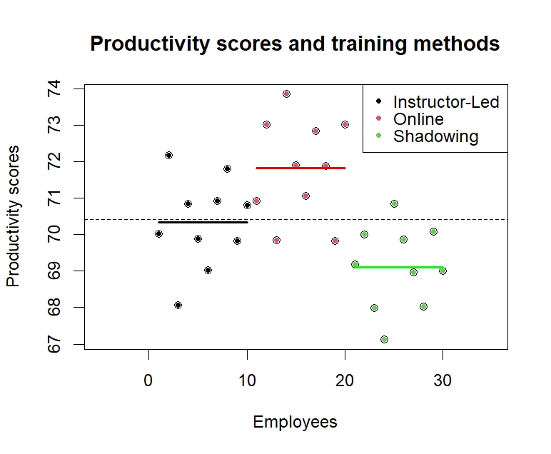
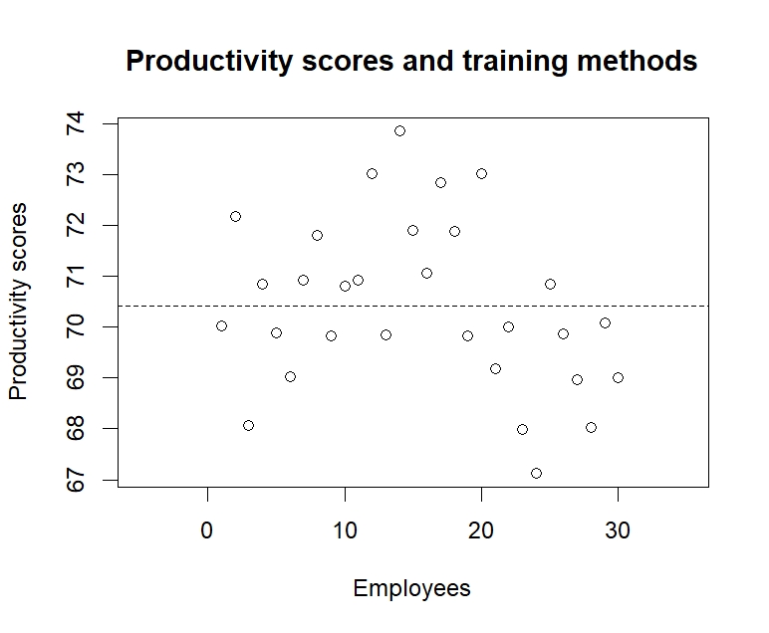
Example Cont’D
The variation in Productivity
some is due to training method
and some is due to error

Slide 7
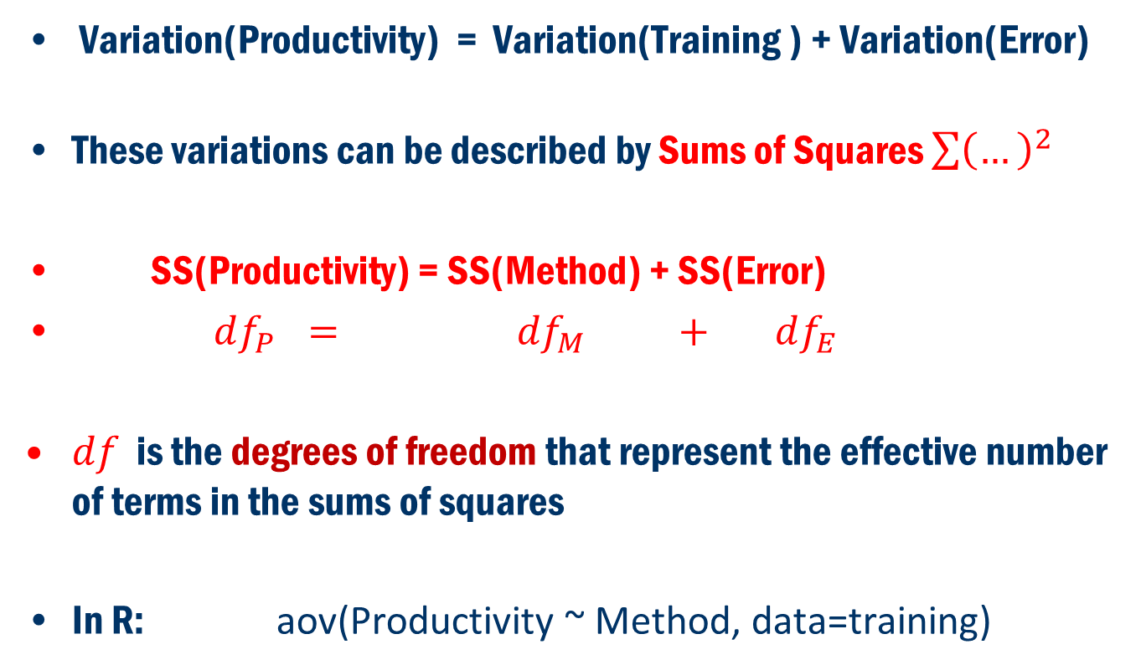
Concept
Variation(Productivity) = Variation(Training ) + Variation(Error)
These variations can be described by Sums of Squares $\sum{{\left(…\right)}^{2}}$
SS(Productivity) = SS(Method) + SS(Error)
$df_{P} = df_{M} + df_{E}$
$df$ is the degrees of freedom that represent the effective number of terms in the sums of squares
In R: aov(Productivity ~ Method, data=training)

Slide 8
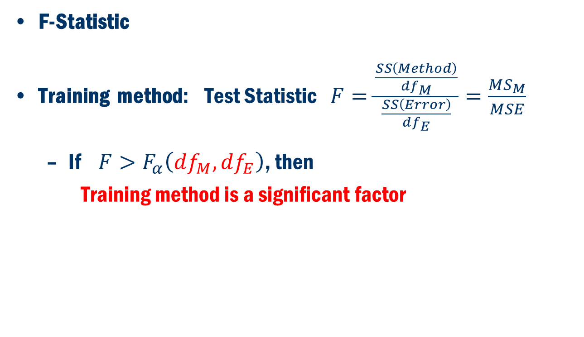
Test Statistic
F-Statistic
Training method: Test Statistic $F=\frac{\frac{SS\left(Method\right)}{df_{M}}}{\frac{SS\left(Error\right)}{df_{E}}}=\frac{MS_{M}}{MSE}$
If $F>F_{α}\left(df_{M},df_{E}\right)$, then
Training method is a significant factor

Slide 9
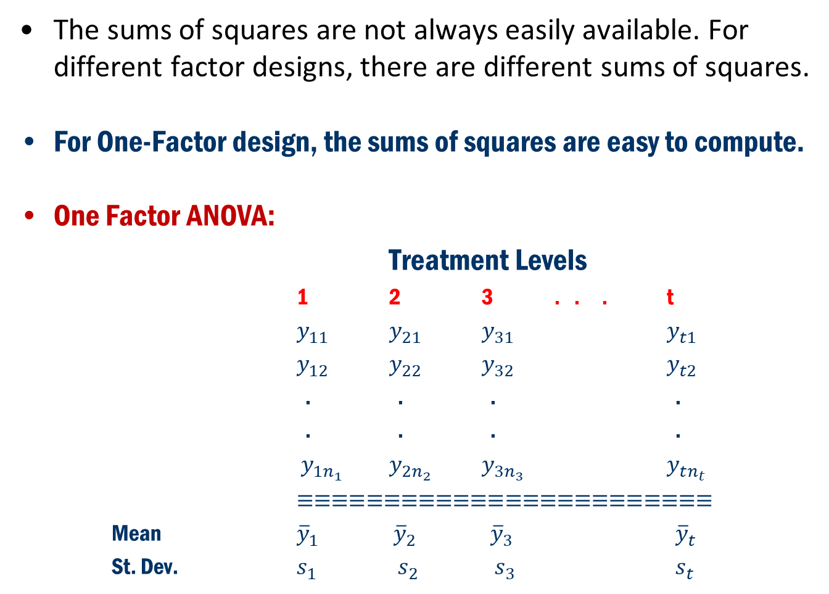
Back to Concept
The sums of squares are not always easily available. For different factor designs, there are different sums of squares.
For One-Factor design, the sums of squares are easy to compute.
One Factor ANOVA:
Treatment Levels
1 2 3 . . . t
$y_{11}$ $y_{21}$ $y_{31}$ $y_{t1}$
$y_{12}$ $y_{22}$ $y_{32}$ $y_{t2}$
. . . .
. . . .
$y_{1n_{1}}$ $y_{2n_{2}}$ $y_{3n_{3}}$ $y_{tn_{t}}$
$≡≡≡≡≡≡≡≡≡≡≡≡≡≡≡≡≡≡≡≡≡≡≡≡$
Mean ${\overline{y}}_{1}$ ${\overline{y}}_{2}$ ${\overline{y}}_{3}$ ${\overline{y}}_{t}$
St. Dev. $s_{1}$ $s_{2}$ $s_{3}$ $s_{t}$

Slide 10
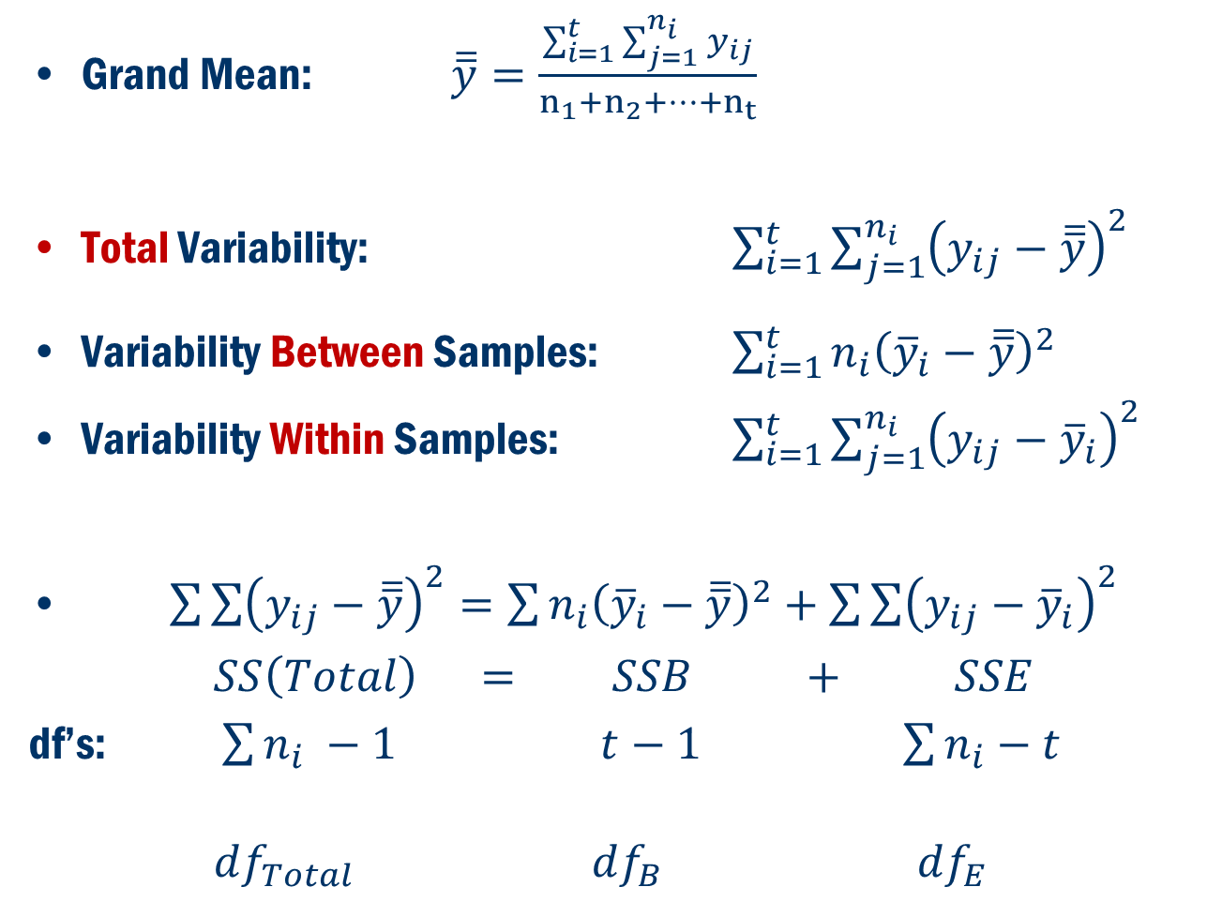
Back To Concept
Grand Mean: $\overline{\overline{y}}=\frac{\sum_{i=1}^{t}{\sum_{j=1}^{n_{i}}{y_{ij}}}}{n_{1}+n_{2}+…+n_{t}}$
Total Variability: $\sum_{i=1}^{t}{\sum_{j=1}^{n_{i}}{{\left(y_{ij}−\overline{\overline{y}}\right)}^{2}}}$
Variability Between Samples: $\sum_{i=1}^{t}{n_{i}{\left({\overline{y}}_{i}−\overline{\overline{y}}\right)}^{2} }$
Variability Within Samples: $\sum_{i=1}^{t}{\sum_{j=1}^{n_{i}}{{\left(y_{ij}−{\overline{y}}_{i}\right)}^{2}}}$
$\sum{\sum{{\left(y_{ij}−\overline{\overline{y}}\right)}^{2}=\sum{n_{i}{\left({\overline{y}}_{i}−\overline{\overline{y}}\right)}^{2}+\sum{\sum{{\left(y_{ij}−{\overline{y}}_{i}\right)}^{2}}}}}}$
$SS\left(Total\right) = SSB + SSE$
df’s: $\sum{n_{i}} −1$ $t−1$ $\sum{n_{i}}−t$
$df_{Total}$ $df_{B}$ $df_{E}$

Slide 11
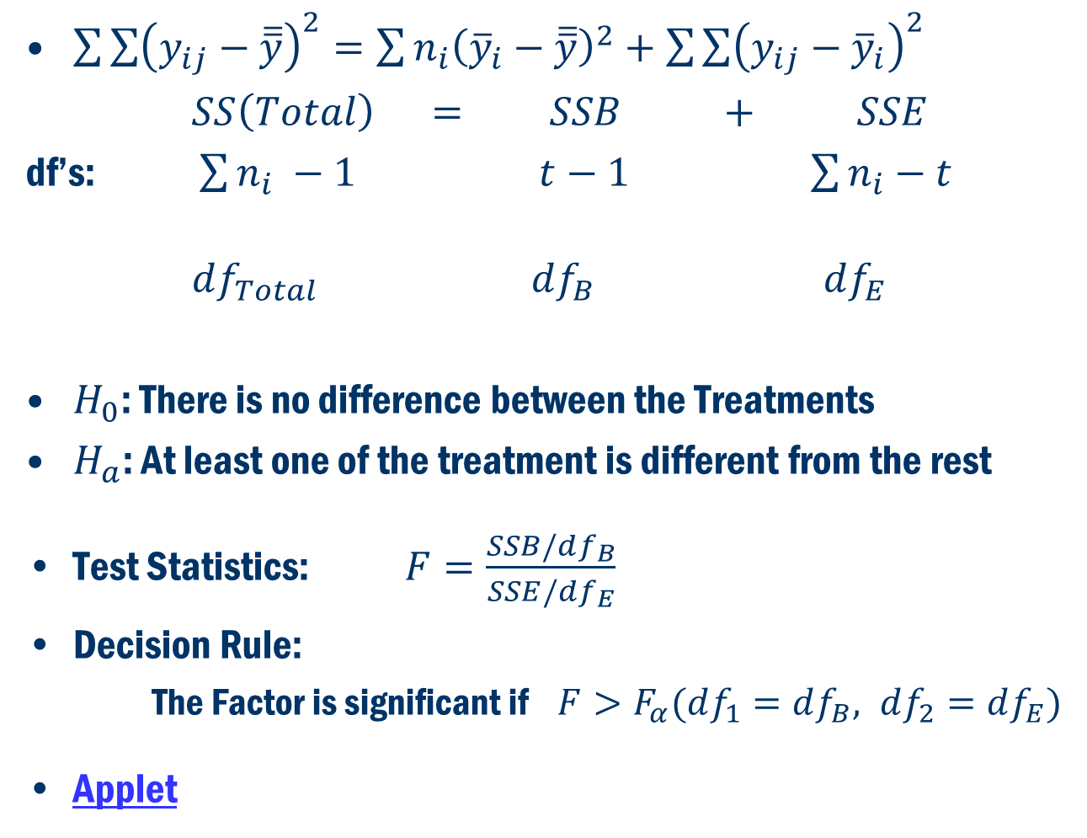
Back to Concept
$\sum{\sum{{\left(y_{ij}−\overline{\overline{y}}\right)}^{2}=\sum{n_{i}{\left({\overline{y}}_{i}−\overline{\overline{y}}\right)}^{2}+\sum{\sum{{\left(y_{ij}−{\overline{y}}_{i}\right)}^{2}}}}}}$
$SS\left(Total\right) = SSB + SSE$
df’s: $\sum{n_{i}} −1$ $t−1$ $\sum{n_{i}}−t$
$df_{Total}$ $df_{B}$ $df_{E}$
$H_{0}$: There is no difference between the Treatments
$H_{a}$: At least one of the treatment is different from the rest
Test Statistics: $F=\frac{SSB/df_{B}}{SSE/df_{E}}$
Decision Rule:
The Factor is significant if $F>F_{α}(df_{1}=df_{B}, df_{2}=df_{E})$
Applet

Slide 12
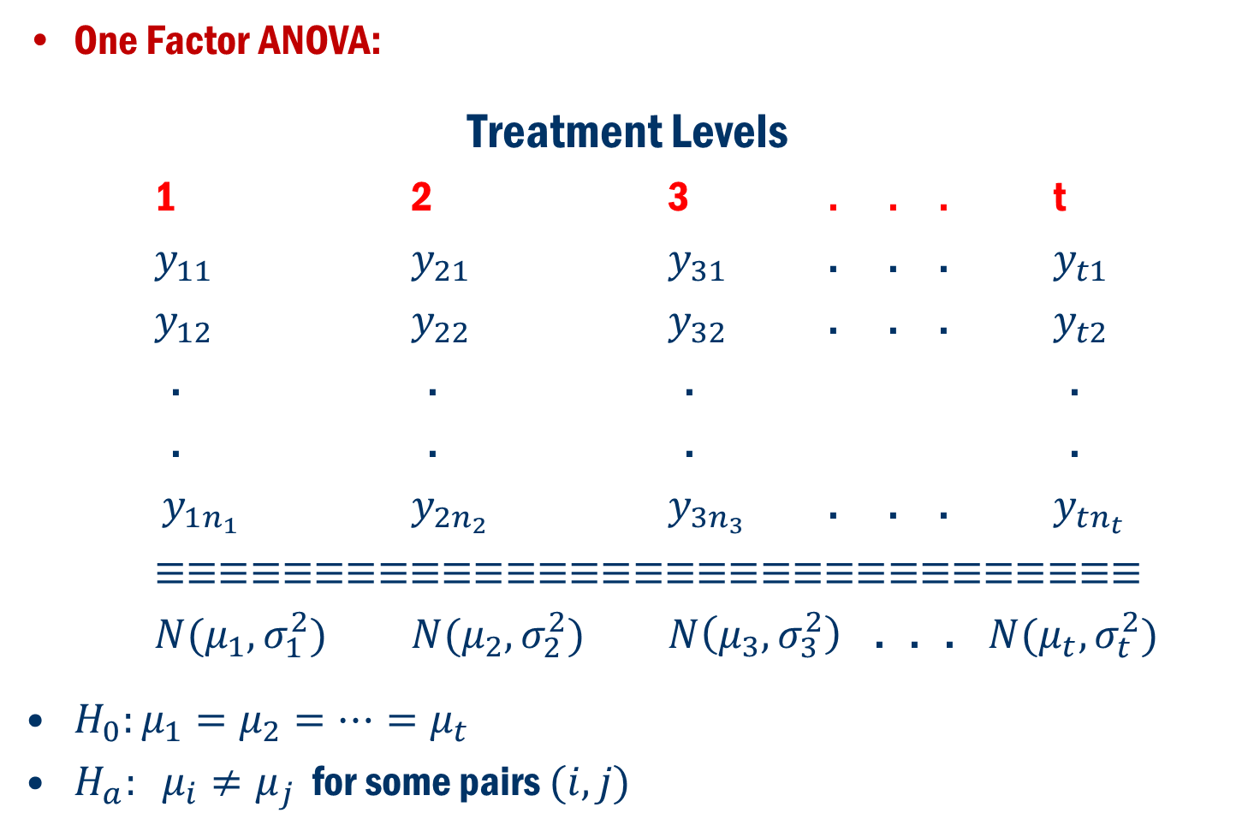
Formulation in terms of Hypothesis Problem
One Factor ANOVA:
Treatment Levels
1 2 3 . . . t
$y_{11}$ $y_{21}$ $y_{31}$ . . . $y_{t1}$
$y_{12}$ $y_{22}$ $y_{32}$ . . . $y_{t2}$
. . . .
. . . .
$y_{1n_{1}}$ $y_{2n_{2}}$ $y_{3n_{3}}$ . . . $y_{tn_{t}}$
$≡≡≡≡≡≡≡≡≡≡≡≡≡≡≡≡≡≡≡≡≡≡≡≡≡≡≡≡≡≡≡$
$N(μ_{1},σ_{1}^{2})$ $N(μ_{2},σ_{2}^{2})$ $N\left(μ_{3},σ_{3}^{2}\right)$ . . . $N(μ_{t},σ_{t}^{2})$
$H_{0}:μ_{1}=μ_{2}=…=μ_{t}$
$H_{a}: μ_{i}≠μ_{j}$ for some pairs $(i, j)$

Slide 13
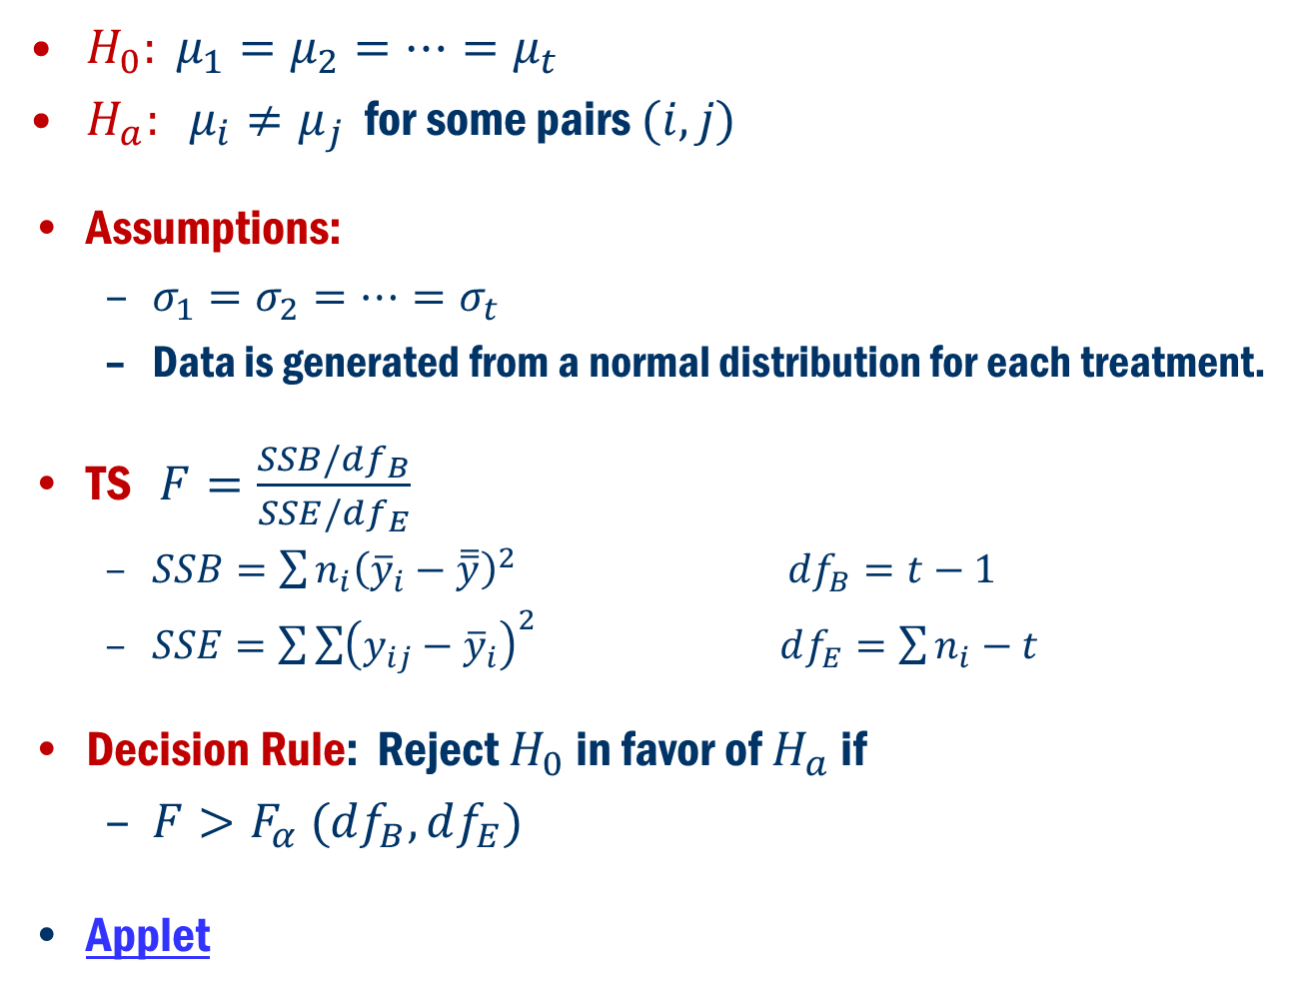
Formulation in terms of Hypothesis Problem Cont’D
$H_{0}: μ_{1}=μ_{2}=…=μ_{t}$
$H_{a}: μ_{i}≠μ_{j}$ for some pairs $(i, j)$
Assumptions:
$σ_{1}=σ_{2}=…=σ_{t}$
Data is generated from a normal distribution for each treatment.
TS $F=\frac{SSB/df_{B}}{SSE/{df}_{E}}$
$SSB=\sum{n_{i}{\left({\overline{y}}_{i}−\overline{\overline{y}}\right)}^{2}}$ $df_{B}=t−1$
$SSE=\sum{\sum{{\left(y_{ij}−{\overline{y}}_{i}\right)}^{2}}}$ $df_{E}=\sum{n_{i}}−t$
Decision Rule: Reject $H_{0}$ in favor of $H_{a}$ if
$F>F_{α} (df_{B}, df_{E})$
Applet

Slide 14

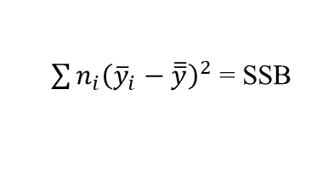


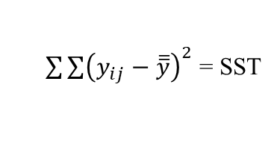



Anova Table
Source of Variation | df | Sum of Squares | Mean Square | F | p-value
Group (Between) | t – 1
Error (Within) | N – t
Total | N – 1
Here:
$N=\sum_{i}^{t}{n_{i}}$
$SST=SSB+SSE$
$\frac{SSB}{{df}_{B}}$ =$MSB$
$${\frac{MSB}{MSE}=F}_{calc}$$
$$Pr⁡(F>F_{calc})$$
$\sum{n_{i}{\left({\overline{y}}_{i}−\overline{\overline{y}}\right)}^{2} }$= SSB
$\sum{\sum{{\left(y_{ij}−{\overline{y}}_{i}\right)}^{2} }}$= SSE
$\frac{SSE}{{df}_{E}}$ =$MS$E
$\sum{\sum{{\left(y_{ij}−\overline{\overline{y}}\right)}^{2} }}$= SST

Slide 15
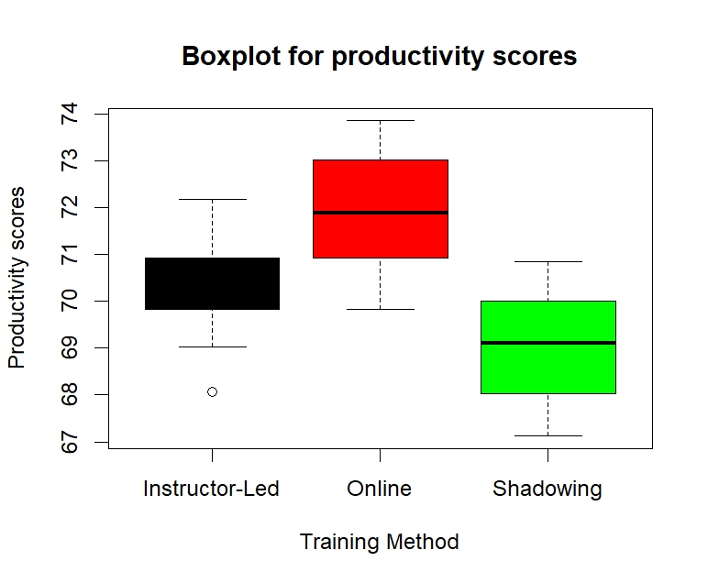
Example 2 CONT’D
ANOVA in Employee Training Program Evaluation

Slide 16
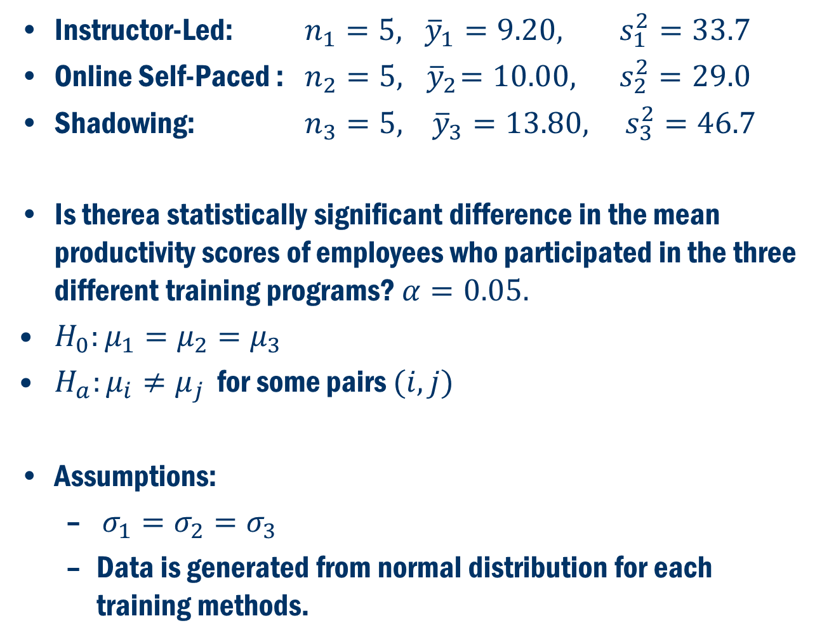
Example 2 Cont’D
Instructor-Led: $n_{1}=5, {\overline{y}}_{1}=9.20, s_{1}^{2}=33.7$
Online Self-Paced : $n_{2}=5, { \overline{y}}_{2}=10.00, s_{2}^{2}=29.0$
Shadowing: $n_{3}=5, {\overline{y}}_{3}=13.80, s_{3}^{2}=46.7$
Is therea statistically significant difference in the mean productivity scores of employees who participated in the three different training programs? $α=0.05.$
$H_{0}:μ_{1}=μ_{2}=μ_{3}$
$H_{a}:μ_{i}≠μ_{j}$ for some pairs $(i,j)$
Assumptions:
$σ_{1}=σ_{2}=σ_{3}$
Data is generated from normal distribution for each training methods.

Slide 17
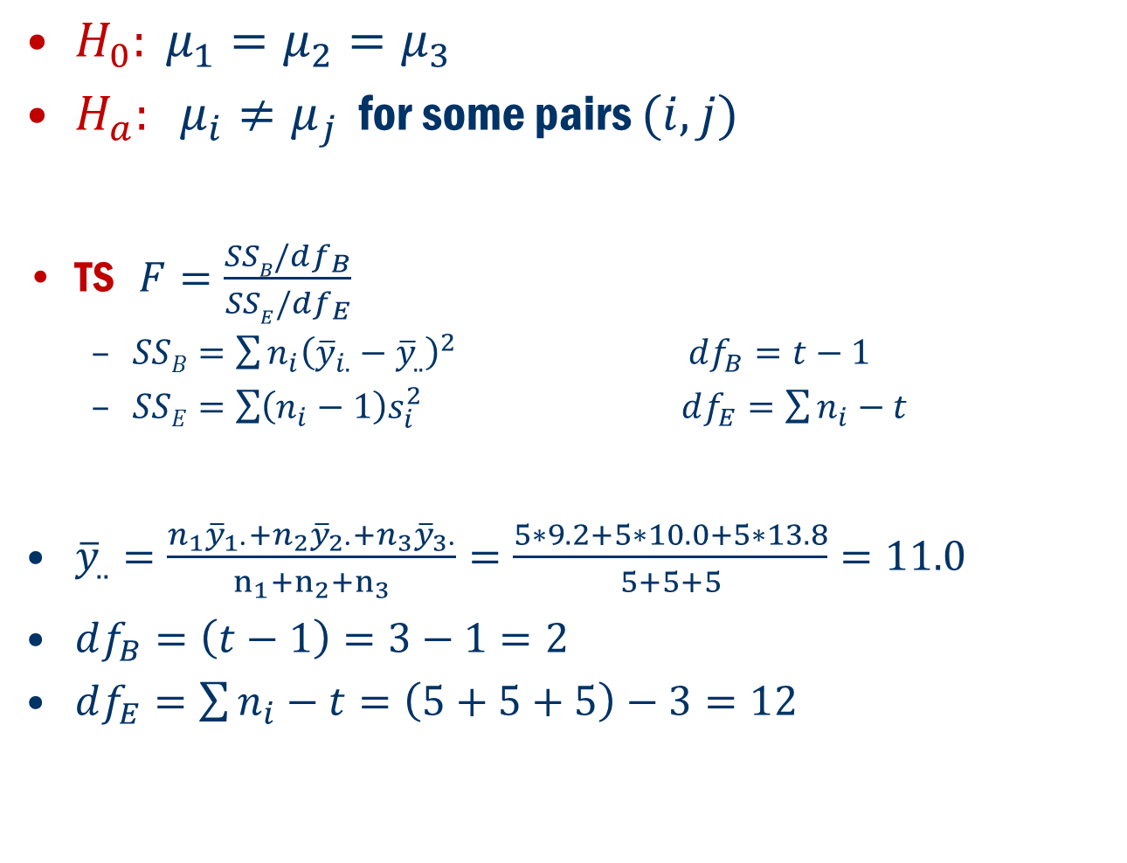
Example 2 Cont’D
$H_{0}: μ_{1}=μ_{2}=μ_{3}$
$H_{a}: μ_{i}≠μ_{j}$ for some pairs $(i, j)$
TS $F=\frac{SSB/df_{B}}{SSE/{df}_{E}}$
$SSB=\sum{n_{i}{\left({\overline{y}}_{i.}−{\overline{y}}_{..}\right)}^{2}}$ $df_{B}=t−1$
$SSE=\sum{\left(n_{i}−1\right)s_{i}^{2}}$ $df_{E}=\sum{n_{i}}−t$
${\overline{y}}_{..}=\frac{n_{1}{\overline{y}}_{1∙}+n_{2}{\overline{y}}_{2∙}+n_{3}{\overline{y}}_{3∙}}{n_{1}+n_{2}+n_{3}}=\frac{5∗9.2+5∗10.0+5∗13.8}{5+5+5}=11.0$
$df_{B}=\left(t−1\right)=3−1=2$
$df_{E}=\sum{n_{i}}−t=\left(5+5+5\right)−3=12$

Slide 18
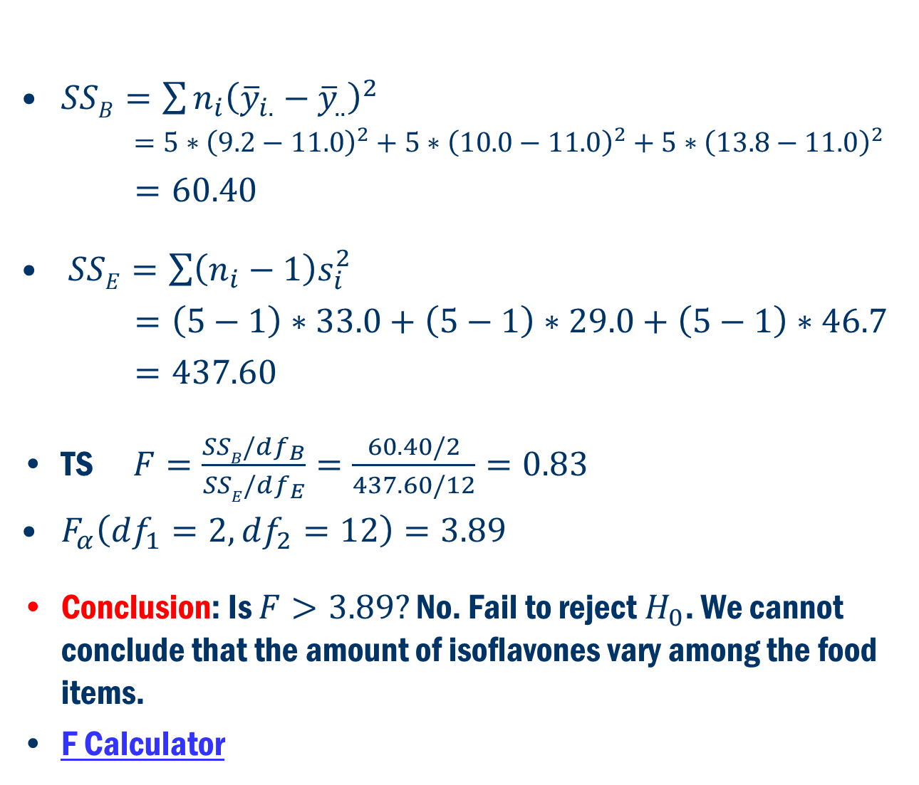
Example 2 Cont’D
$SSB=\sum{n_{i}{\left({\overline{y}}_{i.}−{\overline{y}}_{..}\right)}^{2}}$
$=5∗{\left(9.2−11.0\right)}^{2}+5∗{\left(10.0−11.0\right)}^{2}+5∗{\left(13.8−11.0\right)}^{2}$
$=60.40$
$SSE=\sum{\left(n_{i}−1\right)s_{i}^{2}}$
$=\left(5−1\right)∗33.0+\left(5−1\right)∗29.0+\left(5−1\right)∗46.7$
$=437.60$
TS $F=\frac{SSB/df_{B}}{SSE/df_{E}}=\frac{60.40/2}{437.60/12}=0.83$
$F_{α}\left(df_{1}=2, df_{2}=12\right)=3.89$
Conclusion: Is $F>3.89?$ No. Fail to reject $H_{0}$. We cannot conclude that the amount of isoflavones vary among the food items.
F Calculator

Slide 19
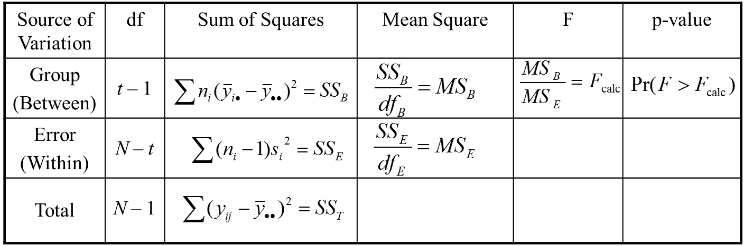
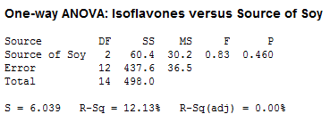
Example 8.1 Anova table
In R
summary(aov(isof ~ source, data=exmp8.1))

