Slide 1


Chapter 13:
Analysis of Variance
(ANOVA)
Instructor: Shirin Nezampour
Department of Management
Fall 2025

Slide 2
Analysis of Variance (ANOVA)
ANOVA is one of the most popular statistical tools of analyzing data.
Does Y (the response) depend on any of the factors?
Factor 1
Y
Factor 2
A Response Variable
Factor 3

Slide 3
ANOVA Examples
Example 1: You are doing a research study on employee performance scores (out of 100) at a company.
Question: What affects performance?
Does Y (the response) depend on any of the factors?
Department?
Sales / HR / IT
Performance
Work Schedule? Onsite / Hybrid / Remote
Education Level?
High School / Bachelor Master / PhD

Slide 4
ANOVA Examples
Example 2: ANOVA in Employee Training Program Evaluation
Research Question: A company's HR manager wants to evaluate the effectiveness of three different employee training programs on improving employee productivity.
Does employee productivity depend on training programs?
Instructor-Led Classroom Training
Productivity
Training program
Online Self-Paced Learning
On-the-Job Shadowing
Response
Factor
Treatments

Slide 5
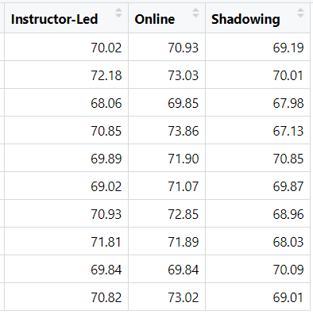



Example 2 Cont’D:
Data: Suppose 10 employees were randomly assigned to each training program. After completion, their productivity was measured using a standardized score.
Objective: Determine if there is a statistically significant difference in the mean productivity scores of employees who participated in the three different training programs.
Mean:
${\overline{y}}_{1}$=70.34
${\overline{y}}_{2}$= 71.82
${\overline{y}}_{3}$= 69.11

Slide 6
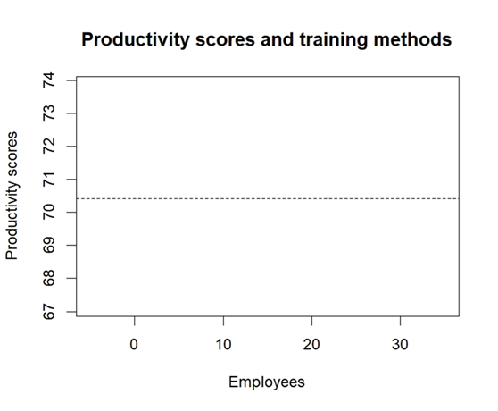
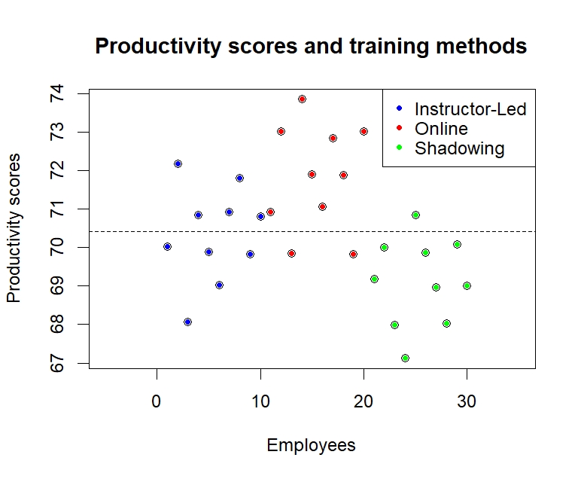
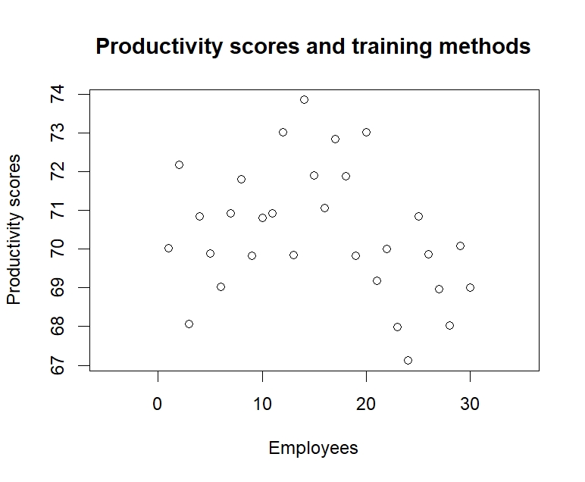
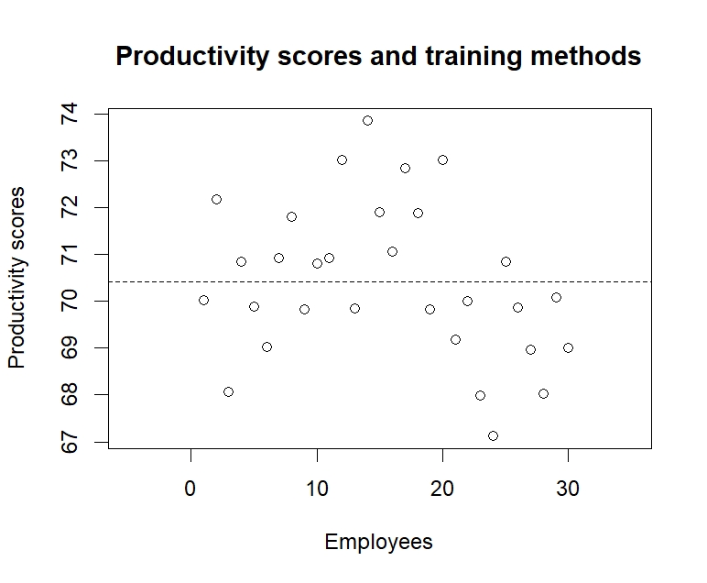


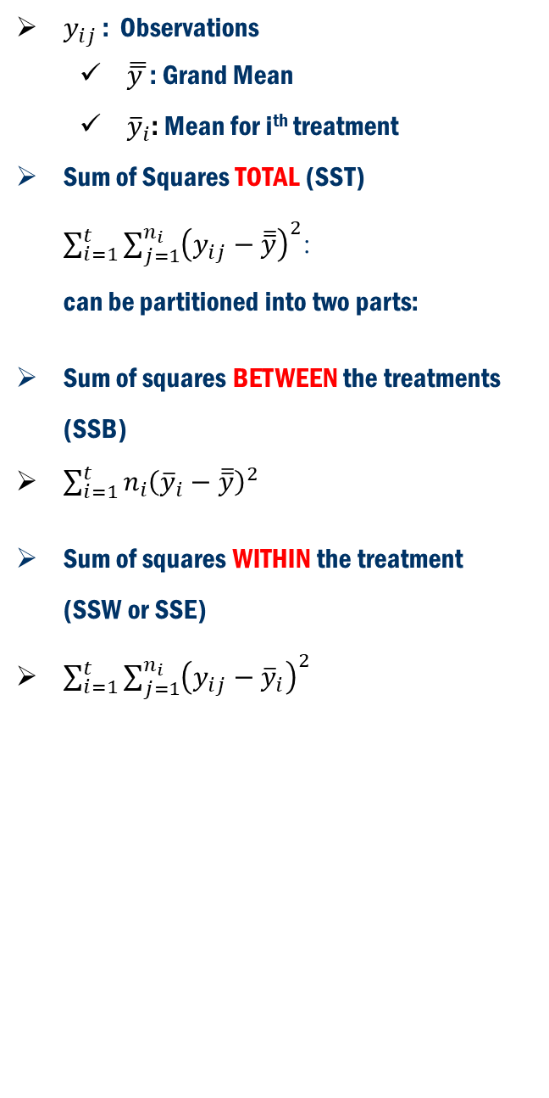


ANOVA concept
$y_{ij}$ : Observations
$\overline{\overline{y }}$: Grand Mean
${\overline{y}}_{i}$: Mean for i^{th} treatment
Sum of Squares TOTAL (SST) $\sum_{i=1}^{t}{\sum_{j=1}^{n_{i}}{{\left(y_{ij}−\overline{\overline{y}}\right)}^{2}}}$: can be partitioned into two parts:
Sum of squares BETWEEN the treatments (SSB)
$\sum_{i=1}^{t}{n_{i}{\left({\overline{y}}_{i}−\overline{\overline{y}}\right)}^{2} }$
Sum of squares WITHIN the treatment (SSW or SSE)
$\sum_{i=1}^{t}{\sum_{j=1}^{n_{i}}{{\left(y_{ij}−{\overline{y}}_{i}\right)}^{2}}}$
${\overline{y}}_{2}$= 71.82
${\overline{y}}_{1}$=70.34
$\overline{\overline{y}}=70.$43
${\overline{y}}_{3}$= 69.11

Slide 7
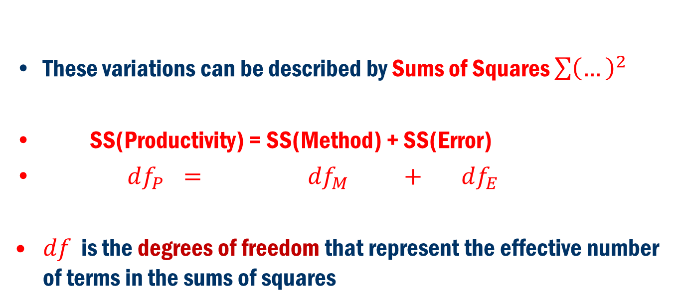
ANOVA Concept
Variation(Productivity) = Variation(Method ) + Variation(Error)
These variations can be described by Sums of Squares $\sum{{\left(…\right)}^{2}}$
SS(Productivity) = SS(Method) + SS(Error)
$df_{P} = df_{M} + df_{E}$
$df$ is the degrees of freedom that represent the effective number of terms in the sums of squares

Slide 8
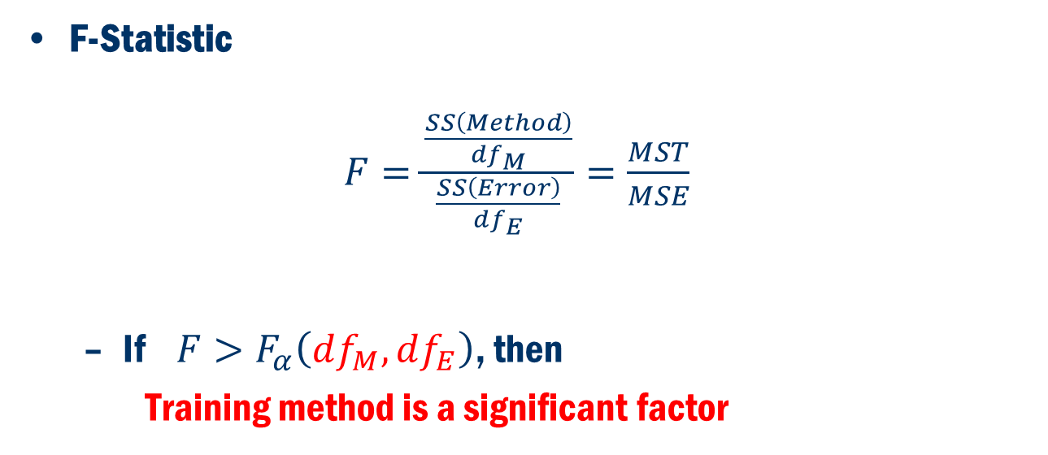
Test Statistic
F-Statistic
$F=\frac{\frac{SS\left(Method\right)}{df_{M}}}{\frac{SS\left(Error\right)}{df_{E}}}=\frac{MST}{MSE}$
If $F>F_{α}\left(df_{M},df_{E}\right)$, then
Training method is a significant factor

Slide 9

Back to Concept
One Factor ANOVA:
Treatment Levels
1 2 3 . . . t
$y_{11}$ $y_{21}$ $y_{31}$ $y_{t1}$
$y_{12}$ $y_{22}$ $y_{32}$ $y_{t2}$
. . . .
. . . .
$y_{1n_{1}}$ $y_{2n_{2}}$ $y_{3n_{3}}$ $y_{tn_{t}}$
$≡≡≡≡≡≡≡≡≡≡≡≡≡≡≡≡≡≡≡≡≡≡≡≡$
Mean ${\overline{y}}_{1}$ ${\overline{y}}_{2}$ ${\overline{y}}_{3}$ ${\overline{y}}_{t}$
St. Dev. $s_{1}$ $s_{2}$ $s_{3}$ $s_{t}$

Slide 10
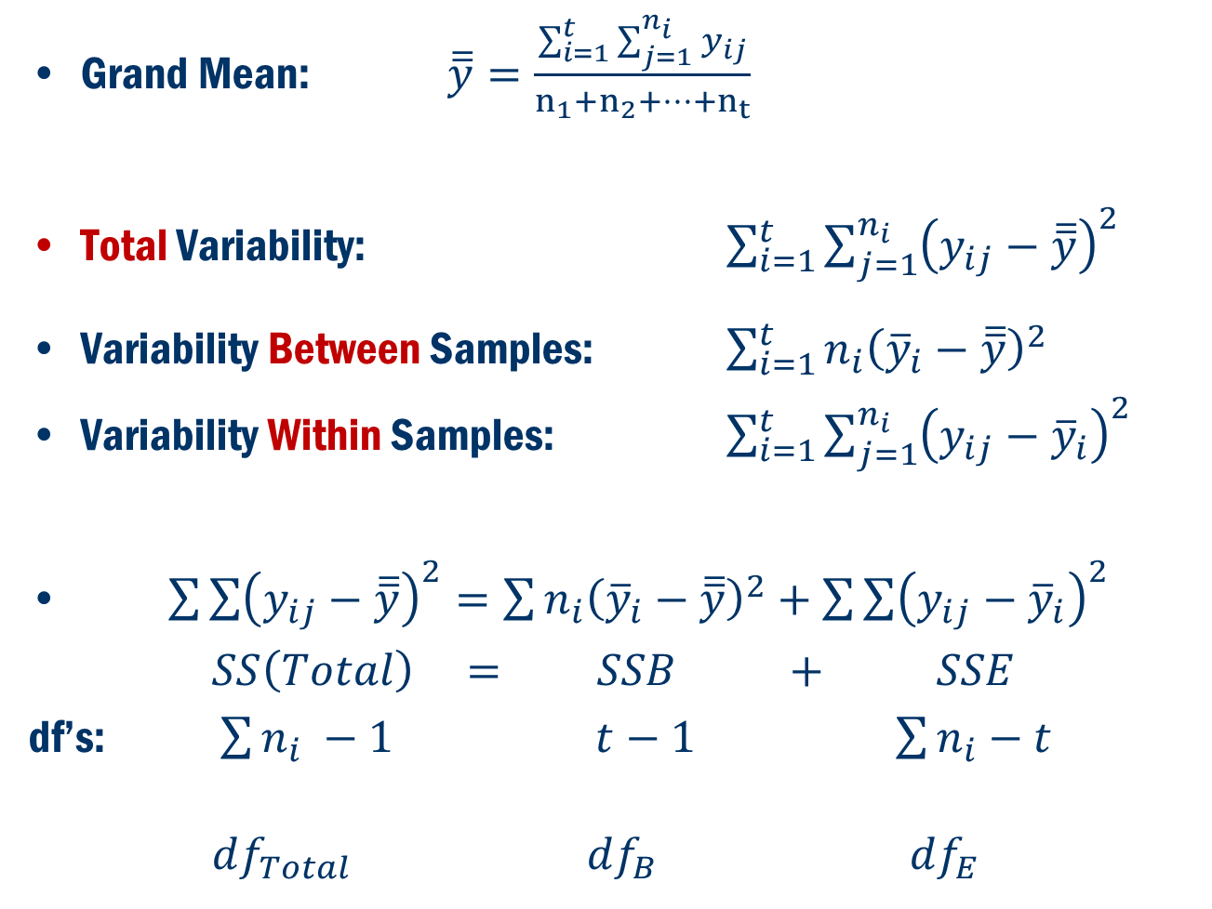
Back To Concept
Grand Mean: $\overline{\overline{y}}=\frac{\sum_{i=1}^{t}{\sum_{j=1}^{n_{i}}{y_{ij}}}}{n_{1}+n_{2}+…+n_{t}}$
Total Variability: $\sum_{i=1}^{t}{\sum_{j=1}^{n_{i}}{{\left(y_{ij}−\overline{\overline{y}}\right)}^{2}}}$
Variability Between Samples: $\sum_{i=1}^{t}{n_{i}{\left({\overline{y}}_{i}−\overline{\overline{y}}\right)}^{2} }$
Variability Within Samples: $\sum_{i=1}^{t}{\sum_{j=1}^{n_{i}}{{\left(y_{ij}−{\overline{y}}_{i}\right)}^{2}}}$
$\sum{\sum{{\left(y_{ij}−\overline{\overline{y}}\right)}^{2}=\sum{n_{i}{\left({\overline{y}}_{i}−\overline{\overline{y}}\right)}^{2}+\sum{\sum{{\left(y_{ij}−{\overline{y}}_{i}\right)}^{2}}}}}}$
$SS\left(Total\right) = SSB + SSE$
df’s: $\sum{n_{i}} −1$ $t−1$ $\sum{n_{i}}−t$
$df_{Total}$ $df_{B}$ $df_{E}$

Slide 11
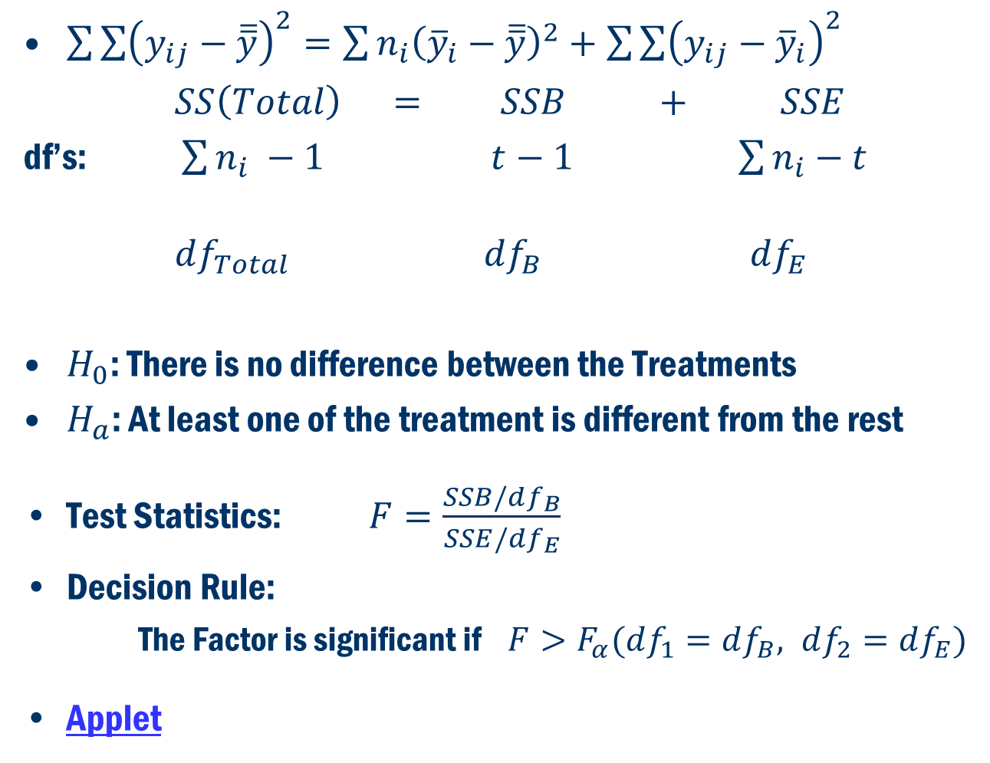
Back to Concept
$\sum{\sum{{\left(y_{ij}−\overline{\overline{y}}\right)}^{2}=\sum{n_{i}{\left({\overline{y}}_{i}−\overline{\overline{y}}\right)}^{2}+\sum{\sum{{\left(y_{ij}−{\overline{y}}_{i}\right)}^{2}}}}}}$
$SS\left(Total\right) = SSB + SSE$
df’s: $\sum{n_{i}} −1$ $t−1$ $\sum{n_{i}}−t$
$df_{Total}$ $df_{B}$ $df_{E}$
$H_{0}$: There is no difference between the Treatments
$H_{a}$: At least one of the treatment is different from the rest
Test Statistics: $F=\frac{SSB/df_{B}}{SSE/df_{E}}$
Decision Rule:
The Factor is significant if $F>F_{α}(df_{1}=df_{B}, df_{2}=df_{E})$
Applet

Slide 12
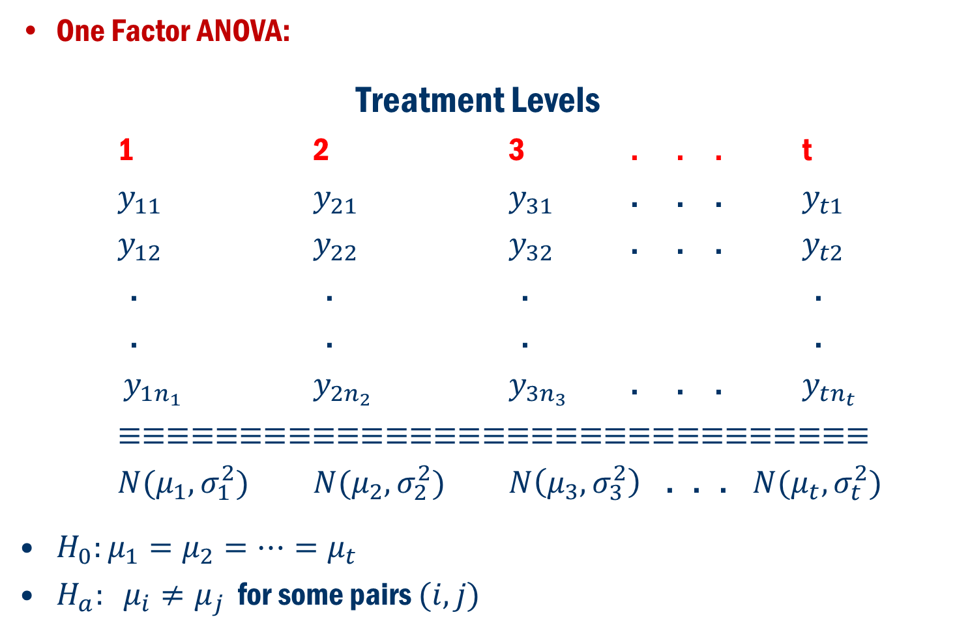
Formulation in terms of Hypothesis Problem
One Factor ANOVA:
Treatment Levels
1 2 3 . . . t
$y_{11}$ $y_{21}$ $y_{31}$ . . . $y_{t1}$
$y_{12}$ $y_{22}$ $y_{32}$ . . . $y_{t2}$
. . . .
. . . .
$y_{1n_{1}}$ $y_{2n_{2}}$ $y_{3n_{3}}$ . . . $y_{tn_{t}}$
$≡≡≡≡≡≡≡≡≡≡≡≡≡≡≡≡≡≡≡≡≡≡≡≡≡≡≡≡≡≡≡$
$N(μ_{1},σ_{1}^{2})$ $N(μ_{2},σ_{2}^{2})$ $N\left(μ_{3},σ_{3}^{2}\right)$ . . . $N(μ_{t},σ_{t}^{2})$
$H_{0}:μ_{1}=μ_{2}=…=μ_{t}$
$H_{a}: μ_{i}≠μ_{j}$ for some pairs $(i, j)$

Slide 13
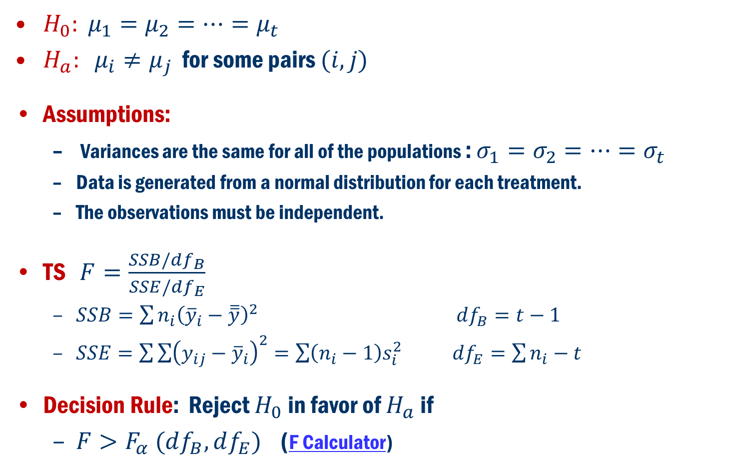
Formulation in terms of Hypothesis Problem
$H_{0}: μ_{1}=μ_{2}=…=μ_{t}$
$H_{a}: μ_{i}≠μ_{j}$ for some pairs $(i, j)$
Assumptions:
Variances are the same for all of the populations : $σ_{1}=σ_{2}=…=σ_{t}$
Data is generated from a normal distribution for each treatment.
The observations must be independent.
TS $F=\frac{SSB/df_{B}}{SSE/{df}_{E}}$
$SSB=\sum{n_{i}{\left({\overline{y}}_{i}−\overline{\overline{y}}\right)}^{2}}$ $df_{B}=t−1$
$SSE=\sum{\sum{{\left(y_{ij}−{\overline{y}}_{i}\right)}^{2}=\sum{\left(n_{i}−1\right)s_{i}^{2}}}}$ $df_{E}=\sum{n_{i}}−t$
Decision Rule: Reject $H_{0}$ in favor of $H_{a}$ if
$F>F_{α} (df_{B}, df_{E})$ (F Calculator)

Slide 14

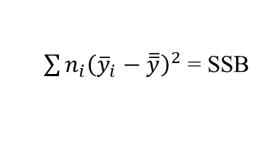


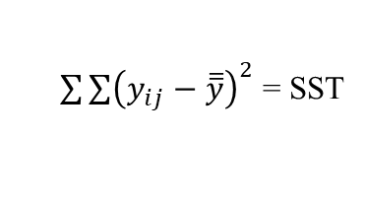



Anova Table
Source of Variation | df | Sum of Squares | Mean Square | F | p-value
Group (Between) | t-1
Error (Within) | N-t
Total | N-1
Here:
$N=\sum_{i}^{t}{n_{i}}$
$SST=SSB+SSE$
$\frac{SSB}{{df}_{B}}$ =$MSB$
$${\frac{MSB}{MSE}=F}_{calc}$$
$$Pr⁡(F>F_{calc})$$
$\sum{n_{i}{\left({\overline{y}}_{i}−\overline{\overline{y}}\right)}^{2} }$= SSB
$\sum{\sum{{\left(y_{ij}−{\overline{y}}_{i}\right)}^{2} }}$= SSE
$\frac{SSE}{{df}_{E}}$ =$MS$E
$\sum{\sum{{\left(y_{ij}−\overline{\overline{y}}\right)}^{2} }}$= SST

Slide 15
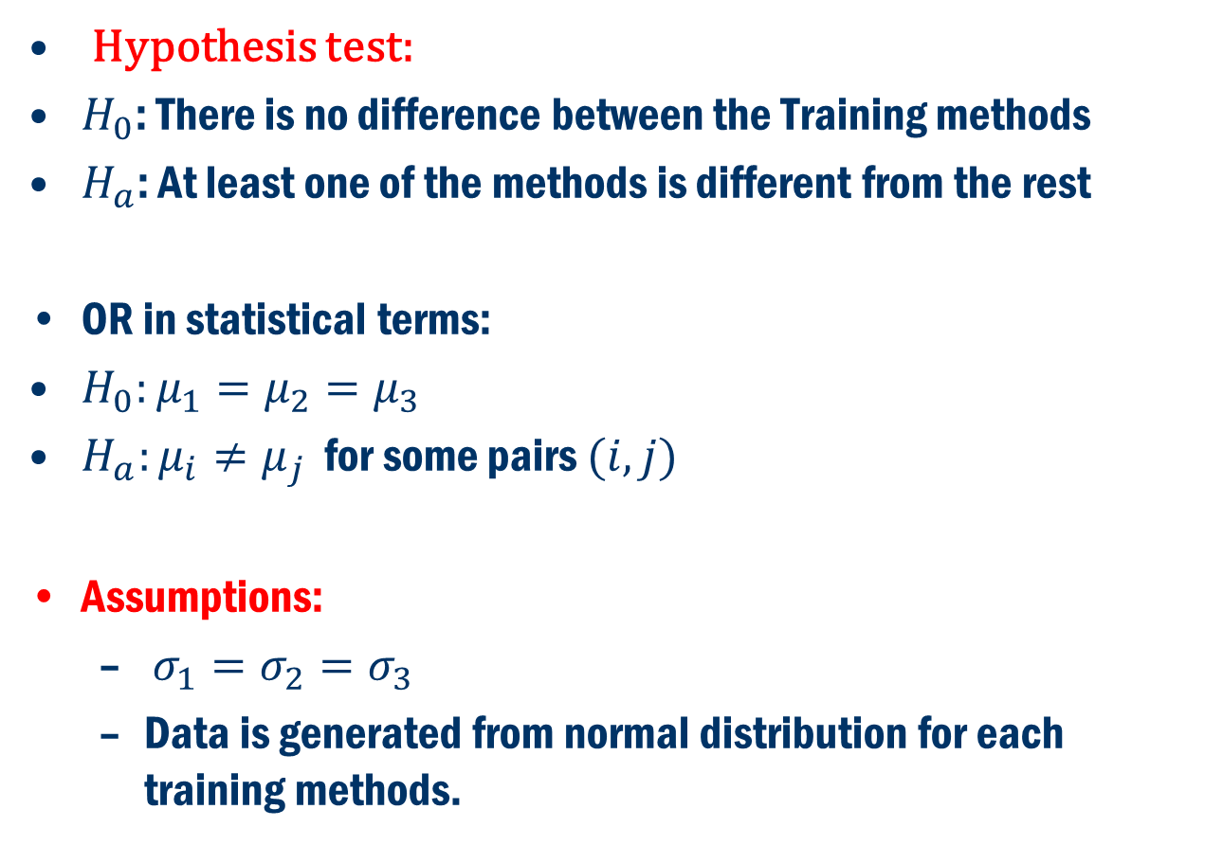
Example 2 Cont’D
Hypothesis test:
$H_{0}$: There is no difference between the Training methods
$H_{a}$: At least one of the methods is different from the rest
OR in statistical terms:
$H_{0}:μ_{1}=μ_{2}=μ_{3}$
$H_{a}:μ_{i}≠μ_{j}$ for some pairs $(i,j)$
Assumptions:
$σ_{1}=σ_{2}=σ_{3}$
Data is generated from normal distribution for each training methods.

Slide 16
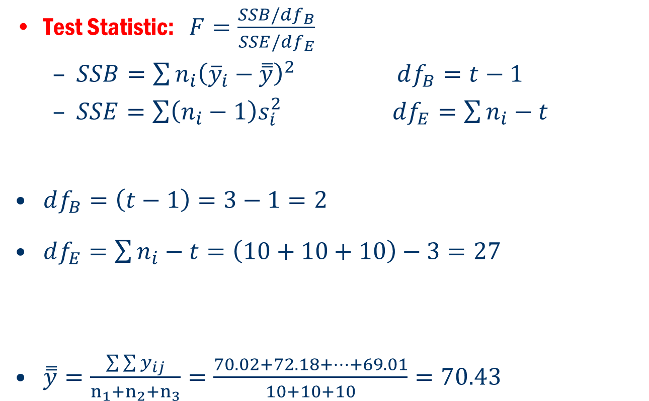
Example 2 Cont’D
Test Statistic: $F=\frac{SSB/df_{B}}{SSE/{df}_{E}}$
$SSB=\sum{n_{i}{\left({\overline{y}}_{i}−\overset{̿}{y}\right)}^{2}}$ $df_{B}=t−1$
$SSE=\sum{\left(n_{i}−1\right)s_{i}^{2}}$ $df_{E}=\sum{n_{i}}−t$
$df_{B}=\left(t−1\right)=3−1=2$
$df_{E}=\sum{n_{i}}−t=\left(10+10+10\right)−3=27$
$\overset{̿}{y}=\frac{\sum{\sum{y_{ij}}}}{n_{1}+n_{2}+n_{3}}=\frac{70.02+72.18+…+69.01}{10+10+10}=70.43$

Slide 17
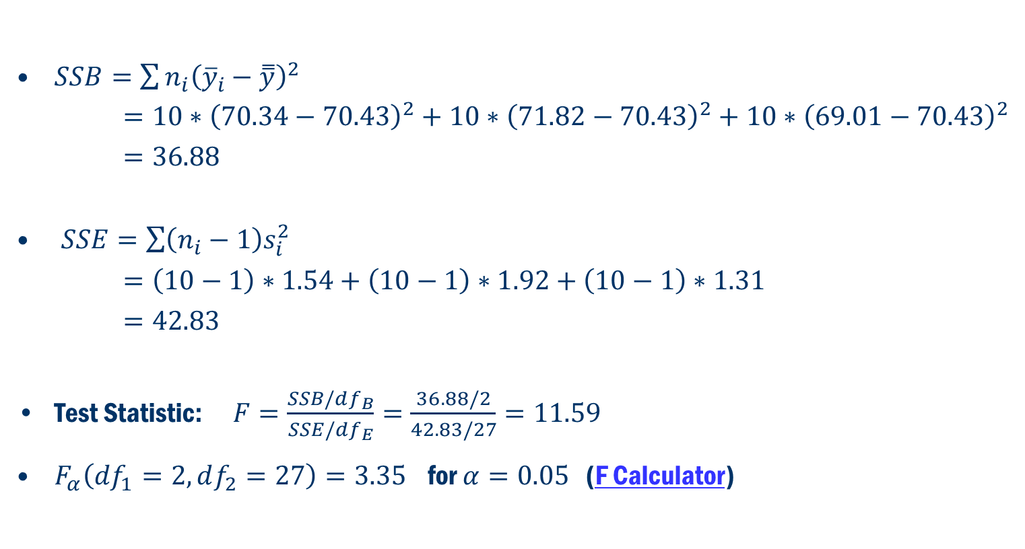
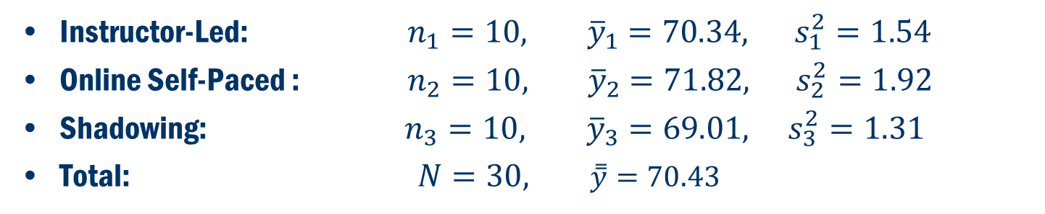
Example 2 Cont’D
Instructor-Led: $n_{1}=10, { \overline{y}}_{1}=70.34, s_{1}^{2}=1.54$
Online Self-Paced : $n_{2}=10, { \overline{y}}_{2}=71.82, s_{2}^{2}=1.92$
Shadowing: $n_{3}=10, {\overline{y}}_{3}=69.01, s_{3}^{2}=1.31$
Total: $N=30, \overset{̿}{y}=70.43$
$SSB=\sum{n_{i}{\left({\overline{y}}_{i}−\overset{̿}{y}\right)}^{2}}$
$=10∗{\left(70.34−70.43\right)}^{2}+10∗{\left(71.82−70.43\right)}^{2}+10∗{\left(69.01−70.43\right)}^{2}$
$=36.88$
$SSE=\sum{\left(n_{i}−1\right)s_{i}^{2}}$
$=\left(10−1\right)∗1.54+\left(10−1\right)∗1.92+\left(10−1\right)∗1.31$
$=42.83$
Test Statistic: $F=\frac{SSB/df_{B}}{SSE/df_{E}}=\frac{36.88/2}{42.83/27}=11.59$
$F_{α}\left(df_{1}=2, df_{2}=27\right)=3.35$ for $α=0.05$ (F Calculator)

Slide 18






Example 2 Anova table
Source of Variation | df | Sum of Squares | Mean Squares | F | F-table
Group (Between)
Error (Within)
Total
3-1=2
SSB=36.88
MSB$=\frac{36.88}{2}=18.44$
F$=\frac{18.44}{1.59}=11.59$
$$F_{0.05}\left(2, 27\right)=3.35$$
30-3=27
SSE=42.83
MSE$=\frac{42.83}{27}=1.59$
30-1=29
Conclusion: Is $F>3.35?$ Yes!
Reject $H_{0}$.
We can conclude that:
mean of productivity scores of employees who participated in the three different training programs are NOT equal.
OR training method is a significant factor in productivity score!

Slide 19
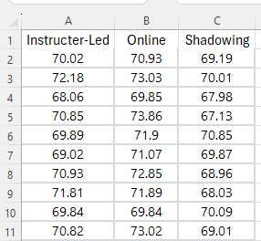
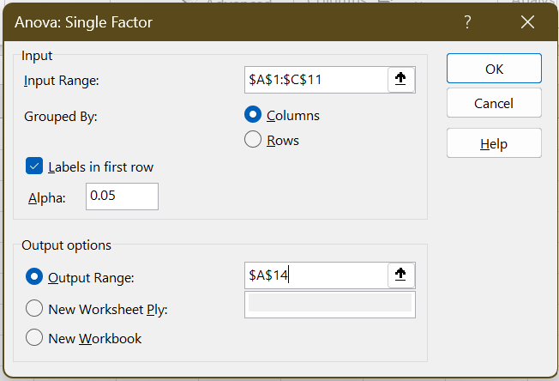
In Excel
Step 1. Click the Data tab on the Ribbon Step 2. In the Analyze group, click Data Analysis Step 3. Choose ANOVA: Single Factor from the list of Analysis Tools Step 4. In the dialog box: Enter A1:C11 in the Input Range: box Select Columns in the Grouped By: area Select the check box for Labels in First Row In the Output options area, select Output Range: and enter A14. Click OK

Slide 20
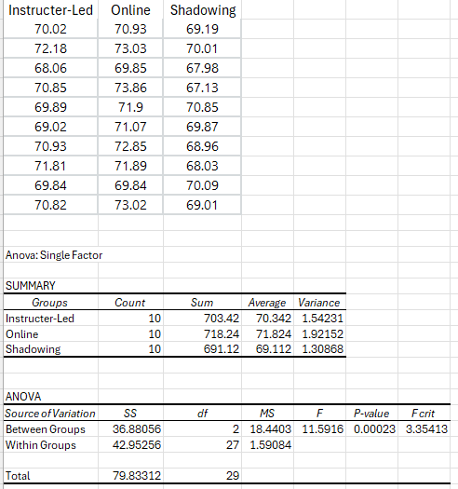

In Excel: results
P-value = 0.00023 < 0.05
Reject $H_{0}$
Training method is a significant factor in the productivity score!

Slide 21
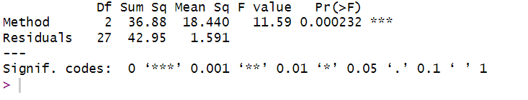

In R
anova_result = summary(aov(Productivity ~ Method, data = training))
P-value = 0.00023 < 0.05
Reject $H_{0}$
Training method is a significant factor in the productivity score!

Slide 22
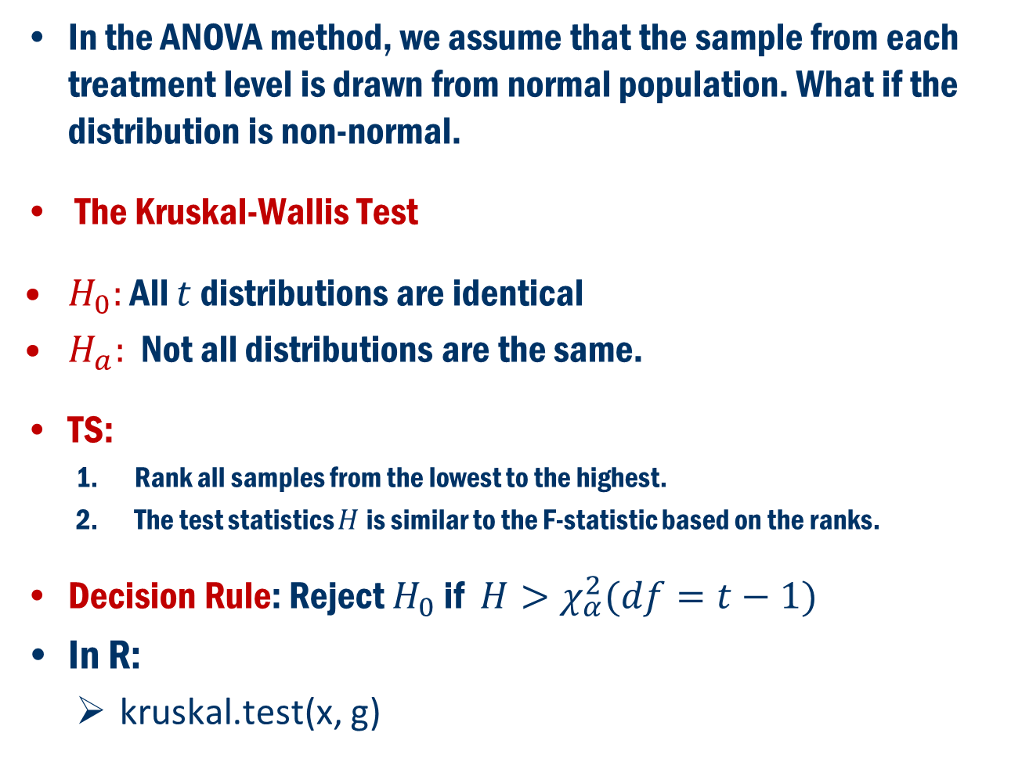
Normality Assumption Fails Non-Parametric Method
In the ANOVA method, we assume that the sample from each treatment level is drawn from normal population. What if the distribution is non-normal.
The Kruskal-Wallis Test
$H_{0}:$ All $t$ distributions are identical
$H_{a}:$ Not all distributions are the same.
TS:
Rank all samples from the lowest to the highest.
The test statistics $H$is similar to the F-statistic based on the ranks.
Decision Rule: Reject $H_{0}$ if $H>χ_{α}^{2}(df=t−1)$
In R:
kruskal.test(x, g)

Slide 23
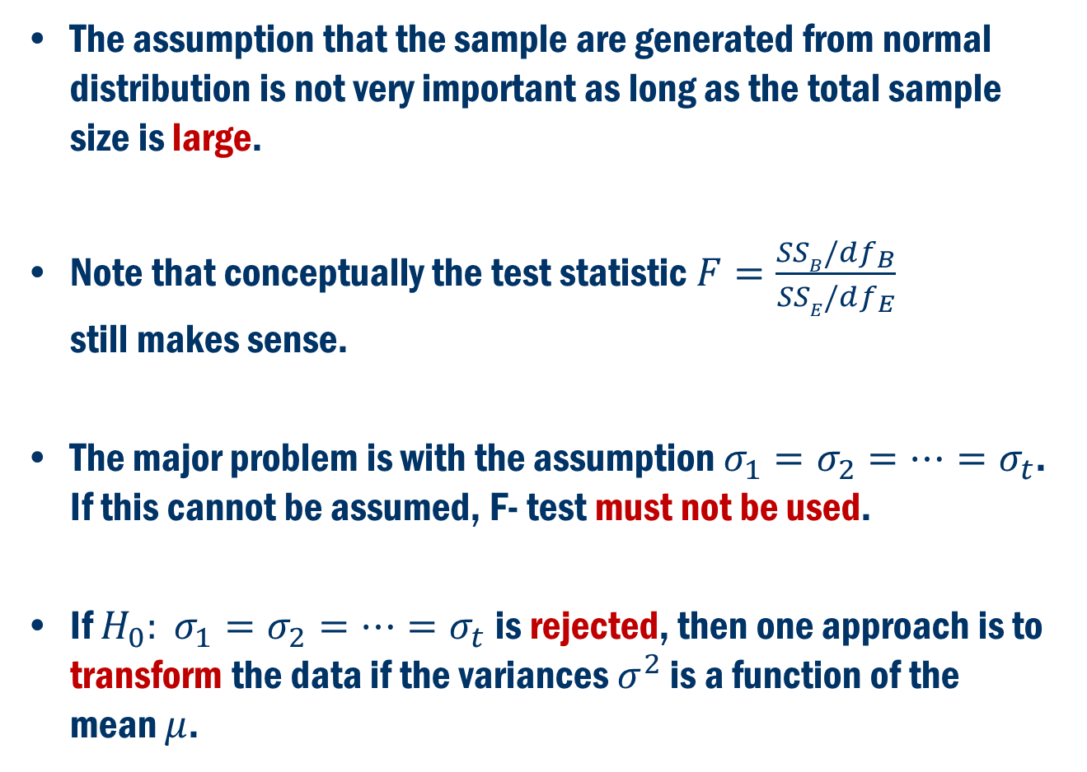
What if Equality of the Variances FAIL?
The assumption that the sample are generated from normal distribution is not very important as long as the total sample size is large.
Note that conceptually the test statistic $F=\frac{SSB/df_{B}}{SSE/df_{E}}$ still makes sense.
The major problem is with the assumption $σ_{1}=σ_{2}=…=σ_{t}$. If this cannot be assumed, F- test must not be used.
If $H_{0}: σ_{1}=σ_{2}=…=σ_{t}$ is rejected, then one approach is to transform the data if the variances $σ^{2}$ is a function of the mean $μ$.

Slide 24
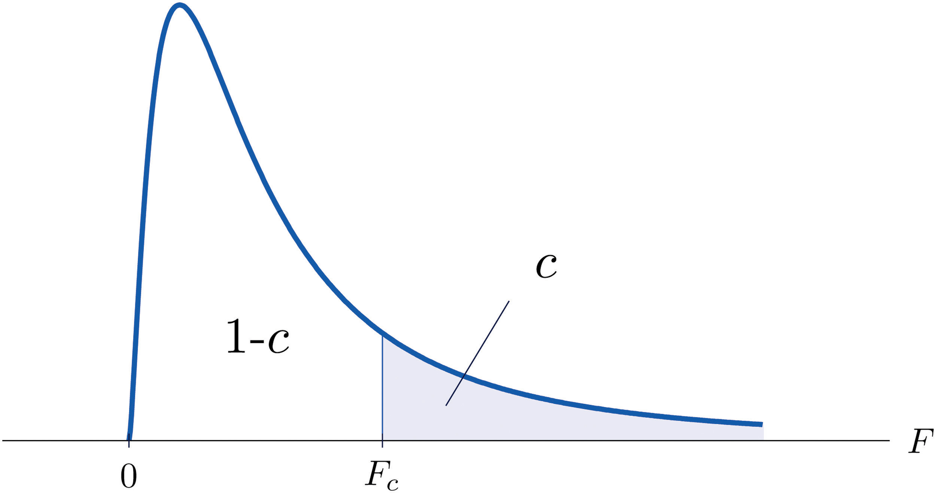
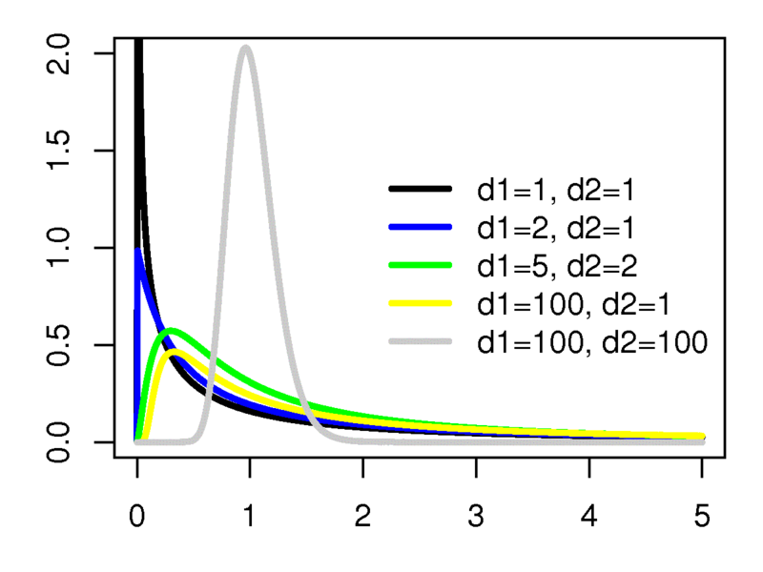
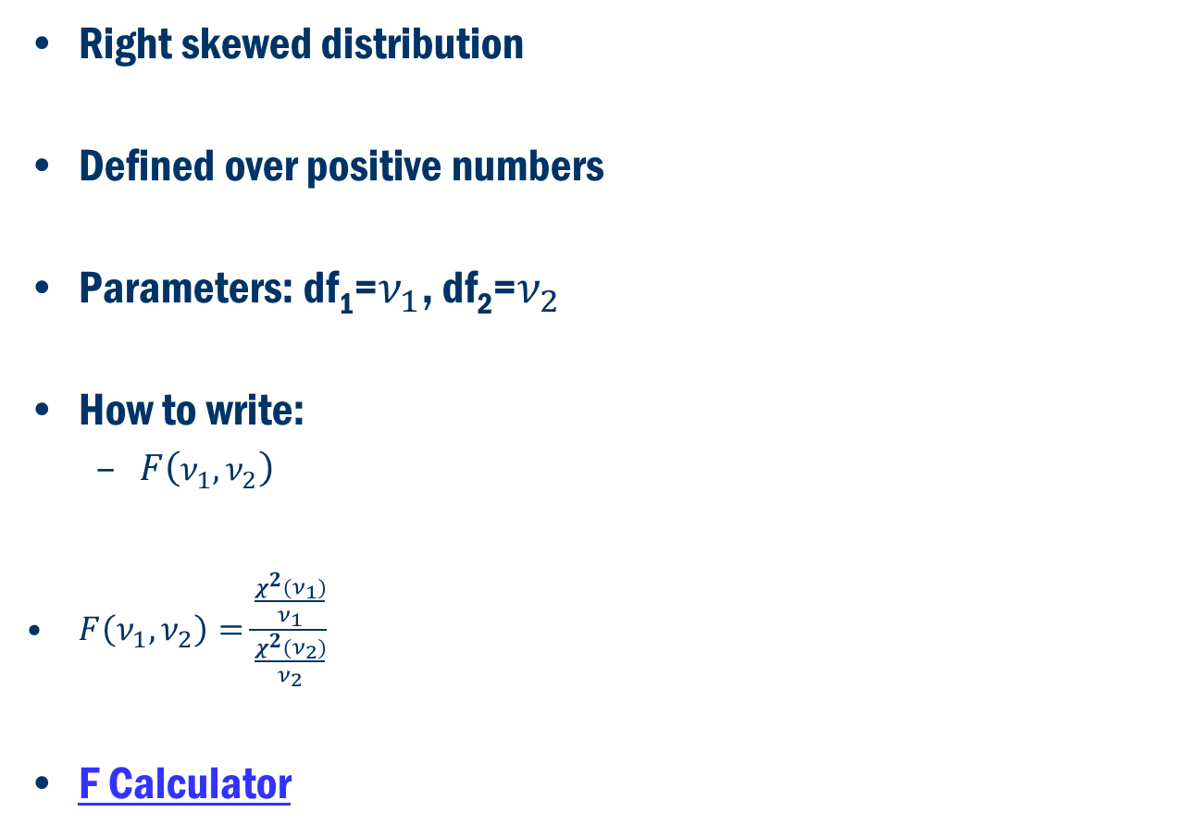
F Distribution
Right skewed distribution
Defined over positive numbers
Parameters: df₁=$ν_{1}$, df₂=$ν_{2}$
How to write:
$F\left(ν_{1},ν_{2}\right)$
$F\left(ν_{1},ν_{2}\right)=\frac{\frac{χ^{2}(ν_{1})}{ν_{1}}}{\frac{χ^{2}(ν_{2})}{ν_{2}}}$
F Calculator
Applet
Source: Wikipedia

