Slide 1
Buying & selling for a good cause
properties for a socially responsible investor
a proposal by real estate data analysts MJR & TD
september 2025

Slide 2

Our client erin robinson
investing in poor neighborhoods
buying & selling
covering costs
small profit
socially responsible
QUESTIONS
what are good types of properties for erin to invest in? to what extent do prices, the house condition and the season matter for erin’s socially responsible purposes?

Slide 3
data set

Slide 4
hypotheses
properties sold below median price are located further away from the city center
properties built before 1990 and in poor condition have a 10% lower median price
properties sold during the winter season have a median price at least 10% lower

Slide 5
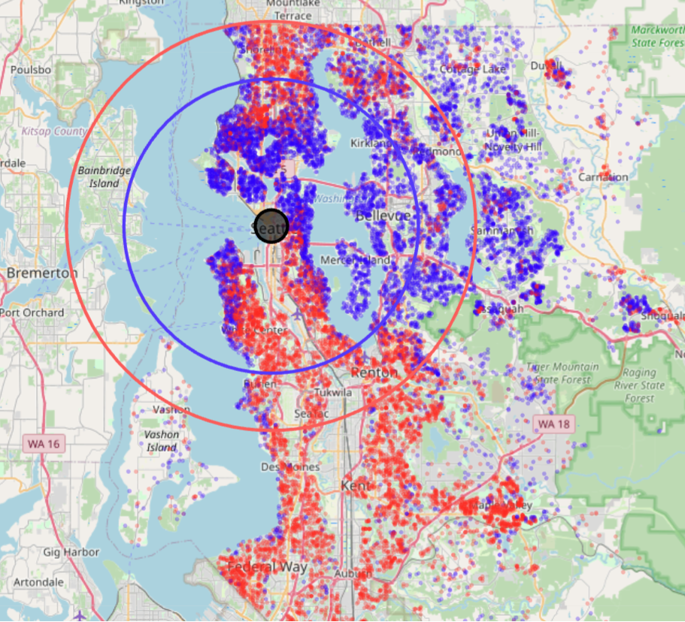
Distance to city center matters
FINDING
typical distance of properties sold under median price = 19,5 km (red circle)
typical distance of properties sold above median price = 14 km (blue circle)
property price decreases slightly as we move away from city center
RECOMMENDATION
generally, properties further away from the city center are more suitable for socially responsible investment

Slide 6
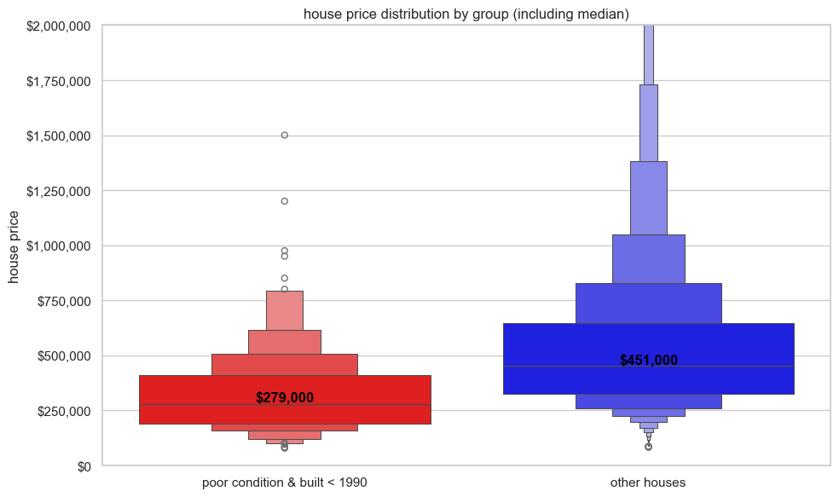
Properties in poor condition
FINDING
typical price for properties in poor condition and built pre-1990 is below 300K
properties built pre-1990 and in poor condition are 38% lower in price than other properties
RECOMMENDATION
properties in poor condition regardless of construction year are suitable for socially responsible investment

Slide 7
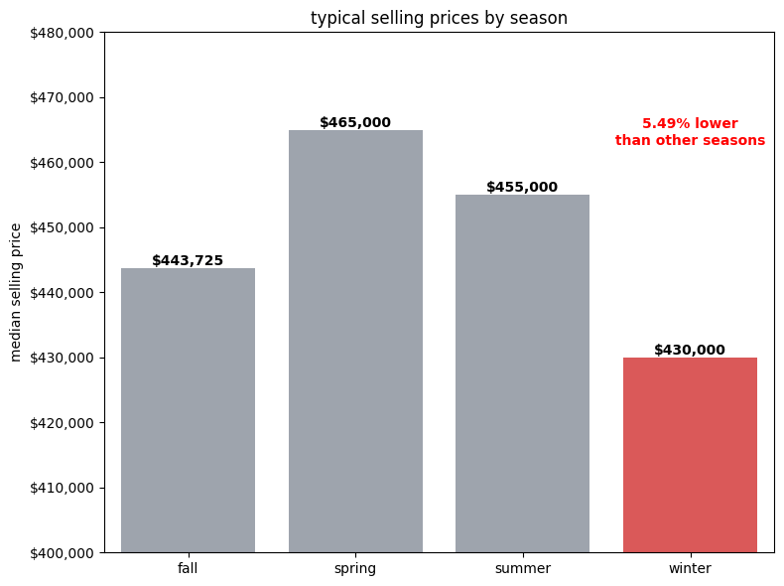
Winter is an attractive month
FINDING
typical selling price for properties lowest in winter, highest in spring
selling price for properties is 5.5% lower in winter than in other seasons
RECOMMENDATION
buying properties in winter recommended
selling properties in winter gives lower-income buyers an opportunity to buy
for small profit, consider selling in fall

Slide 8
Recommendations for a socially responsible investment
priorities
buy properties in poor condition
buy properties sold in winter
sell properties in winter / fall
distance to city center secondary

