Slide 1
Stuck-At Fault Simulation
電機三 B02901059 吳昱陞
電機三 B02901108 吳省澤

Slide 2
outline
Basic structure
Algorithm
Result

Slide 3
Basic structure
Gate. h
CirMgr. h
Main.cpp

Slide 4

Input_Id
Output_Id
Name: NAND2_0
ID: G9

Slide 5
Algorithm
Fault model & Correct model
when encounter a fault
  compare the signal between two model every SIM

Slide 6
example

Slide 7
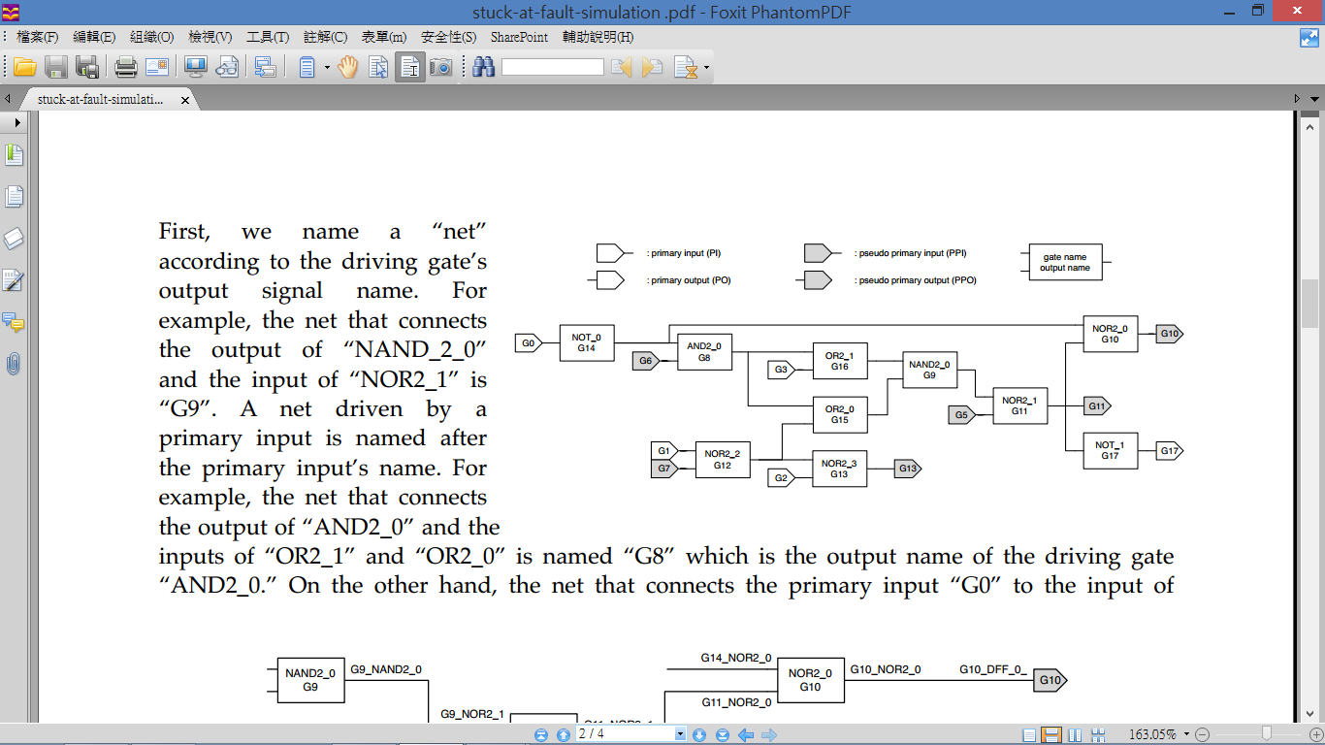

Slide 8
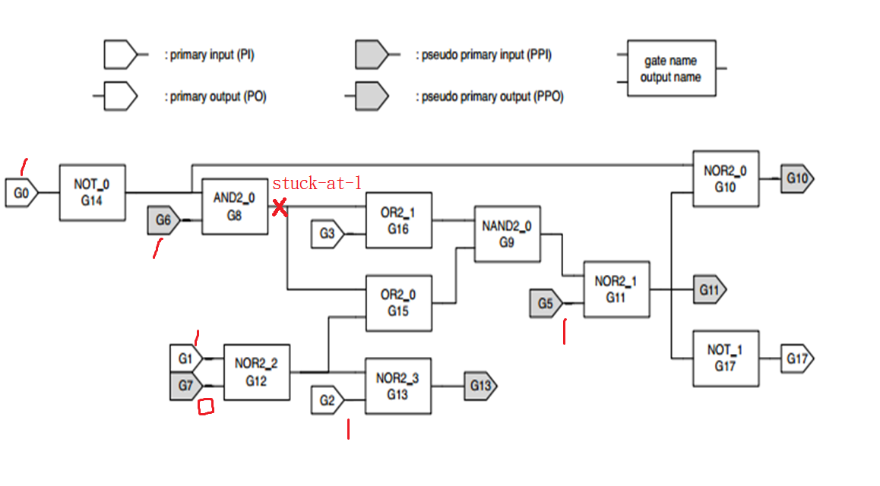
Pattern={1110110}

Slide 9
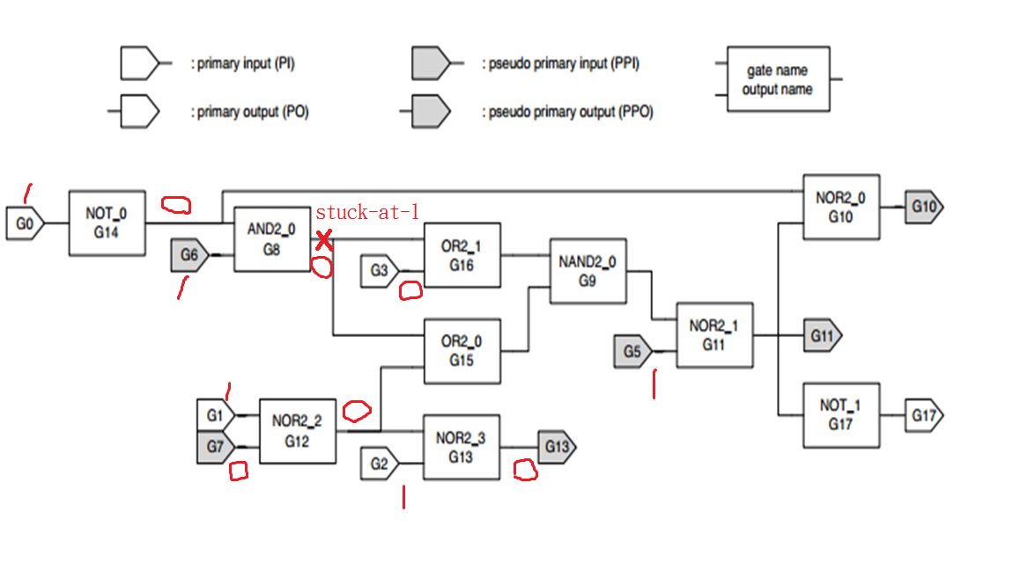
Encounter a fault

Slide 10
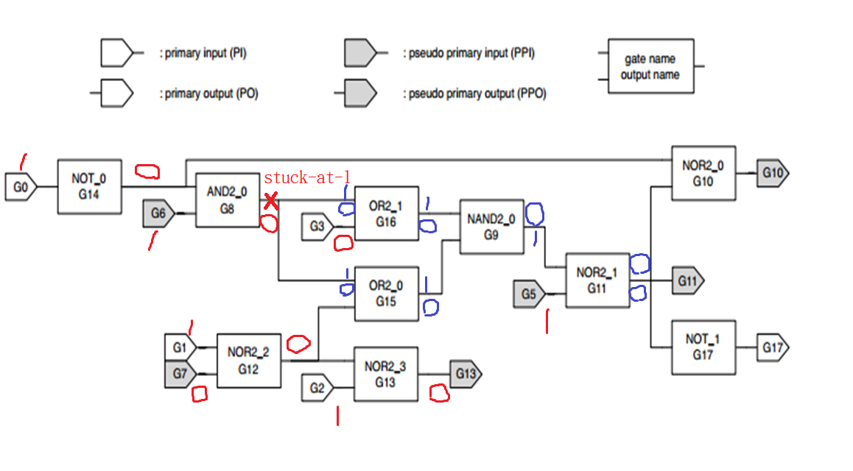
The signal between two is the same
UNDETECTED!!!!!

