Slide 1
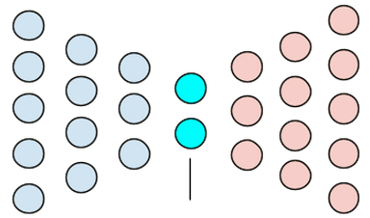

Bow Tie formerly known as cytohackR
Simon, Sebastian, Marie, Bekka, Christian, Joerg
@Github

Slide 2
Task 3 – significant functional+morphological groups using compound annotations
Morphological data (R)
Downloaded all data
Aggregated all in one data frame
Normalize the data per plate against DMSO control
Feature selection (unsupervised filter, decorrelation removal) - 843 to 2xx
Compound annotation (R,Java)
Aggregate all metadata
Normalize compounds for allowing to merge ChEMBL assay data
Calculate compound-compound matrices (chemical functional groups)
Clustering strategy (Jupyter python notebook, keras)
Deeplearning Autoencoder for clustering
Statistical sampling for significance testing of morphological ~ compoundAnnotation data
Visualize

Slide 3
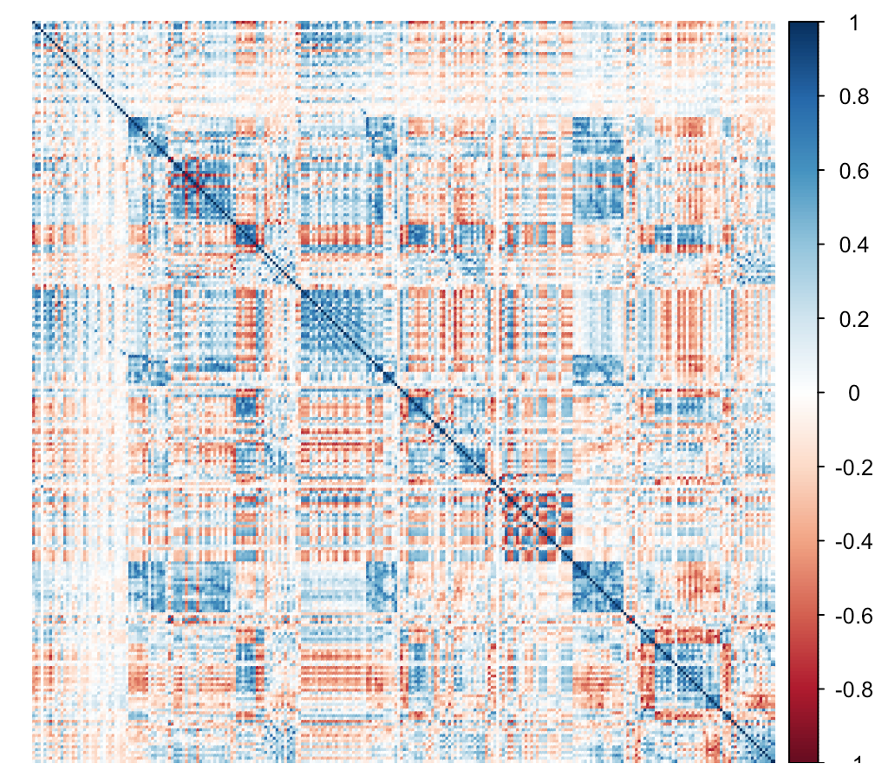
Morphological feature selection (feature correlation matrix)

Slide 4
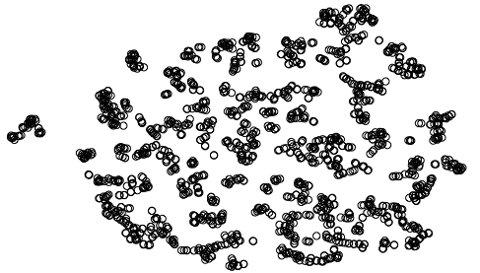
Compound-compound space (via chemical functional features)

Slide 5
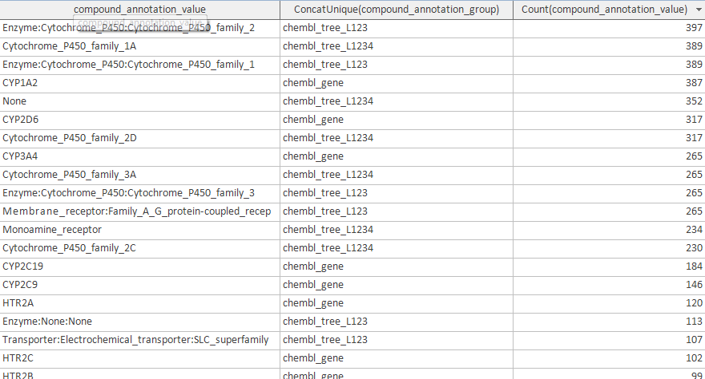
Compound annotations

Slide 6
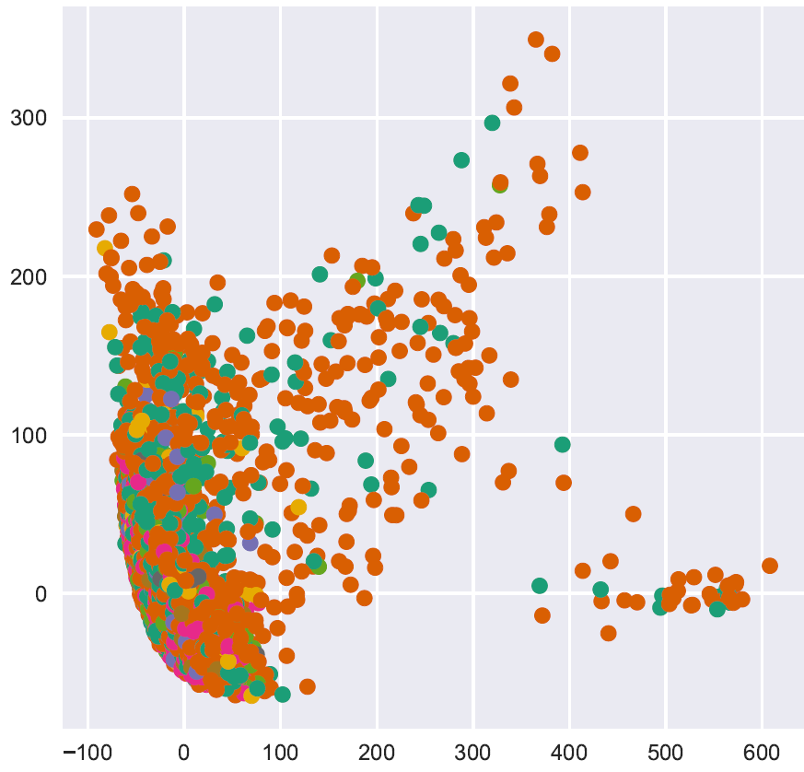
PCA of 32 autoencoder features (autoencoder, morphological features)

Slide 7
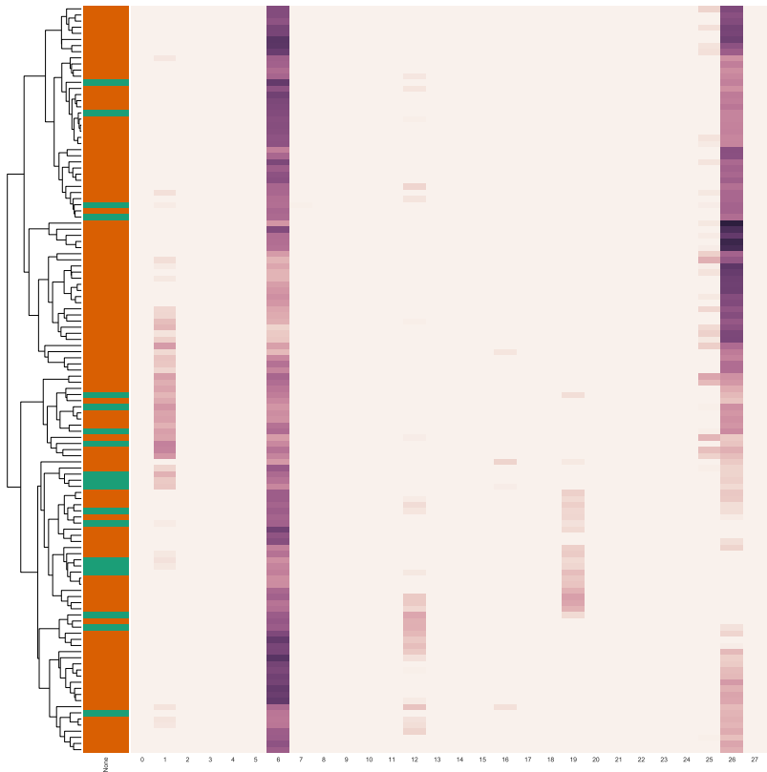
Combining morphological clustering and significant biological groups of compound annotations
Conclusions
More cleanup required, overrepresentation of “unknown”

Slide 8
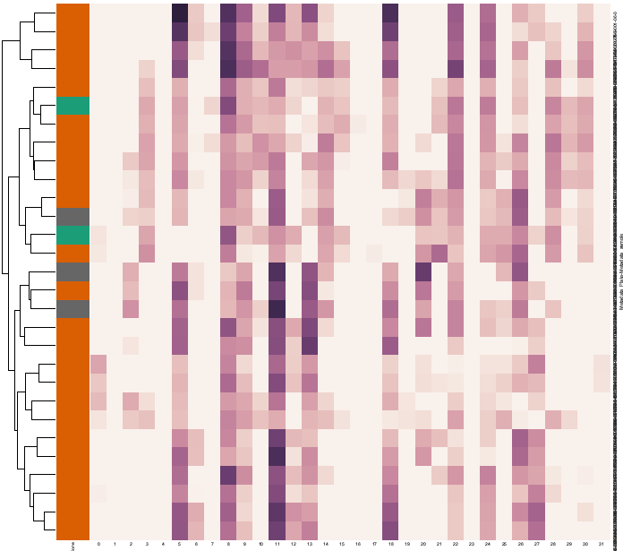
Cytochrome cluster (high significance)

Slide 9
Clustering (autoencoder, chemical functional features)
Next ;)

Slide 10
More details
@Github
Bow tie chat https://gitter.im/shntnu/cytohackR
Compound annotation https://github.com/bioinf-jku/project_BBDD

