Slide 1
Chat application
By object oriented programming using java

Slide 2
Table of contents
Objective
Elements used in the project
Screens, Test cases, and Test Results
Conclusion

Slide 3
Objective
The project aims to achieve the following key objectives:
1. User Authentication
2. Personal and Group Chat:
3. Real Time Messaging
4. UserFriendly Interface
5. Customization
6. Message Management
7. Convenience

Slide 4
Elements in the Project
Java Programming Language
Java Swing or JavaFX for GUI

Slide 5
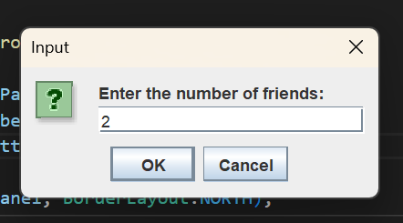
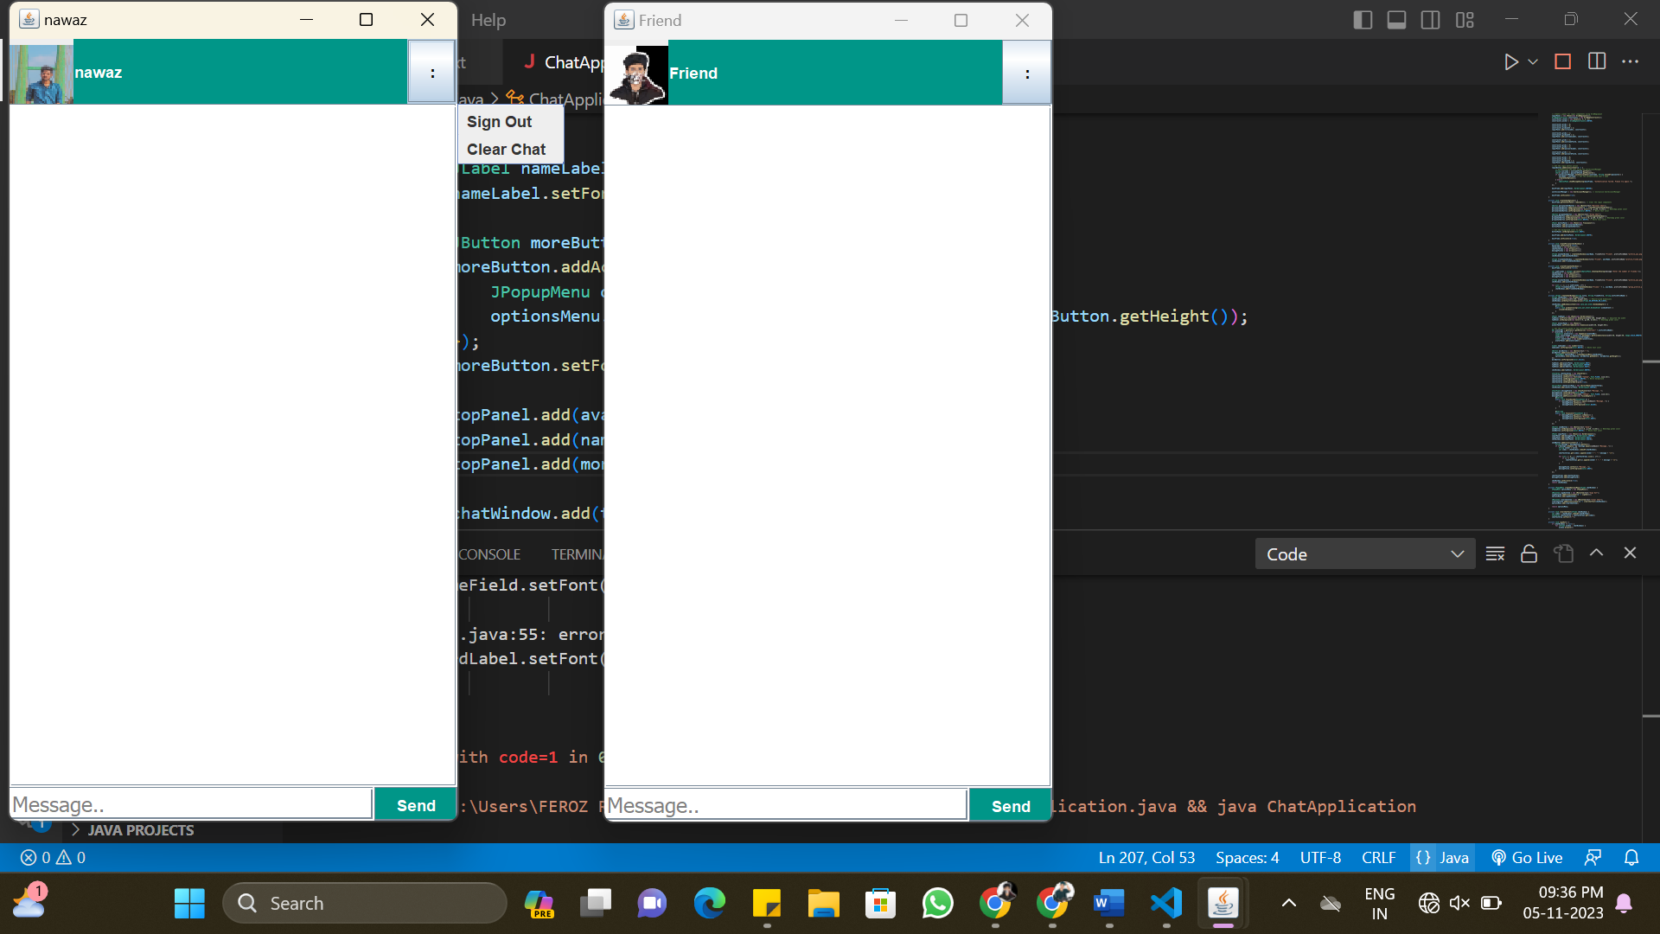

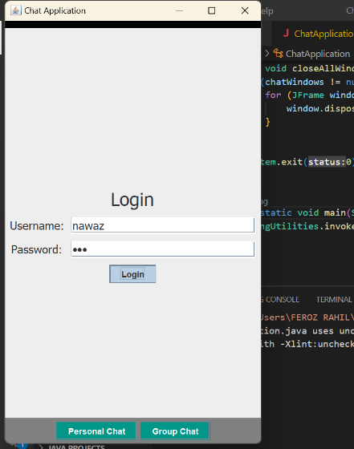
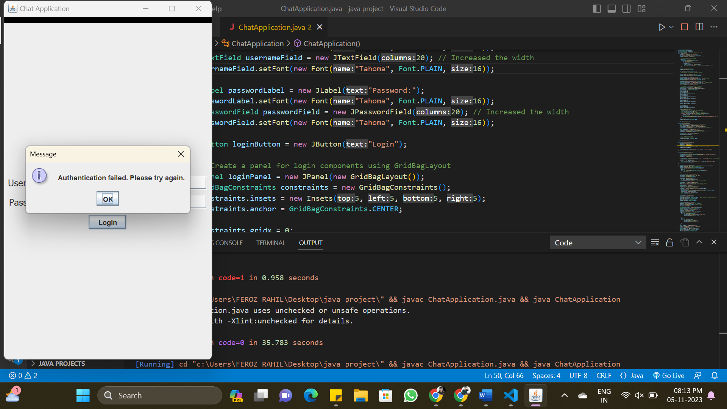
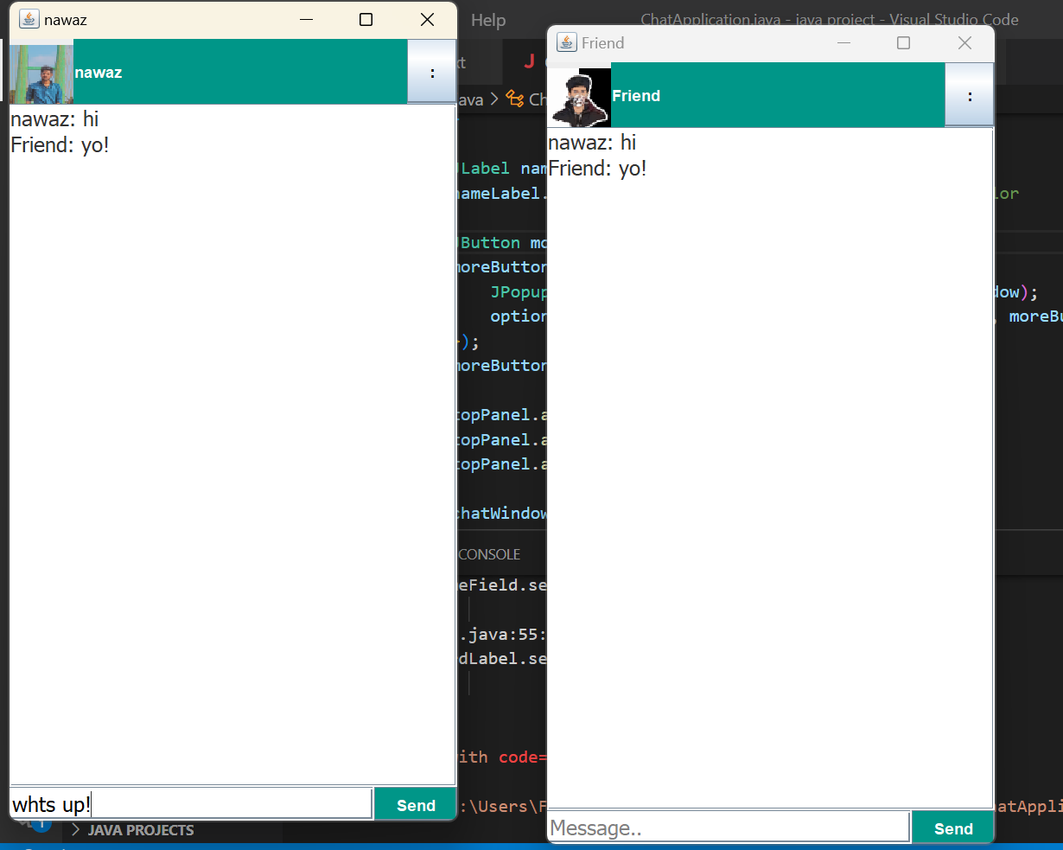
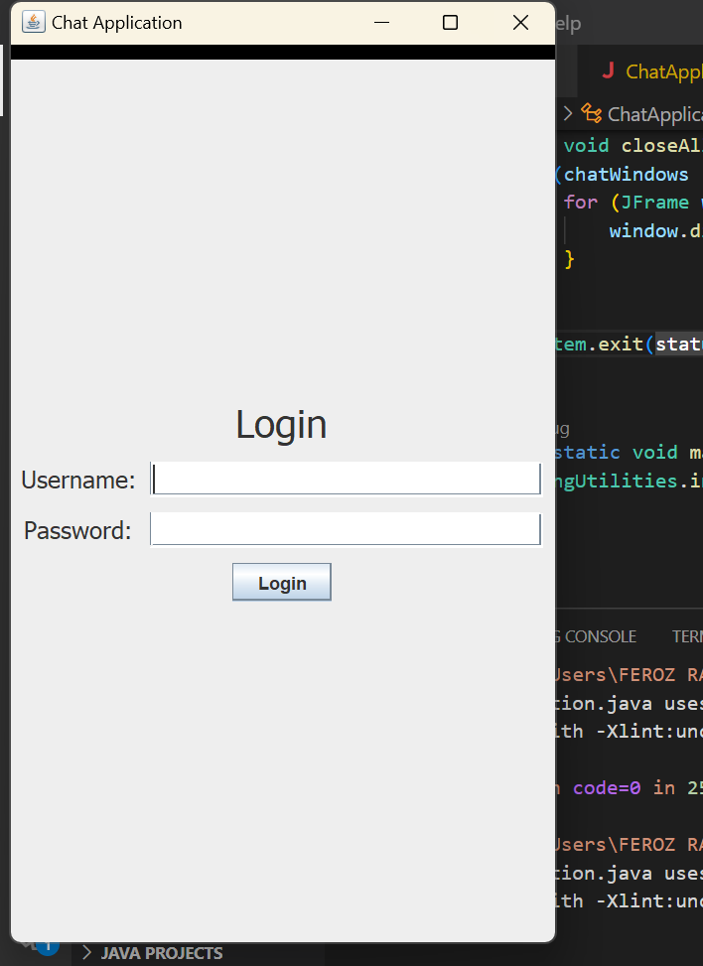
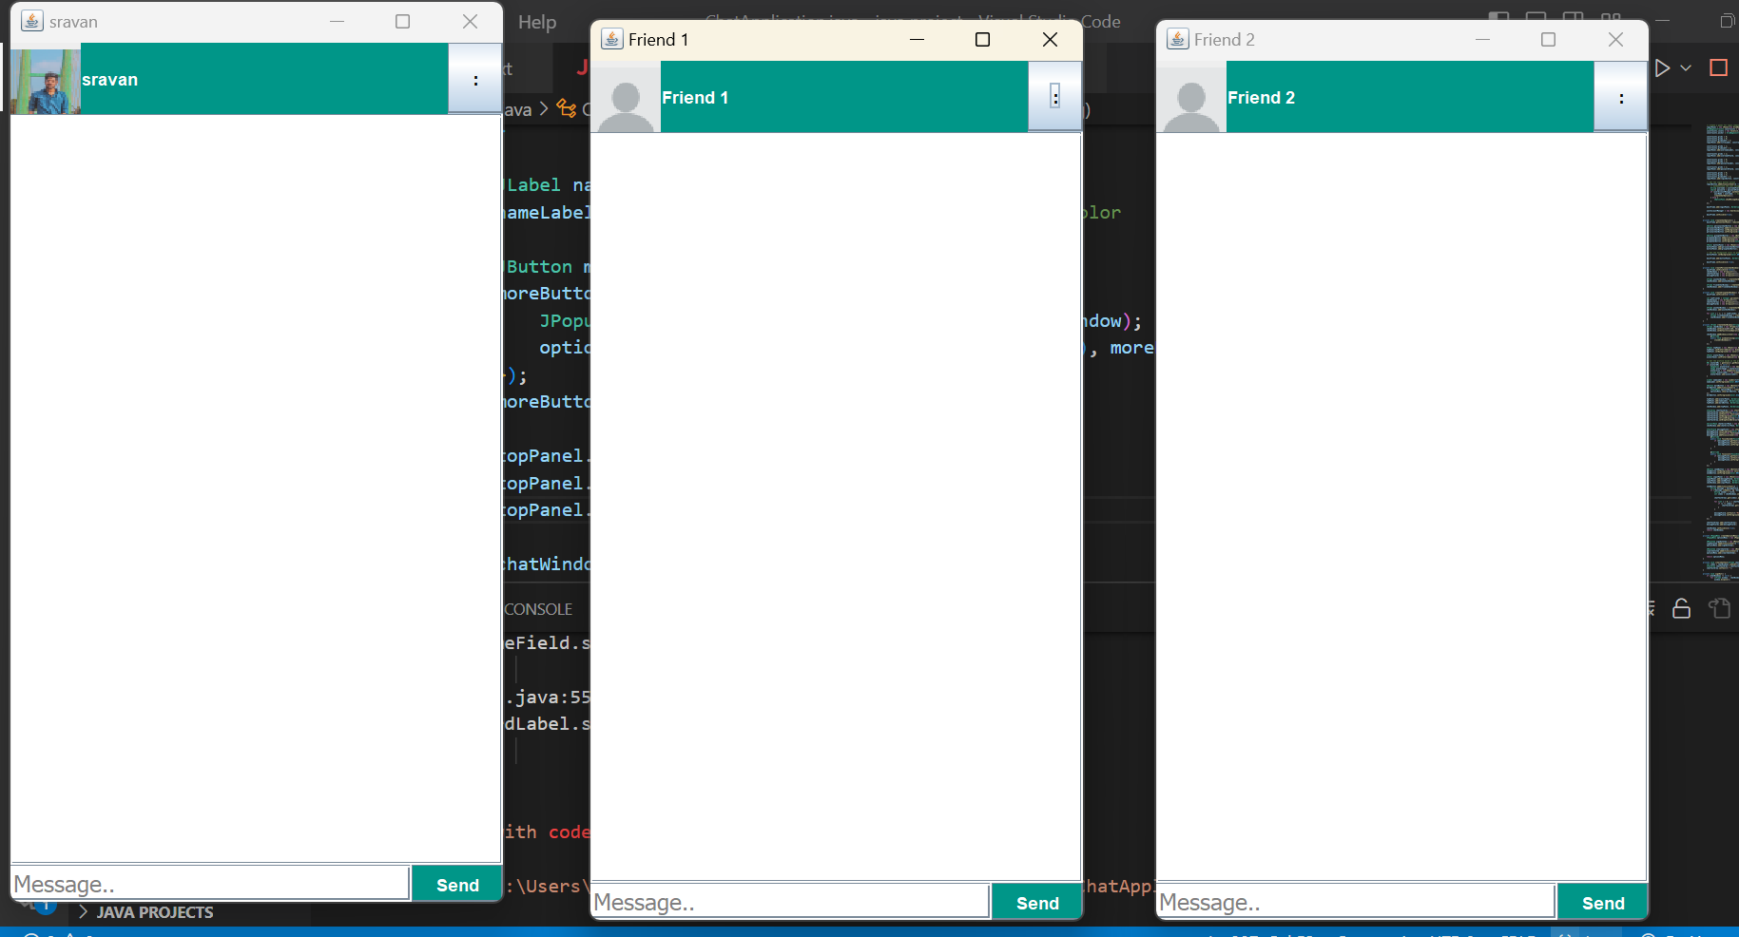
Screens:
Login window

Slide 6
After Authentication will get access to
choose the option you want to do
Personal chat
Group chat

Slide 7
Personal Chat
Personal Chat

Slide 8
Group Chat (Broadcast):
Select the number of friends you want to chat with:

Slide 10
More Option:
sign out
clear chat

Slide 11
Test Cases:
Category | Test Case | Description | Expected Result
Authentication | Valid Credentials | Enter valid username and password, and click the "Login" button. | User is authenticated and the chat options are displayed.
Authentication | Invalid Username | Enter an invalid username and a valid password, and click the "Login" button. | Application displays an error message.
Authentication | Invalid Password | Enter a valid username and an invalid password, and click the "Login" button. | Application displays an error message.
User Management | Add User | Click the "Sign Up" button, enter a new username and passAword, and click the "Submit" button. | New user is added to the UserAccountManager.
User Management | Edit Password | Click the "Change Password" button, enter the current username, old password, and new password, and click the "Submit" button. | Password is updated in the UserAccountManager.

Slide 12
Chat | Clear Chat | Click the "Clear Chat" option in the chat window, and verify that the chat window is cleared. | Chat window is cleared.
Chat | Sign Out | Click the "Sign Out" option in the chat window, and verify that the user is signed out, and the login page is displayed. | User is signed out, and the login page is displayed.
Chat | Personal Chat | Click the "Personal Chat" button, verify that a personal chat window is opened, send a message from one user to the other, and verify that the message is displayed in both users' chat windows. | Personal chat window opens, message is sent, and message is displayed in both users' chat windows.
Chat | Group Chat | Click the "Group Chat" button, enter the number of friends and click "Submit", verify that a group chat window is opened with the specified number of friends, send a message in the group chat, and verify that the message is displayed in all group members' chat windows. | Group chat window opens, group members are added, message is sent, and message is displayed in all group members' chat windows.

Slide 13
Chat | Clear Chat | Click the "Clear Chat" option in the chat window, and verify that the chat window is cleared. | Chat window is cleared.
Chat | Sign Out | Click the "Sign Out" option in the chat window, and verify that the user is signed out, and the login page is displayed. | User is signed out, and the login page is displayed.

Slide 14
Test Result:
The project consists of two main Java classes: ChatApplication and UserAccountManager, which work together to create a simple chat application with user account management. The ChatApplication class is responsible for the user interface and chat functionality, while the UserAccountManager class handles user authentication and account management.
The ChatApplication class features a GUI for user login and chat options. Users can log in, access personal and group chat windows, send and receive messages, and sign out. It provides a user-friendly interface with profile pictures and a clean design.
The UserAccountManager class stores user accounts with usernames and hashed passwords. It supports user authentication, adding new users, updating passwords, and deleting user accounts. For demonstration purposes, it contains default user accounts.

Slide 15
Conclusion
There is always a room for improvements in any apps. Right now we are just dealing with text communication. There are several android apps which serve similar purpose as this project, but these apps were rather difficult to use and provide confusing interfaces. This project hopes to develop a chat service Android app with high quality user interface In future we can extend to include features such as:File Transfer, Voice Message, Video Message, Audio Call, Video Call, Group Call

