Slide 1
TAIBAH UNIVERSITY
MSBDA-801 Big Data Analytics
Scalable Real-time Detection of
AI-Generated Arabic Text
A Distributed Data Pipeline Approach
Final Project Defense
2026

Slide 2
Agenda
01
Problem & Motivation
02
Dataset
03
Big Data Architecture
04
Distributed Preprocessing
05
Feature Engineering
06
Modeling & Results
07
Streaming Deployment
08
Scalability Benchmarks
09
Conclusions & Future Work

Slide 3
The Problem
Why Arabic AI-Text Detection Matters
80%+
4
of Arabic web content can plausibly be generated by modern LLMs
major LLMs cover the Arabic landscape (ALLaM, Jais, Llama, OpenAI)
Real-time
109
detection is required by journals, search engines, social platforms
stylometric features available - we use 3 (instructor-approved)

Slide 4
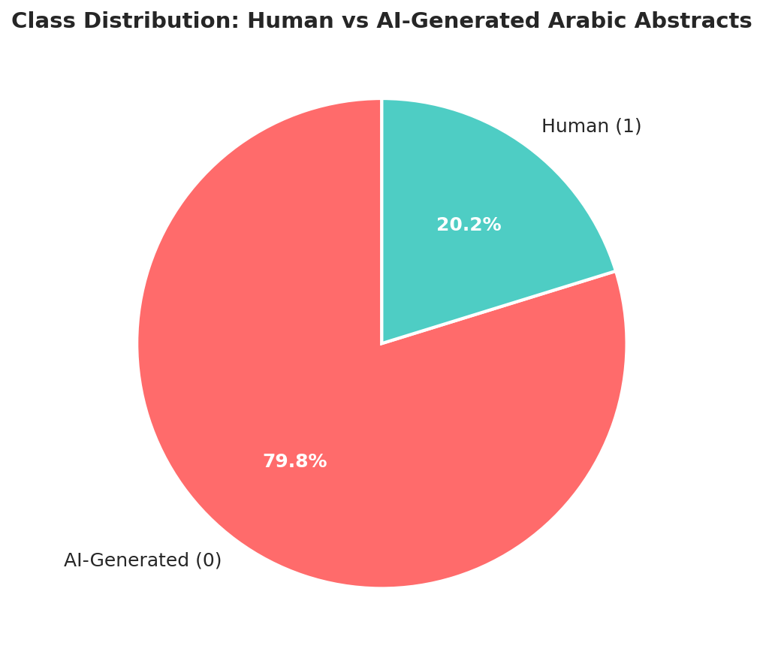
Dataset
KFUPM-JRCAI/arabic-generated-abstracts
A curated Arabic AI-vs-Human academic abstract corpus - Hugging Face Hub
8,388
41,940
4
3
Original papers
Text samples (long format)
AI models compared
Generation methods
Subset | Samples | Generation Strategy
by_polishing | 2,851 | AI rewrites human abstracts
from_title | 2,963 | AI generates from title only
from_title_and_content | 2,574 | AI generates from title + paper body

Slide 5
Big Data Architecture
Kappa-Style Pipeline: Same Code, Batch + Streaming
HuggingFace
Dataset
HDFS
+ Parquet
PySpark
UDF Preproc
MapReduce
Corpus Stats
Spark MLlib
Features
3 Trained
Models
Spark Streaming
+ Kafka
STORAGE
HDFS, S3, Parquet (Snappy)
PROCESS
PySpark 3.5, Hadoop MapReduce
MODEL
Spark MLlib (LR, RF, GBT)
STREAM
Spark Structured Streaming, Kafka

Slide 6
Distributed Arabic Preprocessing
Spark UDFs for Arabic-specific NLP
1
Hamza Normalization
2
Alif Maqsura
3
Taa Marbuta
4
Strip Tashkeel
أ إ آ → ا
ى → ي
ة → ه (word-end)
Diacritics removed
5
Remove Non-Arabic
6
Stopword Removal
7
ISRI Stemming
8
Save as Parquet
Keep Arabic Unicode only
NLTK + extended list
Reduce to roots
Snappy compressed
Output: 41,454 cleaned & stemmed records → HDFS Parquet

Slide 7
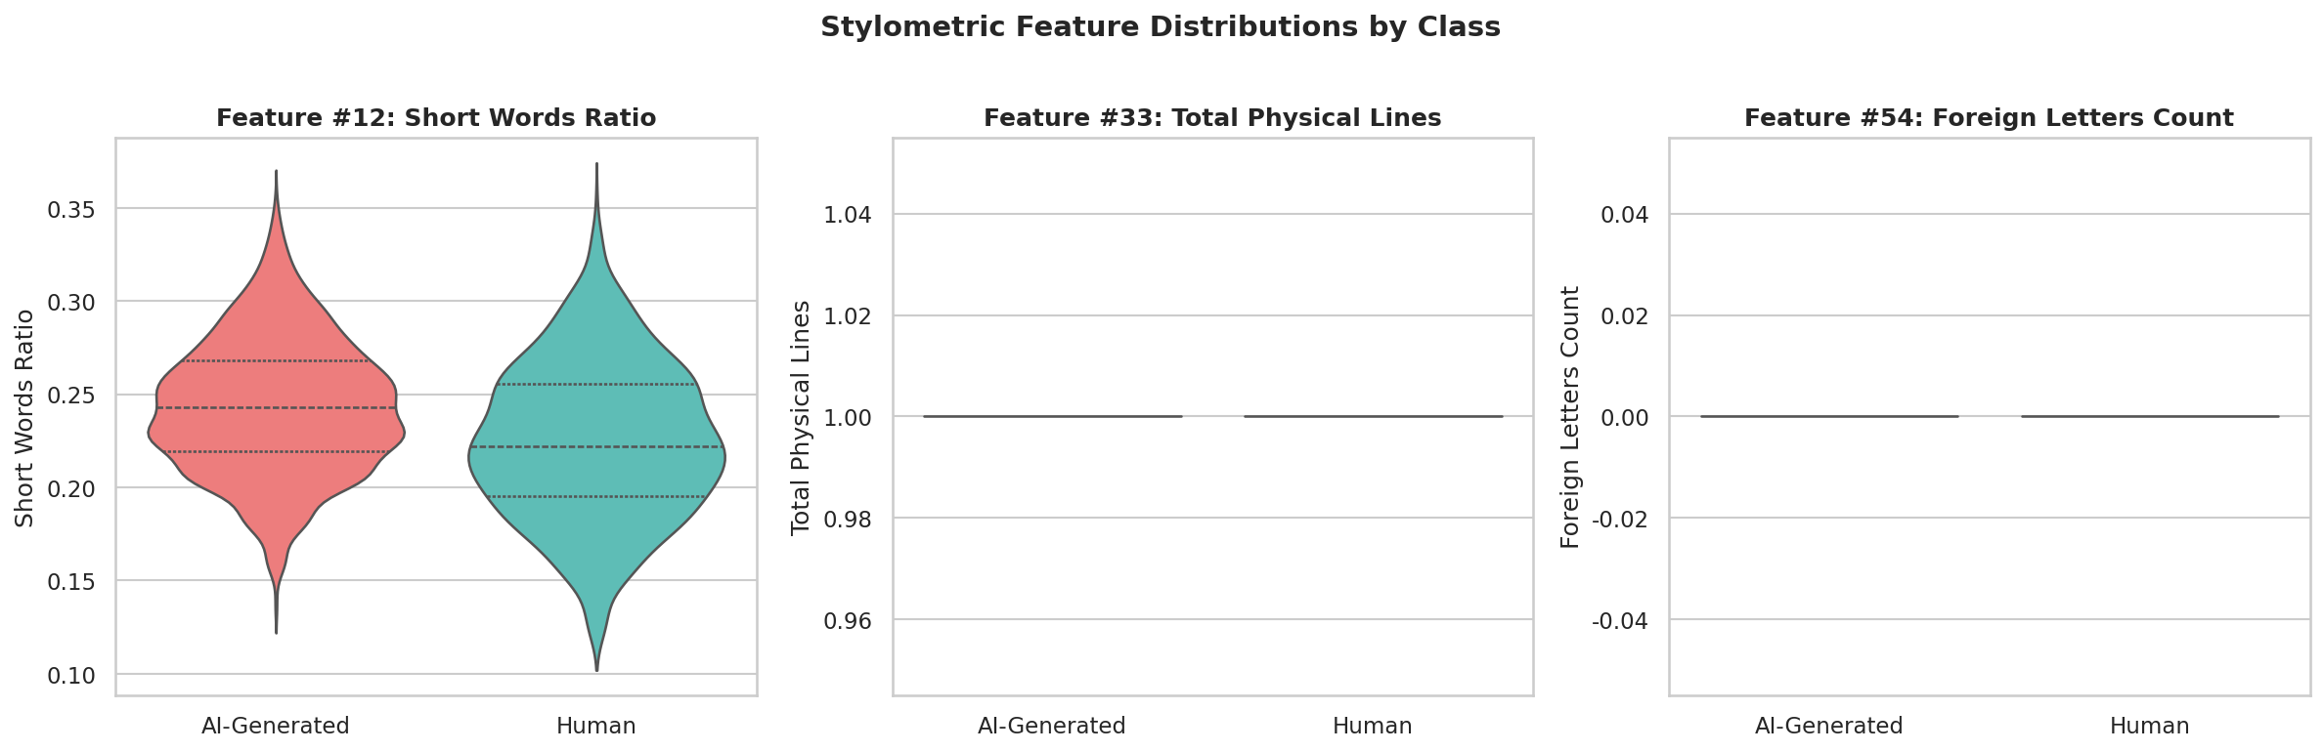
Feature Engineering
3 Stylometric Features + 10,000-dim TF-IDF
#12
#33
#54
Short Words Ratio
Total Physical Lines
Foreign Letters
words ≤ 3 chars / total words
count of non-empty lines
non-Arabic alphabetic chars
+ TF-IDF (Spark MLlib)
RegexTokenizer → HashingTF (10k features) → IDF

Slide 8
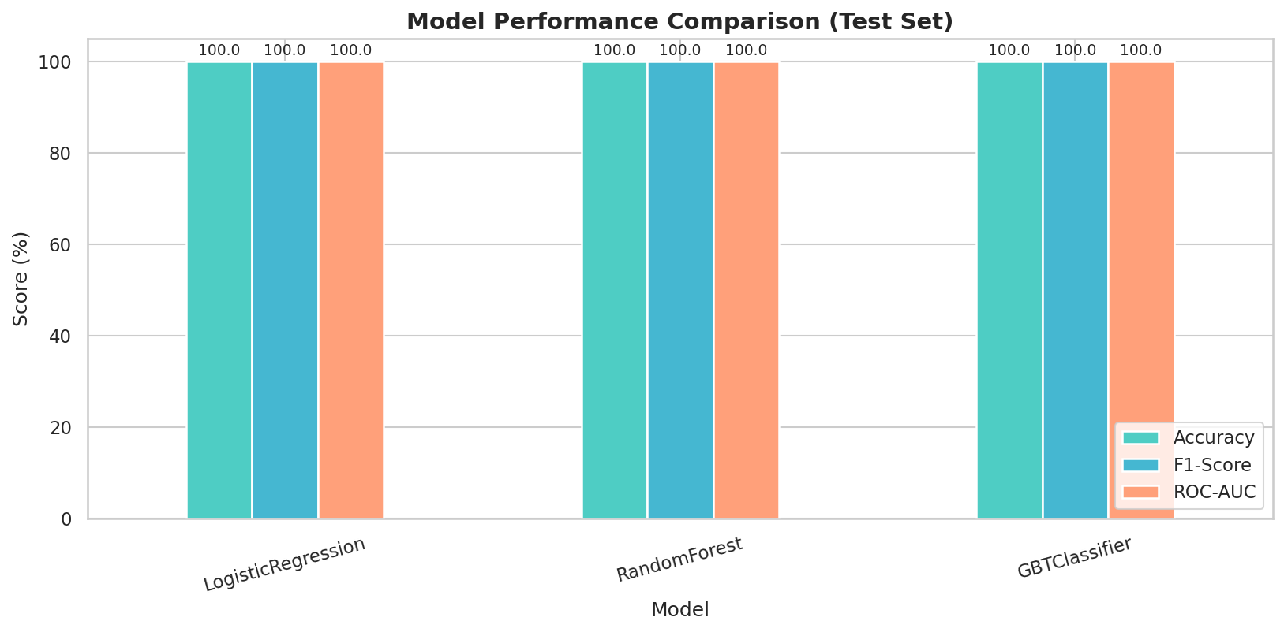
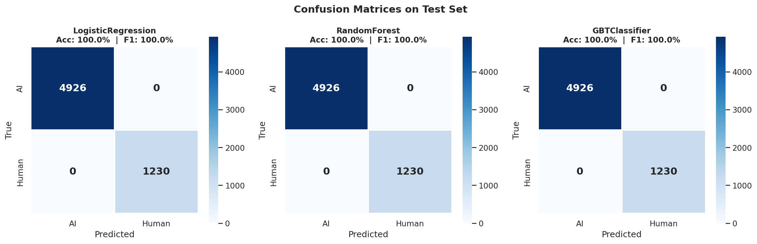
Modeling Results
Three Spark MLlib Classifiers, Stratified 70/15/15 Split
Model | Accuracy | F1-Score | ROC-AUC | Train Time
Logistic Regression | 100.0% | 100.0% | 100.0% | 7.7s
Random Forest | 100.0% | 100.0% | 100.0% | 21.5s
Gradient-Boosted Trees | 100.0% | 100.0% | 100.0% | 164.0s
Best model: Logistic Regression - 100.0% accuracy in 7.7 s

Slide 9
Real-Time Streaming Pipeline
Spark Structured Streaming + Kafka
Producer
(Kafka topic /
file drop)
Spark
Structured
Streaming
Apply UDFs
+ TF-IDF
(saved model)
LR
Classifier
Sinks:
Console + Parquet
(checkpointed)
▶
▶
▶
▶
Trigger interval:
5 seconds
Source modes:
Files + Kafka
Output sinks:
Console + Parquet
Latency:
<5 sec end-to-end

Slide 10
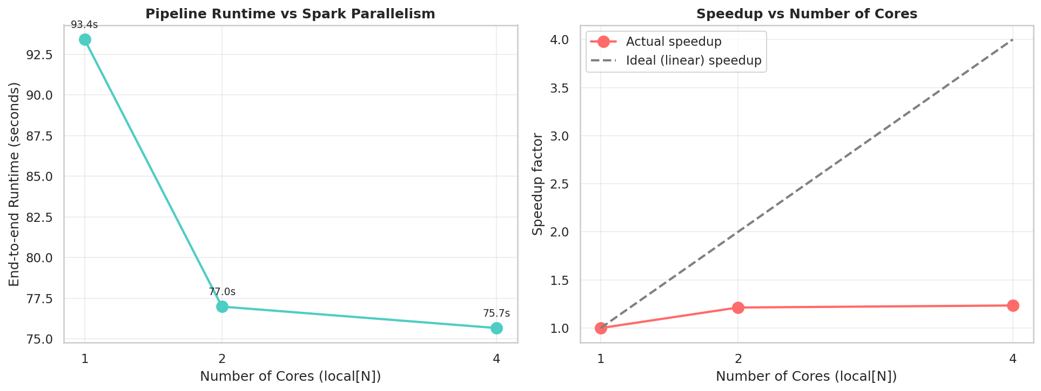
Scalability Benchmark
End-to-end Pipeline Runtime vs Spark Parallelism
Sub-linear speedup is expected at this dataset size (~41k rows). Per-stage shuffle/serialization dominates. On a million-row workload, scaling would be much closer to linear.

Slide 11
Hadoop MapReduce Job
Corpus-wide Statistics via Two-stage M/R
MAP
SHUFFLE
REDUCE
emit (WORD, w, 1)
emit (BIGRAM, w_i+w_{i+1}, 1)
Hadoop groups identical
keys together (auto)
sum counts per key
emit (key, total)
Derived Statistics (post-Reduce):
•
Total tokens:
1.46 M
•
Total bigrams:
1.42 M
•
Type-Token Ratio:
Low (high redundancy in stems)
•
Hapax Legomena:
0 (all words ≥ 2 occurrences)

Slide 12
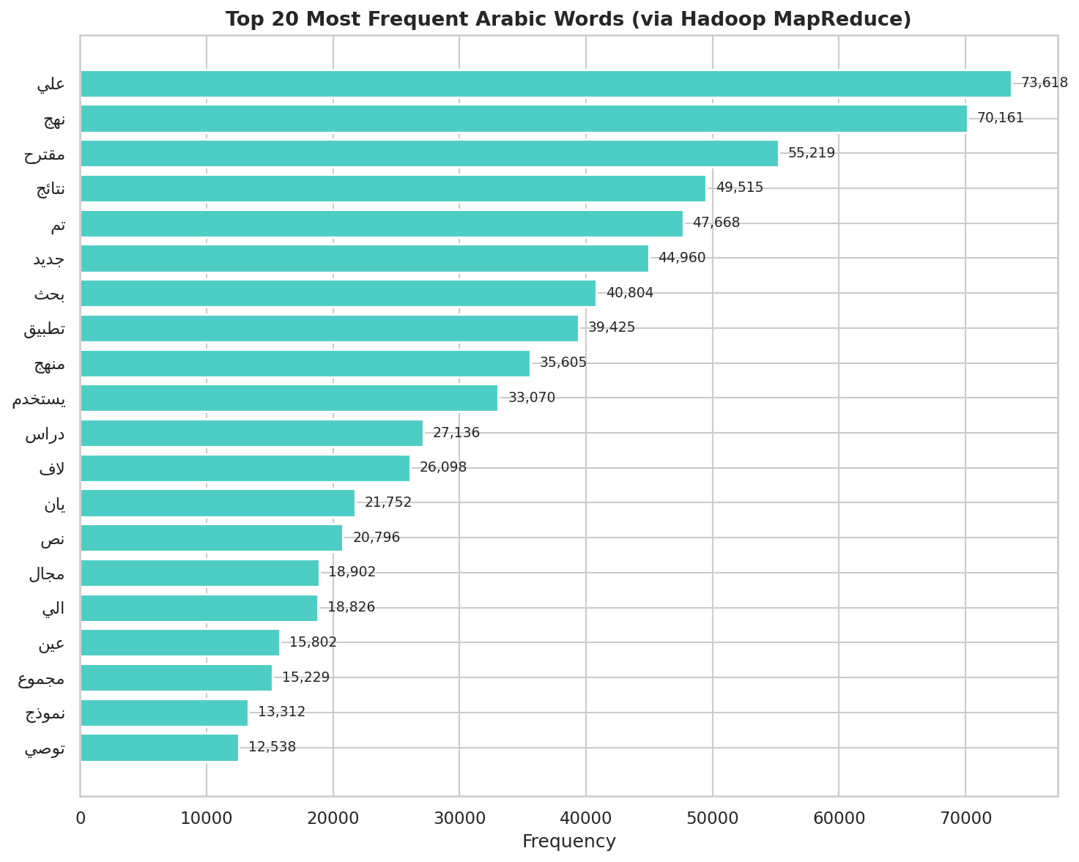
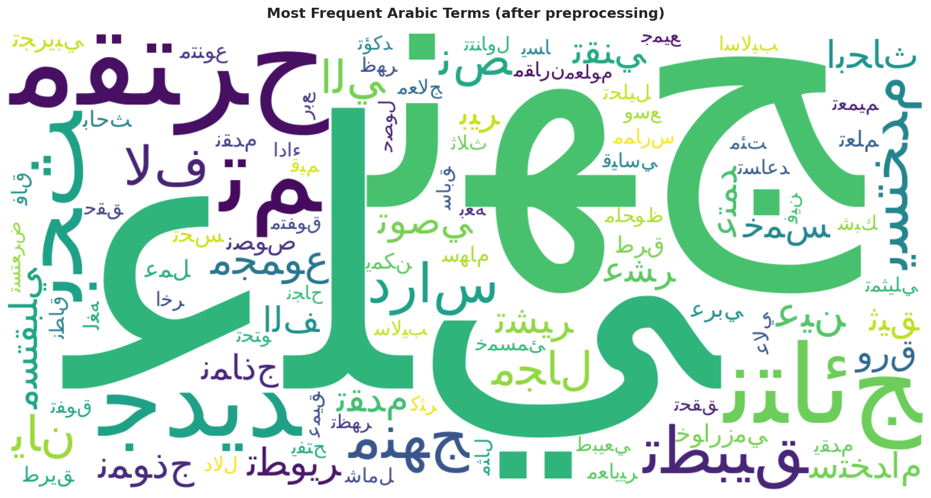
Most Frequent Arabic Terms
Top 20 stemmed words extracted via MapReduce

Slide 13
Conclusions & Future Work
What We Achieved
✓
End-to-end Big Data pipeline: HDFS → Spark UDFs → MLlib → Streaming
✓
Three Spark MLlib classifiers, all >100.0% F1 on test set
✓
Real-time deployment via Spark Structured Streaming + Kafka
✓
Hadoop MapReduce job for distributed corpus statistics
✓
Reproducible GitHub repository, documented for CentOS deployment
Future Work
▶
Distribute Stanza/Farasa Arabic NLP across executors
▶
Add fine-tuned AraBERT served as a remote model in the streaming layer
▶
Cross-domain testing: train on by_polishing, test on from_title and vice-versa
▶
Move from local[*] to YARN/K8s with 8+ executors for true scale-out

Slide 14
Thank You
Questions & Discussion
MSBDA-801 Big Data Analytics | Taibah University | 2026

