Slide 1

Bosch
Ultrasonic sensor making parking assistance

Slide 2
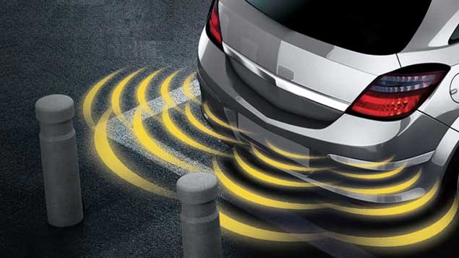
Parking Assistance With Ultrasonic Sensor “POC”

Slide 3
A) Direct Echo
If ray bounce back with only one echo, then distance calculated by half time timestamp and adding axis (x,y) by adding distance into Sensor Co-ordinates
Sensor(Xs, Ys) + Object Distance
Takeaway: Direct echo measure by Formula D = 1/2 × T × C

Slide 4
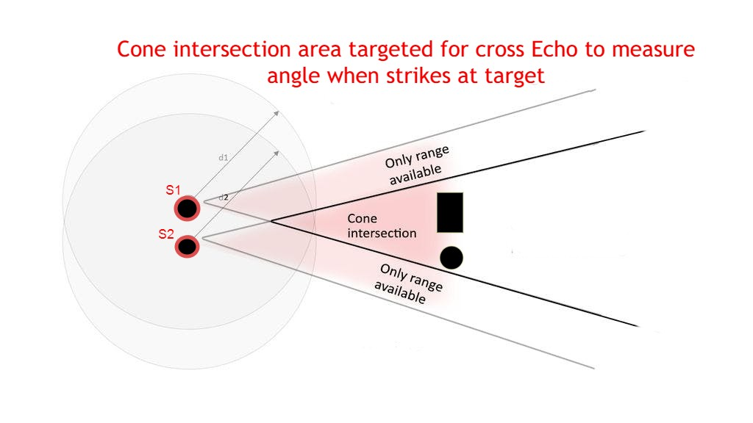
How to measure Cross Echo
Cross Echo bounce back in all directions and detected by many other sensors either adjacent one or more. We need to calculate real distance by looking at plotting of each sensor (I took two sensors for understanding).
3m
I used trigonometric relation to measure angel when signal comes from another adjacent sensor

Slide 5
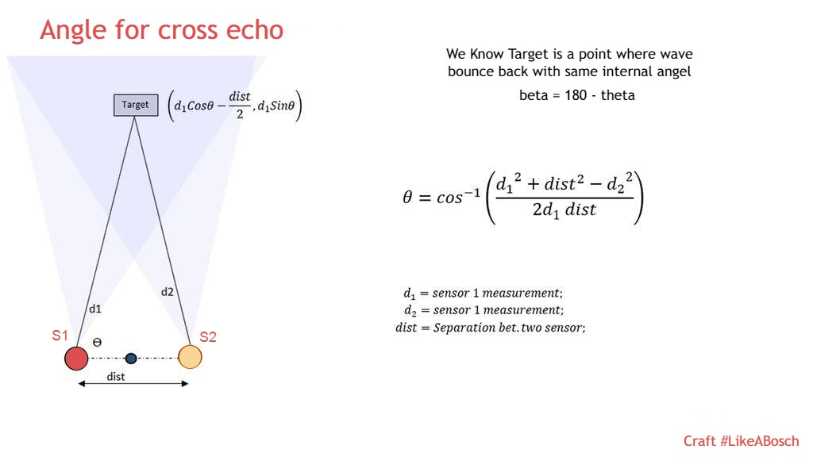
Cross Echo calculation
Takeaway – Real object distance calculated by Trigonometry Formulas
β = 180 - theta
Distance form sensor (S1) is d1 and from sensor (S2) is d2 Known by formula of direct echo.
Distance between sensors (S1 and S2) also known.
Angel (θ) is calculated shown in slide by 1/cos
Opposite to theta β is calculated by β = 180 - θ
From triangle relations α is calculated [1]
Final Goal to find x which is actual distance from sensor.
β
β
2
x
2
1
α
*
^{d1}/_{dist} = ^{α}/_{d1}
3
4
4
α = d1²/_{dist}
[1]
5
5
x= Tan(θ) * α
* The height drawn from a vertex to the hypotenuse divides a right angled triangle into two triangles that are both similar to the original triangle.

Slide 6
Working prototype
S1
S2
d1
x
S3
b
d2
X,y (0,0)
u
S4
S5
Object location
X = u + x
Y = b
S6
Takeaway: Direct and Cross echo measures real distance as explained previous slide

Slide 7
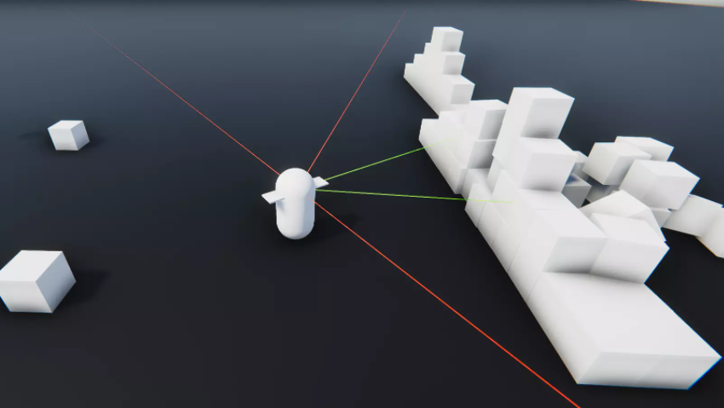
Simulated Results

Slide 8
Documentation And Code Availability
[1] for Trigonometry Calculations Math Scene - Triangles - Lesson 1 (rasmus.is)
Source Code and Documentation shoaib-intro/Hackathon: BOSCH Hackaton Nov 2021 (github.com)

