Slide 1
Chapter 3:
Modeling Data in the Organization
Modern Database Management
6th Edition
Jeffrey A. Hoffer, Mary B. Prescott, Fred R. McFadden

Slide 2
SDLC Revisited – Data Modeling is an Analysis Activity
(figures 2.4, 2.5)
Project Identification
and Selection
Purpose –thorough analysis
Deliverable – functional system specifications
Project Initiation
and Planning
Analysis
Logical Design
Physical Design
Database activity –
conceptual data modeling
Implementation
Maintenance

Slide 3
Business Rules
Statements that define or constrain some aspect of the business
Assert business structure
Control/influence business behavior
Expressed in terms familiar to end users
Automated through DBMS software

Slide 4
A Good Business Rule is:
Declarative – what, not how
Precise – clear, agreed-upon meaning
Atomic – one statement
Consistent – internally and externally
Expressible – structured, natural language
Distinct – non-redundant
Business-oriented – understood by business people

Slide 5
E-R Model Constructs
Entity instance - person, place, object, event, concept (often corresponds to a row in a table)
  Entity Type – collection of entities (often corresponds to a table)
Attribute - property or characteristic of an entity type (often corresponds to a field in a table)
Relationship instance – link between entities (corresponds to primary key-foreign key equivalencies in related tables)
  Relationship type – category of relationship…link between entity types
Notes:
2

Slide 6
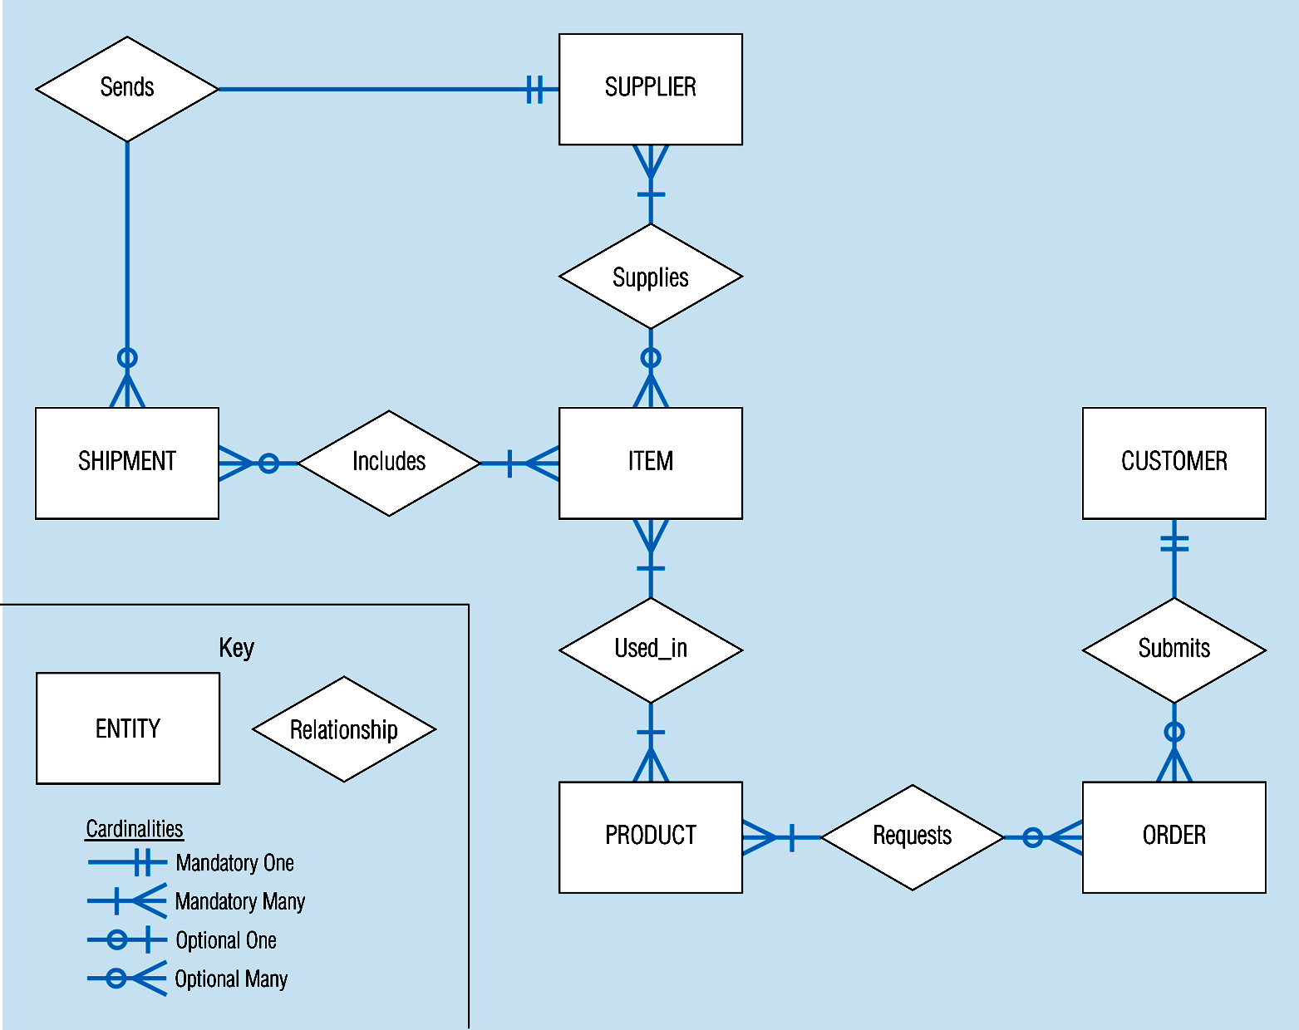
Sample E-R Diagram (figure 3-1)
Notes:
3

Slide 7
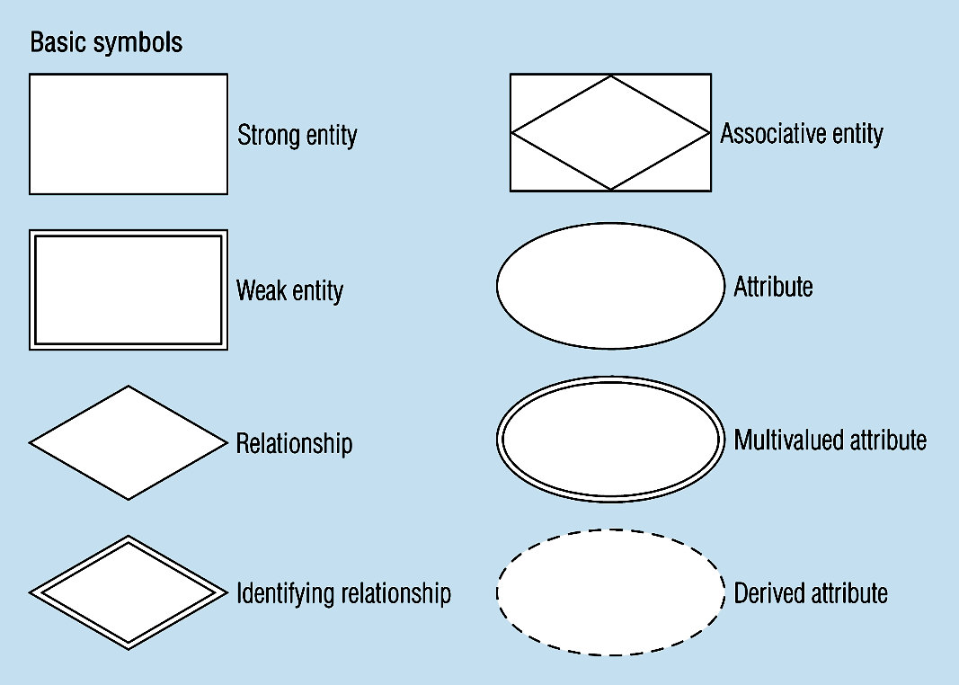
Figure 3-2 -- Basic E-R Notation
A special entity that is also a relationship
Entity symbols
Attribute symbols
Relationship symbols
Notes:
8

Slide 8
What Should an Entity Be?
SHOULD BE:
  An object that will have many instances in the database
  An object that will be composed of multiple attributes
  An object that we are trying to model
SHOULD NOT BE:
  A user of the database system
  An output of the database system (e.g. a report)

Slide 9
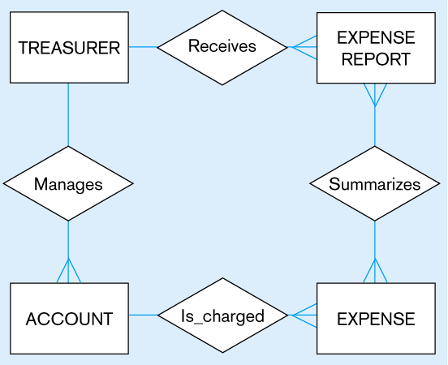
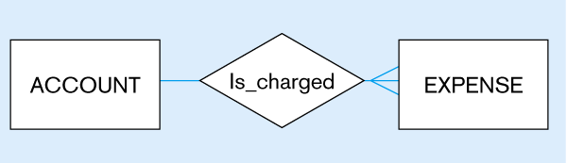
Figure 3-4
Inappropriate entities
System user
System output
Appropriate entities

Slide 10
Attributes
Attribute - property or characteristic of an entity type
Classifications of attributes:
  Simple versus Composite Attribute
  Single-Valued versus Multivalued Attribute
  Stored versus Derived Attributes
  Identifier Attributes
Notes:
5

Slide 11
Identifiers (Keys)
Identifier (Key) - An attribute (or combination of attributes) that uniquely identifies individual instances of an entity type
Simple Key versus Composite Key
Candidate Key – an attribute that could be a key…satisfies the requirements for being a key
Notes:
6

Slide 12
Characteristics of Identifiers
Will not change in value
Will not be null
No intelligent identifiers (e.g. containing locations or people that might change)
Substitute new, simple keys for long, composite keys
Notes:
7

Slide 13
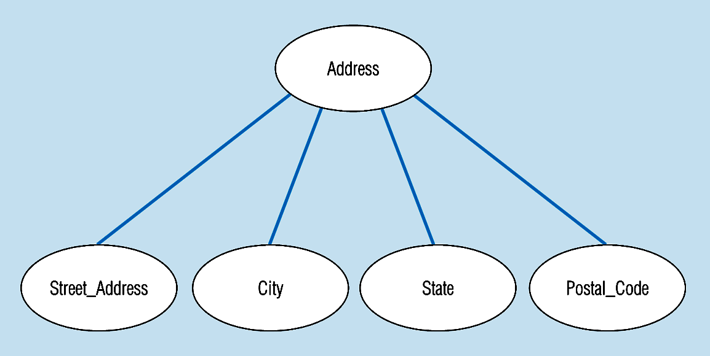
Figure 3-7 -- A composite attribute
An attribute broken into component parts
Notes:
12

Slide 14

Figure 3-9a – Simple key attribute
The key is underlined
Notes:
14

Slide 15
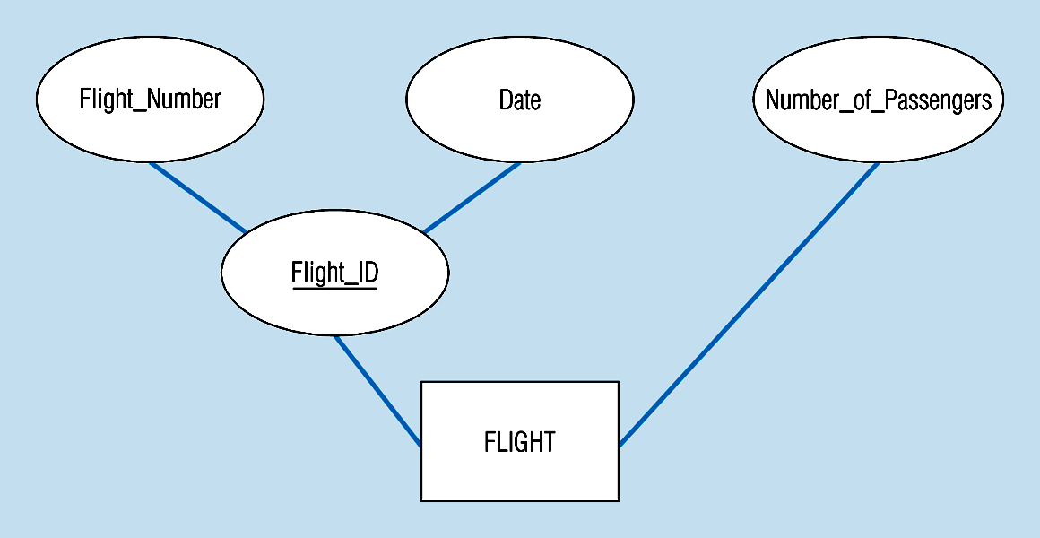
Figure 3-9b -- Composite key attribute
The key is composed
of two subparts
Notes:
15

Slide 16
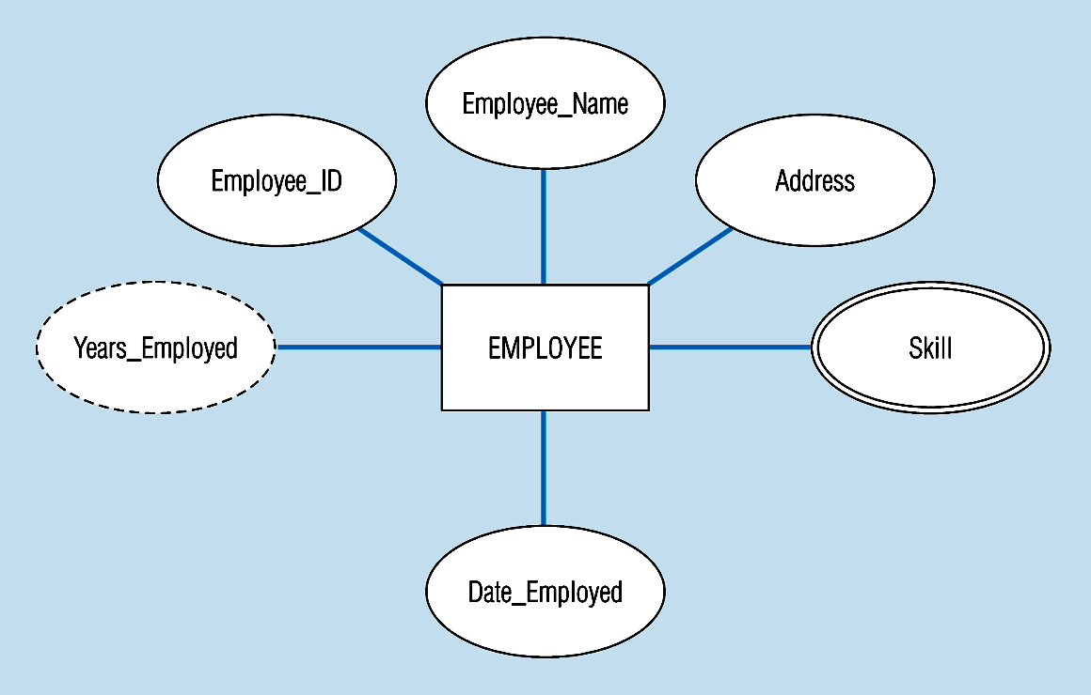
Figure 3-8 -- Entity with a multivalued attribute (Skill) and derived attribute (Years_Employed)
What’s wrong with this?
Multivalued:
an employee can have
more than one skill
Derived
from date employed and current date
Notes:
13

Slide 17
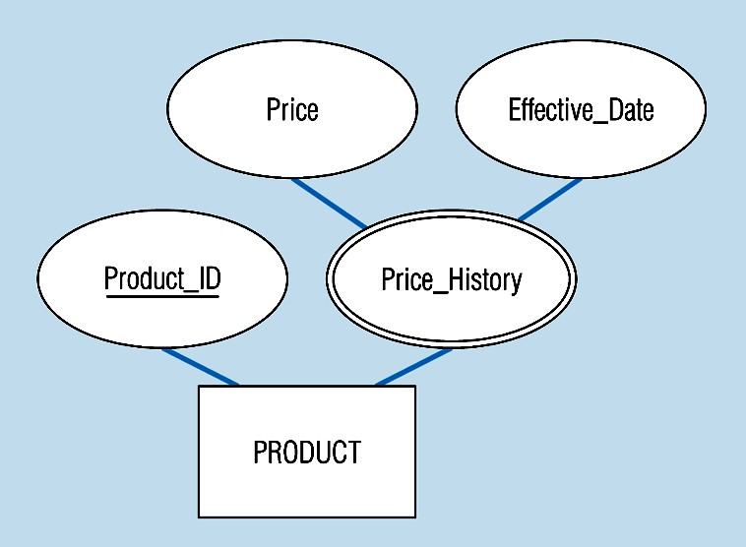
Figure 3-19 – an attribute that is both multivalued and composite
This is an example of time-stamping
Notes:
37

Slide 18
More on Relationships
Relationship Types vs. Relationship Instances
  The relationship type is modeled as the diamond and lines between entity types…the instance is between specific entity instances
Relationships can have attributes
  These describe features pertaining to the association between the entities in the relationship
Two entities can have more than one type of relationship between them (multiple relationships)
Associative Entity = combination of relationship and entity
  More on this later

Slide 19
Degree of Relationships
Degree of a Relationship is the number of entity types that participate in it
  Unary Relationship
  Binary Relationship
  Ternary Relationship
Notes:
16

Slide 20
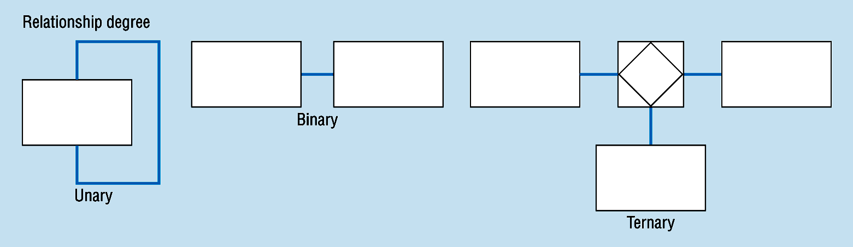
Degree of relationships – from figure 3-2
One entity related to another of the same entity type
Entities of two different types related to each other
Entities of three different types related to each other
Notes:
8

Slide 21
Cardinality of Relationships
One – to – One
  Each entity in the relationship will have exactly one related entity
One – to – Many
  An entity on one side of the relationship can have many related entities, but an entity on the other side will have a maximum of one related entity
Many – to – Many
  Entities on both sides of the relationship can have many related entities on the other side

Slide 22
Cardinality Constraints
Cardinality Constraints - the number of instances of one entity that can or must be associated with each instance of another entity.
Minimum Cardinality
  If zero, then optional
  If one or more, then mandatory
Maximum Cardinality
  The maximum number
Notes:
29

Slide 23
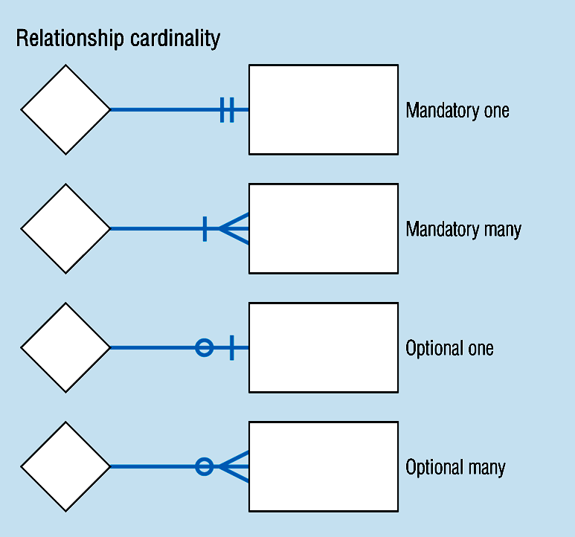
Cardinality – figure 3-2
Notes:
8

Slide 24
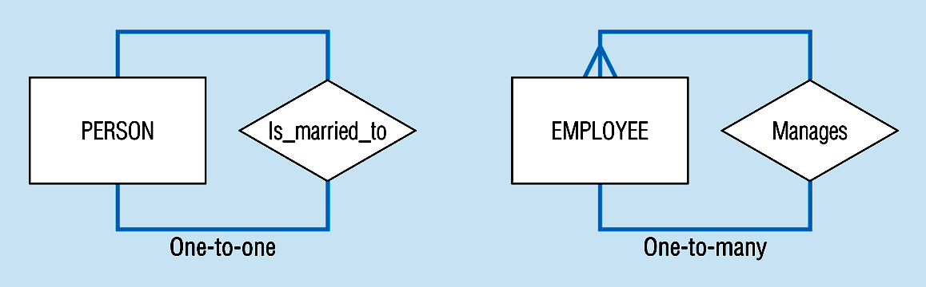
Unary relationships -- figure 3-12a
Notes:
22

Slide 25
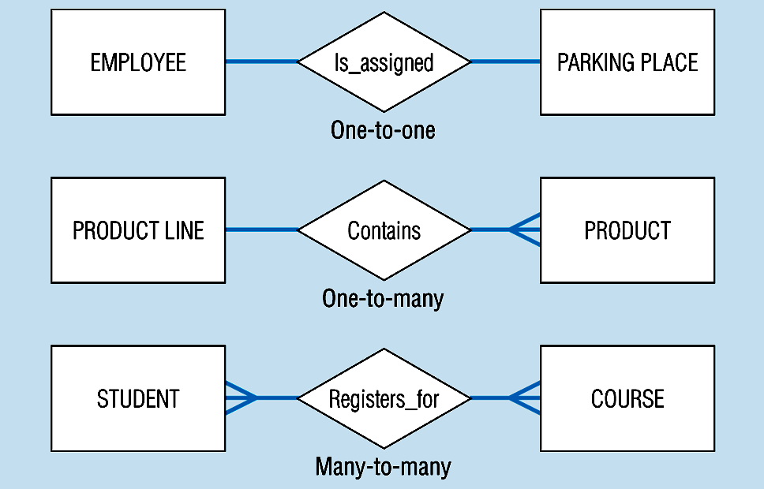
Binary relationships – figure 3-12b
Notes:
23

Slide 26
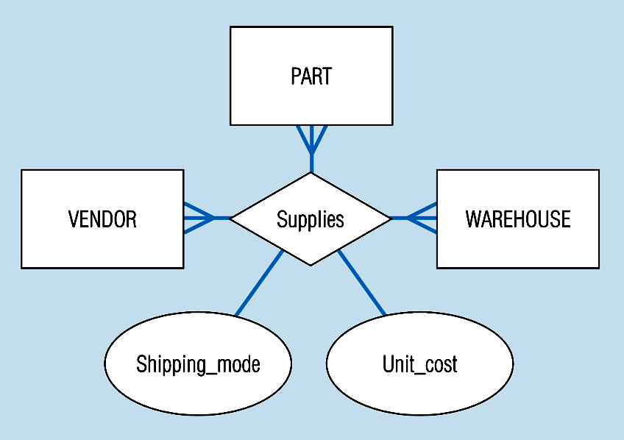
Ternary relationships –figure 3-12c
Note: a relationship can have attributes of its own
Notes:
24

Slide 27
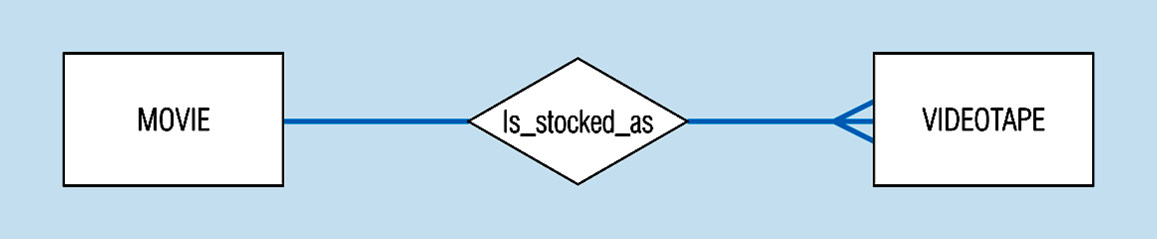
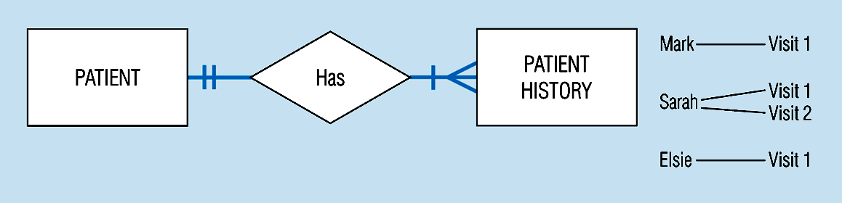
Basic relationship with only maximum cardinalities showing –
figure 3-16a
Mandatory minimum cardinalities – figure 3-17a
Notes:
1

Slide 28
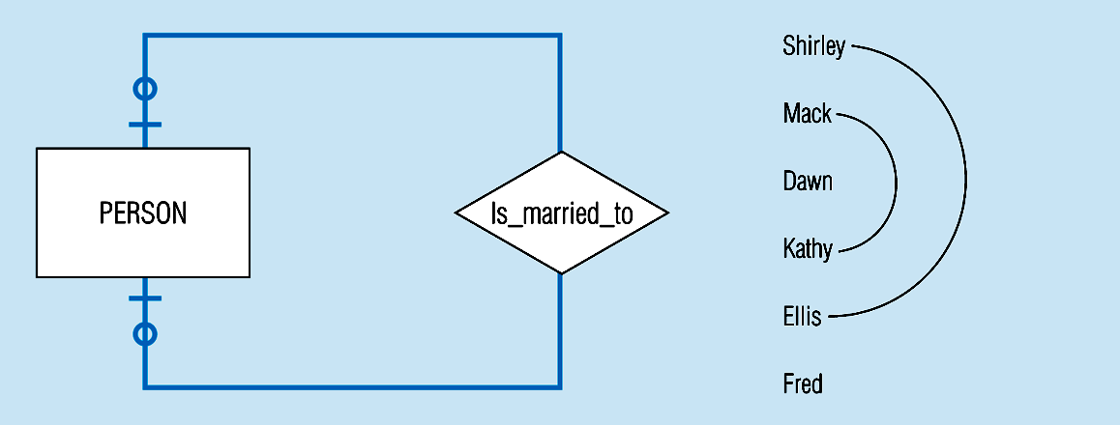
Figure 3-17c
Optional cardinalities with unary degree, one-to-one relationship
Notes:
34

Slide 29
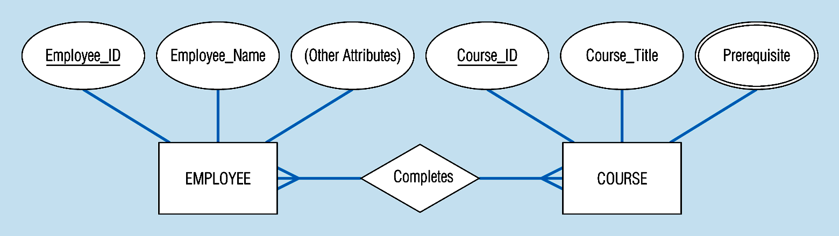
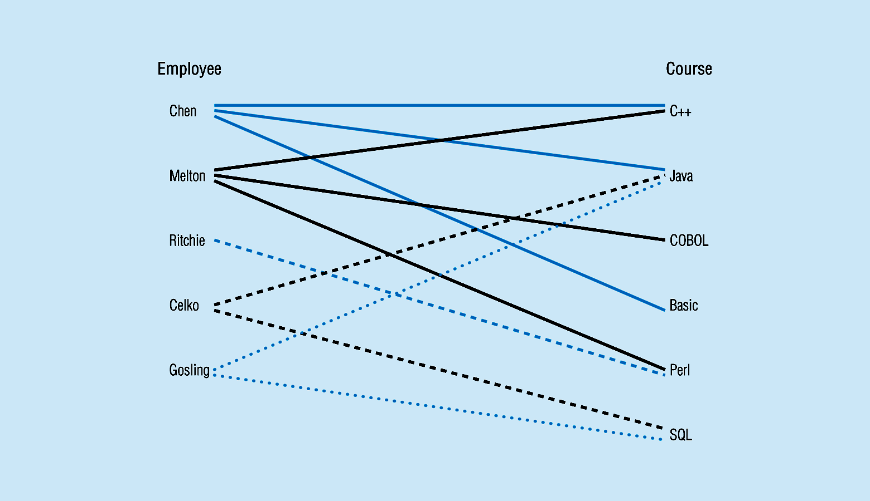
Figure 3-10a Relationship type
3-10b Entity and Relationship instances
Notes:
17

Slide 30
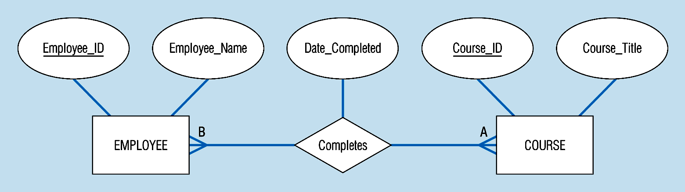
Figure 3-11a A binary relationship with an attribute
Here, the date completed attribute pertains specifically to the employee’s completion of a course…it is an attribute of the relationship
Notes:
20

Slide 31
Figure 3-12c -- A ternary relationship with attributes
Notes:
24

Slide 32
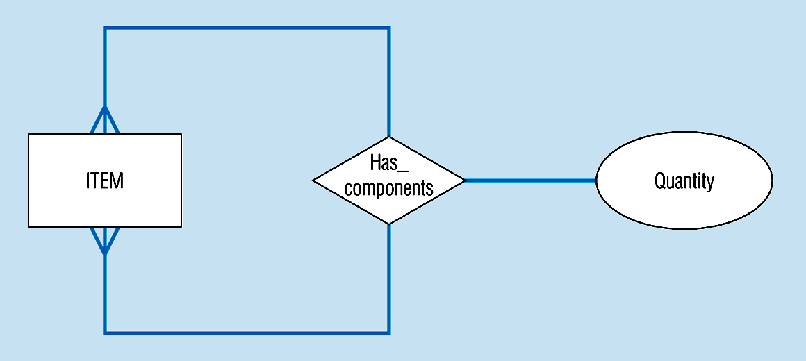
Figure 3-13a A unary relationship with an attribute. This has a many-to-many relationship
Representing a bill-of -materials structure
Notes:
25

Slide 33
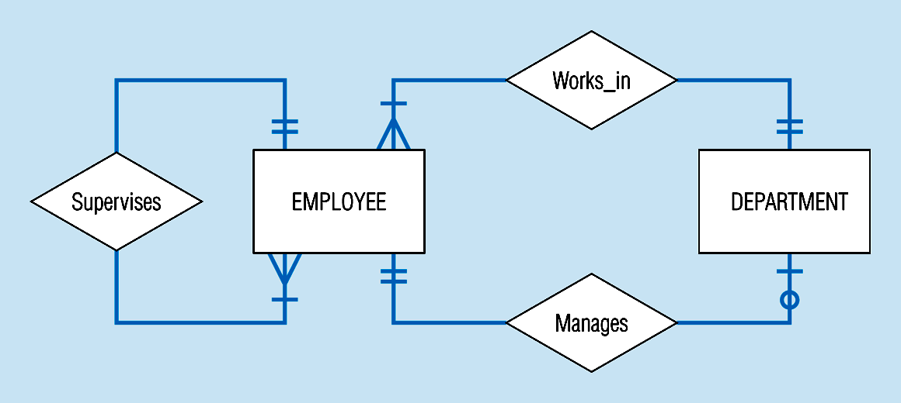
Examples of multiple relationships – entities can be related to one another in more than one way
Figure 3-21a Employees and departments
Notes:
40

Slide 34
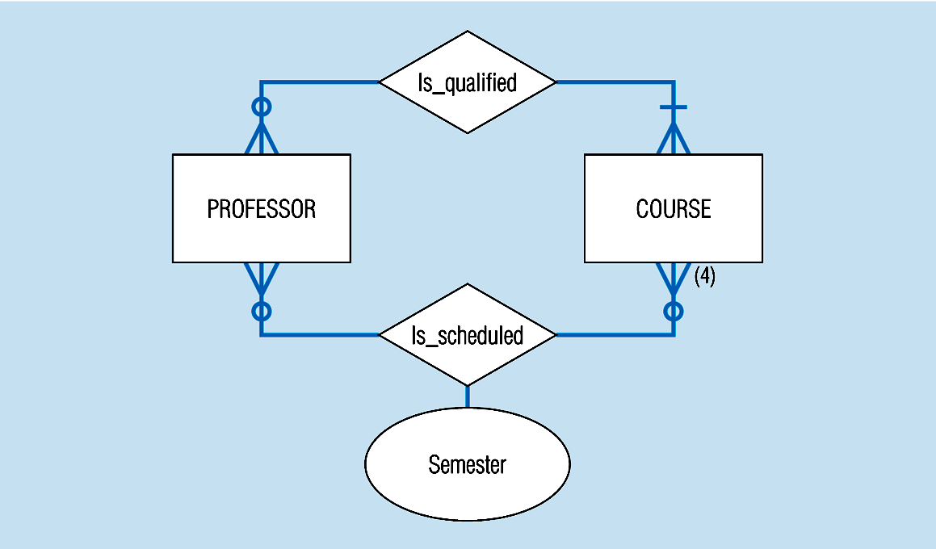
Figure 3-21b -- Professors and courses (fixed upon constraint)
Here,max cardinality constraint is 4
Notes:
41

Slide 35
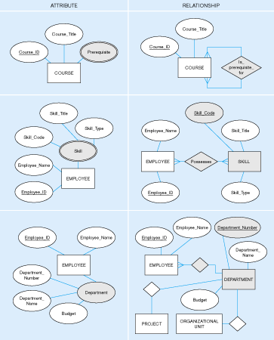
Figure 3-15: Multivalued attribute vs. relationship. Alternative approaches

Slide 36
Strong vs. Weak Entities, and
Identifying Relationships
Strong entities
  exist independently of other types of entities
  has its own unique identifier
  represented with single-line rectangle
Weak entity
  dependent on a strong entity…cannot exist on its own
  Does not have a unique identifier
  represented with double-line rectangle
Identifying relationship
  links strong entities to weak entities
  represented with double line diamond

Slide 37
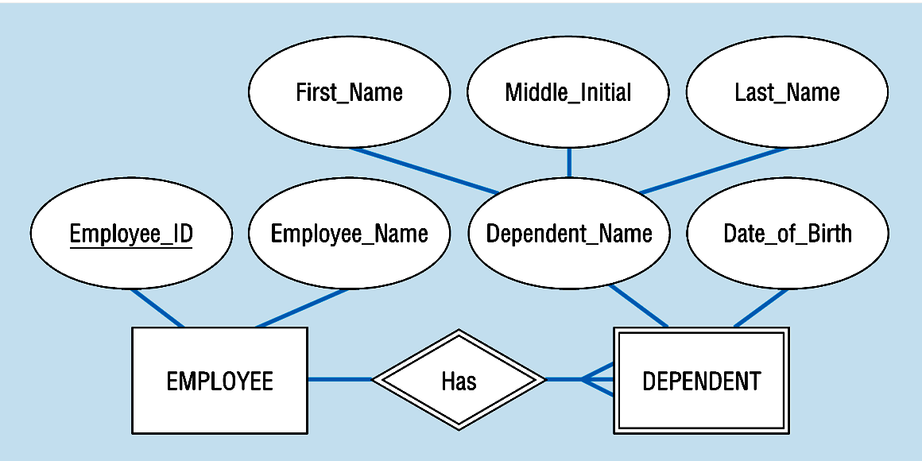
Figure 3-5: Strong and weak entities
Strong entity
Identifying relationship
Weak entity

Slide 38
Associative Entities
It’s an entity – it has attributes
AND it’s a relationship – it links entities together
When should a relationship with attributes instead be an associative entity?
  All relationships for the associative entity should be many
  The associative entity could have meaning independent of the other entities
  The associative entity preferably has a unique identifier, and should also have other attributes
  The associative may be participating in other relationships other than the entities of the associated relationship
  Ternary relationships should be converted to associative entities (p102)

Slide 39
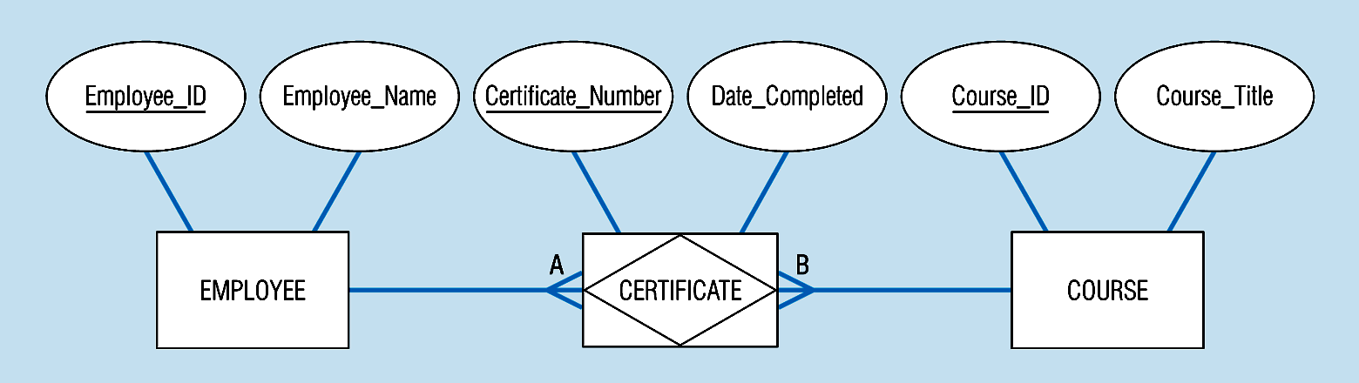
Figure 3-11b: An associative entity (CERTIFICATE)
Associative entity involves a rectangle with a diamond inside.
Note that the many-to-many cardinality symbols face toward the associative entity and not toward the other entities
Notes:
21

Slide 40
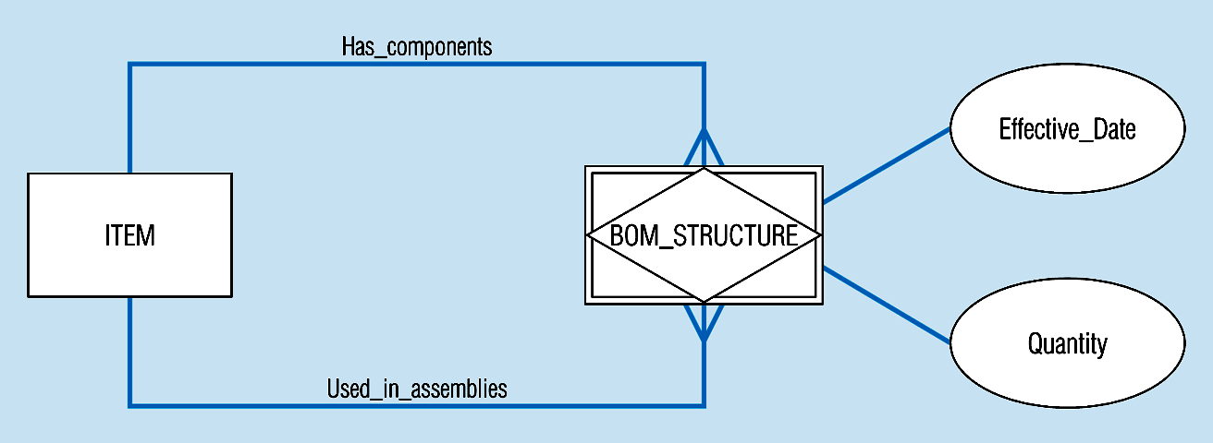
Figure 3-13c -- an associative entity – bill of materials structure
This could just be a relationship with attributes…it’s a judgment call
Notes:
27

Slide 41
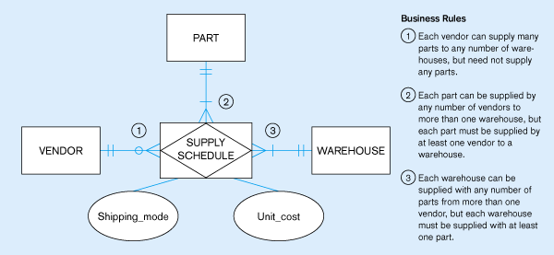
Figure 3.18 -- Ternary relationship as an associative entity
Notes:
36

Slide 42
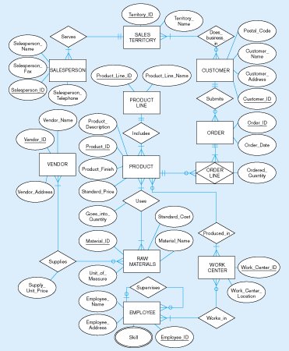
Figure 3-22
E-R diagram for Pine Valley Furniture

