Slide 1
Lecture 2
Introduction to RDBMS and Relational Model - 1
Wednesday, August 29, 2001

Slide 2
Relational Database Management System (RDBMS)
Recall: Database Management System (DBMS)
DBMS is an application, which holds user data permanently and then provide different operations on this data e.g., retrieval of data, insertion of data, updation of data etc.
It is a computerized system whose overall purpose is to maintain information and to make that information available on demand.
RDBMS is an enhancement to DBMS. It is a system in which:
  The data is perceived by the user as tables; and
  The operators (or operations) at the user's disposal include atleast RESTRICT (SELECT), PROJECT and JOIN.
Relational Database:
  A database in which data is perceived as tables

Slide 3
The Relational Model
It is a prescription for a way of representing data by means of tables and a prescription for a way of manipulating such a representation using some operators.
It is an abstract theory of data that is based on certain aspects of mathematics like set theory and predicate logic.
The principles of relational model were originally laid down in 1969-70 by Dr. E.F.Codd.

Slide 4
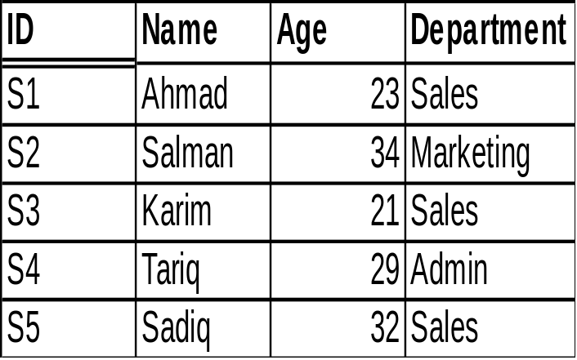
Terms in Relational Model
Relation
Tuple, Attribute
Cardianlity, Degree
Domain
Employee Relation
attributes
tuples
Cardinality
Degree

Slide 5
Important terms and definitions
Scalar values (Atomic)
  at every row and column position in every table there is always exaclty one data value
Repeating Group
A repeating group is a column, or combination of columns that contain several data values in each row
ID
Name
Age
Max.Marks
Marks
  RDBMS does not allow repeating groups
Optimazation
  a system component that determine how to implement user requests
Catalog
  set of system tables

Slide 6
Part and Types of Relation
Parts of Relation
  heading
  fixed set of attributes
  body
  set of tuples
Named Relation
  defined in dbms
Base Relation
  an autonomous named relation
Derived Relation
  a relation consists of part of named relations or base relations
View
    a named derived relation with no physical existence
Snapshot
    a named derived relation with physical existence

Slide 7
Properties of Relations
There are no duplicate Tuples
Tuples are unordered
Attributes are unordered
All attributes have atomic values

Slide 8
Assignment # 1
Explain the following terms:
Concurrent Access, data administration, database, database system, DBA, integration, integrity, persistent data, redundancy, security, sharing, data dictionary, distributed database, DDL, DML

