Slide 1
Lecture 6
Introduction to Relational Algebra - 3

Slide 2
Some more about Relational Operators
Primitive Operators
  Union, Difference, Product, Restriction and Projection
Type Compatible Relations / UNION Compatible
Three more operators
  RENAME
  SUMMARIZE
  EXTEND

Slide 3
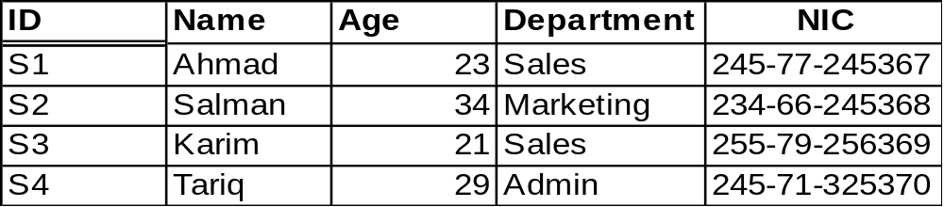
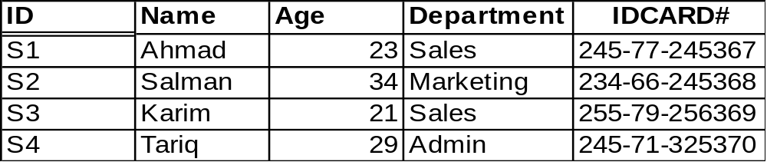
Special Operators
RENAME
  it takes a relation A and conceptually, atleast returns a new copy of that relation in which some attributes has been given a new name.
  Written as A RENAME X AS Y where X is an attribute name in A
  its purpose is basically to rename attributes within a specified relation
A
A RENAME NIC AS IDCARD#

Slide 4
Special Relational Operators
EXTEND
  takes a specified realtion Aand conceptually, atleast makes a new relation that is similar to the original relation but includes some additional attributes, values of which are obtained by evaluating some scalar computational expression.
  Written as EXTEND A ADD exp AS Y
  the attributes added in this way can be used for any θ operation.
  It provides a way of incorporating horizontal or row-wise computations.

Slide 5
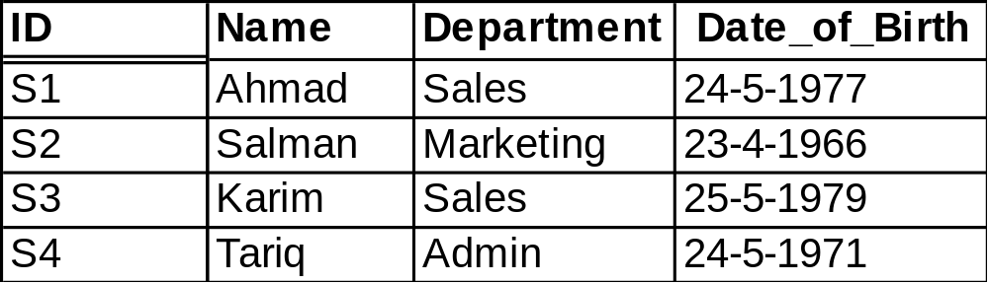
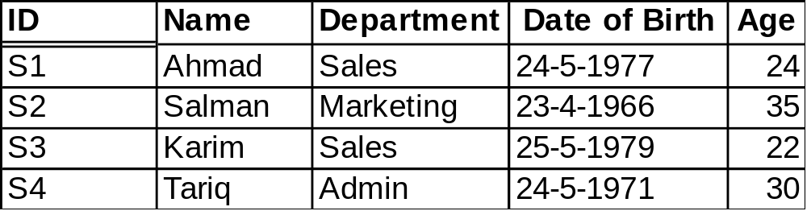
Special Relational Operators
EXTEND
  Returns a relation same as some specified relation but having some extra attributes generated on the basis of some computation.
A
EXTEND A ADD (CURRENTDATE-Date _of_Birth) AS Age

Slide 6
Special Relational Operators
SUMMARIZE
  Let relation A with heading [X,…,Z], then SUMMARIZE A BY (X,..,Y) ADD exp AS M is a relation with heading [X,…,Y,M] and with a body consisting of the set of all tuples that are a projection of A over [X,..,Y], extended with a value for the new attribute M; that new M-value is computed by evaluating the aggregate expression exp on all tuples of A that have the same values for X,..,Y
  It provides a way of incorporating vertical or column-wise computations.

Slide 7
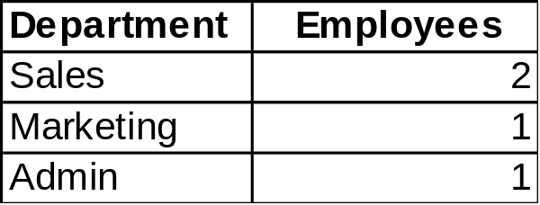
Special Relational Operators
SUMMARIZE
A
SUMMARIZE A BY Department ADD Count AS Employees

Slide 8
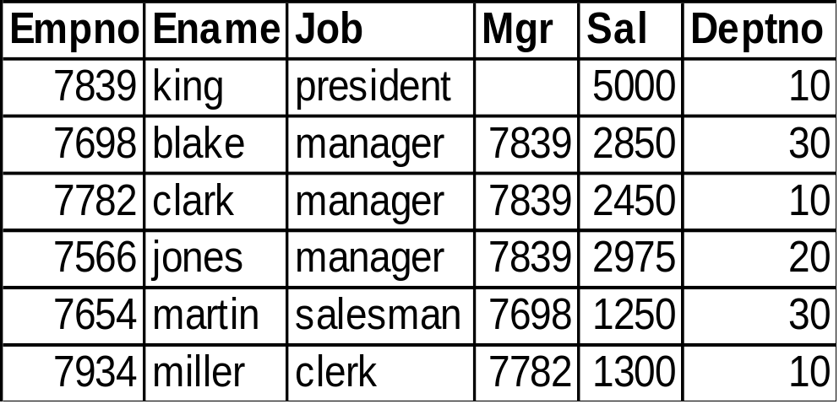
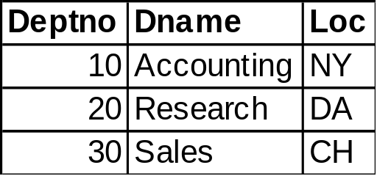
Quiz # 3
Consider relations A and B such that
Find the following:
JOIN A and B over Deptno
θ-JOIN A and B over Deptno where A.Deptno = B.Deptno
Write a statement which results only those tuples from A whose Job is manager and also tell the B.Dname and B.Loc for these tuples.
Write a statement which results A.Ename, B.Dname and B.Loc for those tuples where A.Sal > 2500

