Slide 1


Text-Based Adventure Game
Rungta International Skills University
PS No. 39
Submitted By
Submitted To
Shoaib Akhtar
Mr. Priyanshu
RU ID: RU-26-00647
IBM SME
B.Tech CSE (AI & ML), Semester 1

Slide 2
Introduction
Text-Based Adventure Game is a console project in which the player explores a forest, a cave, and a river through menu choices. The program responds to each choice by changing health or score.
Project objectives
• Organize each place and action with functions.
• Use conditions and loops to control the game.
• Validate input and track health and score.

Slide 3
Project Description & Problem Statement
Create a text-based adventure game where the player chooses between a cave, a river, or quitting. A monster attacks in the cave, treasure is found at the river, and the game ends when the player quits or loses all health.
Game rules
• Start with Health 100 and Score 0.
• Cave: random damage from 10 to 40; surviving earns a key worth 20 points.
• River: find treasure worth 50 points.
• Invalid choices are rejected; health never falls below 0.

Slide 4
Technology & Tools Used
Language and tools
Programming concepts
• Python 3 console application
• Standard library only
• random for monster damage
• unittest for automated tests
• Functions for the Forest, Cave, River, and game loop
• Conditions select actions and check survival
• Loops repeat the menu and validate choices
• Health and score track progress
The test suite contains 14 automated cases, including the four assignment scenarios.

Slide 5
Working of the Project
01
02
03
Get a valid choice
→
Apply the action
→
Continue or finish
Show the Forest menu. Keep asking until the player enters 1, 2, or 3.
Cave: subtract random damage; a survivor gets +20. River: add +50.
Repeat while health is above 0. Quit or reaching 0 health ends the game and shows the final score.
Health is clamped at 0, and the key reward is given only when the player survives.

Slide 6
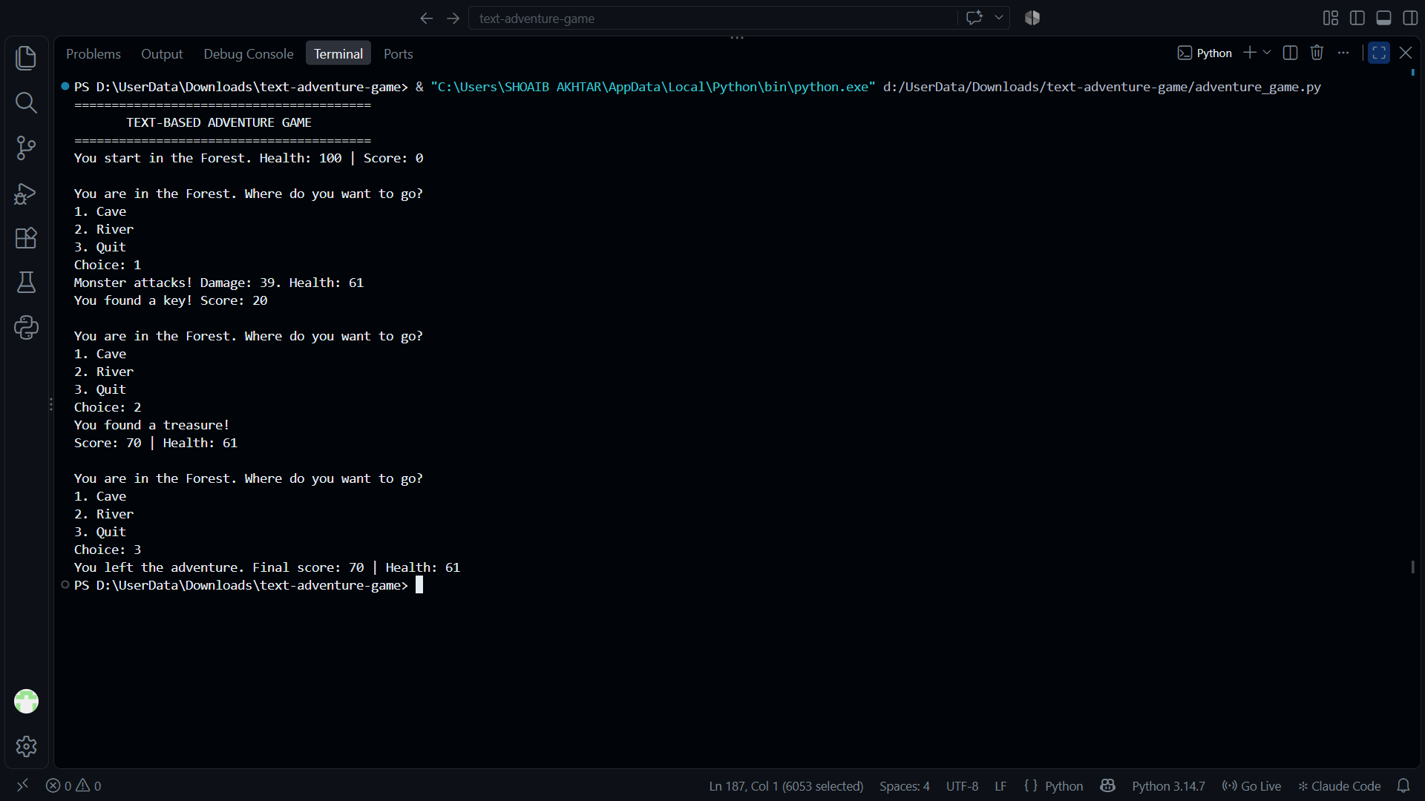
Project Screenshots

Slide 7
Thank You

