Slide 1
TEXT-BASED
ADVENTURE GAME
Project presentation • Problem Solving No. 39
Shoaib Akhtar
B.Tech Computer Science and Engineering
Rungta International Skills University
FOREST → CAVE → RIVER
Notes:
Introduce the project as a small Python console game. The player starts in a forest and chooses between the cave, the river, or quitting. The presentation explains the requirements, code structure, and testing.

Slide 2
Introduction
A console adventure built around repeated choices.
The player explores from a forest menu. Each choice changes the game state: health can fall in the cave, while score can rise in the cave or river.
The game ends when the player quits or health reaches zero.
Project focus
Use basic Python concepts to build a complete interactive program with input, decisions, loops, random events, and clear endings.
02
Notes:
Explain that the game is deliberately small, so its logic is easy to follow. The key programming challenge is keeping the player's health and score consistent as choices repeat.

Slide 3
Problem statement and objectives
Problem statement
Build a playable console game where menu choices trigger different outcomes, invalid input is handled safely, and the player’s health and score are tracked until the game ends.
Objectives
• Present a clear Cave / River / Quit menu
• Apply randomized cave damage and score rewards
• Reject invalid choices without changing game state
• End cleanly on quit or when health reaches zero
• Keep each place in a separate function
03
Notes:
The problem is framed as a programming task: combine user input, branching, changing state, and an ending condition. The objectives map directly to the behavior implemented in the game.

Slide 4
Game rules
Starting state: 100 health • 0 score
Choice | Outcome | Effect on state
1 · Cave | Monster attacks for 10–40 damage. | Health decreases. Survive the attack to earn 20 points for a key.
2 · River | The player finds treasure. | Score increases by 50. Health stays the same.
3 · Quit | The player leaves the adventure. | Show final score and health.
If health reaches 0, the game ends immediately. Health never drops below 0.
04
Notes:
Describe each menu option. In the cave, the key reward is given only when health remains above zero after the attack. River visits add points without affecting health. Quitting or reaching zero health ends the game.

Slide 5
Technical stack
Language
Built-in modules
Python 3.8+
random • selects monster damage
unittest • runs automated checks
Testing
Continuous integration
unittest and unittest.mock
19 automated test methods are included
GitHub Actions runs the test suite on pushes and pull requests across Python 3.9–3.12.
No third-party packages are required.
05
Notes:
Explain the modules by role: random selects monster damage; unittest and unittest.mock support automated checks. The GitHub Actions workflow runs the tests for several Python versions.

Slide 6
Code structure
show_menu() → cave() / river() → play_game()
Menu and input
Input
show_menu() displays the options and repeats until the player enters 1, 2, or 3.
The menu reads input as text and returns a valid choice: 1, 2, or 3.
Game rules
State and helpers
cave() applies damage and gives key points if the player survives. river() adds treasure points.
play_game() keeps track of score and health, calls the place functions, and ends the game.
06
Notes:
Walk through the separation of responsibilities. show_menu handles input and validation. cave and river handle location outcomes. play_game coordinates the game and passes the current state to a place function, which returns the updated score and health.

Slide 7
Program flow
Start → Read options → Show forest menu → Apply choice → Update state
CAVE
RIVER
QUIT
Random damage from 10 to 40
If health stays above 0: +20 points
Add 50 points
Health is unchanged
Print final score and health
Then end the game
The loop repeats while health > 0. Invalid menu input is rejected and requested again.
07
Notes:
Explain the flow as one repeated cycle. The menu returns a validated choice. The selected function updates score or health. Then play checks the loop condition again. If health reaches zero, the loop ends; if the user selects Quit, play returns immediately.

Slide 8
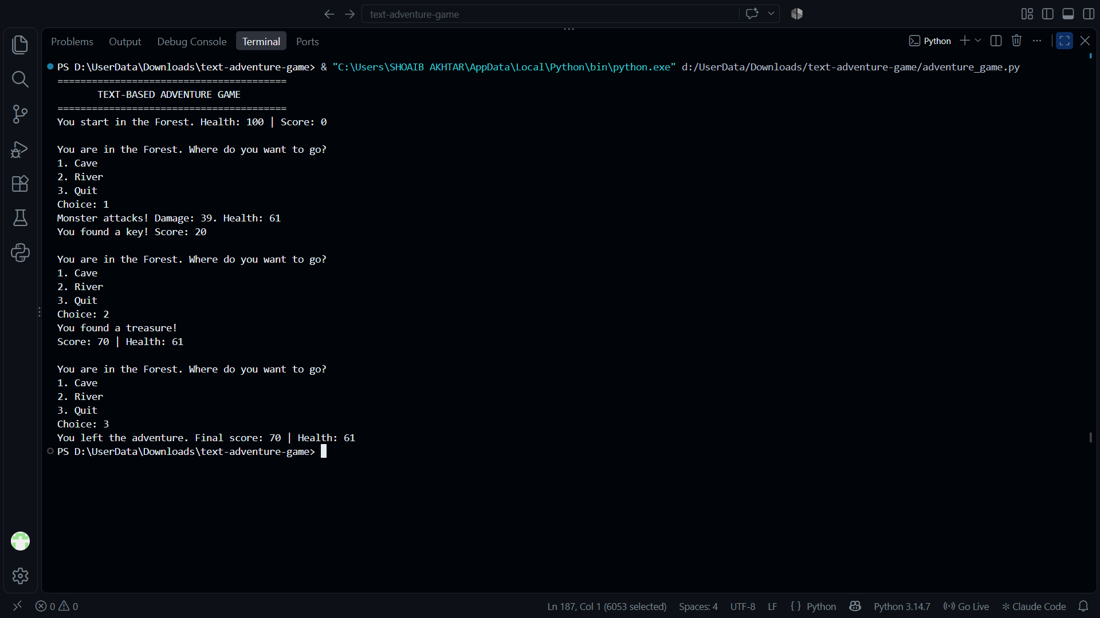
Example gameplay
One run
Start
Health 100 · Score 0
Cave
Damage 39 → Health 61
Key → +20 points
River
Treasure → +50 points
Final
Score 70 · Health 61
08
Notes:
Use the screenshot as a concrete example. The random cave attack is 39, leaving 61 health. Surviving earns 20 points. The river then adds 50, making the final score 70. The player quits with health 61.

Slide 9
Test cases
Case | Input / setup | Expected result
1 · Normal | Choose River, then Quit | Score 50; health 100; treasure message.
2 · Boundary | Health 30; Cave; damage fixed at 30 | Health 0; Game Over; no key reward.
3 · Invalid input | Enter 7, abc, then Quit | Two error messages; health and score unchanged.
4 · Mixed choices | Cave (damage 30), River, Quit | Final score 70; health 70.
19 automated test methods also cover boundaries, input handling, random damage, and returned game state.
09
Notes:
These four cases correspond to the project’s problem statement. The test suite also checks health boundaries, one-health survival, invalid input, and random damage. The test file contains 19 test methods.

Slide 10
Outcome and next steps
What the project demonstrates
Possible extensions
• Variables and constants for health and score
• Functions for menu, Cave, River, and game loop
• Loops and conditions for repeated choices
• Randomness and input validation
• Automated tests with unittest
• Add inventory, healing, and more locations
• Add difficulty settings
• Save a high-score table
• Build a graphical interface
The current version provides a complete, testable console game with clear rules and endings.
10
Notes:
Conclude by summarizing the Python concepts demonstrated. The listed extensions are ideas documented in the project README, not features in the current version. Invite questions.

