Slide 1
Design & Analysis of Algorithms
Shortest Paths

Slide 2
Shortest Path Problems
How can we find the shortest route between two points on a road map?
Model the problem as a graph problem:
  Road map is a weighted graph:
  vertices = cities
  edges = road segments between cities
  edge weights = road distances
  Goal: find a shortest path between two vertices (cities)

Slide 3
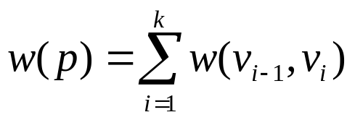
Shortest Path Problem
Input:
  Directed graph G = (V, E)
  Weight function w : E → R
Weight of path p = ⟨v₀, v₁, . . . , v_{k}⟩
Shortest-path weight from u to v:
δ(u, v) = min w(p) : u v if there exists a path from u to v
∞ otherwise
Note: there might be multiple shortest paths from u to v
t
x
3
6
9
3
4
s
0
2
1
2
7
5
3
5
11
6
y
z
p

Slide 4
Variants of Shortest Path
Single-source shortest paths
  G = (V, E) ⇒ find a shortest path from a given source vertex s to each vertex v ∈ V
Single-destination shortest paths
  Find a shortest path to a given destination vertex t from each vertex v
  Reversing the direction of each edge ⇒ single-source

Slide 5
Variants of Shortest Paths (cont’d)
Single-pair shortest path
  Find a shortest path from u to v for given vertices u and v
All-pairs shortest-paths
  Find a shortest path from u to v for every pair of vertices u and v

Slide 6

Single-Source Shortest Path Problem
Single-Source Shortest Path Problem - The problem of finding shortest paths from a source vertex v to all other vertices in the graph.

Slide 7
Dijkstra's algorithm
Dijkstra's algorithm - is a solution to the single-source shortest path problem in graph theory.
Works on both directed and undirected graphs. However, all edges must have nonnegative weights.
Approach: Greedy
Input: Weighted graph G={E,V} and source vertex v∈V, such that all edge weights are nonnegative
Output: Lengths of shortest paths (or the shortest paths themselves) from a given source vertex v∈V to all other vertices

Slide 8
Dijkstra's algorithm - Pseudocode
dist[s] ←0 (distance to source vertex is zero)
for all v ∈ V–{s}
do dist[v] ←∞ (set all other distances to infinity)
S←∅ (S, the set of visited vertices is initially empty)
Q←V (Q, the queue initially contains all vertices)
while Q ≠∅ (while the queue is not empty)
do u ← mindistance(Q,dist) (select the element of Q with the min. distance)
S←S∪{u} (add u to list of visited vertices)
for all v ∈ neighbors[u]
do if dist[v] > dist[u] + w(u, v) (if new shortest path found)
then d[v] ←d[u] + w(u, v) (set new value of shortest path)
(if desired, add traceback code)
return dist

Slide 9
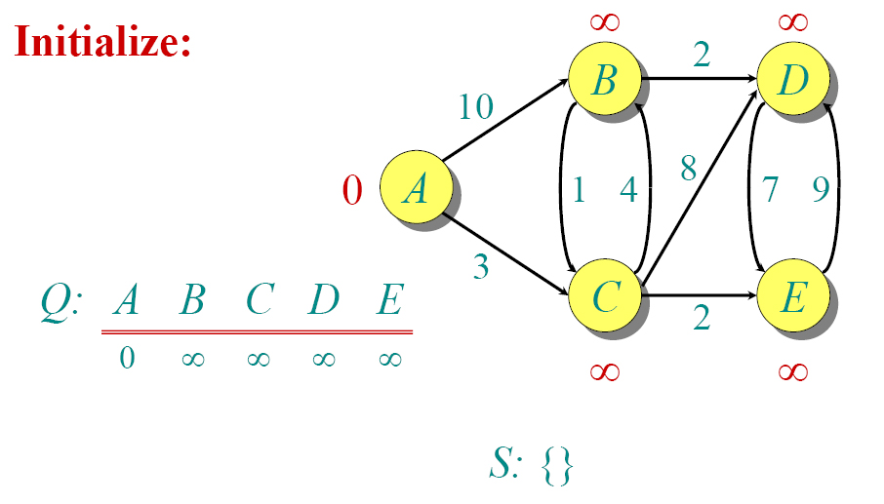
Dijkstra Animated Example

Slide 10

Dijkstra Animated Example

Slide 11

Dijkstra Animated Example

Slide 12

Dijkstra Animated Example

Slide 13

Dijkstra Animated Example

Slide 14

Dijkstra Animated Example

Slide 15

Dijkstra Animated Example

Slide 16

Dijkstra Animated Example

Slide 17

Dijkstra Animated Example

Slide 18

Dijkstra Animated Example

Slide 19
Implementations and Running Times
The simplest implementation is to store vertices in an array or linked list. This will produce a running time of
O(|V|^2 + |E|)
For sparse graphs, or graphs with very few edges and many nodes, it can be implemented more efficiently storing the graph in an adjacency list using a binary heap or priority queue. This will produce a running time of
O((|E|+|V|) log |V|)

Slide 20
Dijkstra (G, w, s)
INITIALIZE-SINGLE-SOURCE(V, s)
S ← ∅
Q ← V[G]
while Q ≠ ∅
do u ← EXTRACT-MIN(Q)
S ← S ∪ {u}
for each vertex v ∈ Adj[u]
do RELAX(u, v, w)
Update Q (DECREASE_KEY)
Running time: O(VlgV + ElgV) = O(ElgV)
Θ(V)
O(V) build min-heap
Executed O(V) times
O(lgV)
O(VlgV)
O(E) times
(total)
O(ElgV)
O(lgV)

Slide 21
Dijkstra's Algorithm - Why It Works
As with all greedy algorithms, we need to make sure that it is a correct algorithm (e.g., it always returns the right solution if it is given correct input).
A formal proof would take longer than this presentation, but we can understand how the argument works intuitively.
If you can’t sleep unless you see a proof, see the second reference or ask us where you can find it.

Slide 22
Dijkstra's Algorithm - Why use it?
As mentioned, Dijkstra’s algorithm calculates the shortest path to every vertex.
However, it is about as computationally expensive to calculate the shortest path from vertex u to every vertex using Dijkstra’s as it is to calculate the shortest path to some particular vertex v.
Therefore, anytime we want to know the optimal path to some other vertex from a determined origin, we can use Dijkstra’s algorithm.

Slide 23


Applications of Dijkstra's Algorithm
- Traffic Information Systems are most prominent use
- Mapping (Map Quest, Google Maps)
- Routing Systems

Slide 24
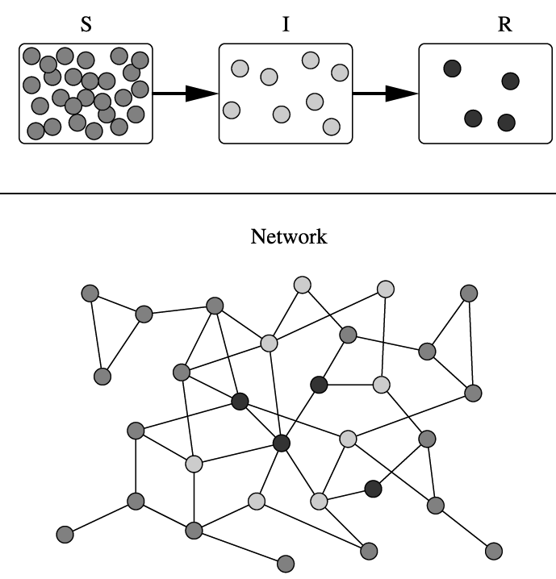
Applications of Dijkstra's Algorithm
One particularly relevant is epidemiology
Prof. Lauren Meyers (Biology Dept.) uses networks to model the spread of infectious diseases and design prevention and response strategies.
Vertices represent individuals and edges their possible contacts. It is useful to calculate how a particular individual is connected to others.
Knowing the shortest path lengths to other individuals can be a relevant indicator of the potential of a particular individual to infect others.

