Slide 1

Lecture 5
Hashing

Slide 2
Hash Tables
We’ll discuss the hash table ADT which supports only a subset of the operations allowed by binary search trees.
The implementation of hash tables is called hashing.
Hashing is a technique used for performing insertions, deletions and finds in constant average time (i.e. O(1))
This data structure, however, is not efficient in operations that require any ordering information among the elements, such as findMin, findMax and printing the entire table in sorted order.

Slide 3
General Idea
The ideal hash table structure is merely an array of some fixed size, containing the items.
A stored item needs to have a data member, called key, that will be used in computing the index value for the item.
  Key could be an integer, a string, etc
  e.g. a name or Id that is a part of a large employee structure
The size of the array is TableSize.
The items that are stored in the hash table are indexed by values from 0 to TableSize – 1.
Each key is mapped into some number in the range 0 to TableSize – 1.
The mapping is called a hash function.

Slide 4
Example
Hash
Table
0
1
Items
Hash
Function
2
john 25000
3
john 25000
phil 31250
key
4
phil 31250
dave 27500
5
mary 28200
6
dave 27500
7
mary 28200
key
8
9

Slide 5
Hash Function
The hash function:
  must be simple to compute.
  must distribute the keys evenly among the cells.
If we know which keys will occur in advance we can write perfect hash functions, but we don’t.

Slide 6
Hash function
Problems:
Keys may not be numeric.
Number of possible keys is much larger than the space available in table.
Different keys may map into same location
  Hash function is not one-to-one => collision.
  If there are too many collisions, the performance of the hash table will suffer dramatically.

Slide 7
Hash Functions
If the input keys are integers then simply Key mod TableSize is a general strategy.
  Unless key happens to have some undesirable properties. (e.g. all keys end in 0 and we use mod 10)
If the keys are strings, hash function needs more care.
  First convert it into a numeric value.

Slide 8
Some methods
Truncation:
  e.g. 123456789 map to a table of 1000 addresses by picking 3 digits of the key.
Folding:
  e.g. 123|456|789: add them and take mod.
Key mod N:
  N is the size of the table, better if it is prime.
Squaring:
  Square the key and then truncate
Radix conversion:
  e.g. 1 2 3 4 treat it to be base 11, truncate if necessary.

Slide 9
Hash Function 1
Add up the ASCII values of all characters of the key.
int hash(const string &key, int tableSize)
{
int hasVal = 0;
for (int i = 0; i < key.length(); i++)
hashVal += key[i];
return hashVal % tableSize;
}
Simple to implement and fast.
However, if the table size is large, the function does not distribute the keys well.
  e.g. Table size =10000, key length <= 8, the hash function can assume values only between 0 and 1016

Slide 10
Hash Function 2
Examine only the first 3 characters of the key.
int hash (const string &key, int tableSize)
{
return (key[0]+27 * key[1] + 729*key[2]) % tableSize;
}
In theory, 26 * 26 * 26 = 17576 different words can be generated. However, English is not random, only 2851 different combinations are possible.
Thus, this function although easily computable, is also not appropriate if the hash table is reasonably large.

Slide 11
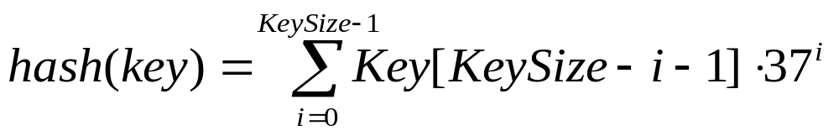
Hash Function 3
int hash (const string &key, int tableSize)
{
int hashVal = 0;
for (int i = 0; i < key.length(); i++)
hashVal = 37 * hashVal + key[i];
hashVal %=tableSize;
if (hashVal < 0) /* in case overflows occurs */
hashVal += tableSize;
return hashVal;
};

Slide 12
Hash function for strings:
98
108
105
key[i]
key
a
l
i
0 1 2
i
KeySize = 3;
hash(“ali”) = (105 * 1 + 108*37 + 98*37²) % 10,007 = 8172
0
hash
function
1
2
“ali”
……
ali
8172
……
10,006 (TableSize)

Slide 13
Collision Resolution
If, when an element is inserted, it hashes to the same value as an already inserted element, then we have a collision and need to resolve it.
There are several methods for dealing with this:
  Open addressing
    Linear Probing
    Quadratic Probing
    Double Hashing
    Pseudorandom Probing
    Ordered Hashing
  Separate chaining

Slide 14
Hashing: Open Addressing

Slide 15
Collision Resolution with
Open Addressing
In an open addressing hashing system, all the data go inside the table.
  Thus, a bigger table is needed.
    Generally the load factor should be below 0.5.
  If a collision occurs, alternative cells are tried until an empty cell is found.

Slide 16
Open Addressing
More formally:
  Cells h₀(x), h₁(x), h₂(x), …are tried in succession where h_{i}(x) = (hash(x) + f(i)) mod TableSize, with f(0) = 0.
  The function f is the collision resolution strategy.
There are three common collision resolution strategies:
  Linear Probing
  Quadratic probing
  Double hashing
  Pseudorandom Probing
  Ordered Hashing

Slide 17
Linear Probing
In linear probing, collisions are resolved by sequentially scanning an array (with wraparound) until an empty cell is found.
  i.e. f is a linear function of i, typically f(i)= i.
Example:
  Insert items with keys: 89, 18, 49, 58, 9 into an empty hash table.
  Table size is 10.
  Hash function is hash(x) = x mod 10.
    f(i) = i;

Slide 18
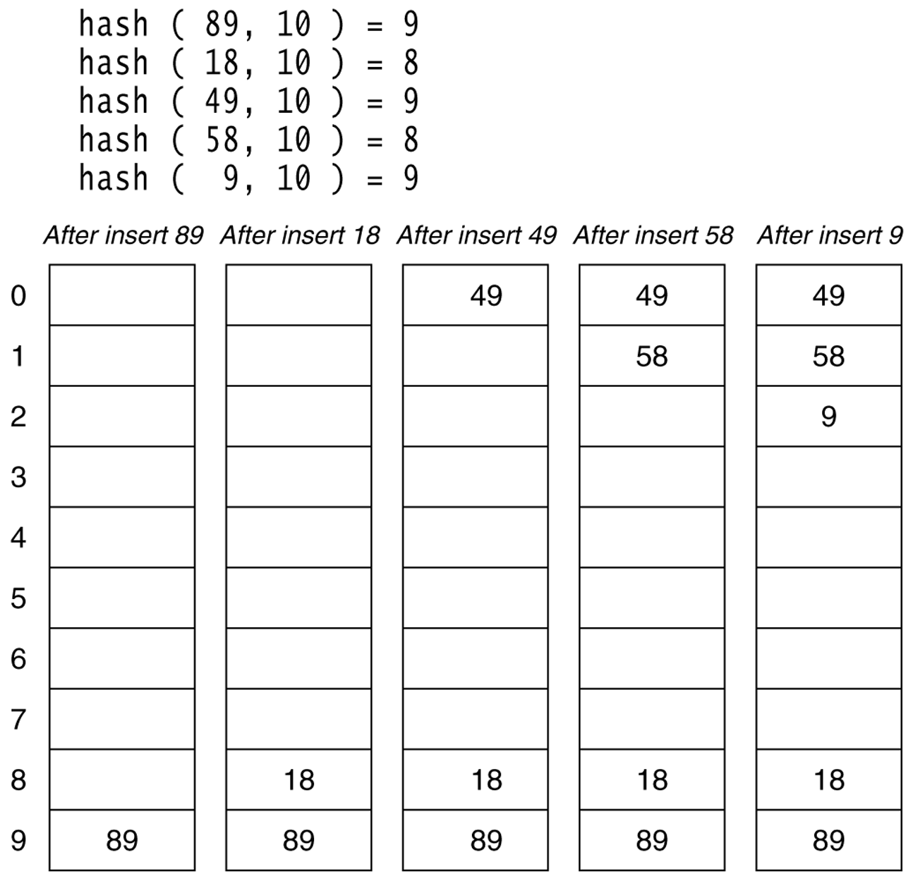
Figure 20.4
Linear probing hash table after each insertion

Slide 19
Find and Delete
The find algorithm follows the same probe sequence as the insert algorithm.
  A find for 58 would involve 4 probes.
  A find for 19 would involve 5 probes.
We must use lazy deletion (i.e. marking items as deleted)
  Standard deletion (i.e. physically removing the item) cannot be performed.
  e.g. remove 89 from hash table.

Slide 20
Clustering Problem
As long as table is big enough, a free cell can always be found, but the time to do so can get quite large.
Worse, even if the table is relatively empty, blocks of occupied cells start forming.
This effect is known as primary clustering.
Any key that hashes into the cluster will require several attempts to resolve the collision, and then it will add to the cluster.

Slide 21
Linear Probing – Analysis -- Example
What is the average number of probes for a successful search and an unsuccessful search for this hash table?
  Hash Function: h(x) = x mod 11
Successful Search:
  20: 9 -- 30: 8 -- 2 : 2 -- 13: 2, 3 -- 25: 3,4
  24: 2,3,4,5 -- 10: 10 -- 9: 9,10, 0
Avg. Probe for SS = (1+1+1+2+2+4+1+3)/8=15/8
Unsuccessful Search:
  We assume that the hash function uniformly distributes the keys.
  0: 0,1 -- 1: 1 -- 2: 2,3,4,5,6 -- 3: 3,4,5,6
  4: 4,5,6 -- 5: 5,6 -- 6: 6 -- 7: 7 -- 8: 8,9,10,0,1
  9: 9,10,0,1 -- 10: 10,0,1
Avg. Probe for US =
(2+1+5+4+3+2+1+1+5+4+3)/11=31/11
0 | 9
1
2 | 2
3 | 13
4 | 25
5 | 24
6
7
8 | 30
9 | 20
10 | 10

Slide 22
Quadratic Probing
Quadratic Probing eliminates primary clustering problem of linear probing.
Collision function is quadratic.
  The popular choice is f(i) = i².
If the hash function evaluates to h and a search in cell h is inconclusive, we try cells h + 1², h+2², … h + i².
  i.e. It examines cells 1,4,9 and so on away from the original probe.
Remember that subsequent probe points are a quadratic number of positions from the original probe point.

Slide 23
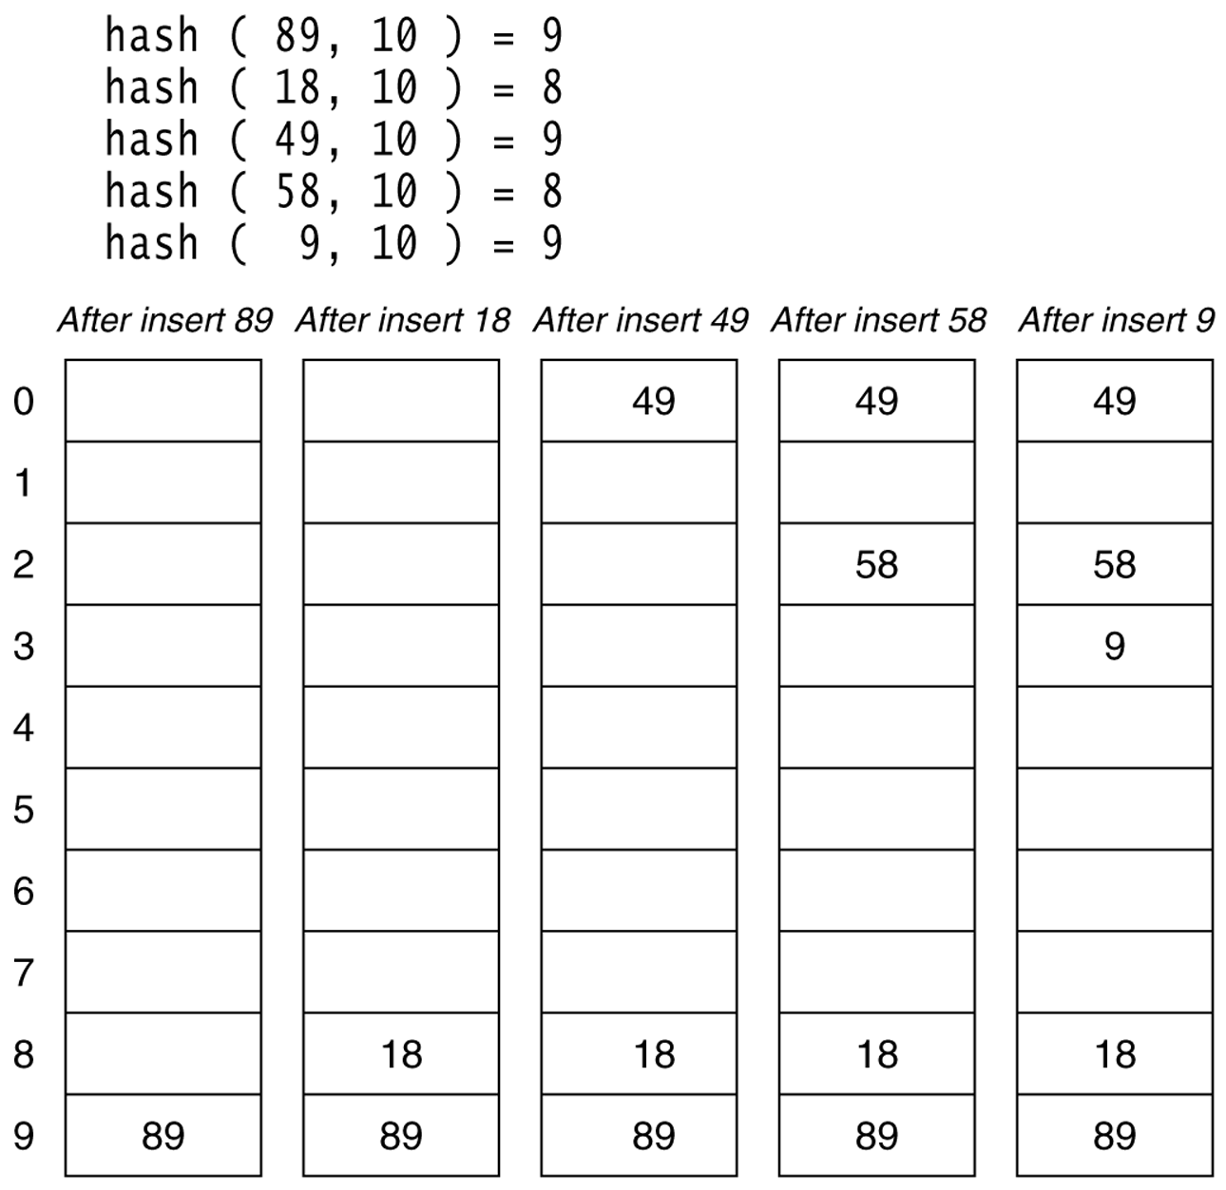
Figure 20.6
A quadratic probing hash table after each insertion (note that the table size was poorly chosen because it is not a prime number).

Slide 24
Double Hashing
A second hash function is used to drive the collision resolution.
  f(i) = i * hash₂(x)
We apply a second hash function to x and probe at a distance hash₂(x), 2*hash₂(x), … and so on.
The function hash₂(x) must never evaluate to zero.
  e.g. Let hash₂(x) = x mod 9 and try to insert 99 in the previous example.
A function such as hash₂(x) = R – ( x mod R) with R a prime smaller than TableSize will work well.
  e.g. try R = 7 for the previous example.(7 - x mode 7)

Slide 25
Pseudorandom Probing
Pseudorandom probing is similar to linear probing, except that the stride is given by a pseudorandom function of the initially mapped location.
In other words, if a value initially maps to position K, its probe sequence is K, K + p, K + 2 * p, ..., where p is determined by a pseudorandom function of K.
Like quadratic probing, pseudorandom probing prevents primary clustering.
Also like quadratic probing, pseudorandom probing is subject to secondary clustering, because values that map to the same initial position follow the same probe sequences.
Pseudorandom probing may also skip over some unused entries and fail to insert an item even though the table isn’t completely full

Slide 26
Ordered Hashing
In some applications, it is more important that the program be able to find values quickly than to insert them quickly.
For example, a program that uses a dictionary, address book, or product lookup table.
A hash table with chaining can find items more quickly if its linked lists are sorted.
When searching for an item, the algorithm can stop if it ever finds an item that is larger than the target item.

Slide 27
Ordered Hashing
For the given pseudocode to work each probe sequence in the table must be properly ordered so that you can search the table quickly.
Unfortunately, often you cannot add the items to a hash table in sorted order because you don’t know that order when you start.
Fortunately, there is a way to create an ordered hash table no matter how you add the items.
  To add an item, follow its probe sequence as usual.
  If you find an empty spot, insert the item, and you’re done.
  If you find a spot containing a value that is larger than the new value, replace it with the new value, and then rehash the larger value.
  As you rehash the larger item, you may encounter another, even larger value.
  If that happens, drop the item you’re hashing in the new position, and rehash the new item.
  Continue the process until you find an empty spot for whatever item you’re currently hashing.

Slide 28
Separate Chaining
The idea is to keep a list of all elements that hash to the same value.
  The array elements are pointers to the first nodes of the lists.
  A new item is inserted to the front of the list.
A hash table with chaining uses a collection of entries called buckets to hold key values.
Advantages:
  Better space utilization for large items.
  Simple collision handling: searching linked list.
  Overflow: we can store more items than the hash table size.
  Deletion is quick and easy: deletion from the linked list.

Slide 29
Example
Keys: 0, 1, 4, 9, 16, 25, 36, 49, 64, 81
hash(key) = key % 10.
0
0
1
81
1
2
3
4
64
4
5
25
6
36
16
7
8
9
49
9

Slide 30
Operations
Initialization: all entries are set to NULL
Find:
  locate the cell using hash function.
  sequential search on the linked list in that cell.
Insertion:
  Locate the cell using hash function.
  (If the item does not exist) insert it as the first item in the list.
Deletion:
  Locate the cell using hash function.
  Delete the item from the linked list.

Slide 31
Time Complexity
To add a key to the hash table, you map the key to a bucket using the hash function, and then add a new cell to the bucket’s linked list.
Hashing the key to find its bucket takes O(1) steps.
Adding the value to the top of the linked list takes O(1) steps.
If the hash table uses B buckets and holds a total of N items, and the items are reasonably evenly distributed, each bucket’s linked list holds roughly N / B items.
So checking that a new item isn’t already present in a bucket takes O(N / B) steps.
That means adding an item to the hash table takes a total of O(1) + O(N / B) = O(N / B) steps.

Slide 32
Hashing Applications
Compilers use hash tables to implement the symbol table (a data structure to keep track of declared variables).
Game programs use hash tables to keep track of positions it has encountered (transposition table)
Online spelling checkers.

Slide 33
Summary
Hash tables can be used to implement the insert and find operations in constant average time.
  it depends on the load factor not on the number of items in the table.
It is important to have a prime TableSize and a correct choice of load factor and hash function.
For separate chaining the load factor should be close to 1.
For open addressing load factor should not exceed 0.5 unless this is completely unavoidable.
  Rehashing can be implemented to grow (or shrink) the table.

Slide 34
Summary
The analysis shows us that the table size is not really important, but the load factor is.
TableSize should be as large as the number of expected elements in the hash table.
  To keep load factor around 1.
TableSize should be prime for even distribution of keys to hash table cells.

