Slide 1


Computer Architecture and Logic Design (CALD)
Lecture 10
Notes:
© 2016 Pearson Education, Inc., Hoboken, NJ. All rights reserved.

Slide 2
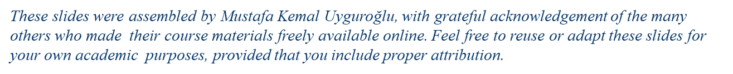
Boolean Algebra and Logic Gates

Slide 3
Algebra
What is an algebra?
  Mathematical system consisting of
    Set of elements
    Set of operators
    Axioms or postulates
Why is it important?
  Defines rules of “calculations”
Example: arithmetic on natural numbers
  Set of elements: N = {1,2,3,4,…}
  Operator: +, –, *
  Axioms: associativity, distributivity, closure, identity elements, etc.
Note: operators with two inputs are called binary
  Does not mean they are restricted to binary numbers!
  Operator(s) with one input are called unary

Slide 4
BASIC DEFINITIONS
The most common postulates used to formulate various algebraic structures are as follows:
Closure: a set S is closed with respect to a binary operator if, for every pair of elements of S, the binary operator specifies a rule for obtaining a unique element of S.
  For example, natural numbers N={1,2,3,...} is closed w.r.t. the binary operator + by the rule of arithmetic addition, since, for any a, b∈N, there is a unique c∈N such that
    a+b = c
    But operator – is not closed for N, because 2-3 = -1 and 2, 3 ∈N, but (-1)∉N.
Associative law: a binary operator * on a set S is said to be associative whenever
  (x * y) * z = x * (y * z) for all x, y, z∈S
    (x+y)+z = x+(y+z)
Commutative law: a binary operator * on a set S is said to be commutative whenever
  x * y = y * x for all x, y∈S
    x+y = y+x

Slide 5
BASIC DEFINITIONS
Identity element: a set S is said to have an identity element with respect to a binary operation * on S if there exists an element e∈S with the property that
  e * x = x * e = x for every x∈S
    0+x = x+0 =x for every x∈I . I = {…, -3, -2, -1, 0, 1, 2, 3, …}.
    1*x = x*1 =x for every x∈I. I = {…, -3, -2, -1, 0, 1, 2, 3, …}.
Inverse: a set having the identity element e with respect to the binary operator to have an inverse whenever, for every x∈S, there exists an element y∈S such that
  x * y = e
    The operator + over I, with e = 0, the inverse of an element a is (-a), since a+(-a) = 0.
Distributive law: if * and ．are two binary operators on a set S, * is said to be distributive over . whenever
  x * (y．z) = (x * y)．(x * z)

Slide 6
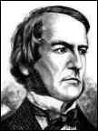
George Boole
Father of Boolean algebra
He came up with a type of linguistic algebra, the three most basic operations of which were (and still are) AND, OR and NOT. It was these three functions that formed the basis of his premise, and were the only operations necessary to perform comparisons or basic mathematical functions.
Boole’s system (detailed in his 'An Investigation of the Laws of Thought, on Which Are Founded the Mathematical Theories of Logic and Probabilities', 1854) was based on a binary approach, processing only two objects - the yes-no, true-false, on-off, zero-one approach.
Surprisingly, given his standing in the academic community, Boole's idea was either criticized or completely ignored by the majority of his peers.
Eventually, one bright student, Claude Shannon (1916-2001), picked up the idea and ran with it
George Boole (1815 - 1864)

Slide 7
Axiomatic Definition of Boolean Algebra
We need to define algebra for binary values
  Developed by George Boole in 1854
Huntington postulates for Boolean algebra (1904):
B = {0, 1} and two binary operations, + and．
  Closure with respect to operator + and operator ·
  Identity element 0 for operator + and 1 for operator ·
  Commutativity with respect to + and ·
    x+y = y+x, x·y = y·x
  Distributivity of · over +, and + over ·
  x·(y+z) = (x·y)+(x·z) and x+(y·z) = (x+y)·(x+z)
        Complement for every element x is x’ with x+x’=1, x·x’=0
  There are at least two elements x,y∈B such that x≠y

Slide 8
Boolean Algebra
Terminology:
  Literal: A variable or its complement
  Product term: literals connected by •
  Sum term: literals connected by +

Slide 9
Postulates of Two-Valued Boolean Algebra
B = {0, 1} and two binary operations, + and．
The rules of operations: AND, OR and NOT.
Closure (+ and ‧)
The identity elements
  (1) +: 0
  (2)．: 1
AND
OR
NOT
x | y | x．y
0 | 0 | 0
0 | 1 | 0
1 | 0 | 0
1 | 1 | 1
x | y | x+y
0 | 0 | 0
0 | 1 | 1
1 | 0 | 1
1 | 1 | 1
x | x'
0 | 1
1 | 0

Slide 10
Postulates of Two-Valued Boolean Algebra
The commutative laws
The distributive laws
x | y | z | y+z | x．(y+z) | x．y | x．z | (x．y)+(x．z)
0 | 0 | 0 | 0 | 0 | 0 | 0 | 0
0 | 0 | 1 | 1 | 0 | 0 | 0 | 0
0 | 1 | 0 | 1 | 0 | 0 | 0 | 0
0 | 1 | 1 | 1 | 0 | 0 | 0 | 0
1 | 0 | 0 | 0 | 0 | 0 | 0 | 0
1 | 0 | 1 | 1 | 1 | 0 | 1 | 1
1 | 1 | 0 | 1 | 1 | 1 | 0 | 1
1 | 1 | 1 | 1 | 1 | 1 | 1 | 1

Slide 11
Postulates of Two-Valued Boolean Algebra
Complement
  x+x'=1 → 0+0'=0+1=1; 1+1'=1+0=1
  x．x'=0 → 0．0'=0．1=0; 1．1'=1．0=0
Has two distinct elements 1 and 0, with 0 ≠ 1
Note
  A set of two elements
  + : OR operation; ．: AND operation
  A complement operator: NOT operation
  Binary logic is a two-valued Boolean algebra

Slide 12
Duality
The principle of duality is an important concept. This says that if an expression is valid in Boolean algebra, the dual of that expression is also valid.
To form the dual of an expression, replace all + operators with . operators, all . operators with + operators, all ones with zeros, and all zeros with ones.
Form the dual of the expression
  a + (bc) = (a + b)(a + c)
Following the replacement rules…
  a(b + c) = ab + ac
Take care not to alter the location of the parentheses if they are present.

Slide 13
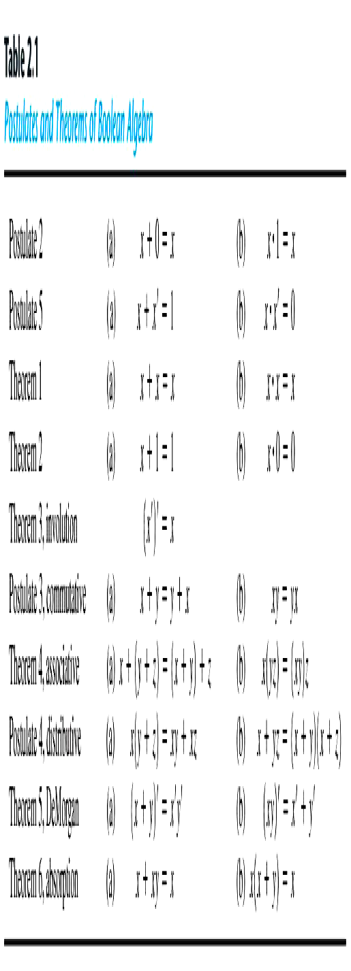
Basic Theorems

Slide 14
Boolean Theorems
Huntington’s postulates define some rules
Need more rules to modify
algebraic expressions
  Theorems that are derived from postulates
What is a theorem?
  A formula or statement that is derived from postulates (or other proven theorems)
Basic theorems of Boolean algebra
  Theorem 1 (a): x + x = x (b): x · x = x
  Looks straightforward, but needs to be proven !
Post. 1: closure
Post. 2: (a) x+0=x, (b) x·1=x
Post. 3: (a) x+y=y+x, (b) x·y=y·x
Post. 4: (a) x(y+z) = xy+xz,
(b) x+yz = (x+y)(x+z)
Post. 5: (a) x+x’=1, (b) x·x’=0

Slide 15
DeMorgan’s Theorem
Theorem 5(a): (x + y)’ = x’y’
Theorem 5(b): (xy)’ = x’ + y’
By means of truth table
x | y | x’ | y’ | x+y | (x+y)’ | x’y’ | xy | x’+y' | (xy)’
0 | 0 | 1 | 1 | 0 | 1 | 1 | 0 | 1 | 1
0 | 1 | 1 | 0 | 1 | 0 | 0 | 0 | 1 | 1
1 | 0 | 0 | 1 | 1 | 0 | 0 | 0 | 1 | 1
1 | 1 | 0 | 0 | 1 | 0 | 0 | 1 | 0 | 0

Slide 16
Consensus Theorem
xy + x’z + yz = xy + x’z
(x+y)•(x’+z)•(y+z) = (x+y)•(x’+z) -- (dual)
Proof:
xy + x’z + yz = xy + x’z + (x+x’)yz
= xy + x’z + xyz + x’yz
= (xy + xyz) + (x’z + x’zy)
= xy + x’z
QED (2 true by duality).

Slide 17
Operator Precedence
The operator precedence for evaluating Boolean Expression is
  Parentheses
  NOT
  AND
  OR
Examples
  x y' + z
  (x y + z)'

Slide 18
Boolean Functions
A Boolean function
  Binary variables
  Binary operators OR and AND
  Unary operator NOT
  Parentheses
Examples
  F₁= x y z'
  F₂ = x + y'z
  F₃ = x' y' z + x' y z + x y'
  F₄ = x y' + x' z

Slide 19
Boolean Functions
  The truth table of 2^{n} entries
Two Boolean expressions may specify the same function
  F₃ = F₄
x | y | z | F₁ | F₂ | F₃ | F₄
0 | 0 | 0 | 0 | 0 | 0 | 0
0 | 0 | 1 | 0 | 1 | 1 | 1
0 | 1 | 0 | 0 | 0 | 0 | 0
0 | 1 | 1 | 0 | 0 | 1 | 1
1 | 0 | 0 | 0 | 1 | 1 | 1
1 | 0 | 1 | 0 | 1 | 1 | 1
1 | 1 | 0 | 1 | 1 | 0 | 0
1 | 1 | 1 | 0 | 1 | 0 | 0

Slide 20
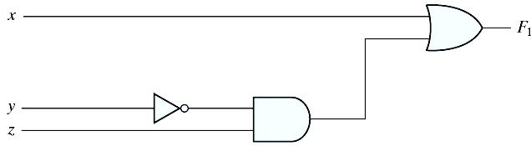
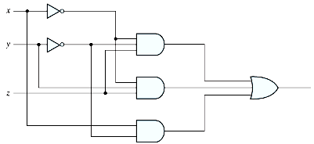
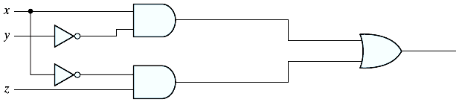
Boolean Functions
Implementation with logic gates
  F₄ is more economical
  F₂ = x + y'z
  F₃ = x' y' z + x' y z + x y'
  F₄ = x y' + x' z

Slide 21
Algebraic Manipulation
To minimize Boolean expressions
  Literal: a primed or unprimed variable (an input to a gate)
  Term: an implementation with a gate
  The minimization of the number of literals and the number of terms → a circuit with less equipment
  It is a hard problem (no specific rules to follow)
Example 2.1
  x(x'+y) = xx' + xy = 0+xy = xy
  x+x'y = (x+x')(x+y) = 1 (x+y) = x+y
  (x+y)(x+y') = x+xy+xy'+yy' = x(1+y+y') = x
  xy + x'z + yz = xy + x'z + yz(x+x') = xy + x'z + yzx + yzx' = xy(1+z) + x'z(1+y) = xy +x'z
  (x+y)(x'+z)(y+z) = (x+y)(x'+z), by duality from function 4. (consensus theorem with duality)

Slide 22
Complement of a Function
An interchange of 0's for 1's and 1's for 0's in the value of F
  By DeMorgan's theorem
  (A+B+C)' = (A+X)’ let B+C = X
  = A'X' by theorem 5(a) (DeMorgan's)
  = A'(B+C)’ substitute B+C = X
  = A'(B'C') by theorem 5(a) (DeMorgan's)
  = A'B'C' by theorem 4(b) (associative)
Generalizations: a function is obtained by interchanging AND and OR operators and complementing each literal.
  (A+B+C+D+ ... +F)' = A'B'C'D'... F'
  (ABCD ... F)' = A'+ B'+C'+D' ... +F'

Slide 23
2.6 Canonical and Standard Forms
Minterms and Maxterms
A minterm (standard product): an AND term consists of all literals in their normal form or in their complement form.
  For example, two binary variables x and y,
    xy, xy', x'y, x'y'
  It is also called a standard product.
  n variables can be combined to form 2^{n} minterms.
A maxterm (standard sums): an OR term
  It is also call a standard sum.
  2^{n} maxterms.

Slide 24
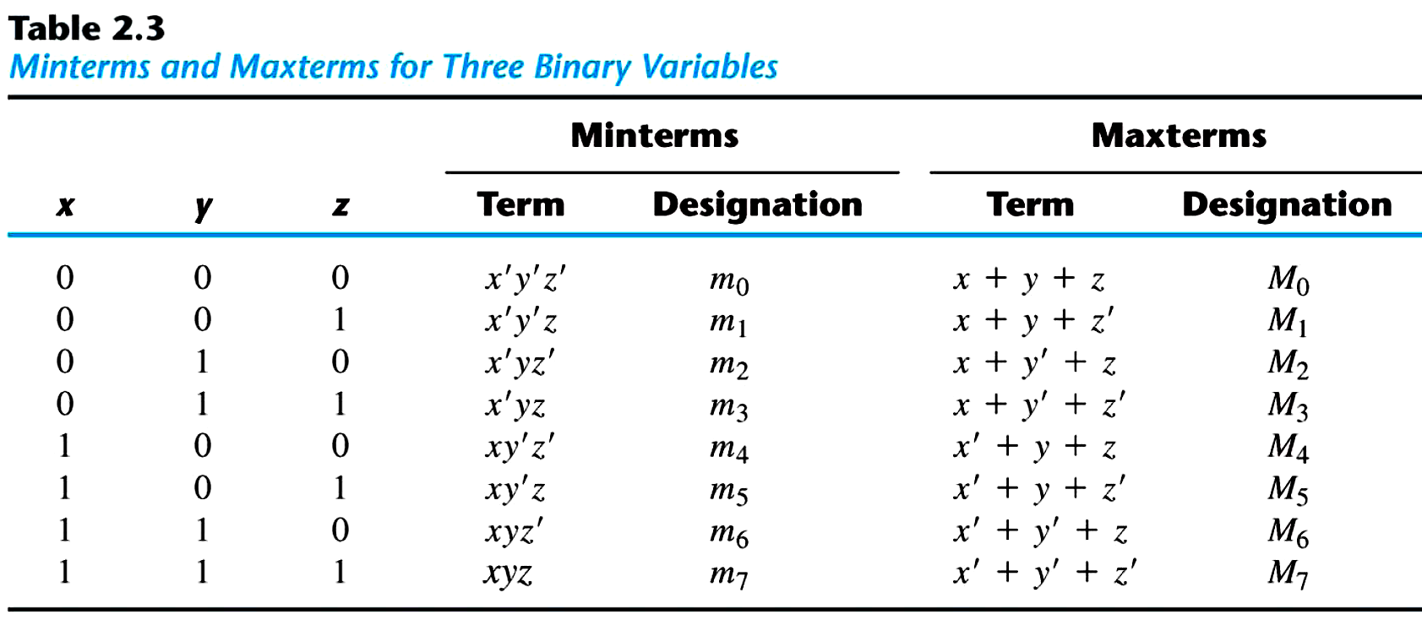
Minterms and Maxterms
  Each maxterm is the complement of its corresponding minterm, and vice versa.

Slide 25
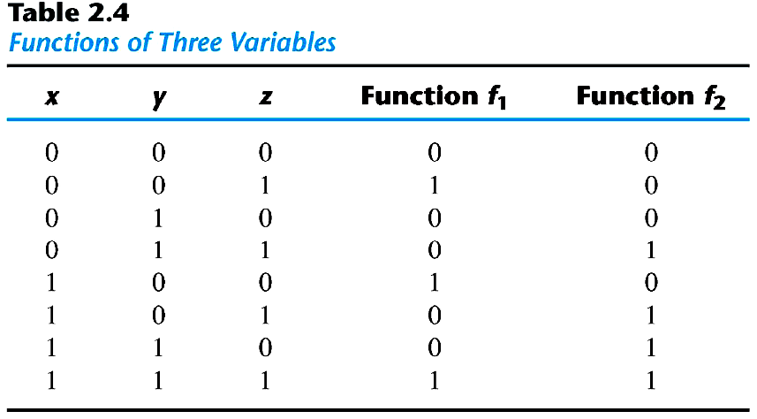
Minterms and Maxterms
An Boolean function can be expressed by
  A truth table
  Sum of minterms
  f₁ = x'y'z + xy'z' + xyz = m₁ + m₄ +m₇ (Minterms)
  f₂ = x'yz+ xy'z + xyz'+xyz = m₃ + m₅ +m₆ + m₇ (Minterms)

Slide 26
Minterms and Maxterms
The complement of a Boolean function
  The minterms that produce a 0
  f₁' = m₀ + m₂ +m₃ + m₅ + m₆ = x'y'z'+x'yz'+x'yz+xy'z+xyz'
  f₁ = (f₁')' = (x+y+z)(x+y'+z) (x+y'+z') (x'+y+z')(x'+y'+z) = M₀ M₂ M₃ M₅ M₆
  f₂ = (x+y+z)(x+y+z')(x+y'+z)(x'+y+z)=M₀M₁M₂M₄
Any Boolean function can be expressed as
  A sum of minterms (“sum” meaning the ORing of terms).
  A product of maxterms (“product” meaning the ANDing of terms).
  Both boolean functions are said to be in Canonical form.

Slide 27
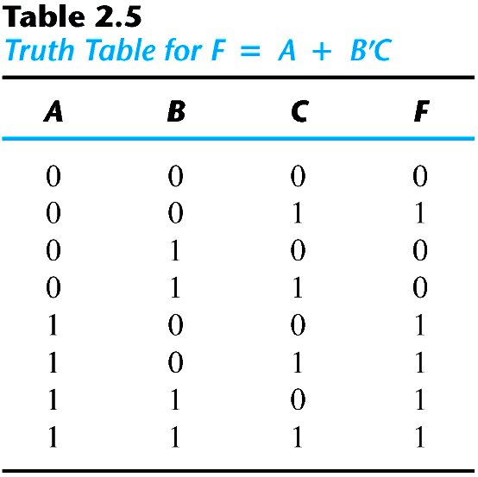
Sum of Minterms
Sum of minterms: there are 2^{n} minterms and 2^{2n} combinations of function with n Boolean variables.
Example 2.4: express F = A+BC' as a sum of minterms.
  F = A+B'C = A (B+B') + B'C = AB +AB' + B'C = AB(C+C') + AB'(C+C') + (A+A')B'C = ABC+ABC'+AB'C+AB'C'+A'B'C
  F = A'B'C +AB'C' +AB'C+ABC'+ ABC = m₁ + m₄ +m₅ + m₆ + m₇
  F(A, B, C) = Σ(1, 4, 5, 6, 7)
  or, built the truth table first

Slide 28
Product of Maxterms
Product of maxterms: using distributive law to expand.
  x + yz = (x + y)(x + z) = (x+y+zz')(x+z+yy') = (x+y+z)(x+y+z')(x+y'+z)
Example 2.5: express F = xy + x'z as a product of maxterms.
  F = xy + x'z = (xy + x')(xy +z) = (x+x')(y+x')(x+z)(y+z) = (x'+y)(x+z)(y+z)
  x'+y = x' + y + zz' = (x'+y+z)(x'+y+z')
  F = (x+y+z)(x+y'+z)(x'+y+z)(x'+y+z') = M₀M₂M₄M₅
  F(x, y, z) = Π(0, 2, 4, 5)

Slide 29
Conversion between Canonical Forms
The complement of a function expressed as the sum of minterms equals the sum of minterms missing from the original function.
  F(A, B, C) = Σ(1, 4, 5, 6, 7)
  Thus, F'(A, B, C) = Σ(0, 2, 3)
  By DeMorgan's theorem
  F(A, B, C) = Π(0, 2, 3)
  F'(A, B, C) =Π (1, 4, 5, 6, 7)
  m_{j}' = M_{j}
  Sum of minterms = product of maxterms
  Interchange the symbols Σ and Π and list those numbers missing from the original form
    Σ of 1's
    Π of 0's

Slide 30
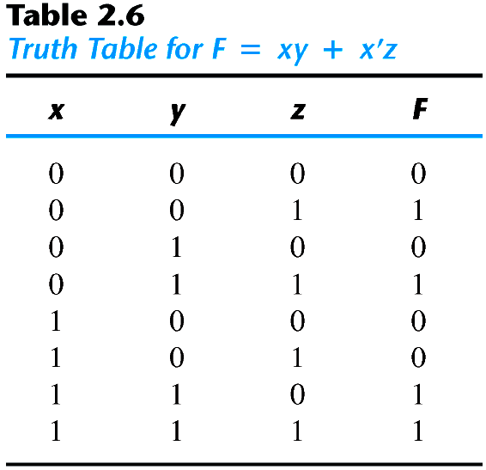
Example
  F = xy + x′z
  F(x, y, z) = Σ(1, 3, 6, 7)
  F(x, y, z) = Π (0, 2, 4, 6)

Slide 31
Standard Forms
Canonical forms are very seldom the ones with the least number of literals.
Standard forms: the terms that form the function may obtain one, two, or any number of literals.
  Sum of products: F₁ = y' + xy+ x'yz'
  Product of sums: F₂ = x(y'+z)(x'+y+z')
  F₃ = A'B'CD+ABC'D'

Slide 32
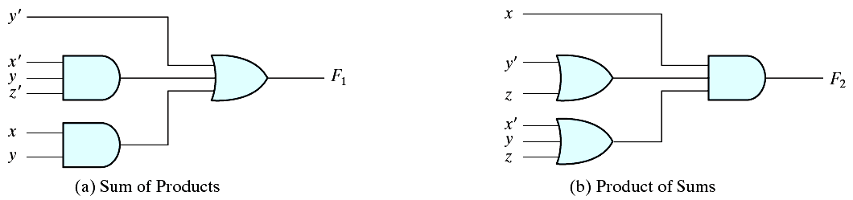
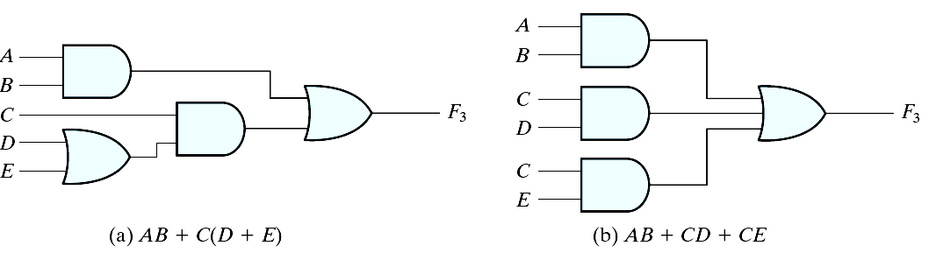
Implementation
Two-level implementation
Multi-level implementation
F₁ = y' + xy+ x'yz'
F₂ = x(y'+z)(x'+y+z')

Slide 33
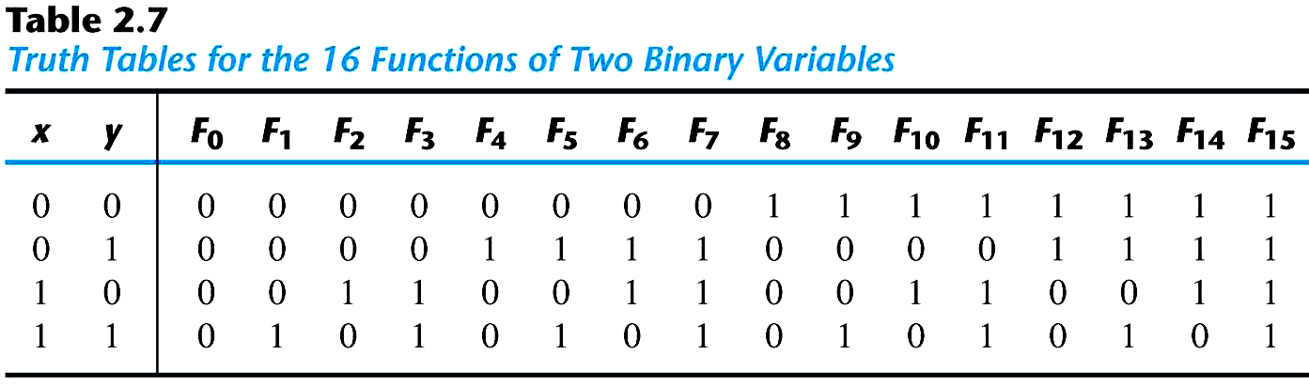
2.7 Other Logic Operations (
2^{n} rows in the truth table of n binary variables.
2^{2n} functions for n binary variables.
16 functions of two binary variables.
All the new symbols except for the exclusive-OR symbol are not in common use by digital designers.

Slide 34
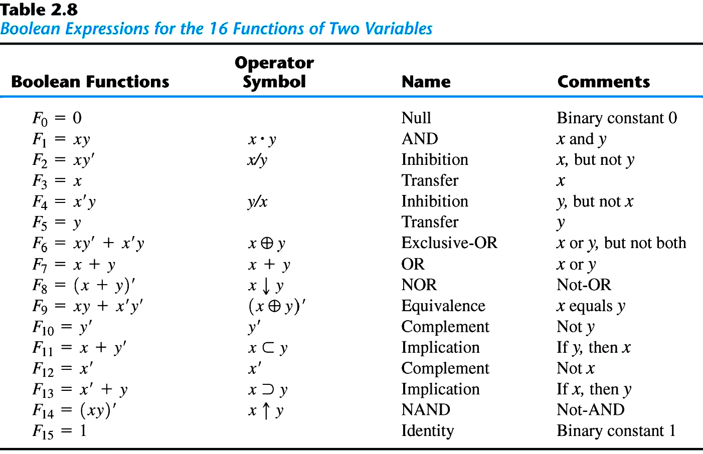
Boolean Expressions

Slide 35
2.8 Digital Logic Gates
Boolean expression: AND, OR and NOT operations
Constructing gates of other logic operations
  The feasibility and economy;
  The possibility of extending gate's inputs;
  The basic properties of the binary operations (commutative and associative);
  The ability of the gate to implement Boolean functions.

Slide 36
Standard Gates
Consider the 16 functions in Table 2.8 (slide 33)
  Two are equal to a constant (F₀ and F₁₅).
  Four are repeated twice (F₄, F₅, F₁₀ and F₁₁).
  Inhibition (F₂) and implication (F₁₃) are not commutative or associative.
  The other eight: complement (F₁₂), transfer (F₃), AND (F₁), OR (F₇), NAND (F₁₄), NOR (F₈), XOR (F₆), and equivalence (XNOR) (F₉) are used as standard gates.
  Complement: inverter.
  Transfer: buffer (increasing drive strength).
  Equivalence: XNOR.

Slide 37
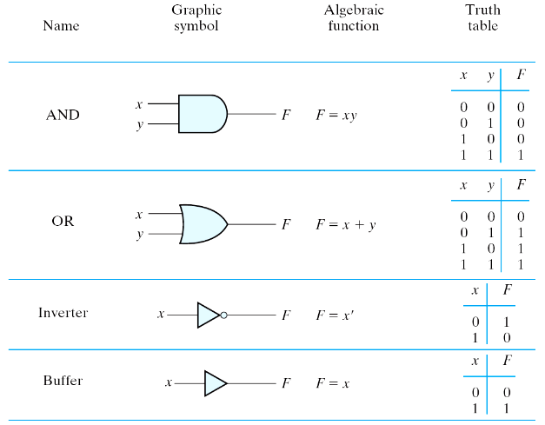
Summary of Logic Gates
Figure 2.5 Digital logic gates

Slide 38
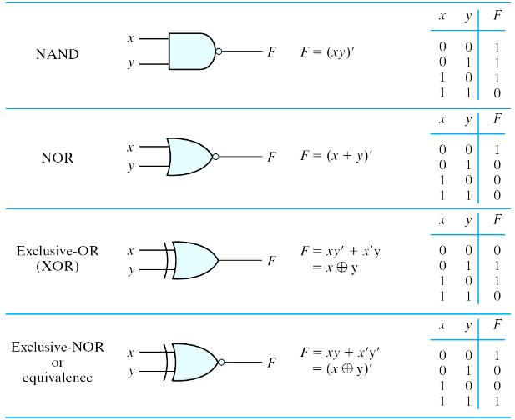
Summary of Logic Gates
Figure 2.5 Digital logic gates

Slide 39
Multiple Inputs
Extension to multiple inputs
  A gate can be extended to multiple inputs.
    If its binary operation is commutative and associative.
  AND and OR are commutative and associative.
    OR
      x+y = y+x
      (x+y)+z = x+(y+z) = x+y+z
    AND
      xy = yx
      (x y)z = x(y z) = x y z

Slide 40
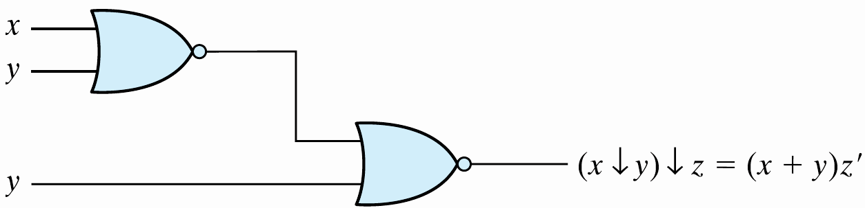
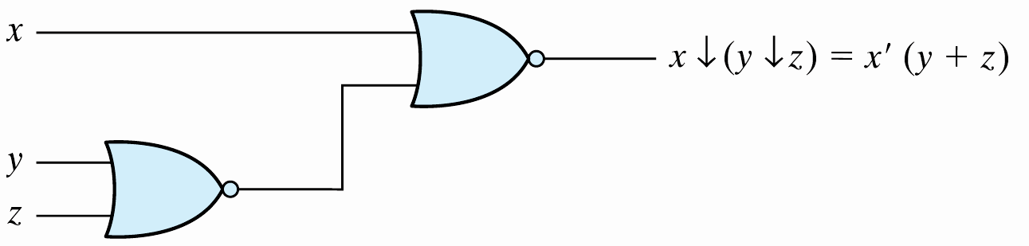
Multiple Inputs
  NAND and NOR are commutative but not associative → they are not extendable.
Figure 2.6 Demonstrating the nonassociativity of the NOR operator; (x ↓ y) ↓ z ≠ x ↓(y ↓ z)

Slide 41
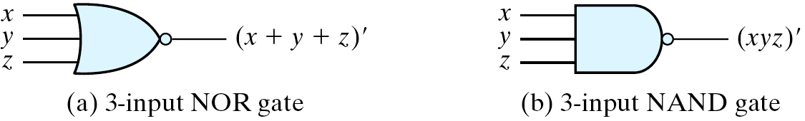
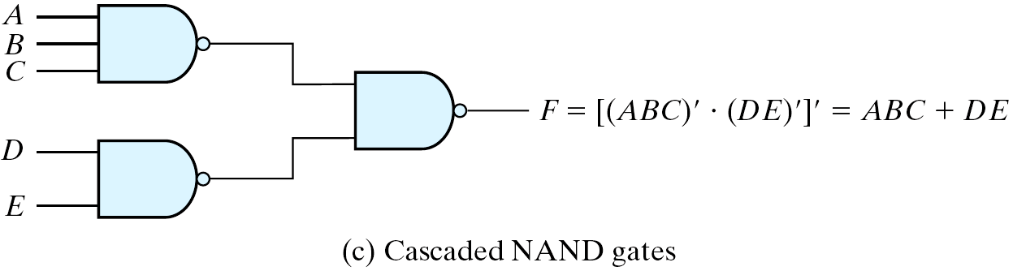
Multiple Inputs
  Multiple NOR = a complement of OR gate, Multiple NAND = a complement of AND.
  The cascaded NAND operations = sum of products.
  The cascaded NOR operations = product of sums.
Figure 2.7 Multiple-input and cascated NOR and NAND gates

Slide 42
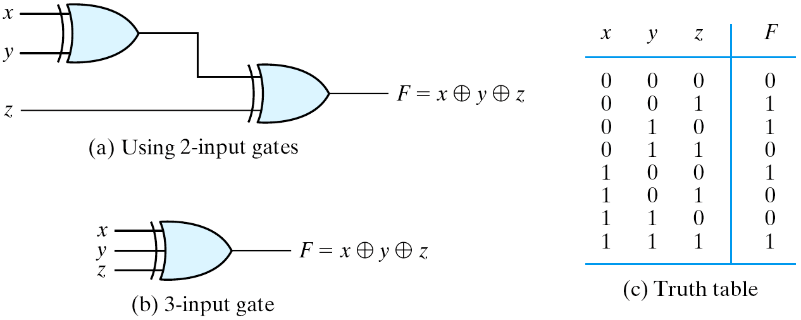
Multiple Inputs
  The XOR and XNOR gates are commutative and associative.
  Multiple-input XOR gates are uncommon?
  XOR is an odd function: it is equal to 1 if the inputs variables have an odd number of 1's.
Figure 2.8 3-input XOR gate

Slide 43
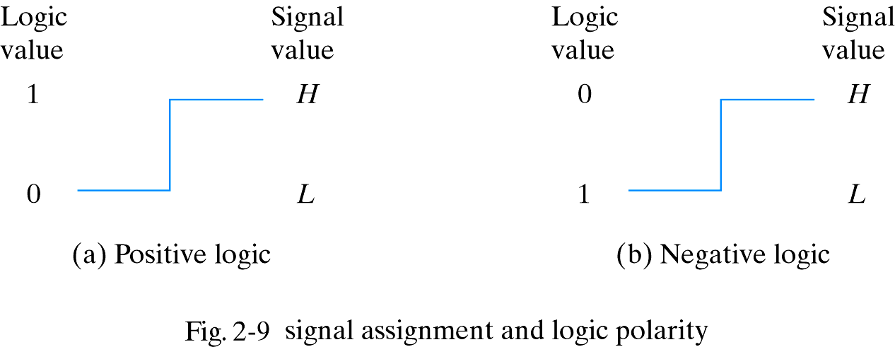
Positive and Negative Logic
Positive and Negative Logic
  Two signal values <=> two logic values
  Positive logic: H=1; L=0
  Negative logic: H=0; L=1
Consider a TTL gate
  A positive logic AND gate
  A negative logic OR gate
  The positive logic is used in this book
Figure 2.9 Signal assignment and logic polarity

Slide 44
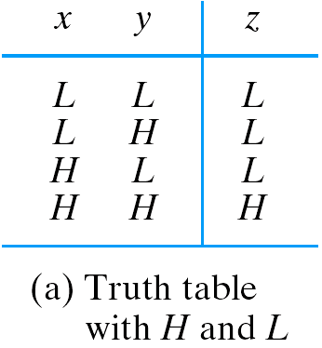
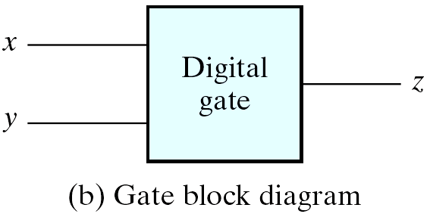
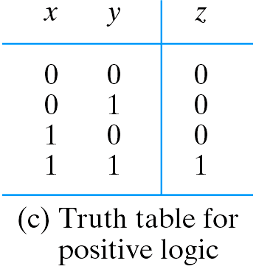
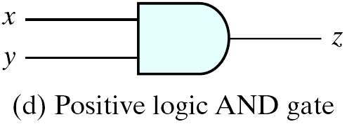
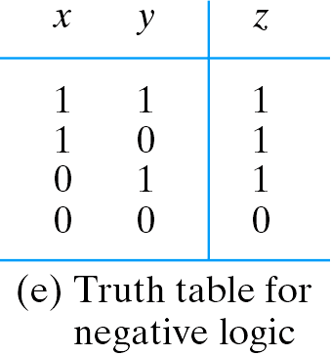
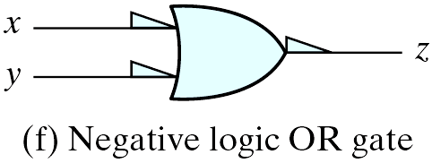
Positive and Negative Logic
Figure 2.10 Demonstration of positive and negative logic

Slide 45
2.9 Integrated Circuits
Level of Integration
An IC (a chip)
Examples:
  Small-scale Integration (SSI): < 10 gates
  Medium-scale Integration (MSI): 10 ~ 100 gates
  Large-scale Integration (LSI): 100 ~ xk gates
  Very Large-scale Integration (VLSI): > xk gates
VLSI
  Small size (compact size)
  Low cost
  Low power consumption
  High reliability
  High speed

Slide 46
Digital Logic Families
Digital logic families: circuit technology
  TTL: transistor-transistor logic (dying?)
  ECL: emitter-coupled logic (high speed, high power consumption)
  MOS: metal-oxide semiconductor (NMOS, high density)
  CMOS: complementary MOS (low power)
  BiCMOS: high speed, high density

Slide 47
Digital Logic Families
The characteristics of digital logic families
  Fan-out: the number of standard loads that the output of a typical gate can drive.
  Power dissipation.
  Propagation delay: the average transition delay time for the signal to propagate from input to output.
  Noise margin: the minimum of external noise voltage that caused an undesirable change in the circuit output.

Slide 48
CAD
CAD – Computer-Aided Design
  Millions of transistors
  Computer-based representation and aid
  Automatic the design process
  Design entry
    Schematic capture
    HDL – Hardware Description Language
      Verilog, VHDL
  Simulation
  Physical realization
    ASIC, FPGA, PLD

Slide 49
Chip Design
Why is it better to have more gates on a single chip?
  Easier to build systems
  Lower power consumption
  Higher clock frequencies
What are the drawbacks of large circuits?
  Complex to design
  Chips have design constraints
  Hard to test
Need tools to help develop integrated circuits
  Computer Aided Design (CAD) tools
  Automate tedious steps of design process
  Hardware description language (HDL) describe circuits
  VHDL (see the lab) is one such system

