Slide 1

Computer Architecture and Logic Design (CALD)
Lecture 11
+

Slide 2
Simplification of Boolean Functions

Slide 3
3-1 Introduction
Gate-level minimization refers to the design task of finding an optimal gate-level implementation of Boolean functions describing a digital circuit.

Slide 4
3-2 The Map Method
The complexity of the digital logic gates
The complexity of the algebraic expression
Logic minimization
Algebraic approaches: lack specific rules
The Karnaugh map
A simple straight forward procedure
A pictorial form of a truth table
Applicable if the # of variables < 7
A diagram made up of squares
Each square represents one minterm

Slide 5
Review of Boolean Function
Boolean function
Sum of minterms
Sum of products (or product of sum) in the simplest form
A minimum number of terms
A minimum number of literals
The simplified expression may not be unique

Slide 6
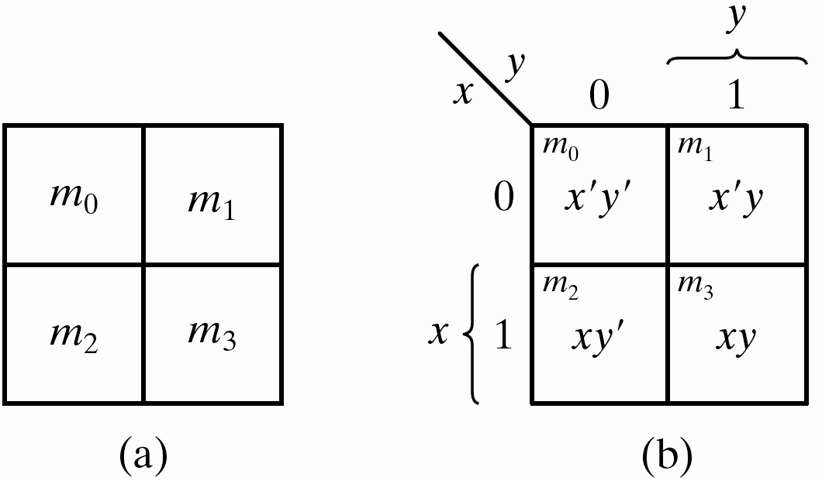
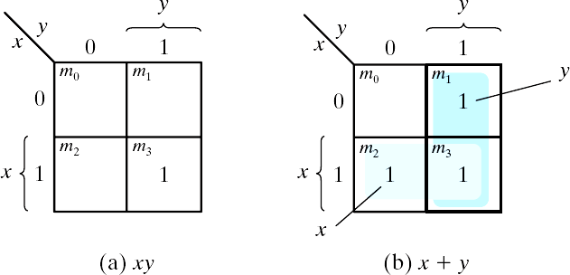
Two-Variable Map
A two-variable map
Four minterms
x' = row 0; x = row 1
y' = column 0; y = column
1
A truth table in square diagram
Fig. 3.2(a): xy = m₃
Fig. 3.2(b): x+y = x'y+xy'
+xy = m₁+m₂+m₃
Figure 3.1 Two-variable Map
Figure 3.2 Representation of functions in the map

Slide 7
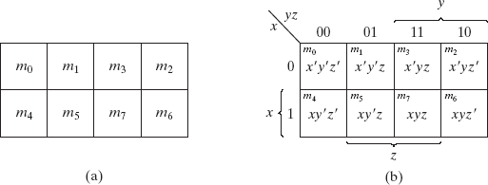
A Three-variable Map
A three-variable map
Eight minterms
The Gray code sequence
Any two adjacent squares in the map differ by only one variable
Primed in one square and unprimed in the other
e.g., m₅ and m₇ can be simplified
m₅+ m₇ = xy'z + xyz = xz (y'+y) = xz
Figure 3.3 Three-variable Map

Slide 8
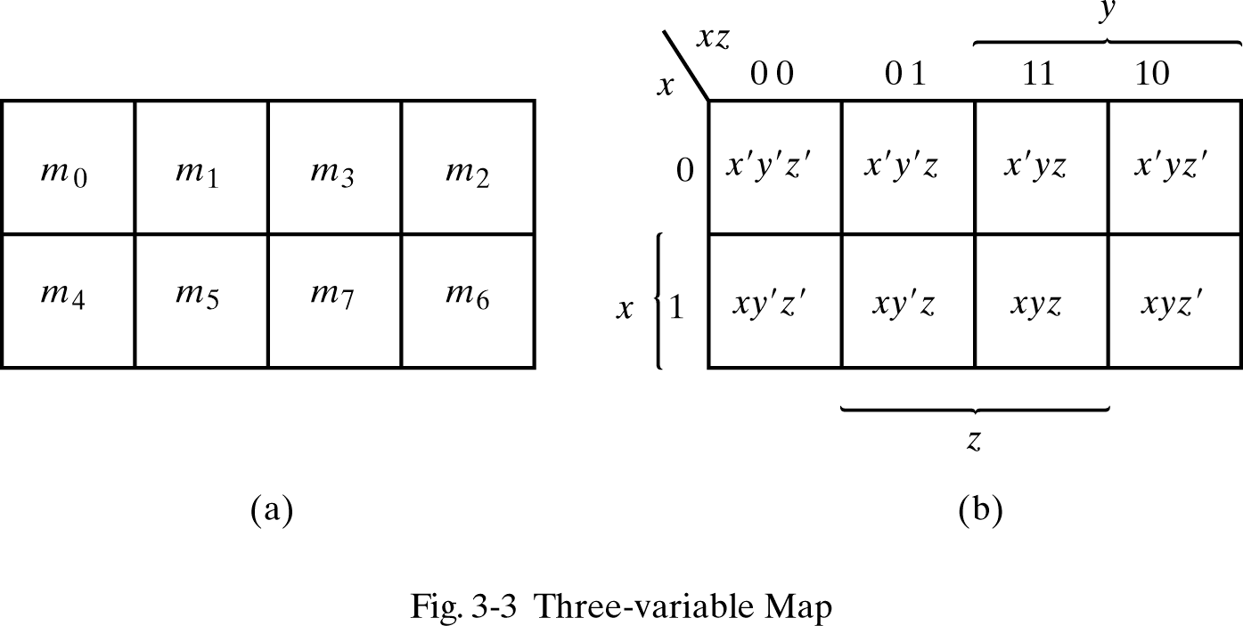
A Three-variable Map
m₀ and m₂ (m₄ and m₆) are adjacent
m₀+ m₂ = x'y'z' + x'yz' = x'z' (y'+y) = x'z'
m₄+ m₆ = xy'z' + xyz' = xz' (y'+y) = xz'

Slide 9
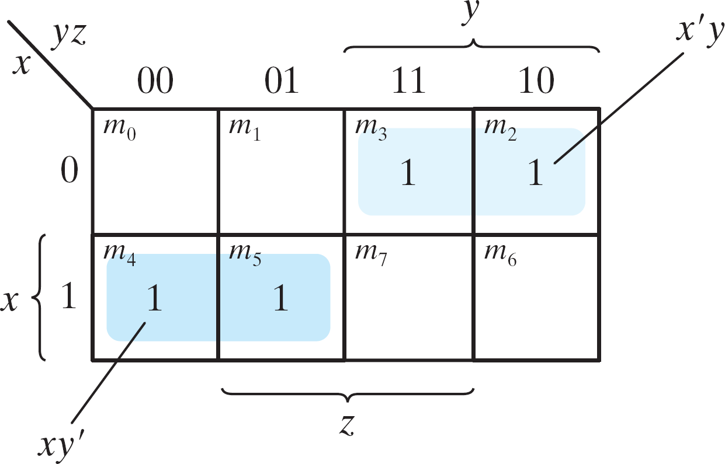
Example 3.1
Example 3.1: simplify the Boolean function F(x, y, z) = Σ(2, 3, 4, 5)
F(x, y, z) = Σ(2, 3, 4, 5) = x'y + xy'
Figure 3.4 Map for Example 3.1, F(x, y, z) = Σ(2, 3, 4, 5) = x'y + xy'

Slide 10
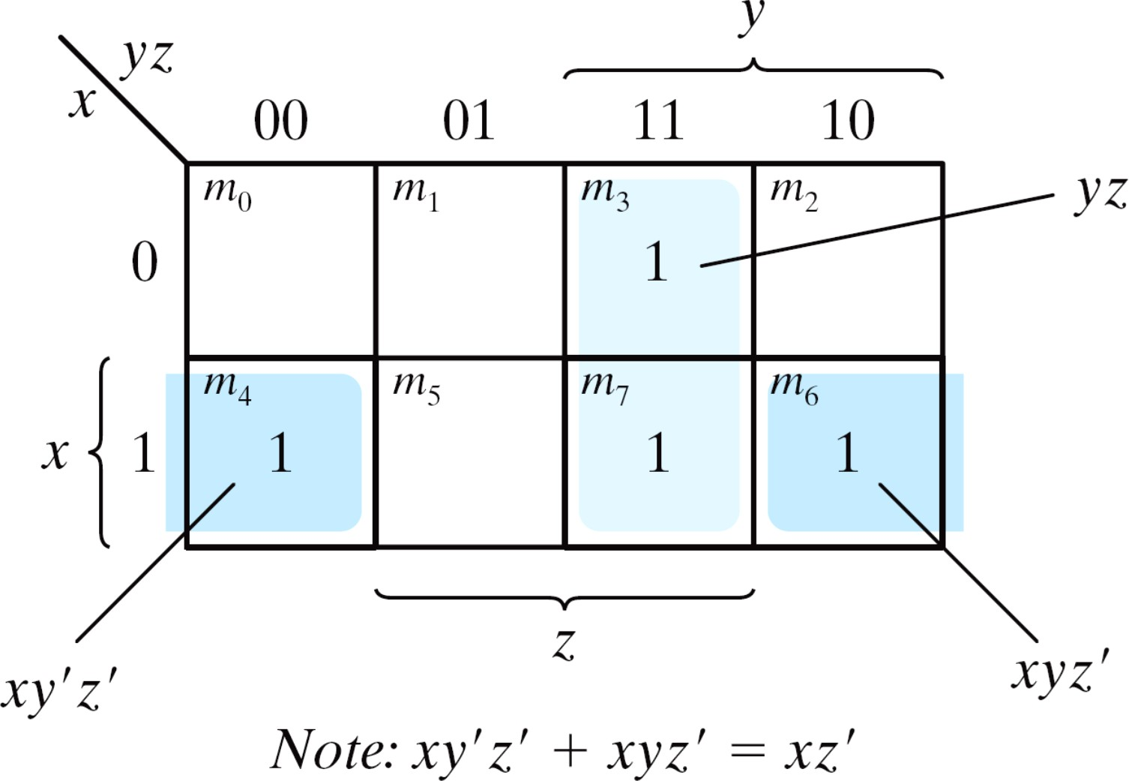
Example 3.2
Example 3.2: simplify F(x, y, z) = Σ(3, 4, 6, 7)
F(x, y, z) = Σ(3, 4, 6, 7) = yz+ xz'
Figure 3.5 Map for Example 3-2; F(x, y, z) = Σ(3, 4, 6, 7) = yz + xz'

Slide 11
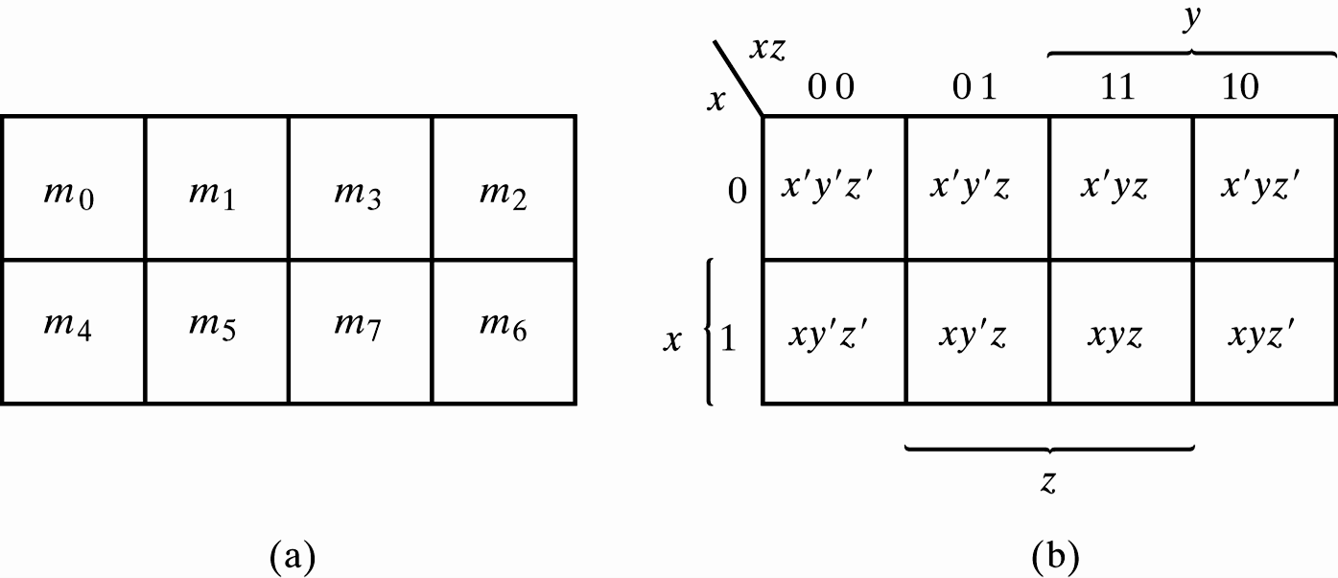
Four adjacent Squares
Consider four adjacent squares
2, 4, and 8 squares
m₀+m₂+m₄+m₆ = x'y'z'+x'yz'+xy'z'+xyz' = x'z'(y'+y) +xz'(y'+y) = x'z' + xz‘ = z'
m₁+m₃+m₅+m₇ = x'y'z+x'yz+xy'z+xyz =x'z(y'+y) + xz(y'+y) =x'z + xz = z
Figure 3.3 Three-variable Map

Slide 12
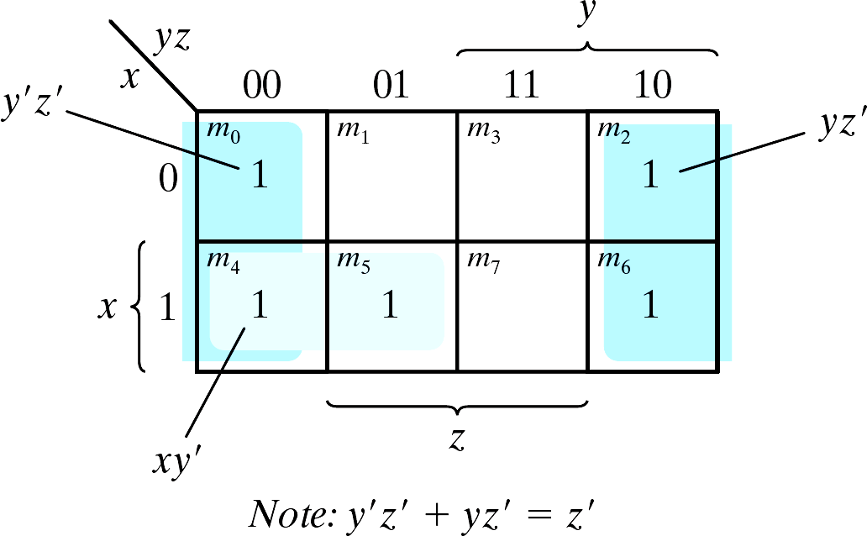
Example 3.3
🞕 Example 3.3: simplify F(x, y, z) = Σ(0, 2, 4, 5, 6)
F(x, y, z) = Σ(0, 2, 4, 5, 6) = z'+ xy'
Figure 3.6 Map for Example 3-3, F(x, y, z) = Σ(0, 2, 4, 5, 6) = z' +xy'

Slide 13
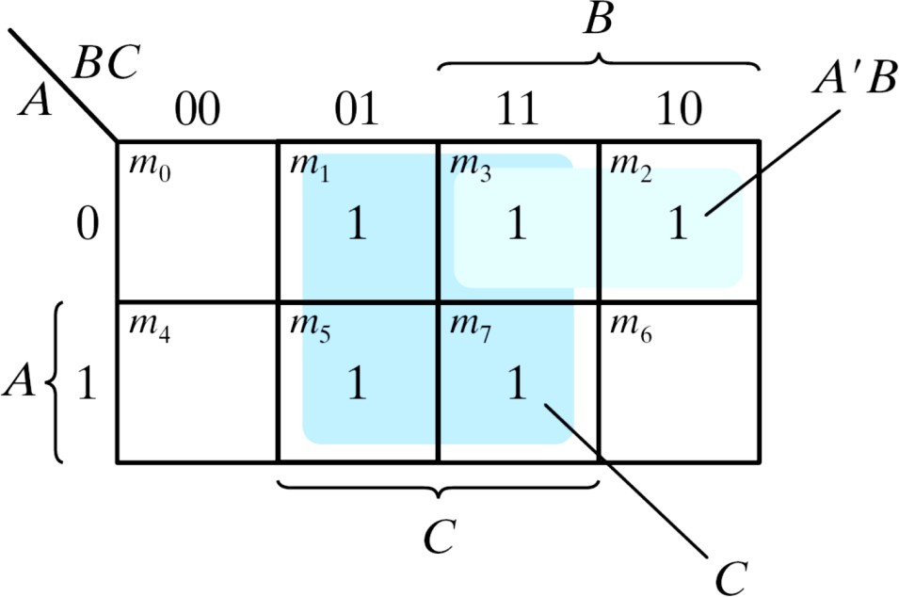
Example 3.4
Example 3.4: let F = A'C + A'B + AB'C + BC
Express it in sum of minterms.
Find the minimal sum of products expression.
Ans:
F(A, B, C) = Σ(1, 2, 3, 5, 7) = C + A'B
Figure 3.7 Map for Example 3.4, A'C + A'B + AB'C + BC = C + A'B

Slide 14
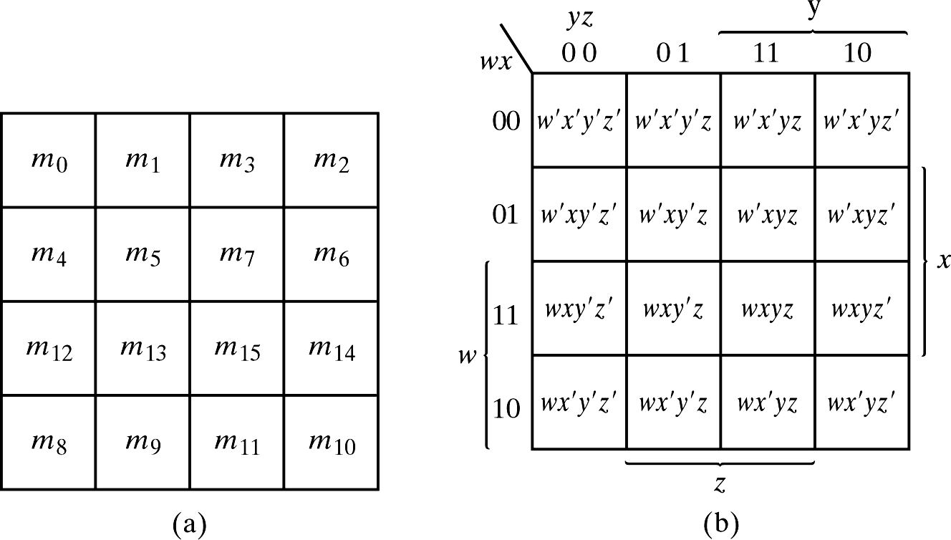
3.3 Four-Variable Map
The map
16 minterms
Combinations of 2, 4, 8, and 16 adjacent squares
Figure 3.8 Four-variable Map
January 1, 2023

Slide 15
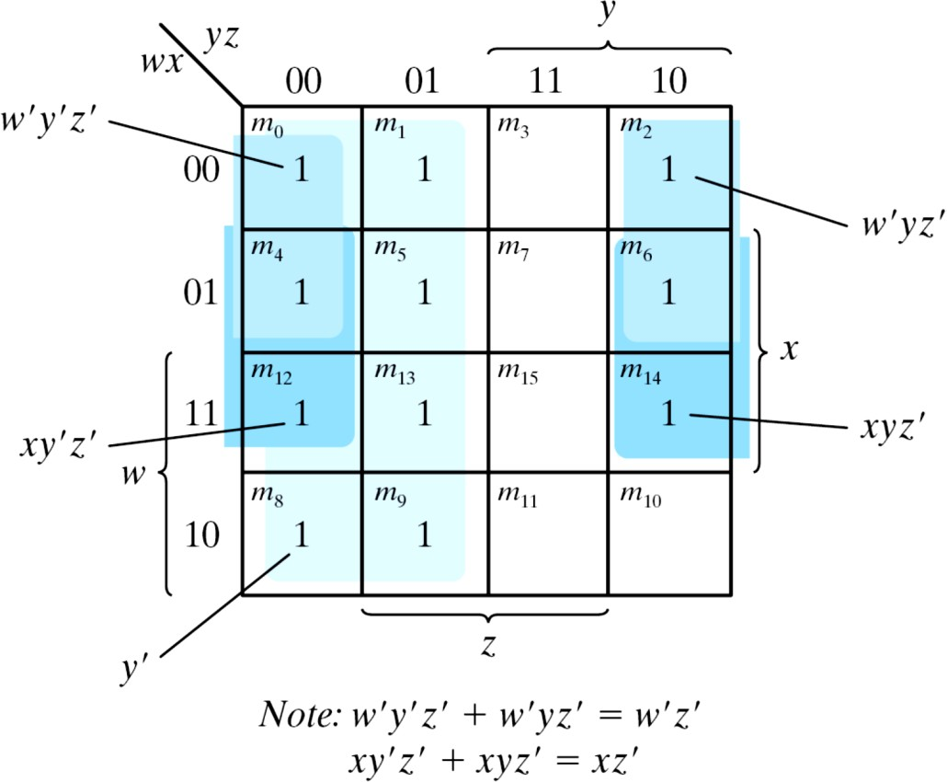
Example 3.5
Example 3.5: simplify F(w, x, y, z) = Σ(0, 1, 2, 4, 5, 6, 8, 9, 12, 13, 14)
F = y'+w'z'+xz'
Figure 3.9 Map for Example 3-5; F(w, x, y, z) = Σ(0, 1, 2, 4, 5, 6, 8, 9, 12, 13, 14) = y' + w' z' +xz'

Slide 16
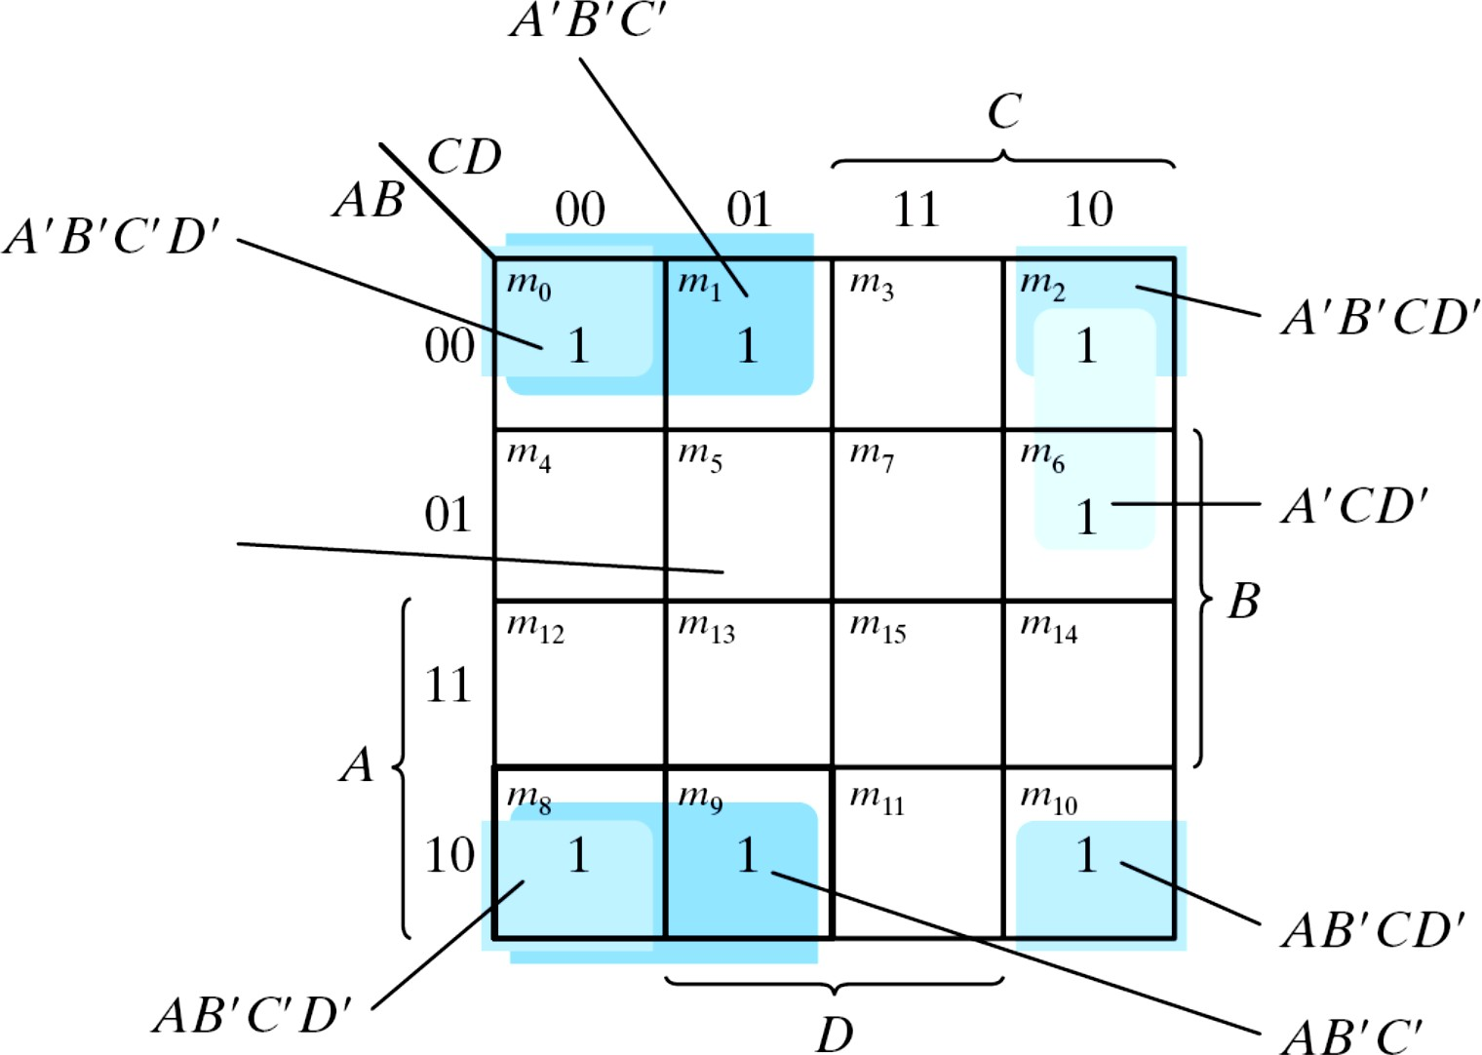
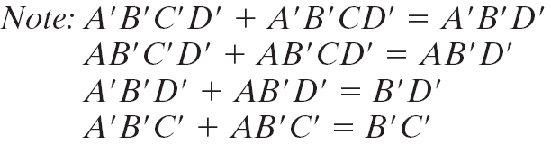
Example 3.6
Example 3-6: simplify F = A′B′C′ + B′CD′ + A′B′C′D′ + AB′C′
Figure 3.9 Map for Example 3-6; A′B′C′ + B′CD′ + A′B′C′D′
+ AB′C′= B′D′ + B′C′ +A′CD′

Slide 17
Prime Implicants
Prime Implicants
All the minterms are covered.
Minimize the number of terms.
A prime implicant: a product term obtained by combining the maximum possible number of adjacent squares (combining all possible maximum numbers of squares).
Essential P.I.: a minterm is covered by only one prime implicant.
The essential P.I. must be included.

Slide 18
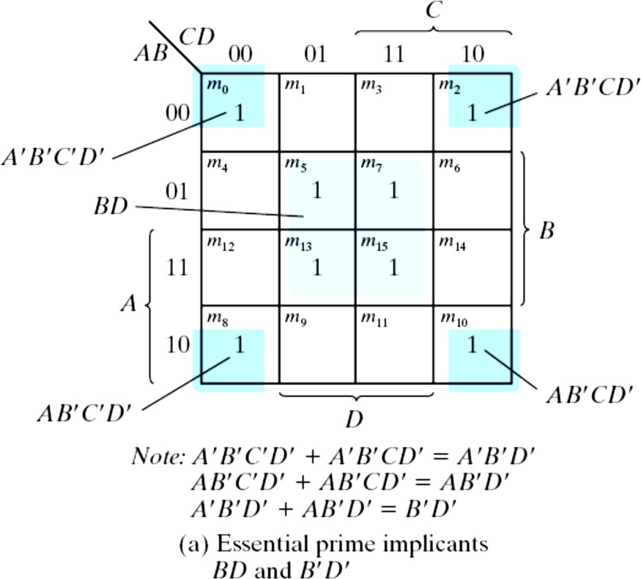
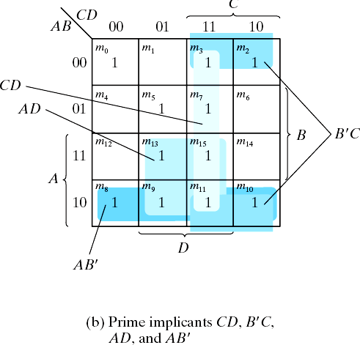
Prime Implicants
Consider F(A, B, C, D) = Σ(0, 2, 3, 5, 7, 8, 9, 10, 11, 13, 15)
The simplified expression may not be unique
F = BD+B'D'+CD+AD = BD+B'D'+CD+AB'
= BD+B'D'+B'C+AD = BD+B'D'+B'C+AB'
Figure 3.11 Simplification Using Prime Implicants

Slide 19
3-5 Product of Sums Simplification
Approach #1
Simplified F' in the form of sum of products
Apply DeMorgan's theorem F = (F')'
F': sum of products → F: product of sums
Approach #2: duality
Combinations of maxterms (it was minterms)
M₀M₁ = (A+B+C+D)(A+B+C+D') = (A+B+C)+(DD') = A+B+C
CD
AB 00
01
11
10
00 01 11 10
M₀ | M₁ | M₃ | M₂
M₄ | M₅ | M₇ | M₆
^{M}12 | ^{M}13 | ^{M}15 | ^{M}14
M₈ | M₉ | ^{M}11 | ^{M}10

Slide 20
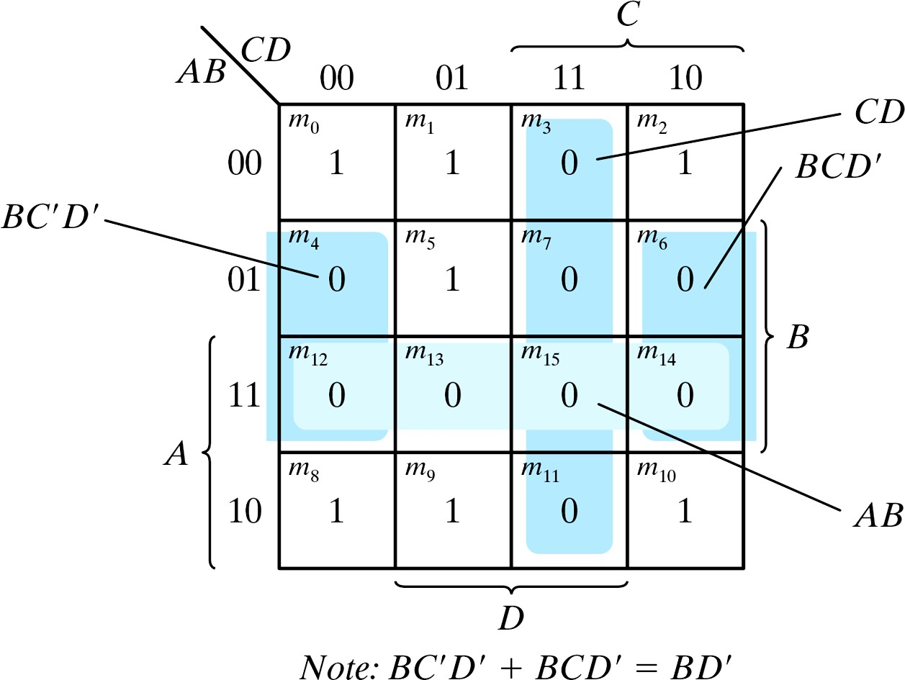
Example 3.8
🞕 Example 3.8: simplify F = Σ(0, 1, 2, 5, 8, 9, 10) into (a) sum-of-products form, and (b) product-of-sums form:
a) F(A, B, C, D)= Σ(0, 1, 2, 5, 8,
9, 10) = B'D'+B'C'+A'C'D
b) F' = AB+CD+BD'
» Apply DeMorgan's theorem;
F=(A'+B')(C'+D')(B'+D)
» Or think in terms of maxterms
Figure 3.14 Map for Example 3.8, F(A, B, C, D)= Σ(0, 1, 2, 5, 8, 9, 10) = B'D'+B'C'+A'C'D

Slide 21
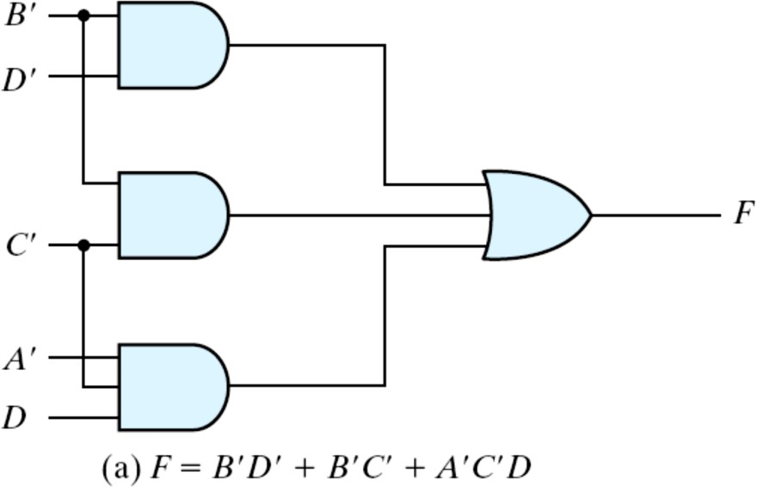
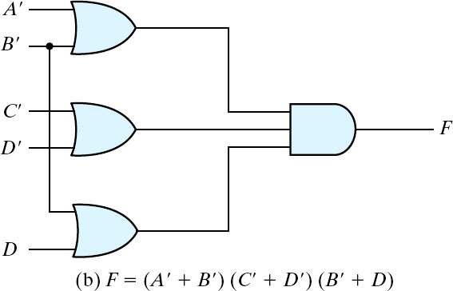
Example 3.8 (cont.)
Gate implementation of the function of Example 3.8
Sum-of products form
Product-of sums form
Figure 3.15 Gate Implementation of the Function of Example 3.8

Slide 22
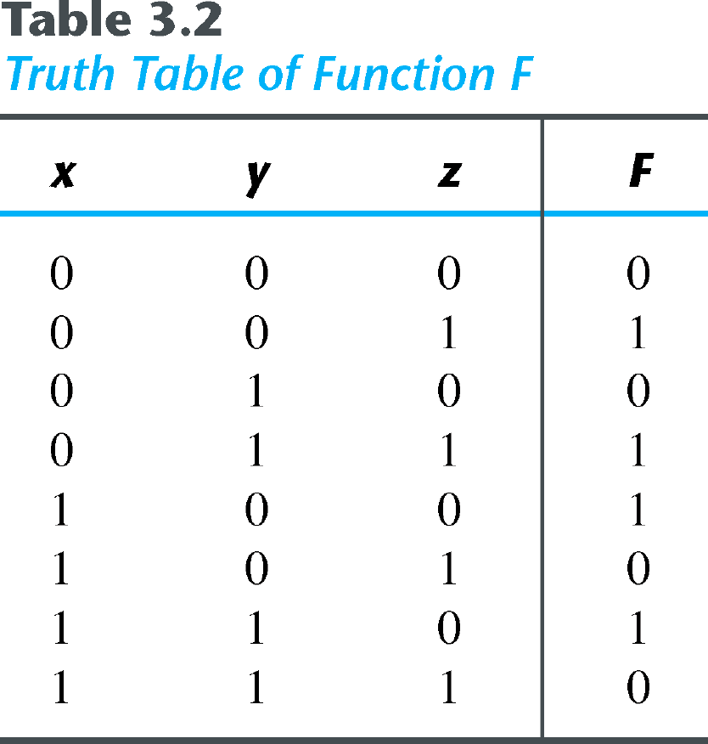
Sum-of-Minterm Procedure
Consider the function defined in Table 3.2.
In sum-of-minterm:
F ( x, y, z) = ∑(1, 3, 4, 6)
In sum-of-maxterm:
F ′( x, y, z) = Π(0, 2,5, 7)
Taking the complement of F′
F ( x, y, z) = ( x′ + z′)( x + z)

Slide 23
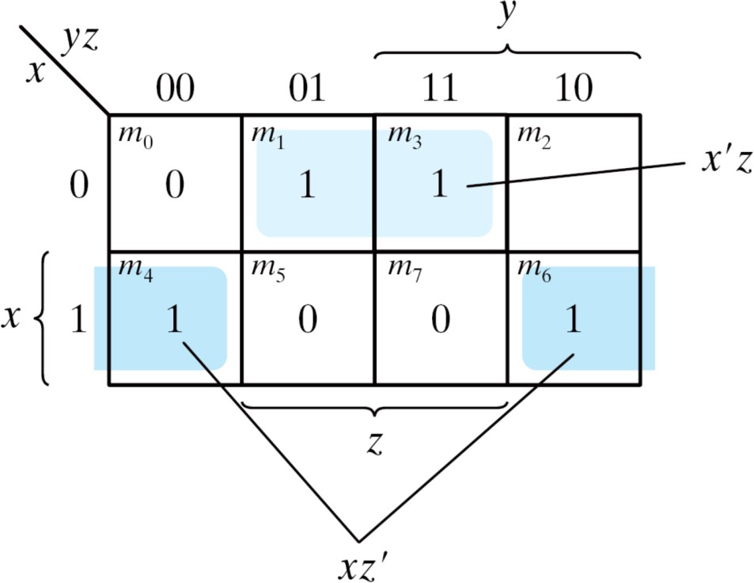
Sum-of-Minterm Procedure
Consider the function defined in Table 3.2.
Combine the 1’s:
F ( x, y, z) = x′z + xz′
Combine the 0’s :
F'( x, y, z) = xz + x′z′
Figure 3.16 Map for the function of Table 3.2

Slide 24
3-6 Don't-Care Conditions
The value of a function is not specified for certain combinations of variables
BCD; 1010-1111: don't care
The don't-care conditions can be utilized in logic minimization
Can be implemented as 0 or 1
Example 3.9: simplify F(w, x, y, z) = Σ(1, 3, 7, 11, 15) which has the don't-care conditions d(w, x, y, z) = Σ(0, 2, 5).

Slide 25
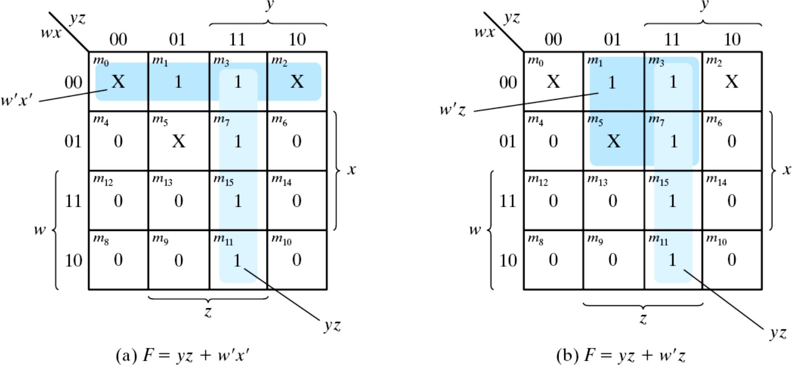
Example 3.9 (cont.)
F = yz + w'x'; F = yz + w'z
F = Σ(0, 1, 2, 3, 7, 11, 15) ; F = Σ(1, 3, 5, 7, 11, 15)
Either expression is acceptable
Figure 3.17 Example with don't-care Conditions

