Slide 1

Computer Architecture and Logic Design (CALD)
Lecture 13
+

Slide 2
Sequential Logic

Slide 3
Sequential Circuits
+
Asynchronous
Inputs
Outputs
Combinational Circuit
Memory Elements
Synchronous
Inputs
Outputs
Combinational Circuit
Flip-flops
Clock

Slide 4
Flip-Flops
+
The memory elements used in clocked sequential circuits
are called flip-flops.
These circuits are binary cells capable of storing one bit of information.
A flip-flop circuit has two outputs; one for the normal value and one for the complement value of the bit stored in it.
Binary information can enter a flip-flop in a variety of ways.
A flip-flop circuit can maintain a binary state indefinitely (as long as power is delivered to the circuit) until directed by an input signal to switch states.

Slide 5
Flip-Flops
+
There are mainly four types of flip-flops:
SR (Set-Reset) Flip-Flop
D (Data) Flip-Flop
T (Toggle) Flip-Flop
JK Flip-Flop

Slide 6
Latch
+
A latch is an electronic device that changes its output
immediately on the basis of the applied input.
One can use it to store either 0 or 1 at a specified time.
A latch contains two inputs- SET and RESET, and it also has
two outputs. They complement each other.
One can use a latch for storing one bit of data.
It is a memory device- just like the flip-flop.
But it is not synchronous, and it does not work on the edges of the clock like the flip-flop.

Slide 7
Latches
+
SR Latch
S R Q₀ | Q | Q’
0 0 0 | 0 | 1
Q = Q₀
0
0
R
Q
Q
S
1
0
Initial Value

Slide 8
Latches
+
SR Latch
S R Q₀ | Q | Q’
0 0 0 | 0 | 1
0 0 1 | 1 | 0
Q = Q₀ Q = Q₀
0
1
R
Q
Q
S
0
0

Slide 9
Latches
+
SR Latch
S R Q₀ | Q | Q’
0 0 0 | 0 | 1
0 0 1 | 1 | 0
0 1 0 | 0 | 1
Q = Q
0
1
0
Q = 0
R
Q
Q
S
1
0

Slide 10
Latches
+
SR Latch
S R Q₀ | Q | Q’
0 0 0 | 0 | 1
0 0 1 | 1 | 0
0 1 0 | 0 | 1
0 1 1 | 0 | 1
Q = Q
0
1
1
Q = 0
Q = 0
R
Q
Q
S
0
0

Slide 11
Latches
+
SR Latch
S R Q₀ | Q | Q’
0 0 0 | 0 | 1
0 0 1 | 1 | 0
0 1 0 | 0 | 1
0 1 1 | 0 | 1
1 0 0 | 1 | 0
Q = Q
0
0
0
Q = 0
Q = 1
R
Q
Q
S
1
1

Slide 12
Latches
+
SR Latch
S R Q₀ | Q | Q’
0 0 0 | 0 | 1
0 0 1 | 1 | 0
0 1 0 | 0 | 1
0 1 1 | 0 | 1
1 0 0 | 1 | 0
1 0 1 | 1 | 0
Q = Q
0
0
1
Q = 0
Q = 1
Q = 1
R
Q
Q
S
0
1

Slide 13
Latches
+
SR Latch
S R Q₀ | Q | Q’
0 0 0 | 0 | 1
0 0 1 | 1 | 0
0 1 0 | 0 | 1
0 1 1 | 0 | 1
1 0 0 | 1 | 0
1 0 1 | 1 | 0
1 1 0 | 0 | 0
Q = Q
0
1
0
Q = 0
R
Q
Q = 1
Q = Q’
Q
S
10
1

Slide 14
Latches
+
SR Latch
S R Q₀ | Q | Q’
0 0 0 | 0 | 1
0 0 1 | 1 | 0
0 1 0 | 0 | 1
0 1 1 | 0 | 1
1 0 0 | 1 | 0
1 0 1 | 1 | 0
1 1 0 | 0 | 0
1 1 1 | 0 | 0
Q = Q
0
1
10
Q = 0
R
Q
Q = 1
Q = Q’ Q = Q’
Q
S
0
1

Slide 15
Latches
+
SR Latch
S R | Q
0 0 | Q₀
0 1 | 0
1 0 | 1
1 1 | Q=Q’=0
R
No change Reset Set Invalid
Q
Q
S
S
S R | Q
0 0 | Q=Q’=1
0 1 | 1
1 0 | 0
1 1 | Q₀
Q
Invalid Set Reset
No change
Q
R

Slide 16
Controlled Latches
+
SR Latch with Control Input
R
R
S
S
Q
Q
C
C
S
Q
R
Q
S
R
C S R | Q
0 x x | Q₀
1 0 0 | Q₀
1 0 1 | 0
1 1 0 | 1
1 1 1 | Q=Q’
No change No change Reset
Set Invalid

Slide 17
Controlled Latches
+
D Latch (D = Data)
Timing Diagram
C
D
S
Q
D
C
R
Q
Q
t
C D | Q
0 x | Q₀
1 0 | 0
1 1 | 1
Output may change
No change Reset Set

Slide 18
Controlled Latches
+
D Latch (D = Data)
Timing Diagram
C
D
S
Q
D
C
R
Q
Q
C D | Q
0 x | Q₀
1 0 | 0
1 1 | 1
Output may change
No change Reset Set

Slide 19
Flip-Flops
+
Controlled latches are level-triggered
C
Flip-Flops are edge-triggered
CLK
Positive Edge
CLK
Negative Edge

Slide 20
Flip-Flops
+
Master-Slave D Flip-Flop
D D
Q
D
Q
Q
D Latch
(Master)
D Latch
(Slave)
C
C
Master
Slave
CLK
CLK
D
Looks like it is negative edge-triggered
^{Q}Master
^{Q}Slave

Slide 21
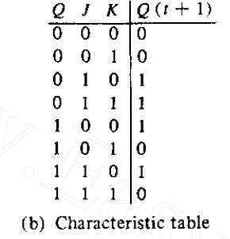
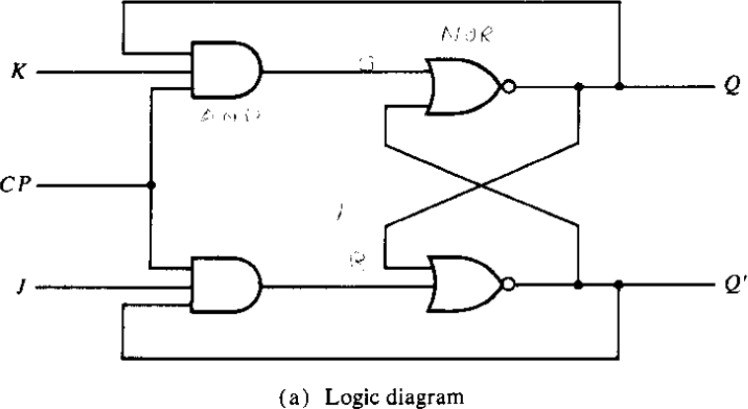
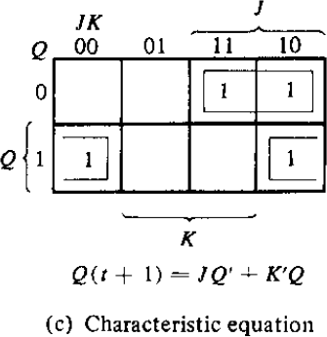

Flip-Flops
+
JK Flip-Flop
Q
Q

Slide 22
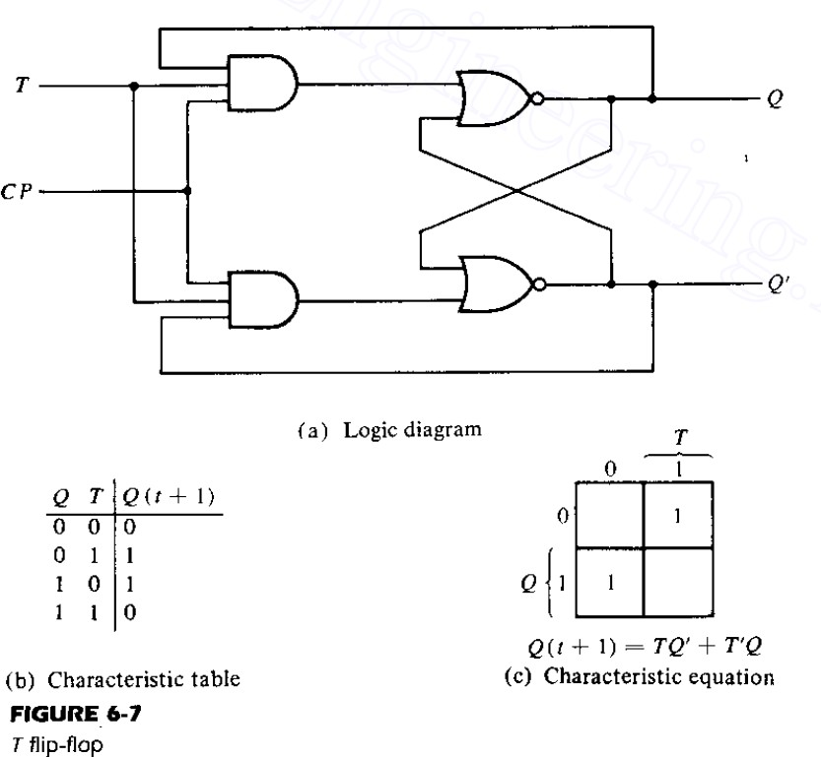

Flip-Flops
+
T Flip-Flop
T Q
Q

Slide 23


Flip-Flop Characteristic Tables
+
D Q
D | Q(t+1)
0 | 0
1 | 1
Reset Set
Q
J | K | Q(t+1)
0 | 0 | Q(t)
0 | 1 | 0
1 | 0 | 1
1 | 1 | Q’(t)
J Q
No change Reset Set Toggle
K Q
T Q
T | Q(t+1)
0 | Q(t)
1 | Q’(t)
No change Toggle
Q

Slide 24
Flip-Flop Characteristic Equations
+
D Q
D | Q(t+1)
0 | 0
1 | 1
Q(t+1) = D
Q
J Q
J | K | Q(t+1)
0 | 0 | Q(t)
0 | 1 | 0
1 | 0 | 1
1 | 1 | Q’(t)
Q(t+1) = JQ’ + K’Q
K Q
T Q
T | Q(t+1)
0 | Q(t)
1 | Q’(t)
Q(t+1) = T ⊕ Q
Q

Slide 25

Flip-Flop Characteristic Equations
+
Analysis / Derivation
 | J | K | Q(t) | Q(t+1)
 | 0 | 0 | 0 | 0
 | 0 | 0 | 1 | 1
 | 0 | 1 | 0
 | 0 | 1 | 1
 | 1 | 0 | 0
 | 1 | 0 | 1
 | 1 | 1 | 0
 | 1 | 1 | 1
No change
Q
Q

Slide 26
Flip-Flop Characteristic Equations
+
Analysis / Derivation
 | J | K | Q(t) | Q(t+1)
 | 0 | 0 | 0 | 0
 | 0 | 0 | 1 | 1
 | 0 | 1 | 0 | 0
 | 0 | 1 | 1 | 0
 | 1 | 0 | 0
 | 1 | 0 | 1
 | 1 | 1 | 0
 | 1 | 1 | 1
No change
J Q
Reset
K Q

Slide 27
Flip-Flop Characteristic Equations
+
Analysis / Derivation
 | J | K | Q(t) | Q(t+1)
 | 0 | 0 | 0 | 0
 | 0 | 0 | 1 | 1
 | 0 | 1 | 0 | 0
 | 0 | 1 | 1 | 0
 | 1 | 0 | 0 | 1
 | 1 | 0 | 1 | 1
 | 1 | 1 | 0
 | 1 | 1 | 1
No change
J Q
Reset
K Q
Set

Slide 28
Flip-Flop Characteristic Equations
+
Analysis / Derivation
 | J | K | Q(t) | Q(t+1)
 | 0 | 0 | 0 | 0
 | 0 | 0 | 1 | 1
 | 0 | 1 | 0 | 0
 | 0 | 1 | 1 | 0
 | 1 | 0 | 0 | 1
 | 1 | 0 | 1 | 1
 | 1 | 1 | 0 | 1
 | 1 | 1 | 1 | 0
No change
J Q
Reset
K Q
Set
Toggle

Slide 29
Flip-Flop Characteristic Equations
+
Analysis / Derivation
J | K | Q(t) | Q(t+1)
0 | 0 | 0 | 0
0 | 0 | 1 | 1
0 | 1 | 0 | 0
0 | 1 | 1 | 0
1 | 0 | 0 | 1
1 | 0 | 1 | 1
1 | 1 | 0 | 1
1 | 1 | 1 | 0
Q
Q
K
 | 0 |  | 1 | 0 |  | 0
J | 1 |  | 1 | 0 |  | 1
 |  | Q
Q(t+1) = JQ’ + K’Q

