Slide 1

Computer Architecture and Logic Design (CALD)
Lecture 14
+

Slide 2
Analysis of Clocked Sequential Circuits

Slide 3
Analysis of Clocked Sequential Circuits
+
The State
State = Values of all Flip-Flops
x
Example
D Q
A
A B = 0 0
Q
D Q
B
CLK
Q
y
Eastern Mediterranean University

Slide 4
Analysis of Clocked Sequential
+
Circuits
State Equations
A(t+1) = D
x
D Q
A
A
= A(t) x(t)+B(t) x(t)
= A x + B x B(t+1) = D_{B}
= A’(t) x(t)
Q
D Q
B
CLK
Q
= A’ x
= [A(t)+ B(t)] x’(t)
= (A + B) x’
y
y(t)
Eastern Mediterranean University

Slide 5

Analysis of Clocked Sequential
+
Circuits
State Table (Transition Table)
x
Present State |  |  |  | Input | Next State |  | Output
 | A | B |  | x | A | B | y
 | 0 | 0 |  | 0 | 0 0 |  | 0
 | 0 | 0 |  | 1 | 0 1 |  | 0
 | 0 | 1 |  | 0 | 0 0 |  | 1
 | 0 | 1 |  | 1 | 1 1 |  | 0
 | 1 | 0 |  | 0 | 0 0 |  | 1
 | 1 | 0 |  | 1 | 1 0 |  | 0
 | 1 | 1 |  | 0 | 0 0 |  | 1
 | 1 | 1 |  | 1 | 1 0 |  | 0
D Q
A
Q
D Q
B
CLK
Q
y
A(t+1) = A x + B x B(t+1) = A’ x
y(t)
= (A + B) x’
t
t+1
t
Eastern Mediterranean University

Slide 6
Analysis of Clocked Sequential
+
Circuits
State Table (Transition Table)
x
D Q
A
Present State |  | Next State |  |  |  | Output
 |  | x = 0 |  | x = 1 |  | x = 0 | x = 1
A | B | A | B | A | B | y | y
0 | 0 | 0 | 0 | 0 | 1 | 0 | 0
0 | 1 | 0 | 0 | 1 | 1 | 1 | 0
1 | 0 | 0 | 0 | 1 | 0 | 1 | 0
1 | 1 | 0 | 0 | 1 | 0 | 1 | 0
Q
D Q
B
CLK
Q
y
A(t+1) = A x + B x B(t+1) = A’ x
t
t+1
t
y(t)
= (A + B) x’
Eastern Mediterranean University

Slide 7
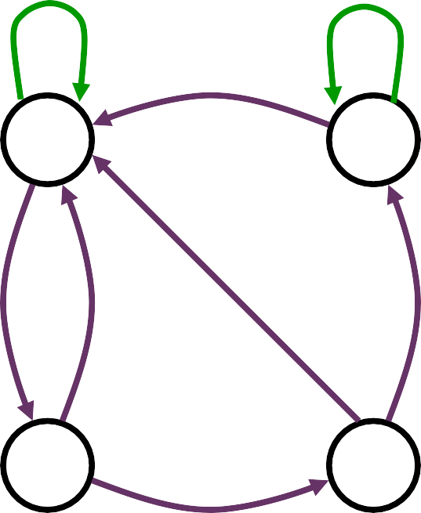

Analysis of Clocked Sequential
Circuits
State Diagram
Present State |  | Next State |  |  |  | Output
 |  | x = 0 |  | x = 1 |  | x = 0 | x = 1
A | B | A | B | A | B | y | y
0 | 0 | 0 | 0 | 0 | 1 | 0 | 0
0 | 1 | 0 | 0 | 1 | 1 | 1 | 0
1 | 0 | 0 | 0 | 1 | 0 | 1 | 0
1 | 1 | 0 | 0 | 1 | 0 | 1 | 0
AB
input/output
0/0
1/0
0/1
0 0
1 0
x
D Q
Q
A
0/1
1/0
0/1
1/0
D Q
Q
B
CLK
0 1
1 1
y
1/0
Eastern Mediterranean

Slide 8

Analysis of Clocked Sequential Circuits
+
D Flip-Flops
Example:
x
D Q
A
y
Present State | Input |  | Next State
A | x | y | A
0 | 0 | 0 | 0
0 | 0 | 1 | 1
0 | 1 | 0 | 1
0 | 1 | 1 | 0
1 | 0 | 0 | 1
1 | 0 | 1 | 0
1 | 1 | 0 | 0
1 | 1 | 1 | 1
CLK
Q
A(t+1) = D_{A} = A ⊕ x ⊕ y
01,10
00,11
0
1
00,11
01,10
Eastern Mediterranean University

Slide 9
Analysis of Clocked Sequential Circuits
+
JK Flip-Flops
Q A
Q
Example:
x
Present State |  | I/P | Next State |  | Flip-Flop Inputs
A | B | x | A | B | J_{A} | K_{A} | J_{B} | K_{B}
0 | 0 | 0 | 0 1 |  | 0 0 |  | 1 0
0 | 0 | 1 | 0 0 |  | 0 0 |  | 0 1
0 | 1 | 0 | 1 1 |  | 1 1 |  | 1 0
0 | 1 | 1 | 1 0 |  | 1 0 |  | 0 1
1 | 0 | 0 | 1 1 |  | 0 0 |  | 1 1
1 | 0 | 1 | 1 0 |  | 0 0 |  | 0 0
1 | 1 | 0 | 0 0 |  | 1 1 |  | 1 1
1 | 1 | 1 | 1 1 |  | 1 0 |  | 0 0
J Q
B
K Q
CLK
J_{A} = B J_{B} = x’
K_{A} = B x’
K_{B} = A ⊕ x
A(t+1) = J_{A} Q’_{A} + K’_{A} Q_{A}
= A’B + AB’ + Ax
B(t+1) = J_{B} Q’_{B} + K’_{B} Q_{B}
= B’x’ + ABx + A’Bx’
Eastern Mediterranean University

Slide 10
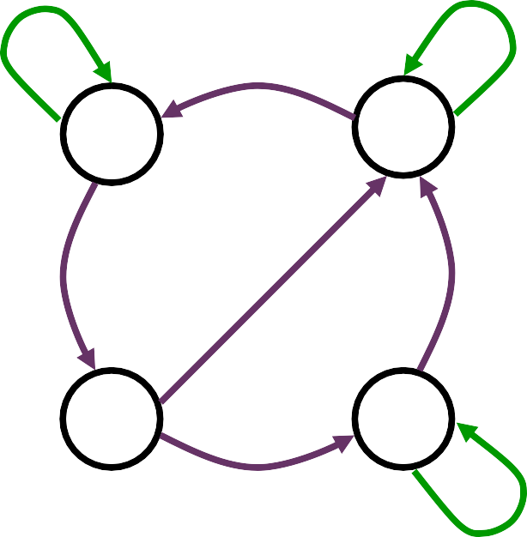
Analysis of Clocked Sequential Circuits
+
JK Flip-Flops
Q A
Q
Example:
x
Present State |  | I/P | Next State |  | Flip-Flop Inputs
A | B | x | A | B | J_{A} | K_{A} | J_{B} | K_{B}
0 | 0 | 0 | 0 1 |  | 0 0 |  | 1 0
0 | 0 | 1 | 0 0 |  | 0 0 |  | 0 1
0 | 1 | 0 | 1 1 |  | 1 1 |  | 1 0
0 | 1 | 1 | 1 0 |  | 1 0 |  | 0 1
1 | 0 | 0 | 1 1 |  | 0 0 |  | 1 1
1 | 0 | 1 | 1 0 |  | 0 0 |  | 0 0
1 | 1 | 0 | 0 0 |  | 1 1 |  | 1 1
1 | 1 | 1 | 1 1 |  | 1 0 |  | 0 0
B
J Q
K Q
CLK
1
0
1
0 0
1 1
0
0
0
0 1
1 0
1
1
Eastern Mediterranean University

Slide 11
Analysis of Clocked Sequential Circuits
+
T Flip-Flops
x
T
_{Q} A
y
Example:
R
Q
Present State |  | I/P | Next State |  | F.F Inputs |  | O/P
A | B | x | A | B | T_{A} | T_{B} | y
0 | 0 | 0 | 0 0 |  | 0 | 0 | 0
0 | 0 | 1 | 0 1 |  | 0 | 1 | 0
0 | 1 | 0 | 0 1 |  | 0 | 0 | 0
0 | 1 | 1 | 1 0 |  | 1 | 1 | 0
1 | 0 | 0 | 1 0 |  | 0 | 0 | 0
1 | 0 | 1 | 1 1 |  | 0 | 1 | 0
1 | 1 | 0 | 1 1 |  | 0 | 0 | 1
1 | 1 | 1 | 0 0 |  | 1 | 1 | 1
T Q
B
R
Q
CLK
Reset
T = B x
T = x
A
y = A B
B
A(t+1) = T_{A} Q’_{A} + T’_{A} Q_{A}
= AB’ + Ax’ + A’Bx
B(t+1) = T_{B} Q’_{B} + T’_{B} Q_{B}
= x ⊕ B
Eastern Mediterranean University

Slide 12
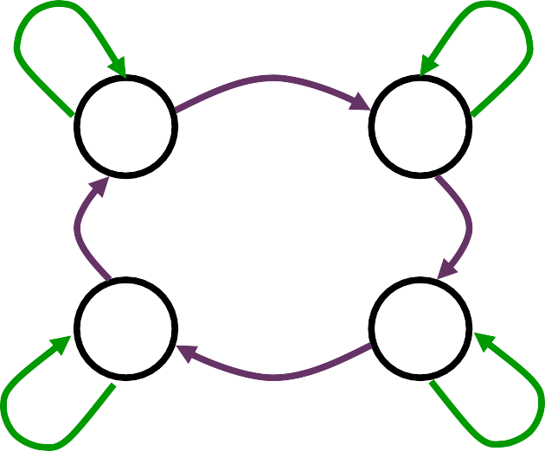
Analysis of Clocked Sequential Circuits
+
T Flip-Flops
x
T Q
A
y
Example:
R
Q
Present State |  | I/P | Next State |  | F.F Inputs |  | O/P
A | B | x | A | B | T_{A} | T_{B} | y
0 | 0 | 0 | 0 0 |  | 0 | 0 | 0
0 | 0 | 1 | 0 1 |  | 0 | 1 | 0
0 | 1 | 0 | 0 1 |  | 0 | 0 | 0
0 | 1 | 1 | 1 0 |  | 1 | 1 | 0
1 | 0 | 0 | 1 0 |  | 0 | 0 | 0
1 | 0 | 1 | 1 1 |  | 0 | 1 | 0
1 | 1 | 0 | 1 1 |  | 0 | 0 | 1
1 | 1 | 1 | 0 0 |  | 1 | 1 | 1
T Q
B
R
Q
CLK
Reset
0/0
0/0
0 0
1/0
0 1
1/1
1/0
1 1
1 0
0/1
0/0
1/0
Eastern Mediterranean University

