Slide 1

Computer Architecture and Logic Design (CALD)
Lecture 15
+

Slide 2
State Reduction and Assignment

Slide 3
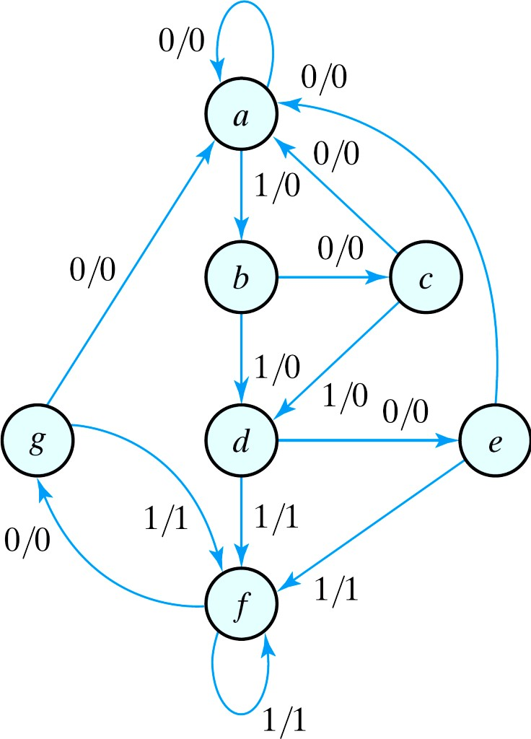
State Reduction and Assignment
State Reduction
Reductions on the number of flip- flops and the number of gates.
A reduction in the number of states may result in a reduction in the number of flip-flops.
An example state diagram showing in Fig. 5.25.
Fig. 5.25 State diagram

Slide 4
State Reduction
State: | a | a | b | c | d | e | f | f | g | f | g | a
Input: | 0 | 1 | 0 | 1 | 0 | 1 | 1 | 0 | 1 | 0 | 0
Output: | 0 | 0 | 0 | 0 | 0 | 1 | 1 | 0 | 1 | 0 | 0
Only the input-output sequences are important.
Two circuits are equivalent
Have identical outputs for all
input sequences;
The number of states is not important.
Fig. 5.25 State diagram

Slide 5
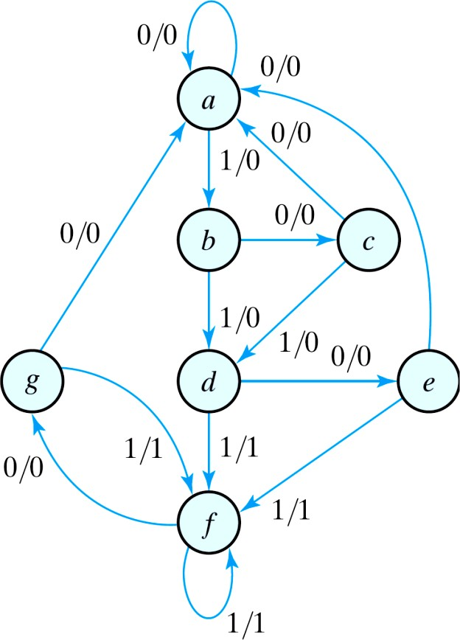
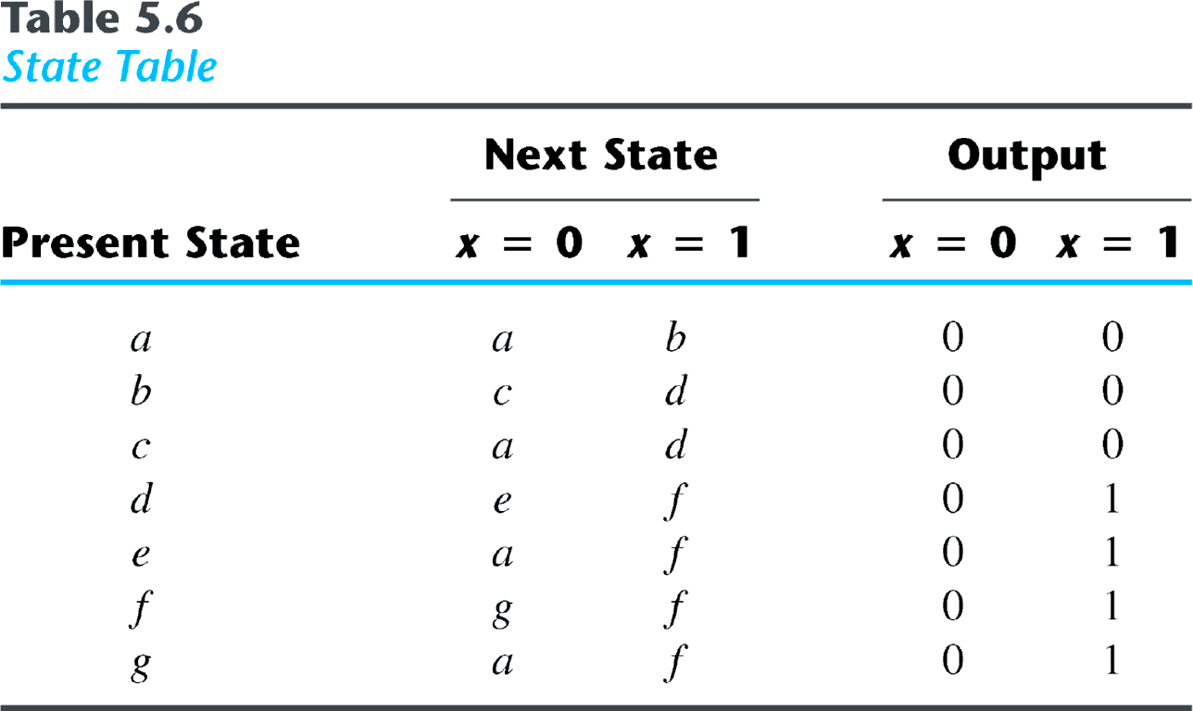
Equivalent states
Two states are said to be equivalent
For each member of the set of inputs, they give exactly the same output and send the circuit to the same state or to an equivalent state.
One of them can be removed.

Slide 6
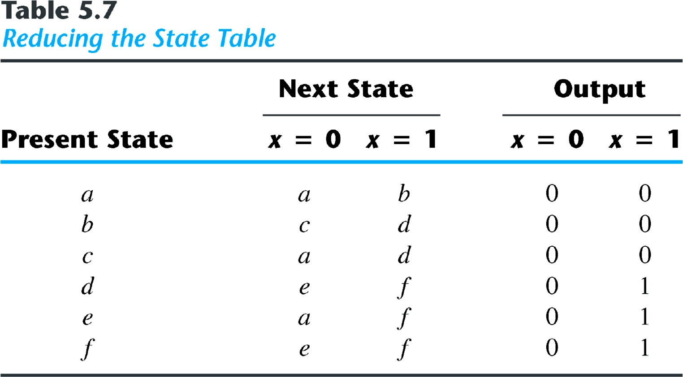
Reducing the state table
e = g (remove g);
d = f (remove f);

Slide 7
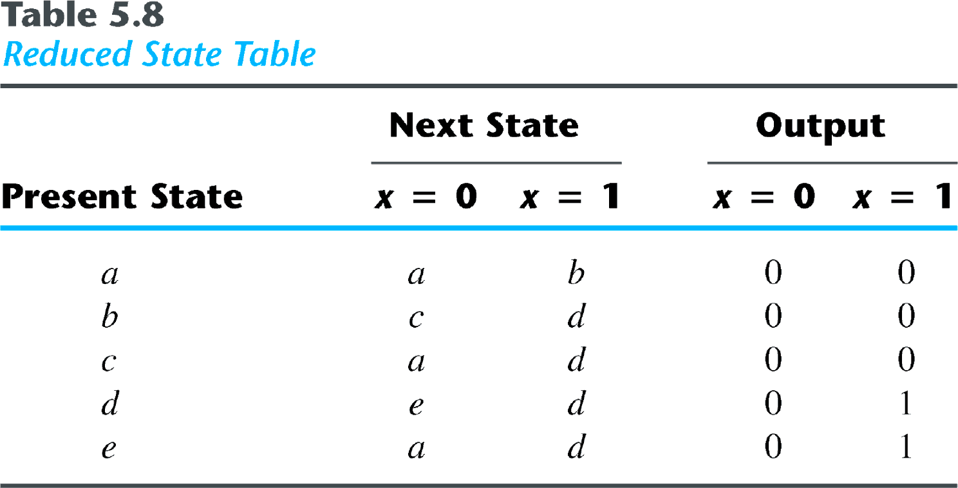
The reduced finite state machine
State: | a | a | b | c | d | e | d | d | e | d | e | a
Input: | 0 | 1 | 0 | 1 | 0 | 1 | 1 | 0 | 1 | 0 | 0
Output: | 0 | 0 | 0 | 0 | 0 | 1 | 1 | 0 | 1 | 0 | 0

Slide 8
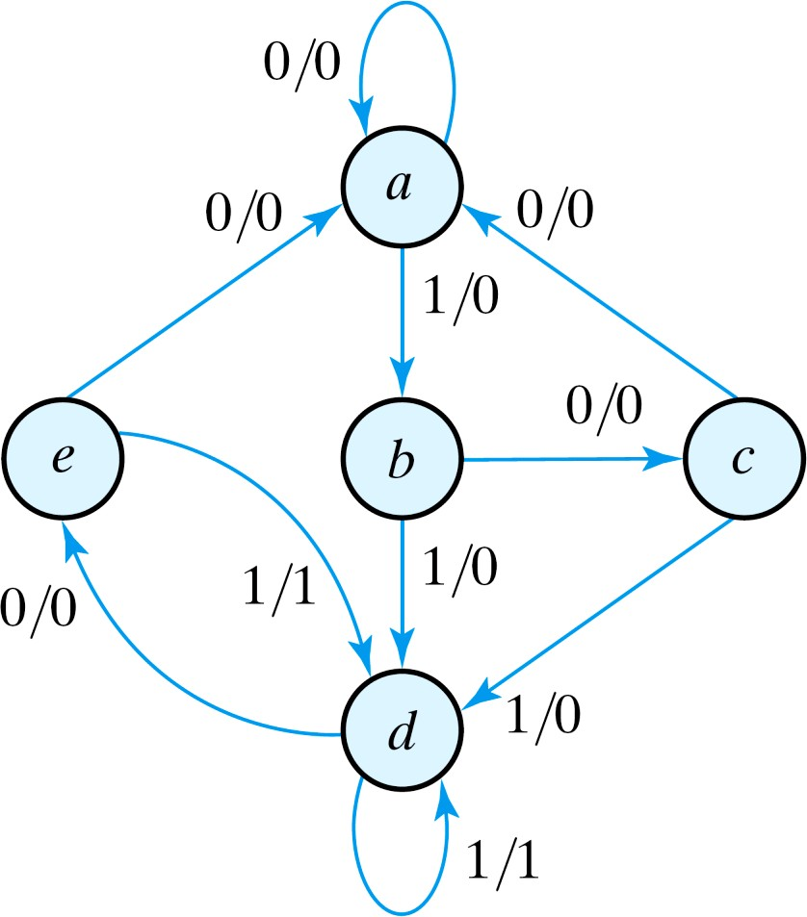

The checking of each pair of states for possible equivalence can be done systematically using Implication Table.
The unused states are treated as don't-care condition ⇒ fewer combinational gates.
Fig. 5.26
Reduced State diagram

Slide 9
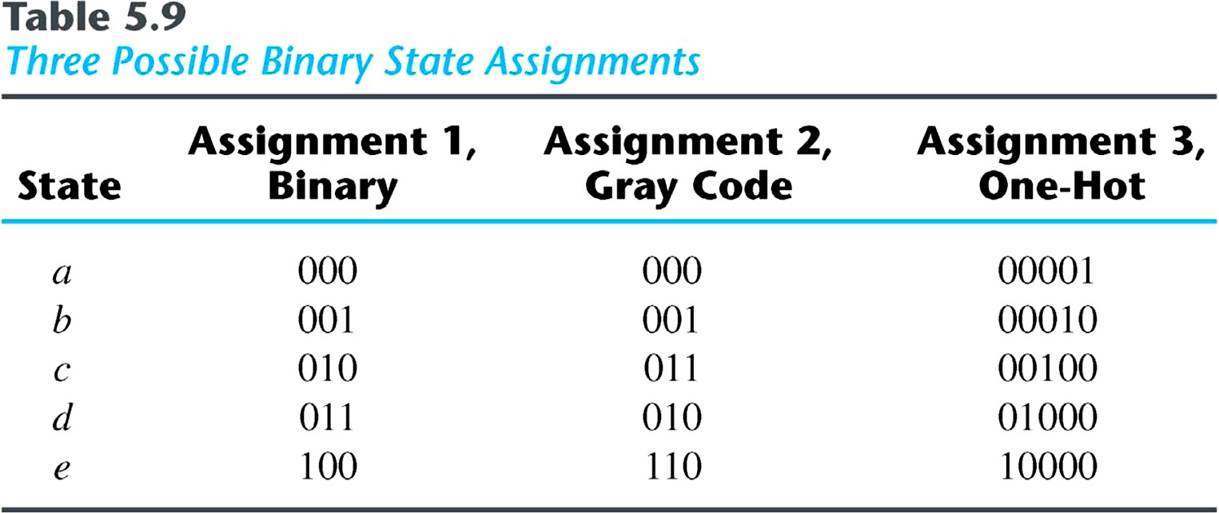
State Assignment
State Assignment
To minimize the cost of the combinational circuits.
Three possible binary state assignments. (m states need n-bits, where 2^{n}
> m)

Slide 10
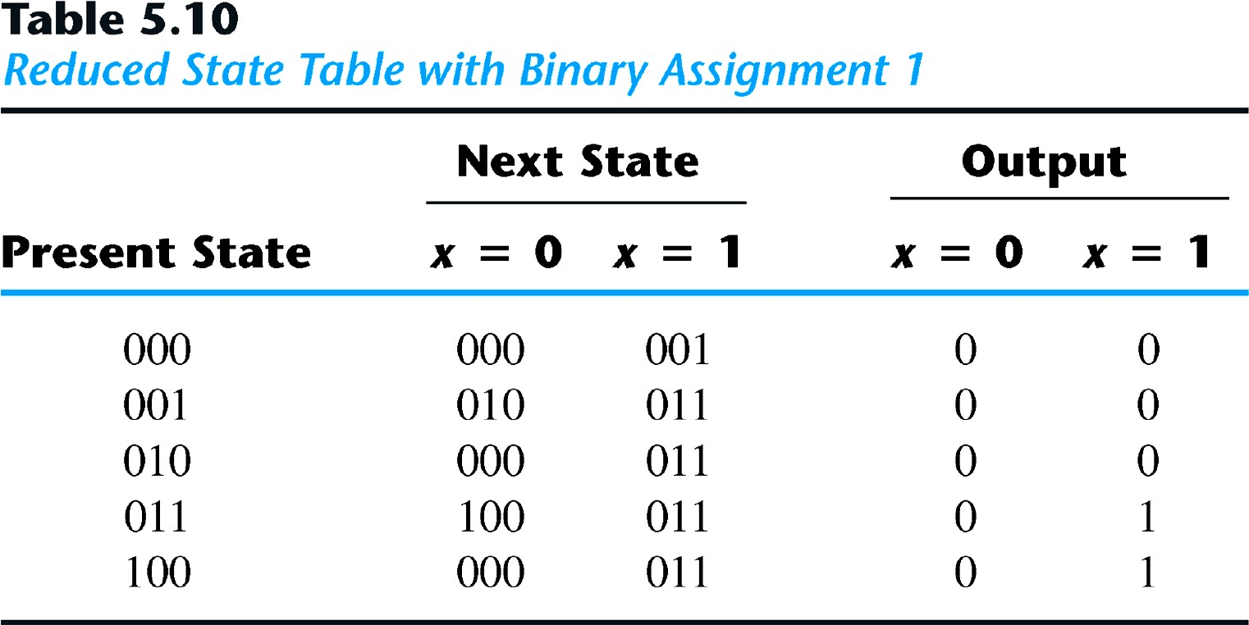
Any binary number assignment is satisfactory as long as each state is assigned a unique number.
Use binary assignment 1.

