Slide 1

Computer Architecture and Logic Design (CALD)
Lecture 16
+

Slide 2
Design Process of Synchronous Sequential Circuits

Slide 3
Design Procedure
Design Procedure for sequential circuit
The word description of the circuit behavior to get a state diagram;
State reduction if necessary;
Assign binary values to the states;
Obtain the binary-coded state table;
Choose the type of flip-flops;
Derive the simplified flip-flop input equations and output equations;
Draw the logic diagram;

Slide 4
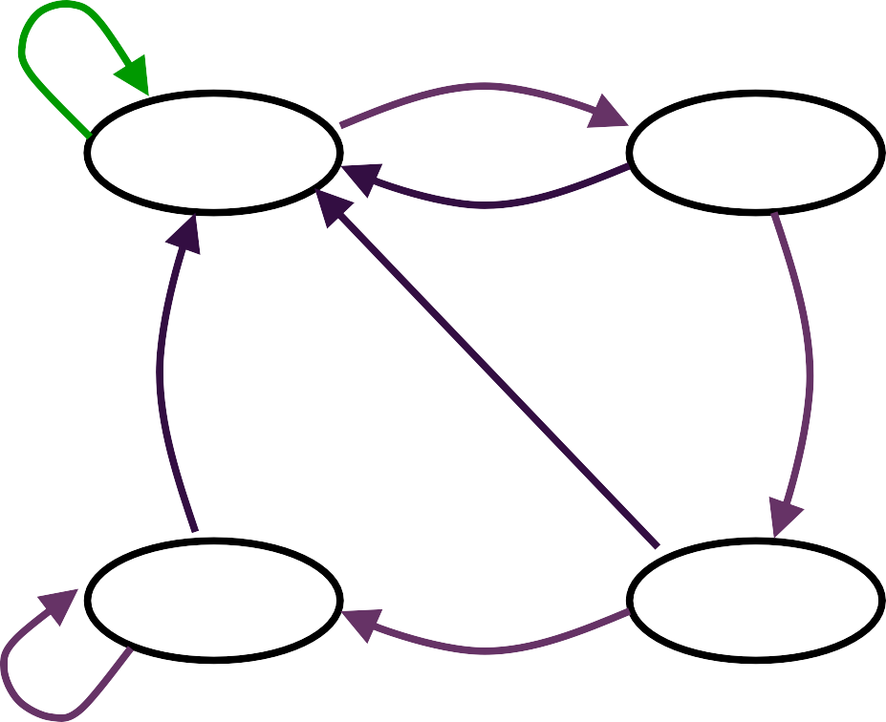
Design of Clocked Sequential Circuits
+
Example:
Detect 3 or more consecutive 1’s
0
1
S₀ / 0
S₁ / 0
0
State | A B
S₀ | 0 0
S₁ | 0 1
S₂ | 1 0
S₃ | 1 1
0
1
0
S₃ / 1
S₂ / 0
1
1

Slide 5
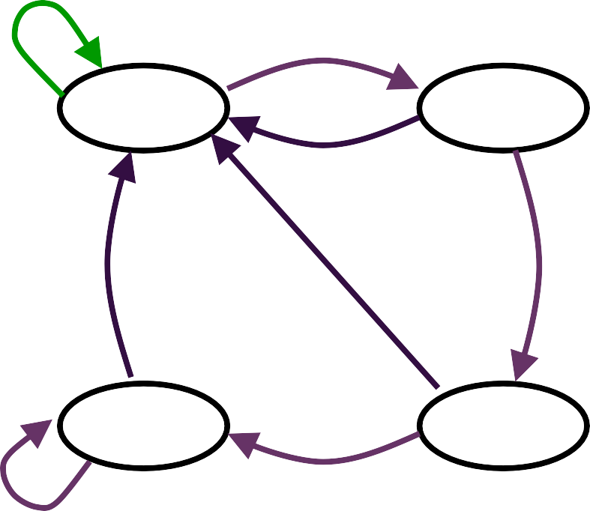
Design of Clocked Sequential Circuits
+
Example:
Detect 3 or more consecutive 1’s
Present State |  |  |  | Input | Next State |  | Output
 | A | B |  | x | A | B | y
 | 0 | 0 |  | 0 | 0 0 |  | 0
 | 0 | 0 |  | 1 | 0 1 |  | 0
 | 0 | 1 |  | 0 | 0 0 |  | 0
 | 0 | 1 |  | 1 | 1 0 |  | 0
 | 1 | 0 |  | 0 | 0 0 |  | 0
 | 1 | 0 |  | 1 | 1 1 |  | 0
 | 1 | 1 |  | 0 | 0 0 |  | 1
 | 1 | 1 |  | 1 | 1 1 |  | 1
0
1
S₀ / 0
S₁ / 0
0
0
1
0
S / 1
S / 0
3
2
1
1

Slide 6

Design of Clocked Sequential Circuits
+
Example:
Detect 3 or more consecutive 1’s
Present State |  | Input | Next State |  | Output
A | B | x | A | B | y
0 | 0 | 0 | 0 0 |  | 0
0 | 0 | 1 | 0 1 |  | 0
0 | 1 | 0 | 0 0 |  | 0
0 | 1 | 1 | 1 0 |  | 0
1 | 0 | 0 | 0 0 |  | 0
1 | 0 | 1 | 1 1 |  | 0
1 | 1 | 0 | 0 0 |  | 1
1 | 1 | 1 | 1 1 |  | 1
Synthesis using D Flip-Flops
A(t+1) = D_{A} (A, B, x)
= ∑ (3, 5, 7)
B(t+1) = D_{B} (A, B, x)
= ∑ (1, 5, 7)
y (A, B, x) = ∑ (6, 7)

Slide 7

Design of Clocked Sequential Circuits
+
with D F.F.
Example:
Detect 3 or more consecutive 1’s
Synthesis using D Flip-Flops
D_{A} (A, B, x) = ∑ (3, 5, 7)
= A x + B x D_{B} (A, B, x) = ∑ (1, 5, 7)
= A x + B’ x
y (A, B, x) = ∑ (6, 7)
B
 | 0 | 0 | 1 | 0
A | 0 | 1 | 1 | 0
 |  | x
B
 | 0 | 1 | 0 | 0
A | 0 | 1 | 1 | 0
 |  | x
B
 | 0 | 0 | 0 | 0
A | 0 | 0 | 1 | 1
 |  | x
= A B
Eastern Mediterranean University

Slide 8
Design of Clocked Sequential
+
Circuits with D F.F.
Example:
Detect 3 or more consecutive 1’s
Synthesis using D Flip-Flops
D_{A} = A x + B x D_{B} = A x + B’ x y = A B
x
D Q
A
Q
y
D Q
B
CLK
Q

Slide 9
Flip-Flop Excitation Tables
+
Present State | Next State | F.F. Input
Q(t) | Q(t+1) | D
0 | 0 | 0
0 | 1 | 1
1 | 0 | 0
1 | 1 | 1
Present State | Next State | F.F. Input
Q(t) | Q(t+1) | J | K
0 | 0 | 0 x
0 | 1 | 1 x
1 | 0 | x 1
1 | 1 | x 0
0 0 (No change)
1 (Reset)
0 (Set)
1 1 (Toggle)
1 (Reset)
1 (Toggle)
0 (No change)
0 (Set)
Q(t) | Q(t+1) | T
0 | 0 | 0
0 | 1 | 1
1 | 0 | 1
1 | 1 | 0

Slide 10

Design of Clocked Sequential
+
Circuits with JK F.F.
Example:
Detect 3 or more consecutive 1’s
Present State |  | Input | Next State |  | Flip-Flop Inputs
A | B | x | A | B | J_{A} | K_{A} | J_{B} | K_{B}
0 | 0 | 0 | 0 | 0 | 0 x |  | 0 x
0 | 0 | 1 | 0 | 1 | 0 x |  | 1 x
0 | 1 | 0 | 0 | 0 | 0 x |  | x 1
0 | 1 | 1 | 1 | 0 | 1 x |  | x 1
1 | 0 | 0 | 0 | 0 | x 1 |  | 0 x
1 | 0 | 1 | 1 | 1 | x 0 |  | 1 x
1 | 1 | 0 | 0 | 0 | x 1 |  | x 1
1 | 1 | 1 | 1 | 1 | x 0 |  | x 0
Synthesis using JK F.F.
J_{A} (A, B, x) = ∑ (3)
d_{JA} (A, B, x) = ∑ (4,5,6,7)
K_{A} (A, B, x) = ∑ (4, 6)
d_{KA} (A, B, x) = ∑ (0,1,2,3)
J_{B} (A, B, x) = ∑ (1, 5)
d_{JB} (A, B, x) = ∑ (2,3,6,7)
K_{B} (A, B, x) = ∑ (2, 3, 6)
d_{KB} (A, B, x) = ∑ (0,1,4,5)

Slide 11

Design of Clocked Sequential
+
Circuits with JK F.F.
Example:
Detect 3 or more consecutive 1’s
Synthesis using JK Flip-Flops
J_{A} = B x J_{B} = x
K_{A} = x’
K_{B} = A’ + x’
B
B
 | 0 | 0 | 1 | 0
A | x | x | x | x
 |  | x
 | x | x | x | x
A | 1 | 0 | 0 | 1
 |  | x
J Q
A
B
B
 | 0 | 1 | x | x
A | 0 | 1 | x | x
 |  | x
 | x | x | 1 | 1
A | x | x | 0 | 1
 |  | x
x
K Q
y
J Q
B
K Q
Ea
CLK
stern Mediterranean University

Slide 12

Design of Clocked Sequential
+
Circuits with T F.F.
Example:
Detect 3 or more consecutive 1’s
Synthesis using T Flip-Flops
T_{A} (A, B, x) = ∑ (3, 4, 6)
T_{B} (A, B, x) = ∑ (1, 2, 3, 5, 6)
Present State |  | Input | Next State |  | F.F. Input
A | B | x | A | B | T_{A} T_{B}
0 | 0 | 0 | 0 | 0 | 0 | 0
0 | 0 | 1 | 0 | 1 | 0 | 1
0 | 1 | 0 | 0 | 0 | 0 | 1
0 | 1 | 1 | 1 | 0 | 1 | 1
1 | 0 | 0 | 0 | 0 | 1 | 0
1 | 0 | 1 | 1 | 1 | 0 | 1
1 | 1 | 0 | 0 | 0 | 1 | 1
1 | 1 | 1 | 1 | 1 | 0 | 0

Slide 13

Design of Clocked Sequential
+
Circuits with T F.F.
Example:
Detect 3 or more consecutive 1’s
Synthesis using T Flip-Flops
T_{A} = A x’ + A’ B x T_{B} = A’ B + B ⊕ x
x
T Q
A
Q
y
B
B
 | 0 |  | 0 | 1 | 0
A | 1 |  | 0 | 0 | 1
 |  |  | x
 | 0 | 1 | 1 | 1
A | 0 | 1 | 0 | 1
 |  | x
T Q
B
Q
CLK

