Slide 1

Computer Architecture and Logic Design (CALD)
Lecture 02

Slide 2
Computer Architecture and Performance Parameters

Slide 3
Von Neumann Architecture
Introduced by John Von Neumann in 1945.
The first generation electronic computer.
Also known as IAS computer.
Designed at the Princeton Institute for Advanced Studies.
Completed in 1952 and is the prototype of all subsequent general- purpose computers.

Slide 4
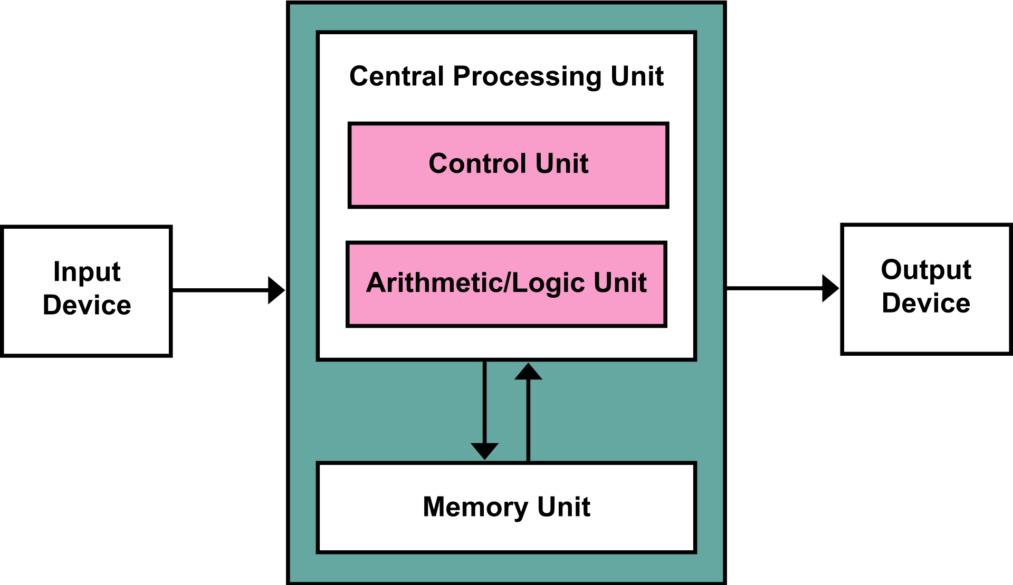
Von Neumann Architecture – Block Diagram

Slide 5
Von Neumann Architecture
Historically there have been 2 types of Computers:
Fixed Program Computers – Their function is very specific and they couldn’t be re-
programmed, for example: Calculators.
Stored Program Computers – These can be programmed to carry out many different tasks, applications are stored on them.
Von Neumann Architecture is based on stored-program computer concept.
It consists of:
A main memory, which stores both data and instructions.
An Arithmetic and Logic Unit (ALU) capable of operating on binary data.
A control unit, which interprets the instructions in memory and causes them to be executed.
Input-Output (I/O) equipment operated by the control unit.

Slide 6
Von Neumann Architecture
Instruction and data are stored in same memory.
Three key concepts:
Data and instructions are stored in a single read-write memory.
The contents of this memory are addressable by location, without regard to the type of data contained there.
Execution occurs in a sequential fashion, from one instruction to the next.

Slide 7
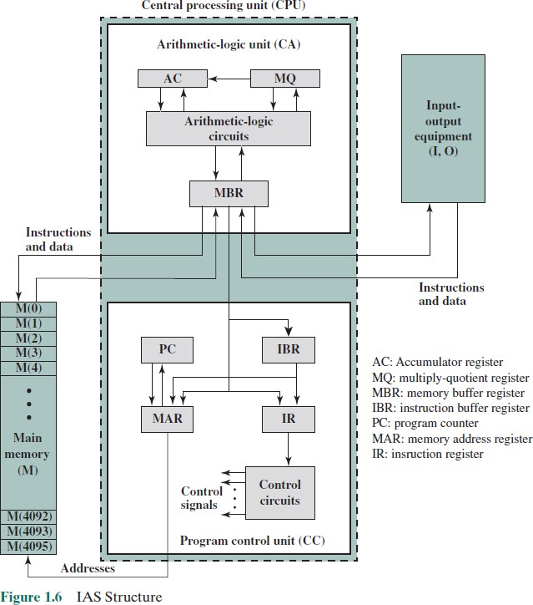

Slide 8
IAS Computer
Memory consists of 4096 storage locations, called words, of 40 bits each.
Instructions and data are stored in binary format.
Each number is represented by a sign bit and a 39-bit value.
A word may contain two 20-bit instructions.
Each instruction with 8-bit opcode (operation code) specifying the operation to be performed, and 12-bit address.

Slide 9
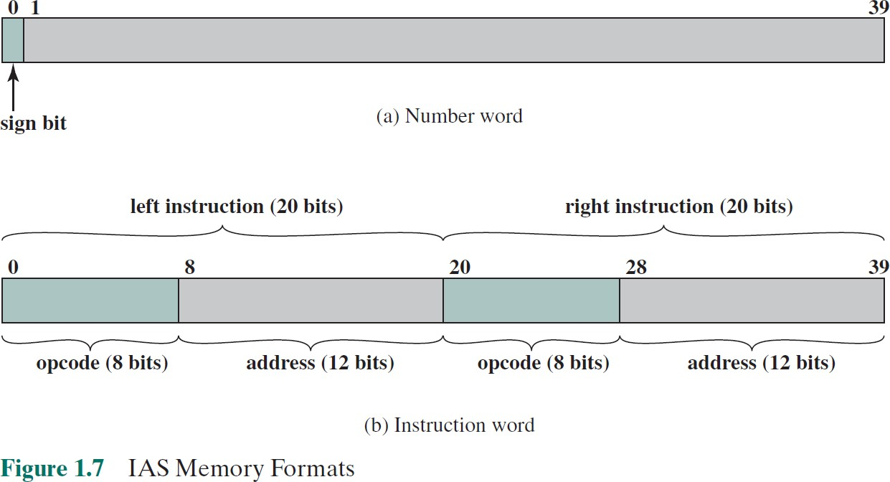
IAS Memory Formats

Slide 10
IAS Registers
Memory buffer register (MBR): Contains a word to be stored in memory or
sent to the I/O unit or is used to receive a word from memory or from the I/O unit.
Memory address register (MAR): Specifies the address in memory of the word to be written from or read into the MBR.
Instruction register (IR): Contains the 8-bit opcode instruction being executed.
Instruction buffer register (IBR): Employed to hold temporarily the right- hand instruction from a word in memory.
Program counter (PC): Contains the address of the next instruction pair to be fetched from memory.
Accumulator (AC) and multiplier quotient (MQ): Employed to hold
temporarily operands and results of ALU operations.

Slide 11
IAS Instruction Set
Total of 21 instructions, grouped in 5 categories as follows:
Data transfer: Move data between memory and ALU registers or between two ALU registers.
Unconditional branch: Normally, the control unit executes instructions in sequence from memory. This sequence can be changed by a branch instruction, which facilitates repetitive operations.
Conditional branch: The branch can be made dependent on a condition, thus allowing decision points.
Arithmetic: Operations performed by the ALU.
Address modify: Permits addresses to be computed in the ALU and then inserted into instructions stored in memory. This allows a program considerable addressing flexibility.

Slide 12
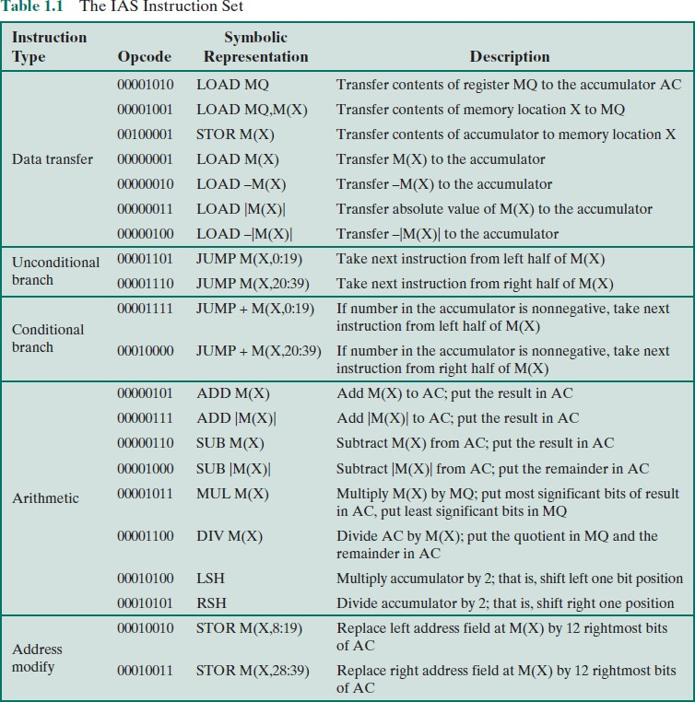

Slide 13
Microprocessor Speed
Pipelining:
Multiple stages of operation including fetching the instruction, decoding the opcode,
fetching operands, performing a calculation, and so on..
Pipelining enables a processor to work simultaneously on multiple instructions.
For example: while one instruction is being executed, the computer is decoding the next instruction.
Branch prediction:
The processor looks ahead in the instruction code fetched from memory and predicts
which branches or group of instructions, are likely to be processed next.
Prefetches the correct instructions and buffer them so that the processor is kept busy.
Superscalar execution:
Ability to issue more than one instruction in every processor clock cycle.
Multiple parallel pipelines are used.

Slide 14
Microprocessor Speed
Data flow analysis:
The processor analyses which instructions are dependent on each other's results, or data, to create an optimized schedule of instructions.
Prevents unnecessary delay.
Speculative execution:
Using branch prediction and data flow analysis, some processors speculatively executes instructions ahead of their actual appearance in the program execution, holding the results in temporary locations.
Enabling processors to keep their execution engines as busy as possible by executing instructions that are likely to be needed.

Slide 15
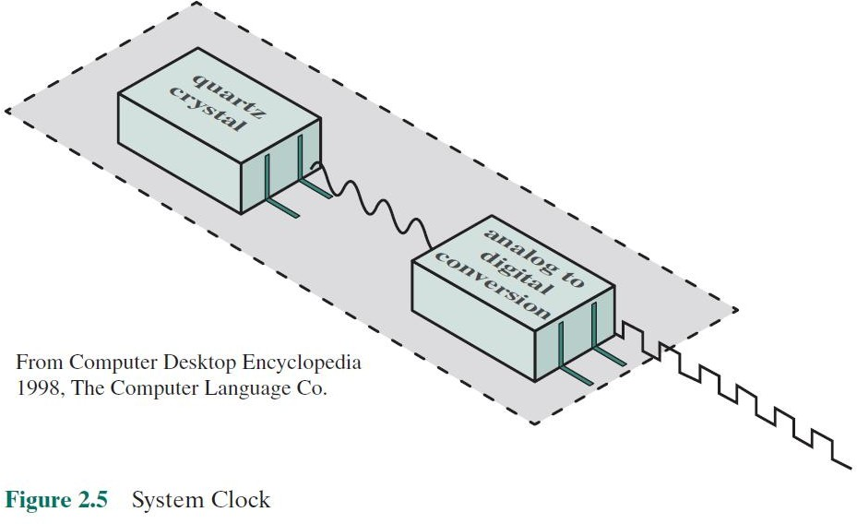
System Clock
Performance is one of the key parameters to consider, along with cost, size, security, reliability, and power consumption (in some cases).
Operations performed by a processor (fetching, decoding, execution), are governed by
a system clock.
All operations begin with the pulse of the clock.

Slide 16
Computer Performance Measures – Clock Speed
Clock rate or clock speed:
Pulse frequency or the rate of pulses produced by the clock.
Measured in number of cycles per second or Hertz (Hz).
Clock cycle or clock tick:
One increment, or pulse of the clock.
Cycle time:
The time between pulses (t = 1/f).

Slide 17
Computer Performance Measures –
Instruction Execution Rate
CPI:
Average number of cycles per instruction.
MIPS:
Millions of Instructions per second.
FLOPS or MFLOPS:
Floating point operations per second or
Millions of floating-point operations per second.

