Slide 1

Computer Architecture and Logic Design (CALD)
Lecture 03

Slide 2
Computer Function and Interconnection

Slide 3
Computer Components
Contemporary computer designs are based on concepts developed by John von Neumann at the Institute for Advanced Studies, Princeton
Referred to as the von Neumann architecture and is based on three key concepts:
Data and instructions are stored in a single read-write memory
The contents of this memory are addressable by location, without regard to the type of data contained there
Execution occurs in a sequential fashion (unless explicitly modified) from one instruction to the next
Hardwired program
The result of the process of connecting the various components in the desired configuration
© 2016 Pearson Education, Inc., Hoboken, NJ. All rights reserved.

Slide 4



Sequence of arithmetic and logic functions
Data
Results
Hardware and Software Approaches
(a) Programming in hardware
Instruction
Instruction interpreter
codes
Control signals
General-purpose arithmetic and logic functions
Data
Results
(b) Programming in software
Figure 3.1 Hardware and Software Approaches
© 2016 Pearson Education, Inc., Hoboken, NJ. All rights reserved.

Slide 5







Software
A sequence of codes or instructions
Part of the hardware interprets each instruction and
generates control signals
Provide a new sequence of codes for each new program instead of rewiring the hardware
Major components:
CPU
Instruction interpreter
Module of general-purpose arithmetic and logic functions
I/O Components
Input module
Contains basic components for accepting data and instructions and converting them into an internal form of signals usable by the system
Output module
Means of reporting results
Software
I/O Components

Slide 6




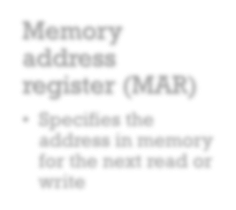
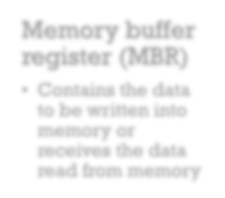









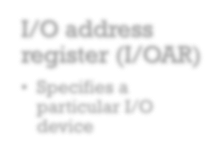
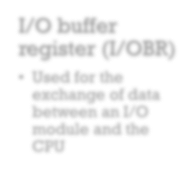





Memory address register (MAR)
Memory buffer register (MBR)
Contains the data to be written into memory or receives the data read from memory
MEMORY
Specifies the address in memory for the next read or write
MAR
I/O address register (I/OAR)
Specifies a particular I/O device
I/O buffer register (I/OBR)
Used for the exchange of data between an I/O module and the CPU
MBR

Slide 7
CPU
Main Memory
Execution unit
System Bus
Instruction
Instruction
Instruction
Data
Data
Data
Data
0
1
2
PC
MAR
IR
MBR
I/O AR
I/O BR
I/O Module
n – 2
n – 1
PC | = | Program counter
IR | = | Instruction register
MAR | = | Memory address register
MBR | = | Memory buffer register
I/O AR | = | Input/output address register
I/O BR | = | Input/output buffer register
Buffers
Figure 3.2 Computer Components: Top-Level View

Slide 8
Fetch Cycle
Execute Cycle
Fetch Next Instruction
Execute Instruction
START
HALT
Figure 3.3 Basic Instruction Cycle

Slide 9

Fetch Cycle
At the beginning of each instruction cycle the processor
fetches an instruction from memory
The program counter (PC) holds the address of the instruction to be fetched next
The processor increments the PC after each instruction
fetch so that it will fetch the next instruction in sequence
The fetched instruction is loaded into the instruction register (IR)
The processor interprets the instruction and performs the required action

Slide 10
























Action Categories
Data transferred from processor to memory or from memory to processor
Data transferred to or from a peripheral device by transferring between the processor and an I/O module
Processor- memory
Processor- I/O
Control
Data processing
An instruction may specify that the sequence of execution be altered
The processor may perform some arithmetic or logic operation on data

Slide 11
0 3 4 15
Opcode
Address
(a) Instruction format
0 1 15
S
Magnitude
Integer format
Program Counter (PC) = Address of instruction Instruction Register (IR) = Instruction being executed Accumulator (AC) = Temporary storage
Internal CPU registers
0001 = Load AC from Memory 0010 = Store AC to Memory 0101 = Add to AC from Memory
Partial list of opcodes
Figure 3.4 Characteristics of a Hypothetical Machine

Slide 12
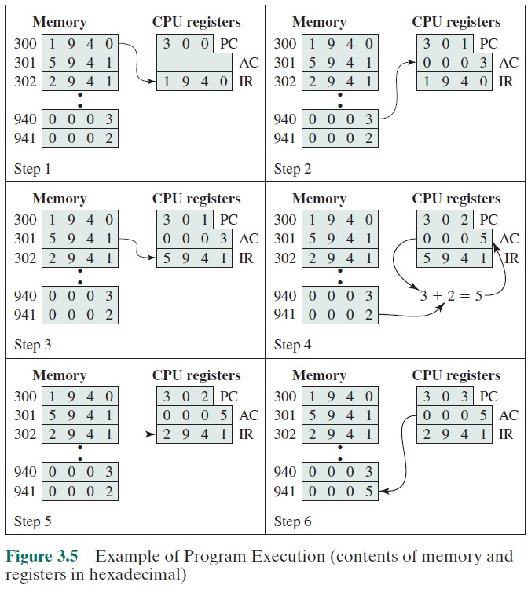

Slide 13
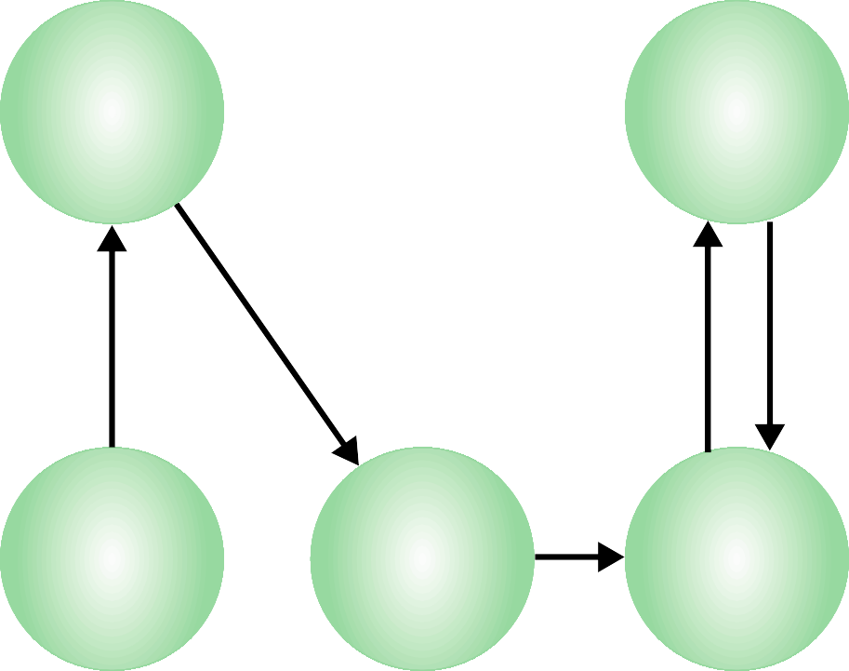
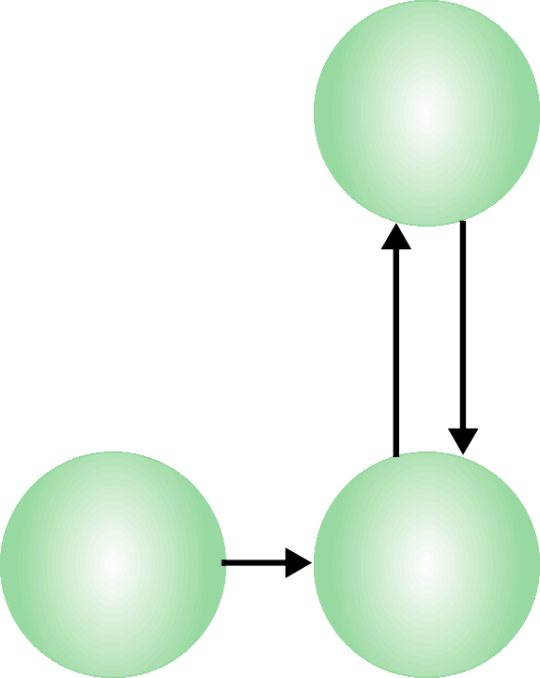
Instruction fetch
Operand fetch
Operand store
Multiple operands
Multiple results
Instruction address calculation
Instruction operation decoding
Operand address calculation
Data Operation
Operand address calculation
Return for string or vector data
Instruction complete, fetch next instruction
Figure 3.6
Instruction Cycle State Diagram

Slide 14
Classes of Interrupts
Program
Generated by some condition that occurs as a result of an instruction execution, such as arithmetic overflow, division by zero, attempt to execute an illegal machine instruction, or reference outside a user's allowed memory space.
Generated by a timer within the processor. This allows the operating system to perform certain functions on a regular basis.
Generated by an I/O controller, to signal normal completion of an operation, request service from the processor, or to signal a variety of error conditions.
Generated by a failure such as power failure or memory parity error.
Timer
I/O
Hardware failure
Table 3.1
Classes of Interrupts

Slide 15
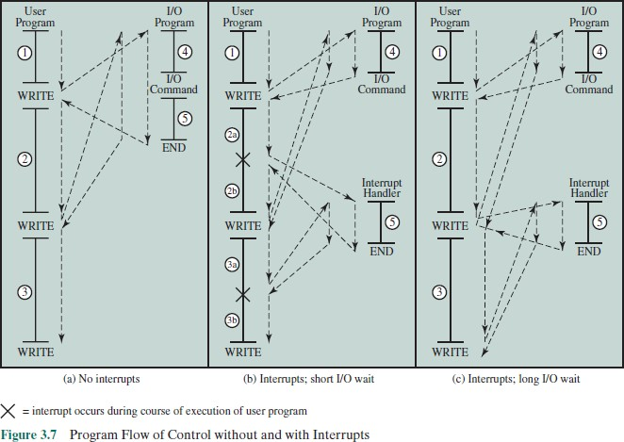

Slide 16
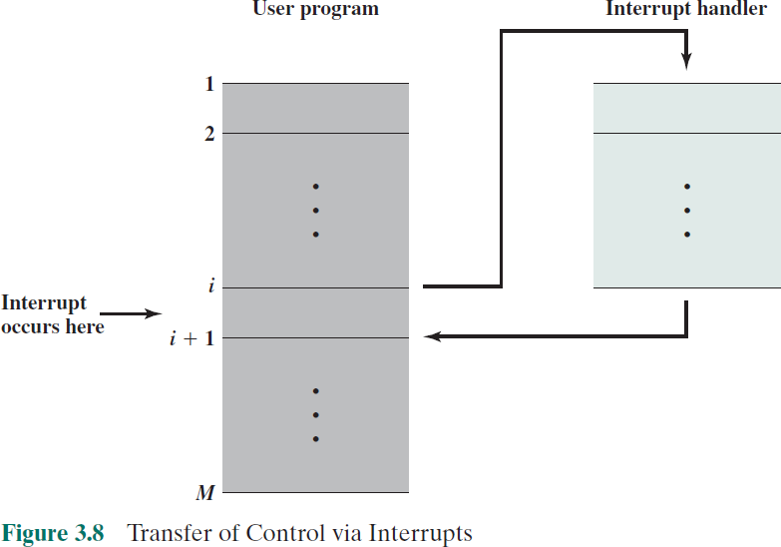
Transfer of Control via Interrupts

Slide 17
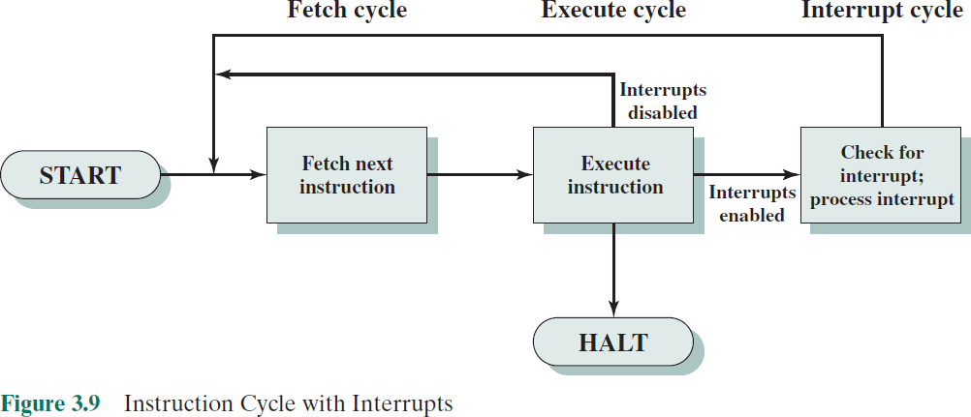
Instruction Cycle with Interrupts

Slide 18
⁺ Instruction Cycle with Interrupts
Added to instruction cycle
Processor checks for interrupt
Indicated by an interrupt signal
If no interrupt, fetch next instruction
If interrupt pending:
Suspend execution of current program
Save context
Set PC to start address of interrupt handler routine
Process interrupt
Restore context and continue interrupted program

Slide 19
Instruction Cycle with Interrupts
If any interrupt occurs the processor does the following:
It suspends execution of the current program being executed and saves its context.
This means saving the address of the next instruction to be executed (current contents of the program counter) and any other data relevant to the processor’s current activity.
It sets the program counter to the starting address of an interrupt handler routine.
The interrupt handler program is generally part of the operating system. Typically, this program determines the nature of the interrupt and performs whatever actions are needed.

Slide 21
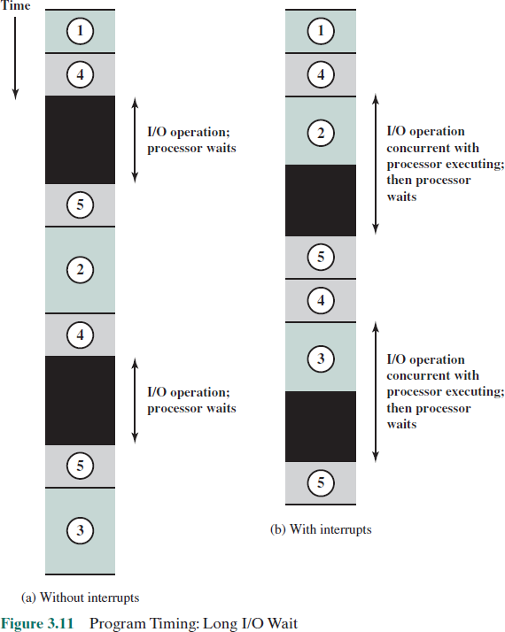
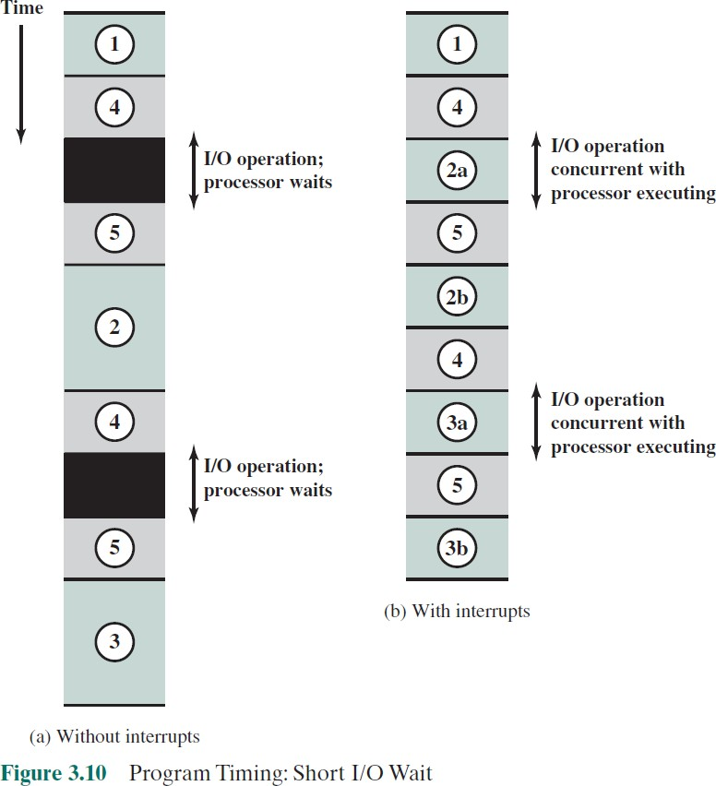
Program Timing

Slide 22
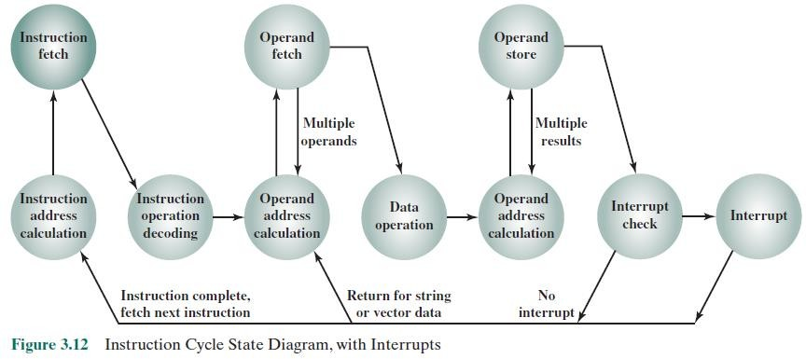
Instruction Cycle with Interrupts

Slide 23
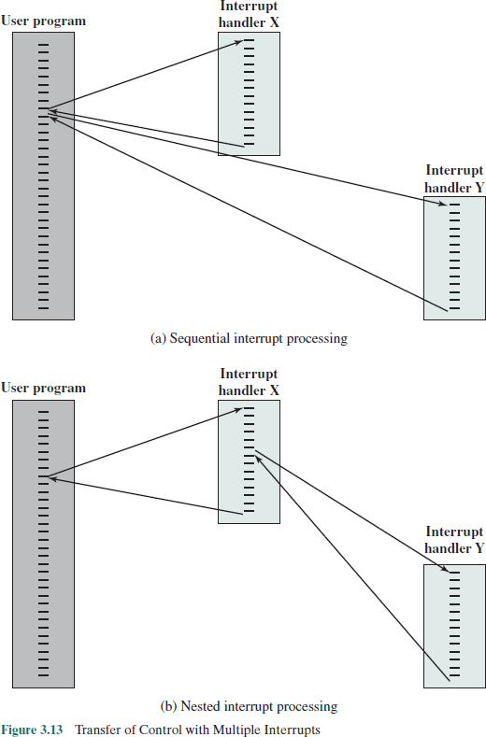
Multiple Interrupts

Slide 24
Multiple Interrupts
Sequential Interrupt Processing
Disabled interrupt:
User program executing -> interrupt occurs -> disable other interrupts -> execute interrupt handler routine -> enable interrupts -> check for additional interrupts -> user program.
Drawback: No priority for time-critical needs.
Nested Interrupt Processing
Define priorities for interrupts
Allow an interrupt of higher priority to cause a lower-priority
interrupt handler to be itself interrupted

Slide 25
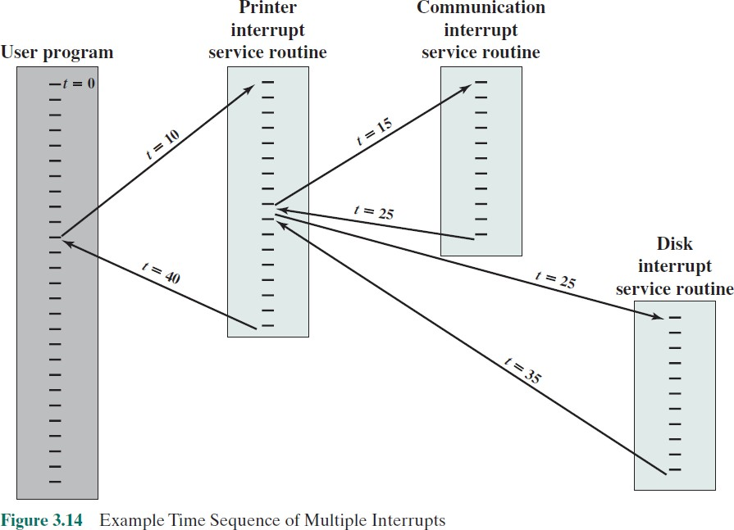
Priority=2
Priority=5
Priority=4

Slide 26

I/O Function
I/O module can exchange data directly with the processor
Processor can read data from or write data to an I/O module
Processor identifies a specific device that is controlled by a particular I/O module
I/O instructions rather than memory referencing instructions
In some cases it is desirable to allow I/O exchanges to occur directly with memory
The processor grants to an I/O module the authority to read from or write to memory so that the I/O memory transfer can occur without tying up the processor
The I/O module issues read or write commands to memory relieving the processor of responsibility for the exchange
This operation is known as direct memory access (DMA)

Slide 27
⁺ Interconnection Structures
Computer Modules or Components:
Processor
Memory
I/O
There must be paths for connecting the modules.
The collection of paths connecting the various modules is called the interconnection structure.

Slide 28
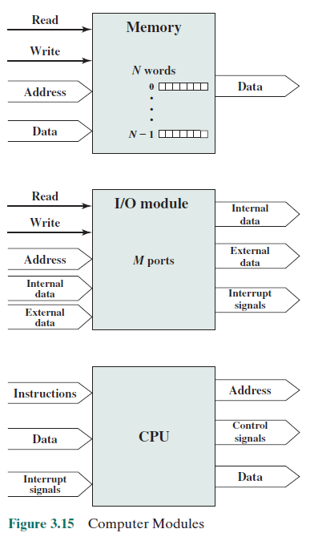

Slide 29
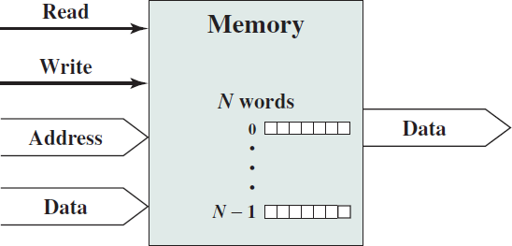
⁺ Memory
Typically, a memory module will consist of N words of equal length.
Each word is assigned a unique numerical address (0, 1, …, N - 1).
A word of data can be read from or written into the memory.
The nature of the operation is indicated by read and write control signals.
The location for the operation is specified by an address.

Slide 30
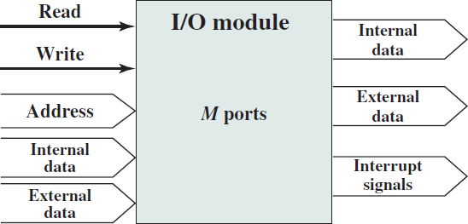
⁺ I/O Module
I/O is functionally similar to memory. There are two operations, read
and write.
Further, an I/O module may control more than one external device. We can refer to each of the interfaces to an external device as a port and give each a unique address (e.g., 0, 1, …, M - 1).
In addition, there are external data paths for the input and output of data with an external device.
Finally, an I/O module may be able to send interrupt signals to the processor.

Slide 31
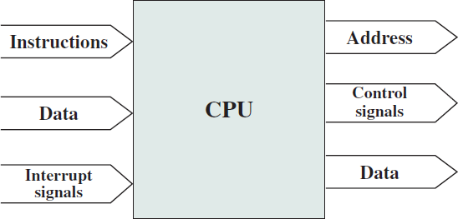
⁺ Processor
The processor reads in instructions and data,
writes out data after processing,
and uses control signals to control the overall operation of the system.
It also receives interrupt signals.

Slide 32






















































The interconnection structure must support the
following types of transfers:
Memory to processor
Processor to memory
I/O to or from memory
I/O to processor
Processor to I/O
An I/O module is allowed to exchange data directly with memory without going through the processor using direct memory access
Processor reads an instruction or a unit of data from memory
Processor reads data from an I/O device via an I/O module
Processor writes a unit of data to memory
Processor sends data to the I/O device
© 2016 Pearson Education, Inc., Hoboken, NJ. All rights reserved.

Slide 33

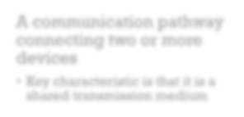
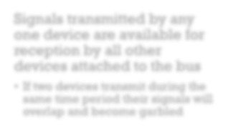







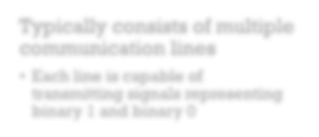



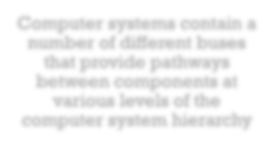









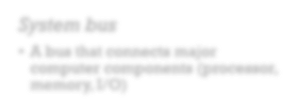



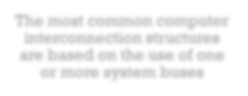



A communication pathway connecting two or more devices
Key characteristic is that it is a shared transmission medium
Signals transmitted by any one device are available for reception by all other devices attached to the bus
If two devices transmit during the same time period their signals will overlap and become garbled
I
n
n e c t i
t e r c
Typically consists of multiple
communication lines
Each line is capable of transmitting signals representing binary 1 and binary 0
Computer systems contain a number of different buses that provide pathways between components at various levels of the computer system hierarchy
B
u s
System bus
A bus that connects major computer components (processor, memory, I/O)
o
The most common computer interconnection structures are based on the use of one or more system buses
o
n
n
© 2016 Pearson Education, Inc., Hoboken, NJ. All rights reserved.

Slide 34


Data Bus
Data lines that provide a path for moving data among system modules
May consist of 32, 64, 128, or more separate lines
The number of lines is referred to as the width of the data bus
The number of lines determines how many bits can be
transferred at a time
The width of the data bus is a key factor in determining overall system performance

Slide 35


Address Bus
Control Bus
Used to designate the source or destination of the data on the data bus
If the processor wishes to read a word of data from memory it puts the address of the desired word on the address lines
Width determines the maximum possible memory capacity of the system
Also used to address I/O ports
The higher order bits are used to select a particular module on the bus and the lower order bits select a memory location or I/O port within the module
Used to control the access and the use of the data and address lines
Because the data and address lines are shared by all components there must be a means of controlling their use
Control signals transmit both command and timing information among system modules
Timing signals indicate the validity
of data and address information
Command signals specify operations to be performed

Slide 36
⁺ Control Lines
Memory write: causes data on the bus to be written into the addressed location
Memory read: causes data from the addressed location to be placed on the bus
I/O write: causes data on the bus to be output to the addressed I/O port
I/O read: causes data from the addressed I/O port to be placed on the bus
Transfer ACK: indicates that data have been accepted from or placed on the bus

Slide 37
⁺ Control Lines
Bus request: indicates that a module needs to gain control of the bus
Bus grant: indicates that a requesting module has been granted control of the bus
Interrupt request: indicates that an interrupt is pending
Interrupt ACK: acknowledges that the pending interrupt has been recognized
Clock: is used to synchronize operations
Reset: initializes all modules

Slide 38
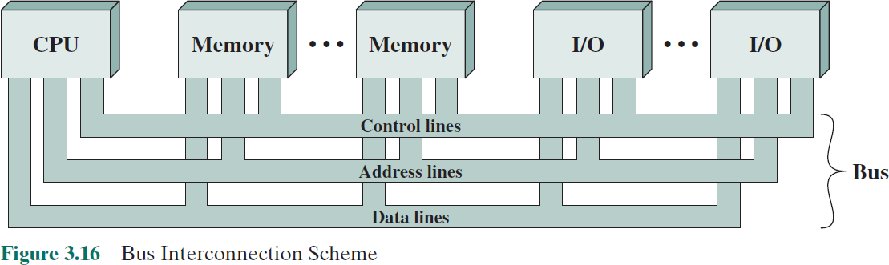
Bus Interconnection Scheme

Slide 39
Summary
A Top-Level View of Computer Function and Interconnection
Chapter 3
Computer components
Computer function
Instruction fetch and execute
Interrupts
I/O function
Interconnection structures
Bus interconnection

