Slide 1

Computer Architecture and Logic Design (CALD)
Lecture 04
+

Slide 2
Memory Systems

Slide 3
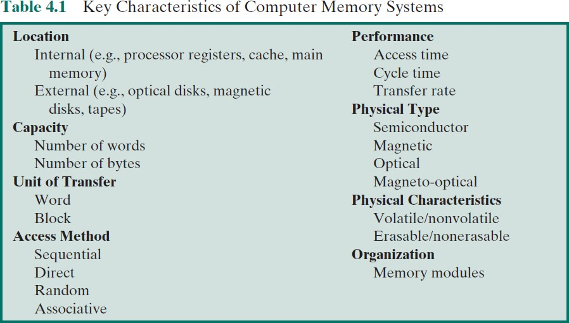
⁺ Characteristics of Memory Systems

Slide 4
⁺ Characteristics of Memory Systems
Location
Refers to whether memory is internal or external to the computer
Internal memory is often equated with main memory
Processor requires its own local memory, in the form of registers
Cache is another form of internal memory
External memory consists of peripheral storage devices that are
accessible to the processor via I/O controllers
Capacity
Memory is typically expressed in terms of bytes
Unit of transfer
For main memory, this is the number of bits read out of or written into memory at a time.
For external memory, data are often transferred in much larger units than a word, and these are referred to as blocks

Slide 5
⁺ Method of Accessing Units of Data
Sequential Access
The memory is accessed in a specific linear sequential manner, like accessing in a single Linked List.
The access time depends on the location of the data.
Examples: magnetic tapes, magnetic disk and optical memories.
Random Access
Any location of the memory can be accessed randomly like accessing in Array.
Physical locations are independent in this access method.
Examples: RAM, and ROM

Slide 6
⁺ Method of Accessing Units of Data
Direct Access
Individual blocks or records have a unique address based on physical location.
Access is accomplished by direct access to reach a general vicinity plus sequential searching, counting or waiting to reach the final destination.
Combination of Sequential and Random access methods.
Example: Magnetic hard-disk
Associate Access
A word is accessed rather than its address.
special type of random access method.
Example: Cache memory.

Slide 7






Capacity and Performance
The two most important characteristics of memory
Three performance parameters are used:
Memory cycle time
Time may be required for the memory to “recover” before next access.
Cycle time = access time
+ recovery time
Transfer rate
The rate at which data can be transferred into or out of a memory unit
Access time (latency)
Time between presenting the address and getting the valid data

Slide 8

Physical Types and Characteristics
+
The most common forms are:
Semiconductor memory
Magnetic surface memory
Optical
Magneto-optical
Several physical characteristics of data storage are important:
Volatile memory
Information decays naturally or is lost when electrical power is switched off
Nonvolatile memory
Once recorded, information remains without deterioration until deliberately changed
No electrical power is needed to retain information
Magnetic-surface memories
Are nonvolatile
Semiconductor memory
May be either volatile or nonvolatile
Nonerasable memory
Cannot be altered, except by destroying the storage unit
Semiconductor memory of this type is known as read-only memory (ROM)
For random-access memory the organization is a key design issue
Organization refers to the physical arrangement of bits to form words

Slide 9

⁺ Memory Hierarchy
Design constraints on a computer’s memory can be summed
up by three questions:
How much, how fast, how expensive
There is a trade-off among capacity, access time, and cost
Faster access time, greater cost per bit
Greater capacity, smaller cost per bit
Greater capacity, slower access time
The way out of the memory dilemma is not to rely on a single memory component or technology, but to employ a memory hierarchy

Slide 10
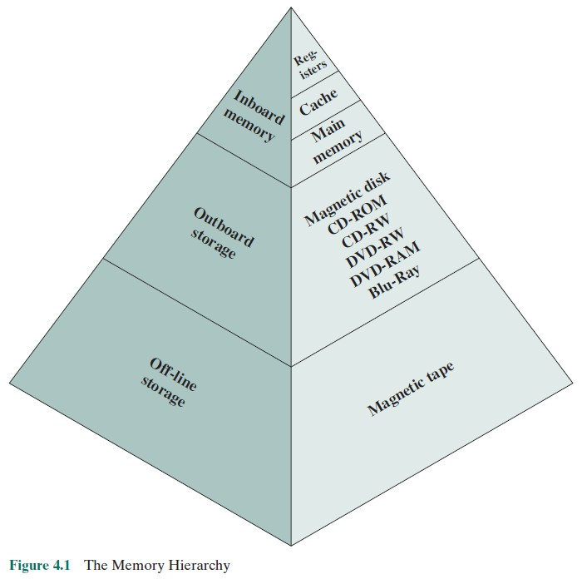
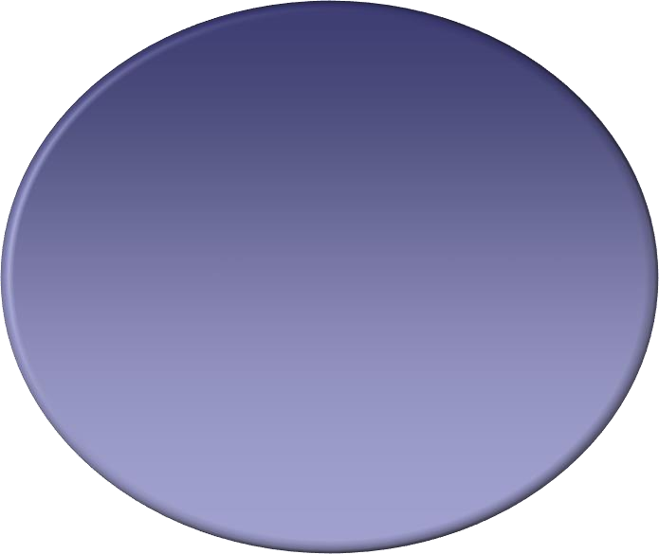
⁺ Memory Hierarchy
Decreasing cost
Increasing capacity
Increasing access time
Decreasing access frequency access

Slide 11
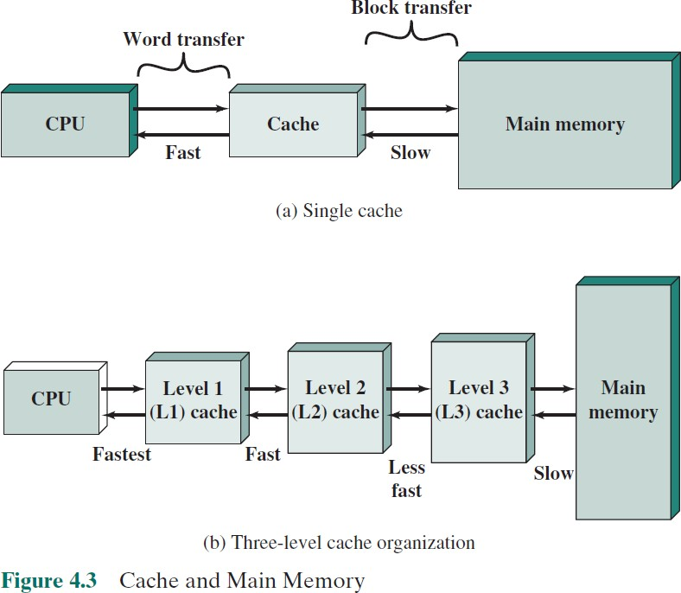
⁺ Cache and Main Memory

Slide 12
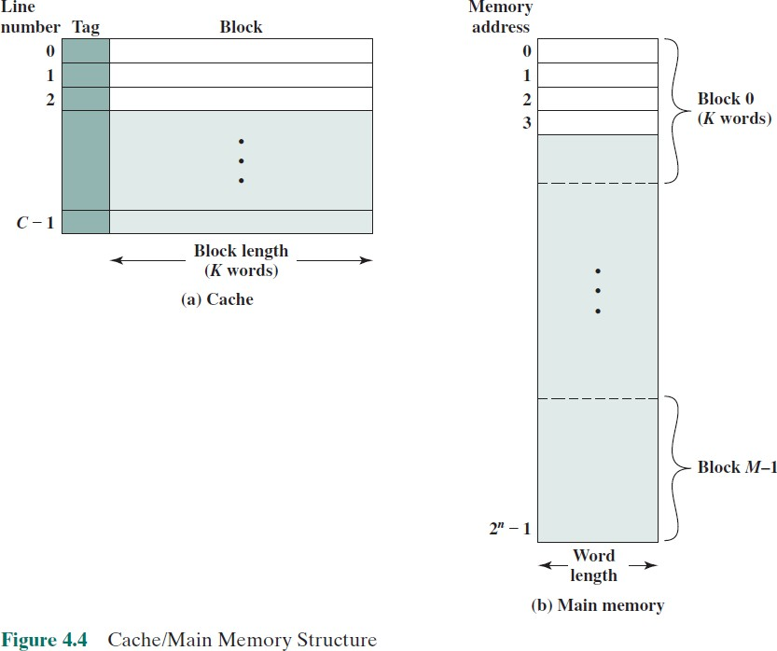

Slide 13
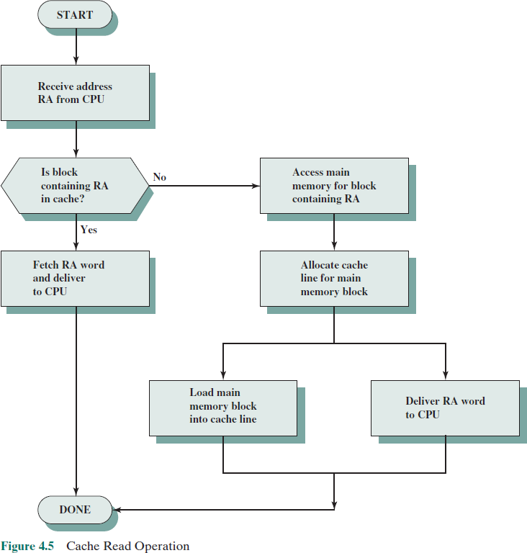

Slide 14
Table 4.3
Processor | Type | Year of Introduction | L1 Cachea | L2 cache | L3 Cache
IBM 360/85 | Mainframe | 1968 | 16 to 32 kB | — | —
PDP-11/70 | Minicomputer | 1975 | 1 kB | — | —
VAX 11/780 | Minicomputer | 1978 | 16 kB | — | —
IBM 3033 | Mainframe | 1978 | 64 kB | — | —
IBM 3090 | Mainframe | 1985 | 128 to 256 kB | — | —
Intel 80486 | PC | 1989 | 8 kB | — | —
Pentium | PC | 1993 | 8 kB/8 kB | 256 to 512 KB | —
PowerPC 601 | PC | 1993 | 32 kB | — | —
PowerPC 620 | PC | 1996 | 32 kB/32 kB | — | —
PowerPC G4 | PC/server | 1999 | 32 kB/32 kB | 256 KB to 1 MB | 2 MB
IBM S/390 G6 | Mainframe | 1999 | 256 kB | 8 MB | —
Pentium 4 | PC/server | 2000 | 8 kB/8 kB | 256 KB | —
IBM SP | High-end server/ supercomputer | 2000 | 64 kB/32 kB | 8 MB | —
CRAY MTAb | Supercomputer | 2000 | 8 kB | 2 MB | —
Itanium | PC/server | 2001 | 16 kB/16 kB | 96 KB | 4 MB
Itanium 2 | PC/server | 2002 | 32 kB | 256 KB | 6 MB
IBM POWER5 | High-end server | 2003 | 64 kB | 1.9 MB | 36 MB
CRAY XD-1 | Supercomputer | 2004 | 64 kB/64 kB | 1MB | —
IBM POWER6 | PC/server | 2007 | 64 kB/64 kB | 4 MB | 32 MB
IBM z10 | Mainframe | 2008 | 64 kB/128 kB | 3 MB | 24-48 MB
Intel Core i7 EE 990 | Workstaton/ server | 2011 | 6 × 32 kB/32 kB | 1.5 MB | 12 MB
IBM zEnterprise 196 | Mainframe/ Server | 2011 | 24 × 64 kB/ 128 kB | 24 × 1.5 MB | 24 MB L3 192 MB L4
Cache Sizes of Some Processors
ª Two values separated by a slash refer to instruction and data caches.
^{b} Both caches are instruction only; no data caches.
(Table can be found on page 134 in the textbook.)
© 2016 Pearson Education, Inc., Hoboken, NJ. All rights reserved.

Slide 15
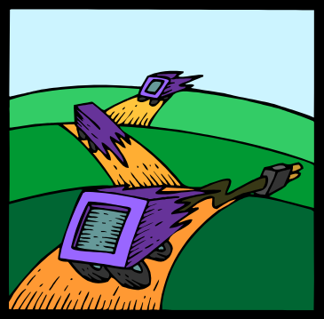
⁺ Replacement Algorithms
Once the cache has been filled, when a new block is brought into the cache, one of the existing blocks must be replaced
To achieve high speed, an algorithm must be implemented in
hardware
© 2016 Pearson Education, Inc., Hoboken, NJ. All rights reserved.

Slide 16
+ The most common replacement algorithms are:
Least recently used (LRU)
Most effective
Replace that block in the set that has been in the cache longest with no reference to it
Because of its simplicity of implementation, LRU is the most popular replacement algorithm
First-in-first-out (FIFO)
Replace that block in the set that has been in the cache longest
Easily implemented as a round-robin or circular buffer technique
Least frequently used (LFU)
Replace that block in the set that has experienced the fewest
references
Could be implemented by associating a counter with each line
© 2016 Pearson Education, Inc., Hoboken, NJ. All rights reserved.

Slide 17









Write Policy
When a block that is resident in the cache is to be replaced there are two cases to consider:
There are two problems to
contend with:
If the old block in the cache has not been altered then it may be overwritten with a new block without first writing out the old block
More than one device may have access to
main memory
If at least one write operation has been performed on a word in that line of the cache then main memory must be updated by writing the line of cache out to the block of memory before bringing in the new block
A more complex problem occurs when multiple processors are attached to the same bus and each processor has its own local cache - if a word is altered in one cache it could conceivably invalidate a word in other caches
© 2016 Pearson Education, Inc., Hoboken, NJ. All rights reserved.

Slide 18


⁺ Write Through
and Write Back
Write through
Simplest technique
All write operations are made to main memory as well as to the cache
The main disadvantage of this technique is that it generates substantial
memory traffic and may create a bottleneck
Write back
Minimizes memory writes
Updates are made only in the cache
Portions of main memory are invalid and hence accesses by I/O
modules can be allowed only through the cache
This makes for complex circuitry and a potential bottleneck
© 2016 Pearson Education, Inc., Hoboken, NJ. All rights reserved.

Slide 19

⁺ Multilevel Caches
As logic density has increased it has become possible to have a cache on the same chip as the processor
The on-chip cache reduces the processor’s external bus activity and
speeds up execution time and increases overall system performance
When the requested instruction or data is found in the on-chip cache, the bus access is eliminated
On-chip cache accesses will complete appreciably faster than would even zero-wait state bus cycles
During this period the bus is free to support other transfers
Two-level cache:
Internal cache designated as level 1 (L1)
External cache designated as level 2 (L2)
Potential savings due to the use of an L2 cache depends on the hit rates in both the L1 and L2 caches
The use of multilevel caches complicates all of the design issues related to caches, including size, replacement algorithm, and write policy
© 2016 Pearson Education, Inc., Hoboken, NJ. All rights reserved.

Slide 20
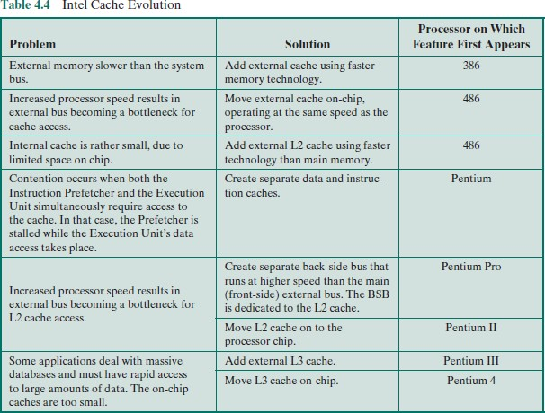
© 2016 Pearson Education, Inc., Hoboken, NJ. All rights reserved.

Slide 21
Summary
+
Cache Memory
Chapter 4
Elements of cache design
Cache size
Replacement algorithms
Write policy
Number of caches
Computer memory system overview
Characteristics of
Memory Systems
Memory Hierarchy
Cache memory principles
© 2016 Pearson Education, Inc., Hoboken, NJ. All rights reserved.

