Slide 1

Computer Architecture and Logic Design (CALD)
Lecture 05
+

Slide 2
Input / Output

Slide 3
+
Address Lines
Data Lines Control Lines
System Bus
I/O Module
I/O Module
I/O module has two major functions:
Interface to the processor and memory via the system bus
Interface to one or more peripheral devices by tailored data links
Links to peripheral devices
Figure 7.1 Generic Model of an I/O Module
© 2016 Pearson Education, Inc., Hoboken, NJ. All rights reserved.

Slide 4




⁺ External Devices
Three categories:
Human readable
Suitable for communicating with
the computer user
Video display terminals (VDTs), printers
Machine readable
Suitable for communicating with equipment
Magnetic disk and tape systems, sensors and actuators
Communication
Suitable for communicating with remote devices such as a terminal, a machine readable device, or another computer
Provide a means of exchanging data between the external environment and the computer
Attach to the computer by a
link to an I/O module
The link is used to exchange control, status, and data between the I/O module and the external device
Peripheral device
An external device connected to an I/O module

Slide 5
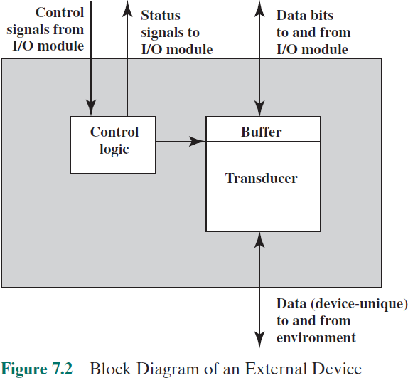

Slide 6
⁺ I/O Module Interface
Control Signals
Control signals determine the function that the device will perform, such as
send data to the I/O module (INPUT or READ),
accept data from the I/O module (OUTPUT or WRITE)
Status Signals
Status signals indicate the state of the device.
Examples are READY/NOT-READY to show whether the device is ready for data transfer.
Data are in the form of a set of bits to be sent to or received from the I/O module.

Slide 7




























The major functions for an I/O module fall into the following categories:
Control and timing
Coordinates the flow of traffic between internal resources and external devices
Processor communication
Involves command decoding, data, status reporting, address recognition
Device communication
Involves commands, status information, and data
Data buffering
Performs the needed buffering operation to balance device and memory speeds
Error detection
Detects and reports transmission errors

Slide 8
⁺ Transfer of Data from External Device to Processor
The processor interrogates the I/O module to check the
status of the attached device.
The I/O module returns the device status.
If the device is operational and ready to transmit, the processor requests the transfer of data, by means of a command to the I/O module.
The I/O module obtains a unit of data (e.g., 8 or 16 bits) from the external device.
The data are transferred from the I/O module to the processor.

Slide 9
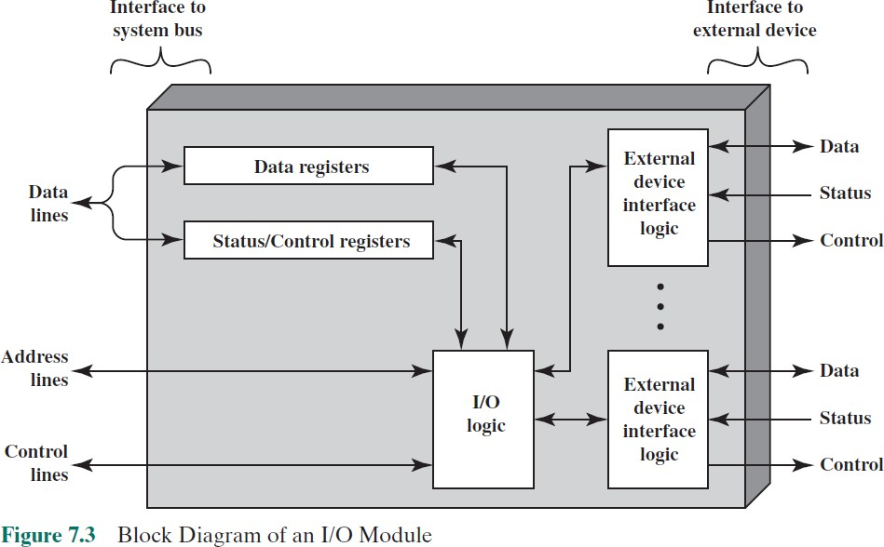

Slide 10
⁺ I/O Module Functions
The module connects to the rest of the computer through a set of signal
lines (e.g., system bus lines).
Data transferred to and from the module are buffered in one or more data registers.
There may also be one or more status registers that provide current
status information.
The logic within the module interacts with the processor via a set of control lines.
The processor uses the control lines to issue commands to the I/O module.
the I/O module contains logic specific to the interface with each device that it controls.

Slide 11

+ I/O Techniques
Three techniques are possible for I/O operations:
Programmed I/O
Data are exchanged between the processor and the I/O module
Processor executes a program that gives it direct control of the I/O operation
When the processor issues a command it must wait until the I/O operation is complete
If the processor is faster than the I/O module this is wasteful of
processor time
Interrupt-driven I/O
Processor issues an I/O command, continues to execute other instructions, and is interrupted by the I/O module when the latter has completed its work
Direct memory access (DMA)
The I/O module and main memory exchange data directly without processor involvement

Slide 12

I/O Commands
+
There are four types of I/O commands that an I/O module may
receive when it is addressed by a processor:
Control
used to activate a peripheral and tell it what to do
Test
used to test various status conditions associated with an I/O
module and its peripherals
Read
causes the I/O module to obtain an item of data from the peripheral and place it in an internal buffer
Write
causes the I/O module to take an item of data from the data bus and subsequently transmit that data item to the peripheral

Slide 13
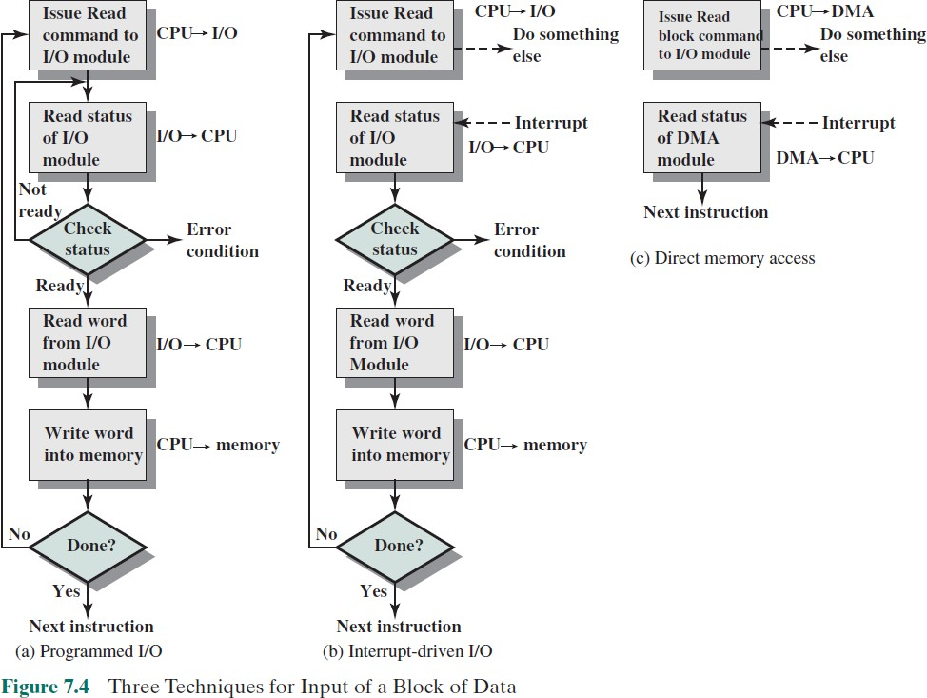

Slide 14
















I/O Instructions
With programmed I/O there is a close correspondence between the I/O-related instructions that the processor fetches from memory and the I/O commands that the processor issues to an I/O module to execute the instructions
Each I/O device connected through I/O modules is given a unique identifier or address
The form of the instruction depends on the way in which external devices are addressed
When the processor issues an I/O command, the command contains the address of the desired device
Thus each I/O module must interpret the address lines to determine if the command is for itself
Memory-mapped I/O
There is a single address space for memory locations and I/O devices
A single read line and a single write line are needed on the bus

Slide 15
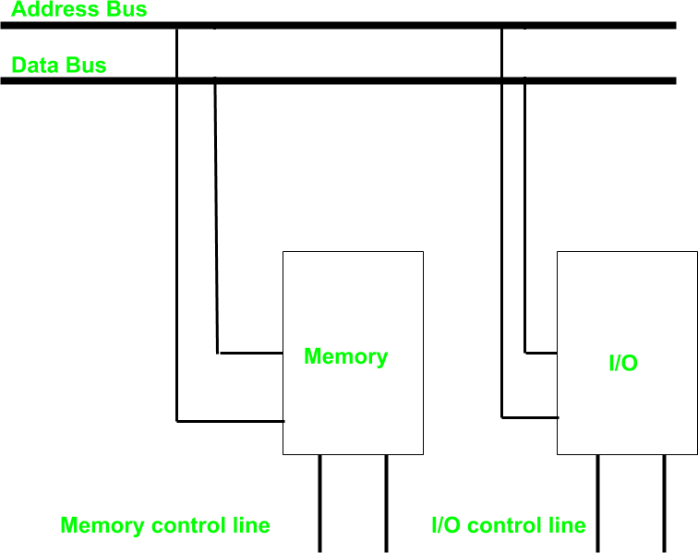
⁺ Isolated I/O
common bus(data and address) for
I/O and memory
but separate read and write control lines for I/O.
So when CPU decode instruction then if data is for I/O then it places the address on the address line and set I/O read or write control line on due to which data transfer occurs between CPU and I/O.
different read-write instruction for both I/O and memory.

Slide 16
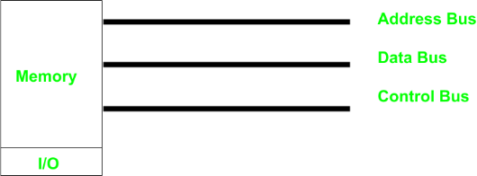
⁺ Memory-mapped I/O
Every bus in common
same set of instructions work for memory and I/O.
Hence we manipulate I/O same as memory and both have same address space,
due to which addressing capability of memory become less because some part is occupied by the I/O.

Slide 17

⁺ I/O Mapping Summary
Memory mapped I/O
Devices and memory share an address space
I/O looks just like memory read/write
No special commands for I/O
Large selection of memory access commands available
Isolated I/O
Separate address spaces
Need I/O or memory select lines
Special commands for I/O
Limited set

Slide 18
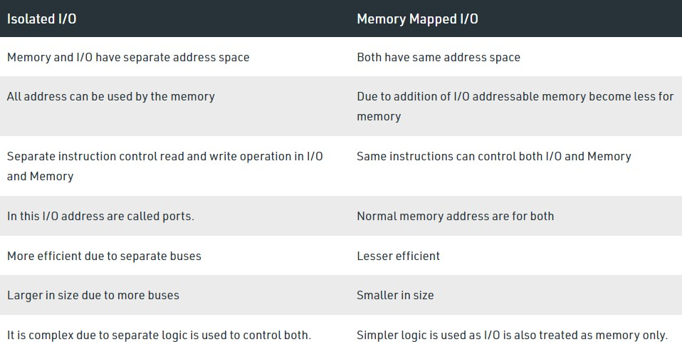
⁺ Isolated vs. Memory-mapped I/O

Slide 19
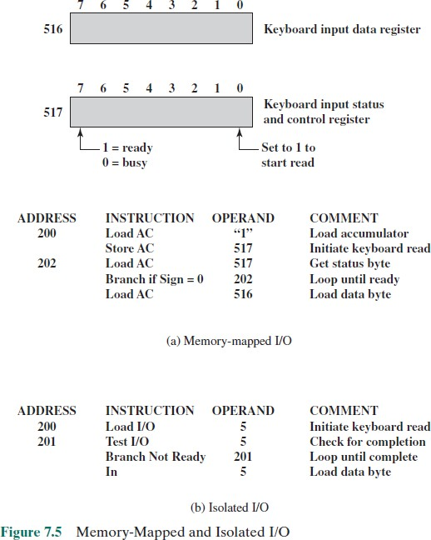

Slide 20


















Interrupt-Driven I/O
The problem with programmed I/O is that the processor has to wait a long time for the I/O module to be ready for either reception or transmission of data
An alternative is for the processor to issue an I/O command to a module and then go on to do some other useful work
The I/O module will then interrupt the processor to request service when it is ready to exchange data with the processor
The processor executes the data transfer and
resumes its former processing

Slide 21
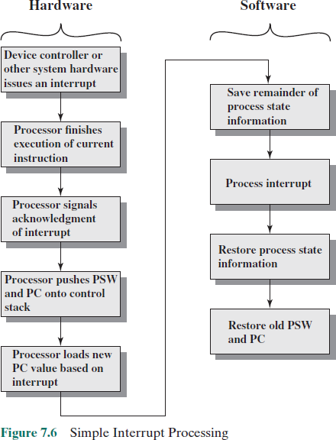
PSW =
Program Status Word

Slide 22



Drawbacks of Programmed and Interrupt-Driven I/O
Both forms of I/O suffer from two inherent
drawbacks:
The I/O transfer rate is limited by the speed with which the processor can test and service a device
The processor is tied up in managing an I/O transfer; a number of instructions must be executed for each I/O transfer
When large volumes of data are to be moved a more
efficient technique is direct memory access (DMA)
+

Slide 23
⁺ Trade-offs
There is somewhat of a trade-off between these two
drawbacks.
Consider the transfer of a block of data.
Using simple programmed I/O, the processor is dedicated to the task of I/O and can move data at a rather high rate, at the cost of doing nothing else.
Interrupt I/O frees up the processor to some extent at the expense of the I/O transfer rate.
Nevertheless, both methods have an adverse impact on both processor activity and I/O transfer rate.

Slide 24
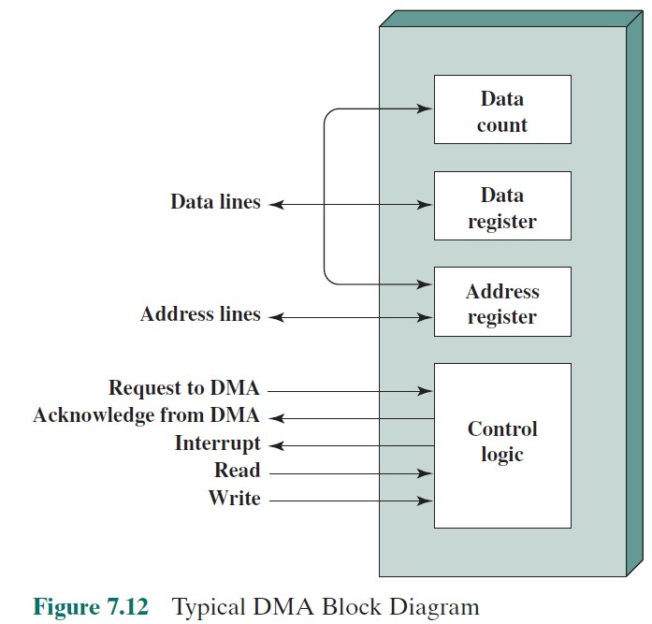
⁺ Direct Memory Access (DMA)

Slide 25
⁺ Direct Memory Access (DMA)
The DMA module is capable of taking over control of the
system from the processor.
It needs to do this to transfer data to and from memory over the system bus.
Cycle Stealing:
the DMA module must use the bus only when the processor does not need it, or it must force the processor to suspend operation temporarily.
the DMA module in effect steals a bus cycle.

Slide 26
⁺ Direct Memory Access (DMA)
The processor issues a command to the DMA module
Read or Write Signal
The address of the I/O device involved
The starting location in memory to read from or write to
The number of words to be read or written
The processor then continues with other work.
It has delegated this I/O operation to the DMA module.
The DMA module transfers the entire block of data, one word at a time, directly to or from memory, without going through the processor.
When the transfer is complete, the DMA module sends an interrupt signal to the processor.
Thus, the processor is involved only at the beginning and end of the transfer

Slide 27
Summary
+
Input/Output
Chapter 7
External devices
Keyboard/monitor
Disk drive
I/O modules
Module function
I/O module structure
Programmed I/O
Overview of programmed I/O
I/O commands/instructions
Direct memory access
Drawbacks of programmed
and interrupt-driven I/O
DMA function
Interrupt-driven I/O

