Slide 1

Computer Architecture and Logic Design (CALD)
Lecture 07
+

Slide 2
Instruction Sets:
Addressing Modes and Formats

Slide 3













Addressing Modes
Immediate
Direct Indirect Register
Register indirect Displacement
Stack

Slide 4
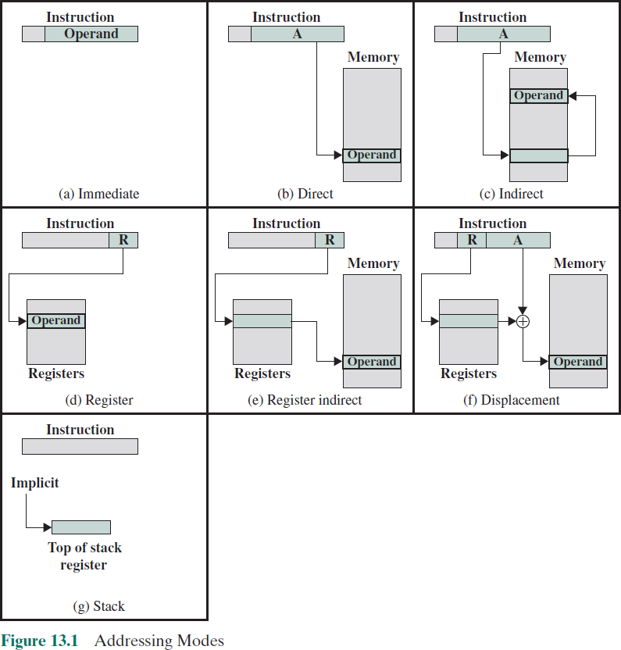

Slide 5
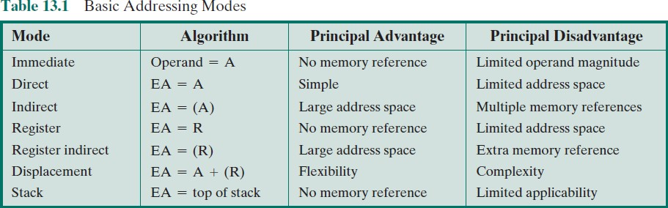
⁺ Basic Addressing Modes

Slide 6

⁺ Immediate Addressing
Simplest form of addressing
Operand is part of instruction
Operand = address field
e.g. ADD 5
Add 5 to contents of accumulator
5 is operand
Advantage:
No memory reference other than the instruction fetch is required to obtain the operand, thus saving one memory or cache cycle in the instruction cycle
Disadvantage:
The size of the number is restricted to the size of the address field, which,
in most instruction sets, is small compared with the word length

Slide 7


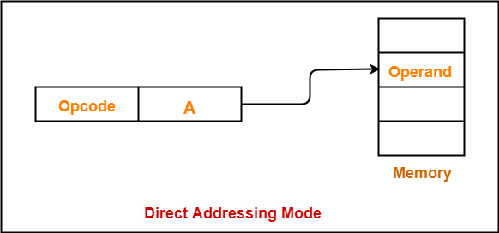








Direct Addressing
Address field contains the effective address of the operand
Effective address (EA) = address field (A)
Was common in earlier generations of computers
Requires only one memory reference and no special calculation
Limitation is that it provides only a limited address space

Slide 8

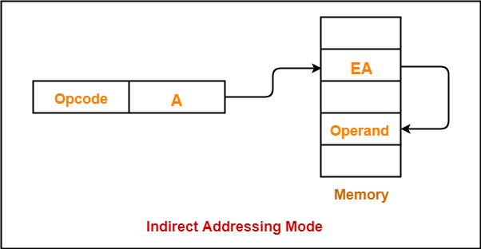
⁺ Indirect Addressing

Slide 9


⁺ Indirect Addressing
Reference to the address of a word in memory which contains a full-length address of the operand
EA = (A)
Parentheses are to be interpreted as meaning contents of
Advantage:
For a word length of N an address space of 2^{N} is now available
Disadvantage:
Instruction execution requires two memory references to fetch the operand
One to get its address and a second to get its value
A rarely used variant of indirect addressing is multilevel or cascaded indirect addressing
EA = ( . . . (A) . . . )
Disadvantage is that three or more memory references could be required to fetch an operand

Slide 10






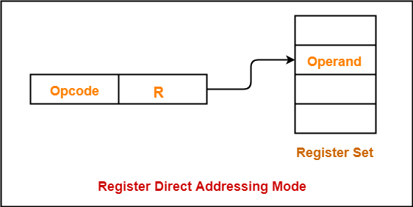


Register Addressing
Address field refers to a register rather than a main memory address
EA = R
Advantages:
Only a small address field is needed in the instruction
No time-consuming memory references are required
Disadvantage:
The address space is very limited

Slide 11

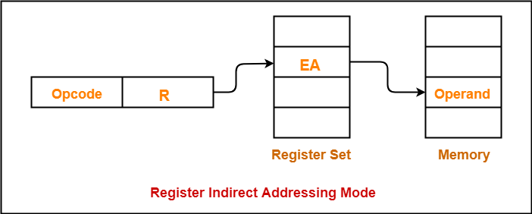
⁺ Register Indirect Addressing

Slide 12

⁺ Register Indirect Addressing
Analogous to indirect addressing
The only difference is whether the address field refers to a memory location or a register
EA = (R)
Address space limitation of the address field is overcome by having that field refer to a word-length location containing an address
Uses one less memory reference than indirect addressing

Slide 13

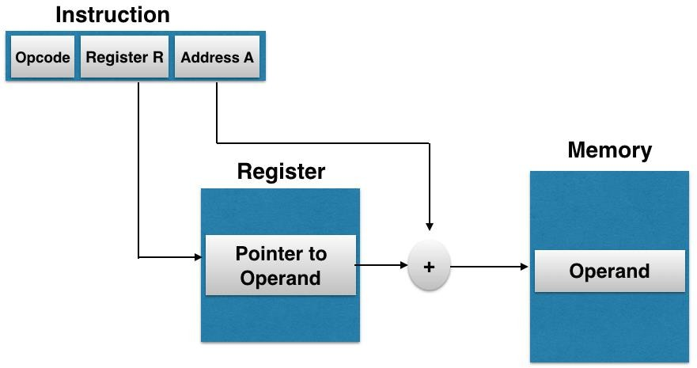
⁺ Displacement Addressing

Slide 14

⁺ Displacement Addressing
Combines the capabilities of direct addressing and register
indirect addressing
EA = A + (R)
Requires that the instruction have two address fields, at least one of which is explicit
The value contained in one address field (value = A) is used directly
The other address field refers to a register whose contents are added to A to produce the effective address
Most common uses:
Relative addressing
Base-register addressing
Indexing

Slide 15


⁺ Stack Addressing
A stack is a linear array of locations
Sometimes referred to as a pushdown list or last-in-first-out queue
A stack is a reserved block of locations
Items are appended to the top of the stack so that the block is partially filled
Associated with the stack is a pointer whose value is the address of the top of the stack
The stack pointer is maintained in a register
Thus references to stack locations in memory are in fact register indirect addresses
Is a form of implied addressing
The machine instructions need not include a memory reference but implicitly operate on the top of the stack

Slide 16






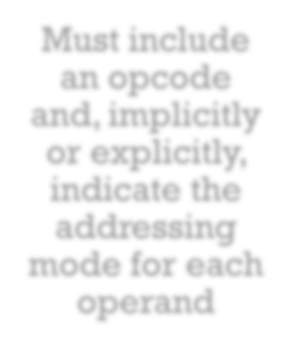
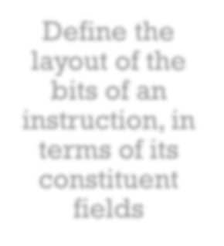
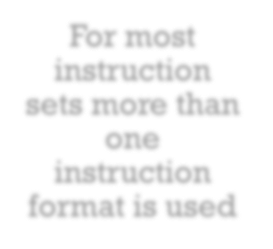
Instruction Formats
Must include an opcode and, implicitly or explicitly, indicate the addressing mode for each operand
Define the layout of the bits of an instruction, in terms of its constituent fields
For most instruction sets more than one instruction format is used

Slide 17

Instruction Length
+
Most basic design issue
Affects, and is affected by:
Memory size
Memory organization
Bus structure
Processor complexity
Processor speed
Should be equal to the memory-transfer length or one should be a multiple of the other
Should be a multiple of the character length, which is usually 8 bits, and of the length of fixed-point numbers

Slide 18

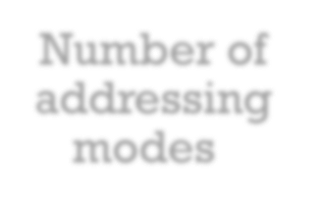












Allocation of Bits
Number of addressing modes
Register versus memory
Number of operands
Number of register sets
Address range
Address granularity

Slide 19



Variable-Length Instructions
+
Variations can be provided efficiently and compactly
Increases the complexity of the processor
Does not remove the desirability of making all of the instruction lengths integrally related to word length
Because the processor does not know the length of the next instruction to be fetched a typical strategy is to fetch a number of bytes or words equal to at least the longest possible instruction
Sometimes multiple instructions are fetched

Slide 20
Summary
+
Instruction Sets: Addressing Modes and Formats
Chapter 13
Instruction formats
Instruction length
Allocation of bits
Variable-length instructions
Addressing modes
Immediate addressing
Direct addressing
Indirect addressing
Register addressing
Register indirect addressing
Displacement addressing
Stack addressing

