Slide 1

Computer Architecture and Logic Design (CALD)
Lecture 08
+

Slide 2
Processor Structure and Function

Slide 3


⁺ Processor Organization
Processor Requirements:
Fetch instruction
The processor reads an instruction from memory (register, cache, main memory)
Interpret instruction
The instruction is decoded to determine what action is required
Fetch data
The execution of an instruction may require reading data from memory or an I/O module
Process data
The execution of an instruction may require performing some arithmetic or logical operation on data
Write data
The results of an execution may require writing data to memory or an I/O module
In order to do these things the processor needs to store some data temporarily and therefore needs a small internal memory

Slide 4
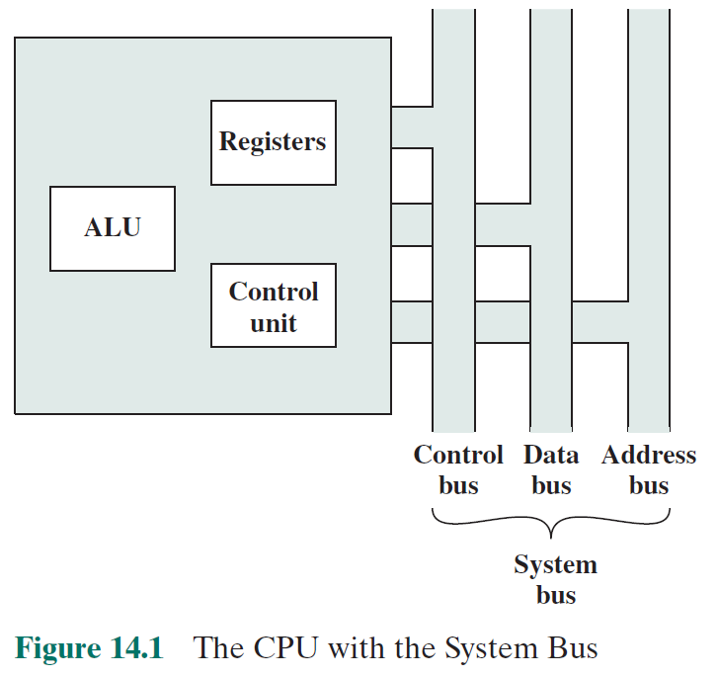

Slide 5
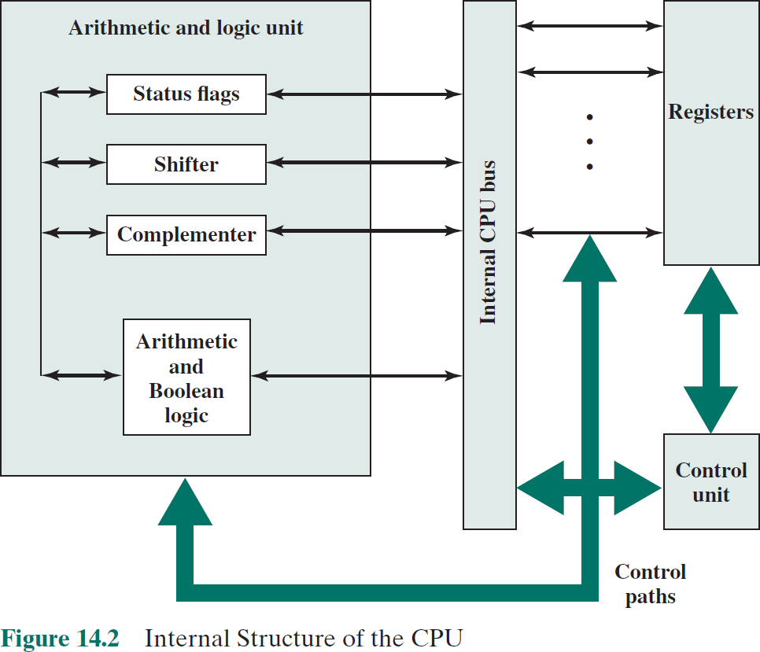

Slide 6
Register Organization
+
Within the processor there is a set of registers that function as a level of memory above main memory and cache in the hierarchy
The registers in the processor perform two roles:
User-Visible Registers
Control and Status Registers
Enable the machine or assembly language programmer to minimize main memory references by optimizing use of registers
Used by the control unit to control the operation of the processor and by privileged operating system programs to control the execution of programs

Slide 7






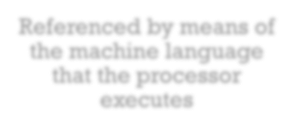




User-Visible Registers
Categories:
Referenced by means of the machine language that the processor executes
General purpose
Can be assigned to a variety of functions by the programmer
Data
May be used only to hold data and cannot be employed in the calculation of an operand address
Address
May be somewhat general purpose or may be devoted to a particular addressing mode
Examples: segment pointers, index
registers, stack pointer
Condition codes
Also referred to as flags
Bits set by the processor hardware as the result of operations

Slide 8
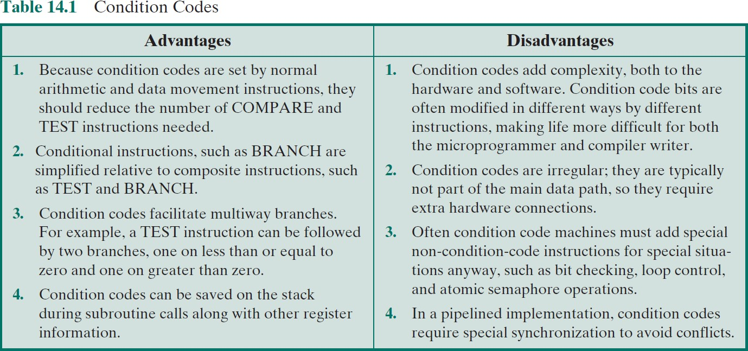
⁺ Condition Codes

Slide 9


⁺ Control and Status Registers
Four registers are essential to instruction execution:
Program counter (PC)
Contains the address of an instruction to be fetched
Instruction register (IR)
Contains the instruction most recently fetched
Memory address register (MAR)
Contains the address of a location in memory
Memory buffer register (MBR)
Contains a word of data to be written to memory or the word most
recently read

Slide 10





⁺ Program Status Word (PSW)
Register or set of registers that contain status information
Common fields or flags include:
Sign
Zero
Carry
Equal
Overflow
Interrupt Enable/Disable
Supervisor

Slide 11
⁺ Common Flags in PSW Register
Sign: Contains the sign bit of the result of the last arithmetic operation.
Zero: Set when the result is 0.
Carry: Set if an operation resulted in a carry (addition) into or borrow (sub- traction) out of a high-order bit. Used for multiword arithmetic operations.
Equal: Set if a logical compare result is equality.
Overflow: Used to indicate arithmetic overflow.
Interrupt Enable/Disable: Used to enable or disable interrupts.
Supervisor: Indicates whether the processor is executing in supervisor or user mode. Certain privileged instructions can be executed only in supervisor mode, and certain areas of memory can be accessed only in supervisor mode.

Slide 12
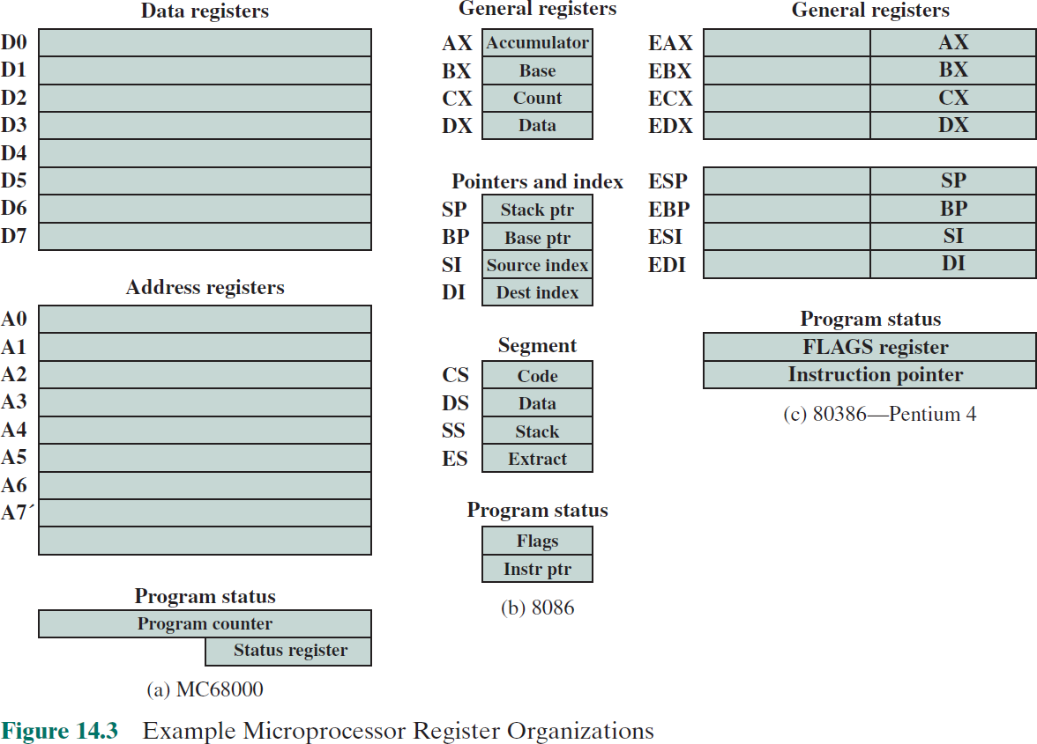

Slide 13






Instruction Cycle
Includes the following stages:
Fetch
Execute
Interrupt
If interrupts are enabled and an interrupt has occurred, save the current process state and service the interrupt
Read the next instruction from memory into the processor
Interpret the opcode and perform the indicated operation

Slide 14
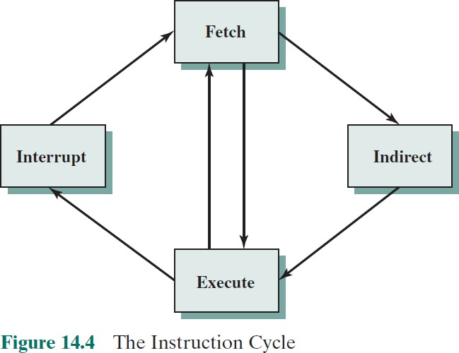
⁺ Instruction Cycle

Slide 15
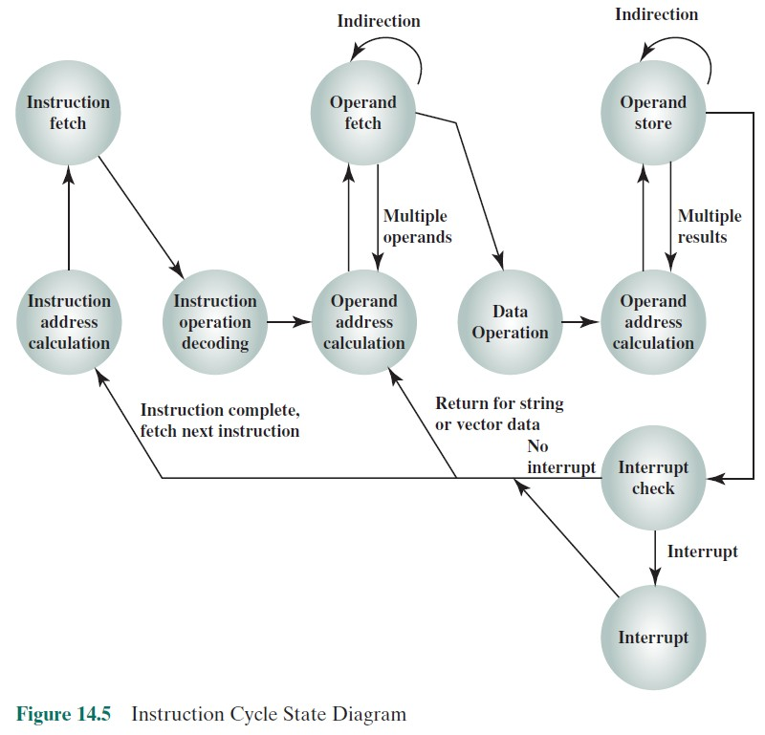

Slide 16
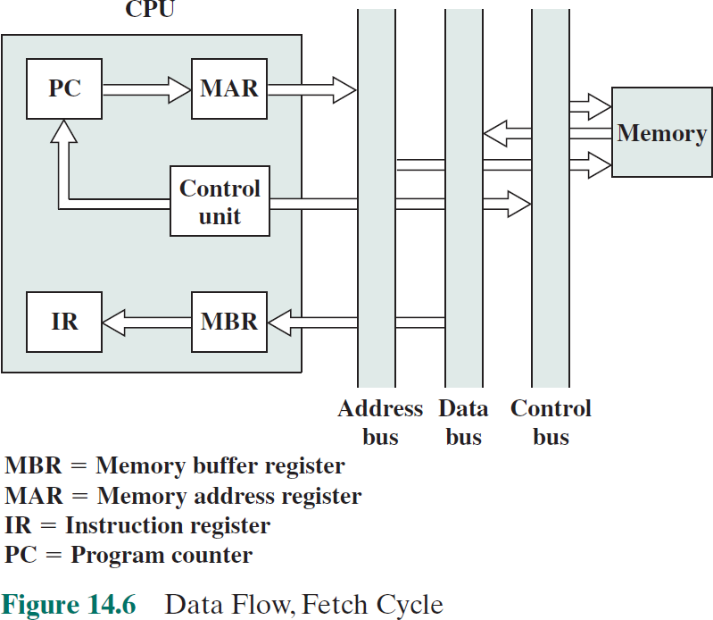
⁺ Fetch Cycle
During the fetch cycle, an
instruction is read from memory.
The PC contains the address of the next instruction to be fetched.
This address is moved to the MAR and placed on the address bus.
The control unit requests a memory read, and the result is placed on the data bus and copied into the MBR and then moved to the IR.
Meanwhile, the PC is incremented by 1, preparatory for the next fetch.

Slide 17
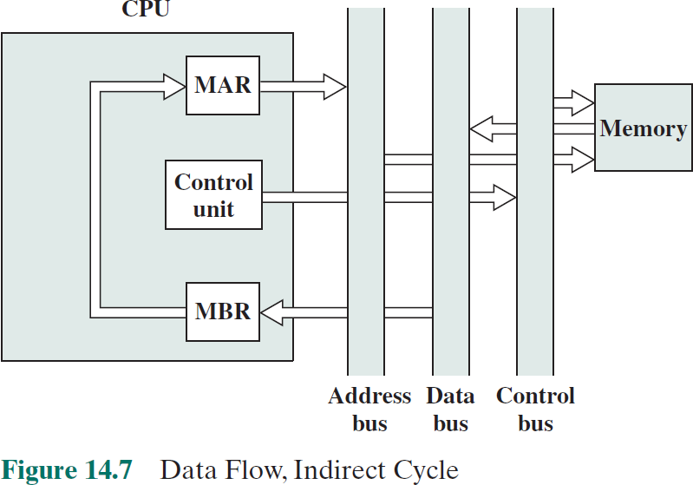
⁺ Indirect Cycle
Once the fetch cycle is over, the control unit examines the contents of the IR to determine if it contains an operand specifier using indirect addressing.
If so, an indirect cycle is performed.
The right- most N bits of the MBR, which contain the address reference, are transferred to the MAR.
Then the control unit requests a memory read, to get the desired address of the operand into the MBR.

Slide 18
⁺ Interrupt Cycle
The current contents of the PC must be saved so that the
processor can resume normal activity after the interrupt.
Thus, the contents of the PC are transferred to the MBR to be written into memory.
The special memory location reserved for this purpose is loaded into the MAR from the control unit.
It might, for example, be a stack pointer.
The PC is loaded with the address of the interrupt routine.
As a result, the next instruction cycle will begin by fetching the appropriate instruction.

Slide 19
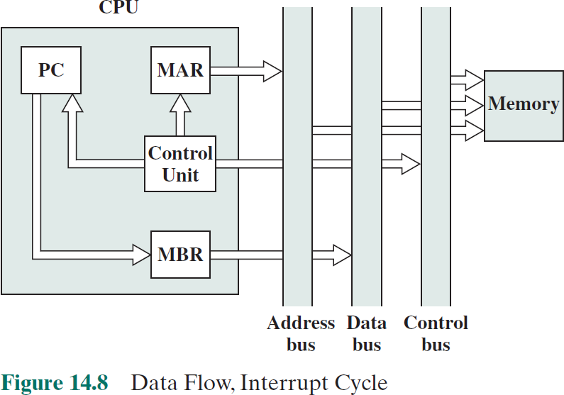
⁺ Interrupt Cycle

Slide 20








Pipelining Strategy
To apply this concept to instruction execution we must recognize that an instruction has a number of stages
Similar to the use of an assembly line in a manufacturing plant
New inputs are accepted at one end before previously accepted inputs appear as outputs at the other end

Slide 21
⁺ Pipelining
Pipelining is an implementation technique whereby multiple
instructions are overlapped in execution
Today, pipelining is the key implementation technique used to make fast CPUs
A pipeline is like an assembly line
Each step operates in parallel with the other steps
In a computer pipeline, each step in the pipeline completes a
part of an instruction

Slide 22
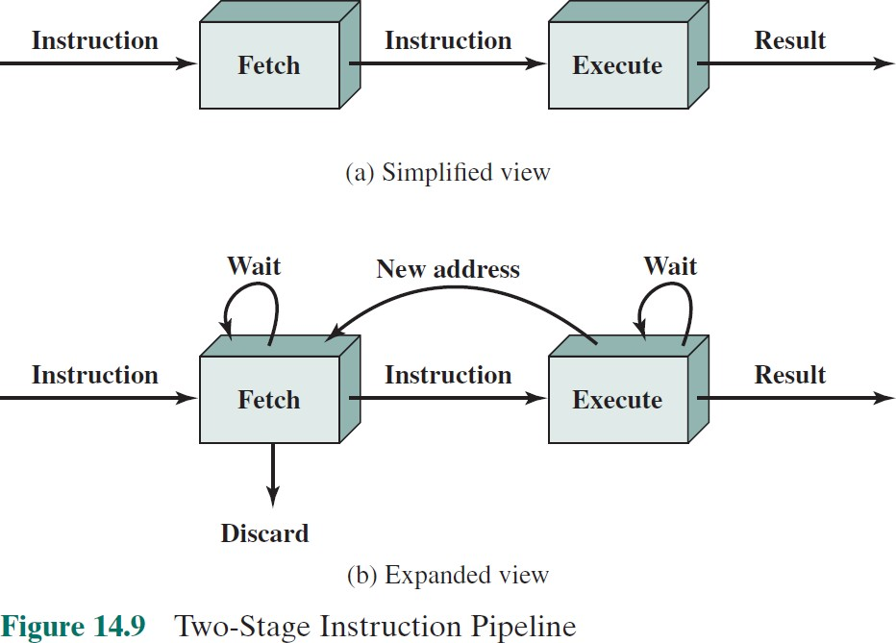
⁺ Instruction Pipeline

Slide 23

+ Additional Stages
Fetch instruction (FI)
Read the next expected instruction into a buffer
Decode instruction (DI)
Determine the opcode and
the operand specifiers
Calculate operands (CO)
Calculate the effective address of each source operand
This may involve displacement, register indirect, indirect, or other forms of address calculation
Fetch operands (FO)
Fetch each operand from memory
Operands in registers need not be fetched
Execute instruction (EI)
Perform the indicated operation and store the result, if any, in the specified destination operand location
Write operand (WO)
Store the result in memory

Slide 24
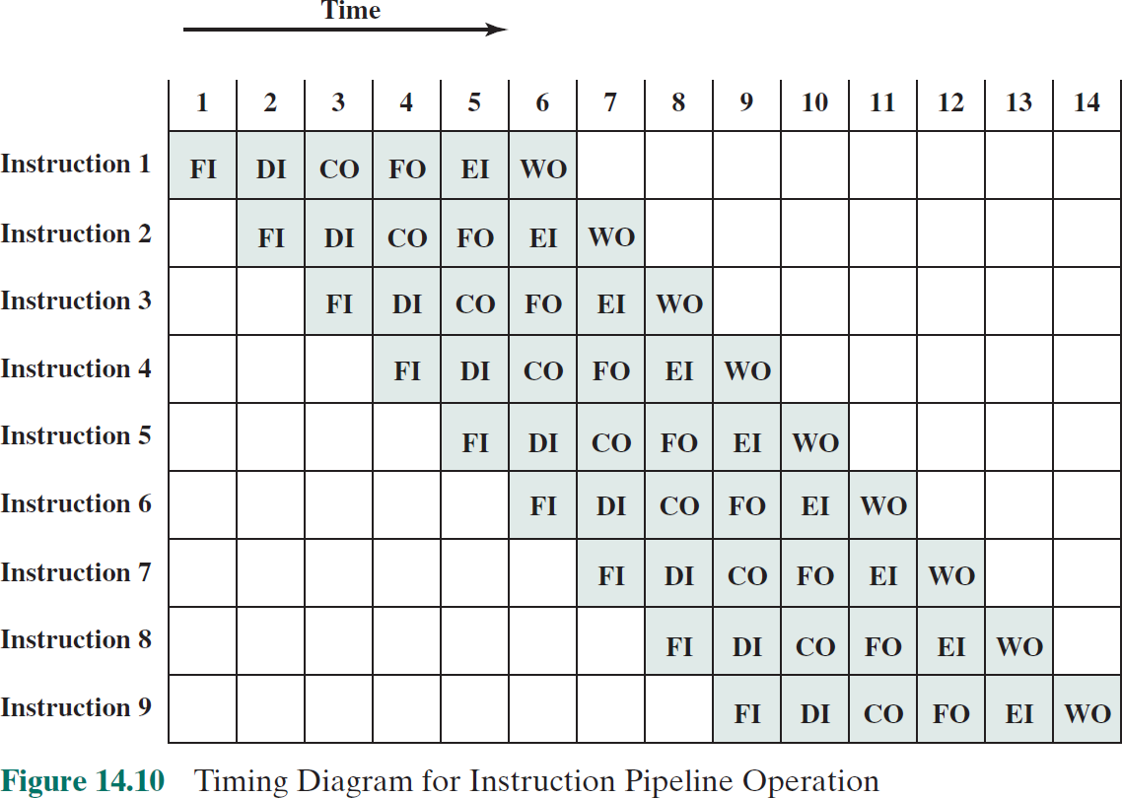

Slide 25
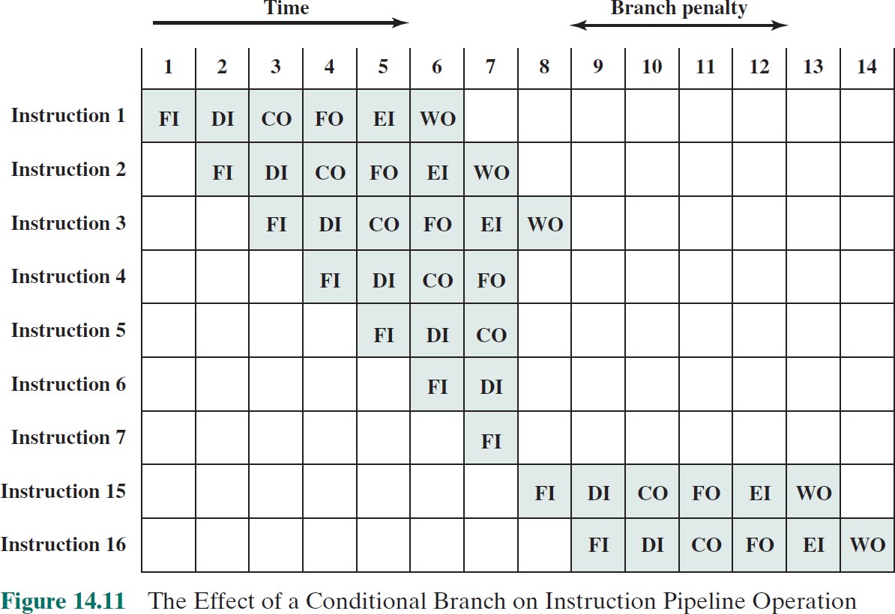

Slide 26
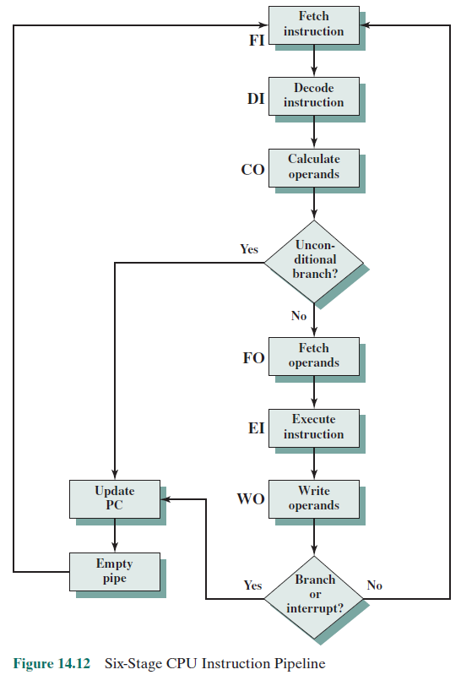

Slide 27
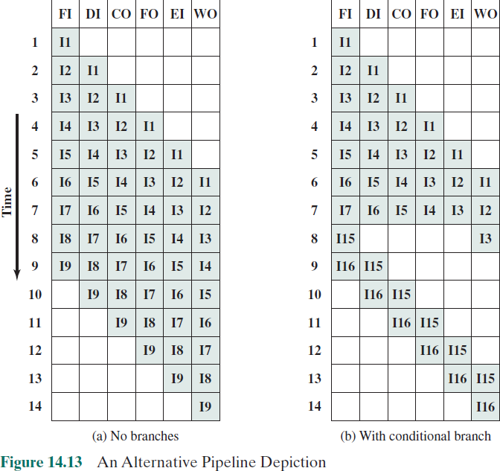

Slide 28









Pipeline Hazards
Occur when the pipeline, or some portion of the pipeline, must stall because conditions do not permit continued execution
There are three types of hazards:
Resource
Data
Control
Also referred to as a
pipeline bubble

Slide 29
⁺ Resource Hazards
A resource hazard occurs when two (or more) instructions
that are already in the pipeline need the same resource.
The result is that the instructions must be executed in serial rather than parallel for a portion of the pipeline.
A resource hazard is sometime referred to as a structural hazard.

Slide 30
Clock cycle
1 2 3 4 5 6 7 8 9
I1
I2 I3 I4
(a) Five-stage pipeline, ideal case
FI | DI | FO | EI | WO
 | FI | DI | FO | EI | WO
 |  | FI | DI | FO | EI | WO
 |  |  | FI | DI | FO | EI | WO
Instrutcion
Clock cycle
1 2 3 4 5 6 7 8 9
I1
I2 I3 I4
(b) I1 source operand in memory
FI | DI | FO | EI | WO
 | FI | DI | FO | EI | WO
 |  | Idle | FI | DI | FO | EI | WO
 |  |  |  | FI | DI | FO | EI | WO
Instrutcion
Figure 14.15 Example of Resource Hazard

Slide 31
⁺ Resource Hazards
Assume that main memory has a single port and that all instruction fetches and data reads and writes must be performed one at a time.
An operand read to or write from memory cannot be performed in parallel with an instruction fetch.
This is illustrated in Figure 14.15b, which assumes that the source operand for instruction I1 is in memory, rather than a register.
Therefore, the fetch instruction stage of the pipeline must idle for one cycle before beginning the instruction fetch for instruction I3.
The figure assumes that all other operands are in registers.

Slide 32
⁺ Resource Hazards
Another example of a resource conflict is a situation in which multiple instructions are ready to enter the execute instruction phase and there is a single ALU.
One solutions to such resource hazards is to increase available resources, such as having multiple ports into main memory and multiple ALU units.

Slide 33
⁺ Data Hazards
A data hazard occurs when there is a conflict in the access of
an operand location.
In general terms, we can state the hazard in this form:
Two instructions in a program are to be executed in sequence and both access a particular memory or register operand.
If the two instructions are executed in strict sequence, no problem occurs.
However, if the instructions are executed in a pipeline, then it is possible for the operand value to be updated in such a way as to produce a different result than would occur with strict sequential execution.
In other words, the program produces an incorrect result because of the use of pipelining.

Slide 34
Clock cycle
1 2 3 4 5 6 7 8 9 10
FI | DI | FO | EI | WO
 | FI | DI | Idle |  | FO | EI | WO
 |  | FI |  |  | DI | FO | EI | WO
 |  |  |  |  | FI | DI | FO | EI | WO
ADD EAX, EBX
SUB ECX, EAX
I3 I4
Figure 14.16 Example of Data Hazard

Slide 35

⁺ Types of Data Hazard
Read after write (RAW), or true dependency
An instruction modifies a register or memory location
Succeeding instruction reads data in memory or register location
Hazard occurs if the read takes place before write operation is
complete
Write after read (WAR), or antidependency
An instruction reads a register or memory location
Succeeding instruction writes to the location
Hazard occurs if the write operation completes before the
read operation takes place
Write after write (WAW), or output dependency
Two instructions both write to the same location
Hazard occurs if the write operations take place in the reverse order of the intended sequence

Slide 36


⁺ Control Hazard
Also known as a branch hazard
Occurs when the pipeline makes the wrong decision on a
branch prediction
Brings instructions into the pipeline that must subsequently be discarded
Dealing with Branches:
Multiple streams
Prefetch branch target
Loop buffer
Branch prediction
Delayed branch

Slide 37



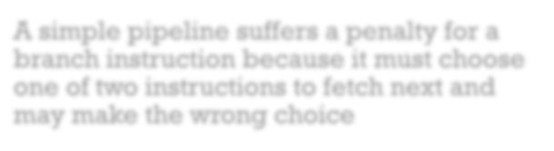


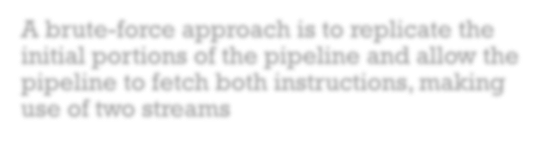
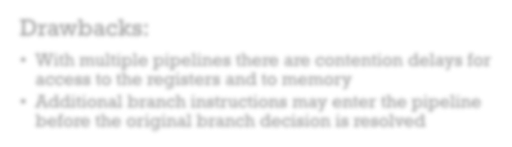

Multiple Streams
A simple pipeline suffers a penalty for a branch instruction because it must choose one of two instructions to fetch next and may make the wrong choice
A brute-force approach is to replicate the initial portions of the pipeline and allow the pipeline to fetch both instructions, making use of two streams
Drawbacks:
With multiple pipelines there are contention delays for
access to the registers and to memory
Additional branch instructions may enter the pipeline before the original branch decision is resolved

Slide 38


Prefetch Branch Target
When a conditional branch is recognized, the target of the branch is prefetched, in addition to the instruction following the branch
Target is then saved until the branch instruction is executed
If the branch is taken, the target has already
been prefetched
IBM 360/91 uses this approach
+

Slide 39

⁺ Loop Buffer
Small, very-high speed memory maintained by the instruction fetch stage of the pipeline and containing the n most recently fetched instructions, in sequence
Benefits:
Instructions fetched in sequence will be available without the usual memory access time
If a branch occurs to a target just a few locations ahead of the address of the branch instruction, the target will already be in the buffer
This strategy is particularly well suited to dealing with loops
Similar in principle to a cache dedicated to instructions
Differences:
The loop buffer only retains instructions in sequence
Is much smaller in size and hence lower in cost

Slide 40

Branch Prediction
+
Various techniques can be used to predict whether a branch
will be taken:
Predict never taken
Predict always taken
Predict by opcode
These approaches are static
They do not depend on the execution history up to the time of the conditional branch instruction
Taken/not taken switch
Branch history table
These approaches are dynamic
They depend on the execution history

Slide 41





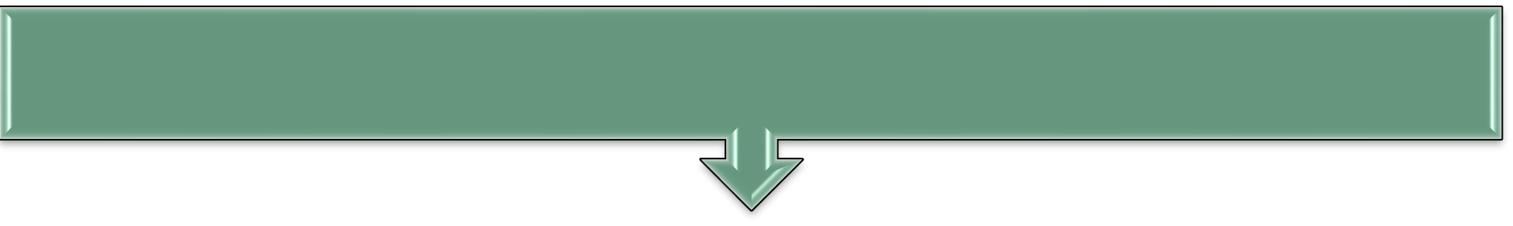
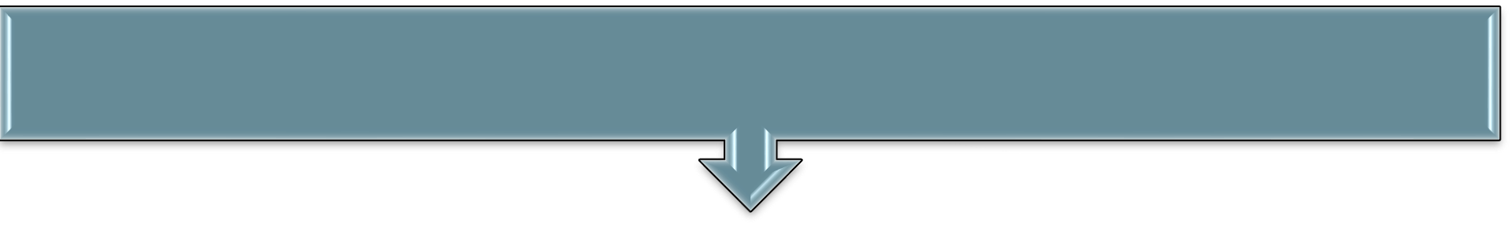

Intel 80486 Pipelining
Fetch
Objective is to fill the prefetch buffers with new data as soon as the old data have been consumed by the instruction decoder
Operates independently of the other stages to keep the prefetch buffers full
Decode stage 1
3 bytes of instruction are passed to the D1 stage from the prefetch buffers
All opcode and addressing-mode information is decoded in the D1 stage
D1 decoder can then direct the D2 stage to capture the rest of the instruction
Decode stage 2
Expands each opcode into control signals for the ALU
Also controls the computation of the more complex addressing
modes
Execute
Stage includes ALU operations, cache access, and register update
Write back
Updates registers and status flags modified during the preceding execute stage

Slide 42
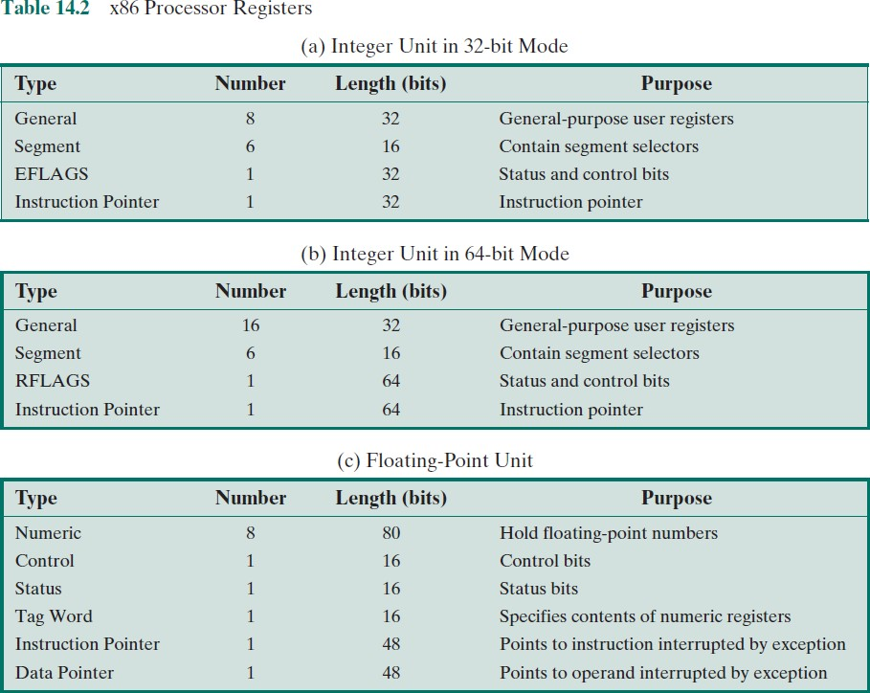

Slide 43
Summary
+
Processor Structure and Function
Chapter 14
Processor organization
Register organization
User-visible registers
Control and status registers
Instruction cycle
The indirect cycle
Data flow
The x86 processor family
Register organization
Interrupt processing
Instruction pipelining
Pipelining strategy
Pipeline performance
Pipeline hazards
Dealing with branches
Intel 80486 pipelining

