Slide 1

Computer Architecture and Logic Design (CALD)
Lecture 09
+

Slide 2
Digital Systems and Binary Numbers
These slides were assembled by Mustafa Kemal Uyguroğlu, with grateful acknowledgement of the many others who made their course materials freely available online. Feel free to reuse or adapt these slides for your own academic purposes, provided that you include proper attribution.

Slide 3
Outline of Chapter 1
🞕 1.1 Digital Systems
🞕 1.2 Binary Numbers
🞕 1.3 Number-base Conversions
🞕 1.4 Octal and Hexadecimal Numbers
🞕 1.5 Complements
🞕 1.6 Binary Storage and Registers
🞕 1.7 Binary Logic

Slide 4
Digital Systems and Binary Numbers
🞕 Digital age and information age
🞕 Digital computers
General purposes
Many scientific, industrial and commercial applications
🞕 Digital systems
Telephone switching exchanges
Digital camera
Electronic calculators, PDA's
Digital TV
🞕 Discrete information-processing systems
Manipulate discrete elements of information
For example, {1, 2, 3, …} and {A, B, C, …}…

Slide 5
Analog and Digital Signal
🞕 Analog system
The physical quantities or signals may vary continuously over a specified range.
🞕 Digital system
The physical quantities or signals can assume only discrete values.
Greater accuracy
X(t) X(t)
t
t
Analog signal
Digital signal

Slide 6
Binary Digital Signal
🞕 An information variable represented by physical quantity.
🞕 For digital systems, the variable takes on discrete values.
Two level, or binary values are the most prevalent values.
🞕 Binary values are represented abstractly by: ^{V(t)}
Digits 0 and 1
Words (symbols) False (F) and True (T)
Words (symbols) Low (L) and High (H)
And words On and Off
 |  | Logic 1
 |  | undefine
 |  | Logic 0
🞕 Binary values are represented by values or ranges of values of physical quantities.
t
Binary digital signal

Slide 7

Decimal Number System
🞕 Base (also called radix) = 10
10 digits { 0, 1, 2, 3, 4, 5, 6, 7, 8, 9 }
🞕 Digit Position
Integer & fraction
2 1 0
-1 -2
🞕 Digit Weight
Weight = (Base) ^{Position}
5
1
2
7
4
100 10 1
0.1 0.01
🞕 Magnitude
Sum of “Digit x Weight”
🞕 Formal Notation
500 10 2 0.7 0.04
_{d} 2 1 0 -1 -2
₂*B +d₁*B +d₀*B +d₋₁*B +d₋₂*B
(512.74)₁₀

Slide 8
Octal Number System
🞕 Base = 8
8 digits { 0, 1, 2, 3, 4, 5, 6, 7 }
🞕 Weights
Weight = (Base) ^{Position}
🞕 Magnitude
Sum of “Digit x Weight”
64 8 1
1/8 1/64
5
1
2
7
4
2 1 0 -1 -2
🞕 Formal Notation
5 *8²+1 *8¹+2 *8⁰+7 *8⁻¹+4 *8⁻
2
=(330.9375)₁₀
(512.74)₈

Slide 9
Binary Number System
🞕 Base = 2
2 digits { 0, 1 }, called binary digits or “bits”
🞕 Weights
Position
4 2 1
1/2 1/4
Weight = (Base)
1
0
1
0
1
🞕 Magnitude
Sum of “Bit x Weight”
2 1 0 -1 -2
1 *2²+0 *2¹+1 *2⁰+0 *2⁻¹+1 *2⁻
🞕 Formal Notation
2
=(5.25)₁₀
(101.01)₂
🞕 Groups of bits
4 bits = Nibble
8 bits = Byte
1 0 1 1
1 1 0 0 0 1 0 1

Slide 10
Hexadecimal Number System
🞕 Base = 16
16 digits { 0, 1, 2, 3, 4, 5, 6, 7, 8, 9, A, B, C, D, E, F }
🞕 Weights
Weight = (Base) ^{Position}
🞕 Magnitude
Sum of “Digit x Weight”
256 16 1
1/16 1/256
1
E
5
7
A
2 1 0 -1 -2
1 *16²+14 *16¹+5 *16⁰+7 *16⁻¹+10 *16⁻²
=(485.4765625)₁₀
(1E5.7A)₁₆
🞕 Formal Notation

Slide 11
The Power of 2
n | ₂n
0 | 2⁰=1
1 | 2¹=2
2 | 2²=4
3 | 2³=8
4 | 2⁴=16
5 | 2⁵=32
6 | 2⁶=64
7 | 2⁷=128
n | ₂n
8 | 2⁸=256
9 | 2⁹=512
10 | 2¹⁰=1024
11 | 2¹¹=2048
12 | 2¹²=4096
20 | 2²⁰=1M
30 | 2³⁰=1G
40 | 2⁴⁰=1T
Kilo
Mega
Giga Tera

Slide 12
Addition
🞕 Decimal Addition
1 1
5 5
+ 5 5
Carry
1 1 0

Slide 13
Binary Addition
🞕 Column Addition
1 1 |  | 1 | 1 | 1 | 1
1 |  | 1 | 1 | 1 | 0 | 1 | = 61
+ |  | 1 | 0 | 1 | 1 | 1 | = 23
1 | 0 | 1 | 0 | 1 | 0 | 0 | = 84

Slide 14
Binary Subtraction
🞕 Borrow a “Base” when needed
 |  | 1 |  |  | 2 |  |  | = (10)₂
 | 0 | 2 | 2 | 0 | 0 | 2
 | 1 | 0 | 0 | 1 | 1 | 0 | 1 | = 77
− |  |  | 1 | 0 | 1 | 1 | 1 | = 23
 | 0 | 1 | 1 | 0 | 1 | 1 | 0 | = 54

Slide 15
Binary Multiplication
🞕 Bit by bit
 |  | 1 | 0 | 1 | 1 | 1
x |  |  | 1 | 0 | 1 | 0
 |  | 0 | 0 | 0 | 0 | 0
 | 1 | 0 | 1 | 1 | 1
0 | 0 | 0 | 0 | 0
1 0 | 1 | 1 | 1
1 1 | 1 | 0 | 0 | 1 | 1 | 0

Slide 16
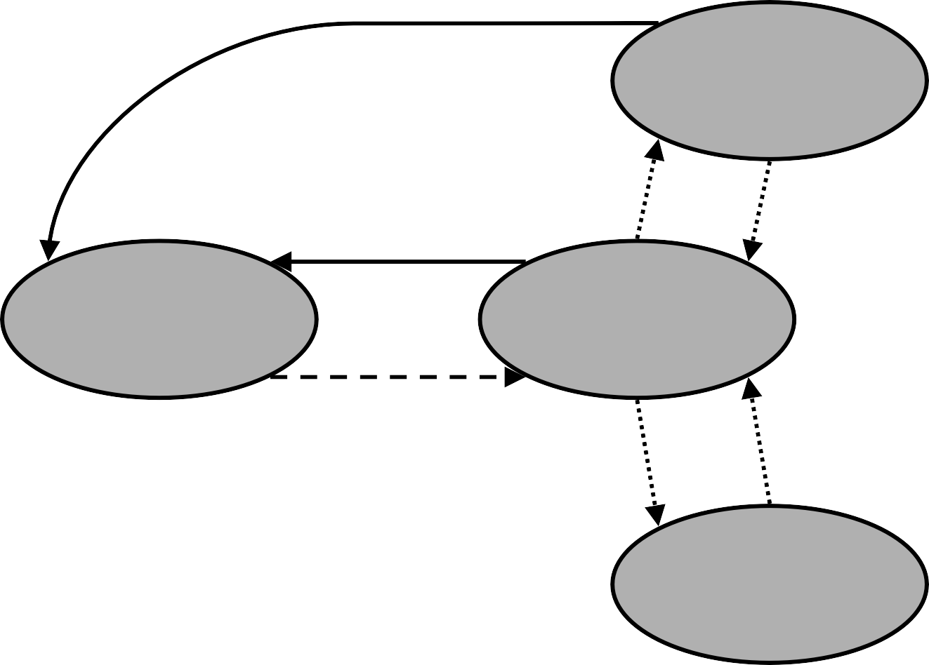
Number Base Conversions
Evaluate Magnitude
Octal (Base 8)
Evaluate Magnitude
Decimal (Base 10)
Binary (Base 2)
Hexadecimal (Base 16)
Evaluate Magnitude

Slide 17

Decimal (Integer) to Binary Conversion
🞕 Divide the number by the ‘Base’ (=2)
🞕 Take the remainder (either 0 or 1) as a coefficient
🞕 Take the quotient and repeat the division
Example: (13)₁₀
Quotient Remainder
6 1
3 0
1 1
0 1
Coefficient
a₀ = 1
a₁ = 0
a₂ = 1
a₃ = 1
13/ 2 =
6 / 2 =
3 / 2 =
1 / 2 =
Answer:
(13)₁₀ = (a₃ a₂ a₁ a₀)₂ = (1101)₂
MSB LSB

Slide 18

Decimal (Fraction) to Binary Conversion
🞕 Multiply the number by the ‘Base’ (=2)
🞕 Take the integer (either 0 or 1) as a coefficient
🞕 Take the resultant fraction and repeat the division
Example: (0.625)₁₀
 | Integer Fraction | Coefficient
0.625 * 2 = | 1 . 25 | a₋₁ = 1
0.25 * 2 = | 0 . 5 | a₋₂ = 0
0.5 * 2 = | 1 . 0 | a₋₃ = 1
Answer:
(0.625)₁₀ = (0.a₋₁ a₋₂ a₋₃)₂ = (0.101)₂
MSB LSB

Slide 19
Decimal to Octal Conversion
Example: (175)₁₀
Quotient
175 / 8 = 21
Remainder
7
Coefficient
a₀ = 7
21 | / 8 = | 2 | 5 | a₁ = 5
2 | / 8 = | 0 | 2 | a₂ = 2
Answer:
(175)₁₀ = (a₂ a₁ a₀)₈ = (257)₈
Example: (0.3125)₁₀
Integer Fraction
2 . 5
4 . 0
Coefficient
a₋₁ = 2
a₋₂ = 4
0.3125 * 8 =
0.5 * 8 =
Answer: (0.3125)₁₀ = (0.a₋₁ a₋₂ a₋₃)₈ = (0.24)₈

Slide 20
Binary − Octal Conversion
Octal | Binary
0 | 0 0 0
1 | 0 0 1
2 | 0 1 0
3 | 0 1 1
4 | 1 0 0
5 | 1 0 1
6 | 1 1 0
7 | 1 1 1
🞕 8 = 2³
🞕 Each group of 3 bits represents an octal digit
Example:
Assume Zeros
( 1 0 1 1 0 . 0 1 )₂
( 2 6 . 2 )₈
Works both ways (Binary to Octal & Octal to Binary)

Slide 21
Binary − Hexadecimal Conversion
Hex | Binary
0 | 0 0 0 0
1 | 0 0 0 1
2 | 0 0 1 0
3 | 0 0 1 1
4 | 0 1 0 0
5 | 0 1 0 1
6 | 0 1 1 0
7 | 0 1 1 1
8 | 1 0 0 0
9 | 1 0 0 1
A | 1 0 1 0
B | 1 0 1 1
C | 1 1 0 0
D | 1 1 0 1
E | 1 1 1 0
F | 1 1 1 1
🞕 16 = 2⁴
🞕 Each group of 4 bits represents a hexadecimal digit
Example:
Assume Zeros
( 1 0 1 1 0 . 0 1 )
2
( 1 6 . 4
⁾16
Works both ways (Binary to Hex & Hex to Binary)

Slide 22
Octal − Hexadecimal Conversion
🞕 Convert to Binary as an intermediate step
Example:
( 2 6 . 2 )₈
Assume Zeros
Assume Zeros
( 0 1 0 1 1 0 . 0 1 0 )₂
( 1 6 . 4
⁾16
Works both ways (Octal to Hex & Hex to Octal)

Slide 23
Decimal, Binary, Octal and Hexadecimal
Decimal | Binary | Octal | Hex
00 | 0000 | 00 | 0
01 | 0001 | 01 | 1
02 | 0010 | 02 | 2
03 | 0011 | 03 | 3
04 | 0100 | 04 | 4
05 | 0101 | 05 | 5
06 | 0110 | 06 | 6
07 | 0111 | 07 | 7
08 | 1000 | 10 | 8
09 | 1001 | 11 | 9
10 | 1010 | 12 | A
11 | 1011 | 13 | B
12 | 1100 | 14 | C
13 | 1101 | 15 | D
14 | 1110 | 16 | E
15 | 1111 | 17 | F

Slide 24
1.5 Complements
🞕 There are two types of complements for each base-r system: the radix
complement and diminished radix complement.
🞕 Diminished Radix Complement - (r-1)’s Complement
Given a number N in base r having n digits, the (r–1)’s complement of N is defined as:
(r^{n} –1) – N
🞕 Example for 6-digit decimal numbers:
9’s complement is (r^{n} – 1)–N = (10⁶–1)–N = 999999–N
9’s complement of 546700 is 999999–546700 = 453299
🞕 Example for 7-digit binary numbers:
1’s complement is (r^{n} – 1) – N = (2⁷–1)–N = 1111111–N
1’s complement of 1011000 is 1111111–1011000 = 0100111
🞕 Observation:
Subtraction from (r^{n} – 1) will never require a borrow
Diminished radix complement can be computed digit-by-digit
For binary: 1 – 0 = 1 and 1 – 1 = 0

Slide 25
Complements
🞕 1’s Complement (Diminished Radix Complement)
All ‘0’s become ‘1’s
All ‘1’s become ‘0’s
Example (10110000)₂
(01001111)₂
If you add a number and its 1’s complement …
1 0 1 1 0 0 0 0
+ 0 1 0 0 1 1 1 1
1 1 1 1 1 1 1 1

Slide 26
Complements
🞕 Radix Complement
The r's complement of an n-digit number N in base r is defined as
r^{n} – N for N ≠ 0 and as 0 for N = 0. Comparing with the (r − 1) 's complement, we note that the r's complement is obtained by adding 1 to the (r − 1) 's complement, since r^{n} – N = [(r^{n} − 1) – N] + 1.
🞕 Example: Base-10
The 10's complement of 012398 is 987602 The 10's complement of 246700 is 753300
The 2's complement of 1101100 is 0010100 The 2's complement of 0110111 is 1001001
🞕 Example: Base-2

Slide 27
Complements
🞕 2’s Complement (Radix Complement)
Take 1’s complement then add 1
Toggle all bits to the left of the first ‘1’ from the right
OR
Example: Number: 1’s Comp.:
 | 1 0 1 1 0 0 0 0 | 1 0 1 1 0 0 0 0
 | 0 1 0 0 1 1 1 1
+ | 1
 | 0 1 0 1 0 0 0 0 | 0 1 0 1 0 0 0 0

Slide 28
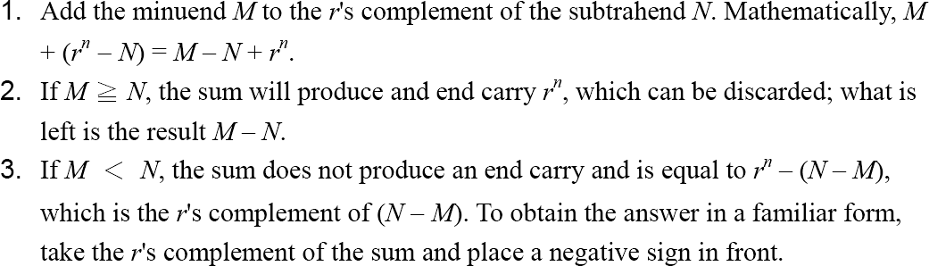
Complements
🞕 Subtraction with Complements
The subtraction of two n-digit unsigned numbers M – N in base r
can be done as follows:

Slide 29
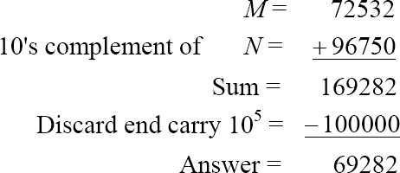
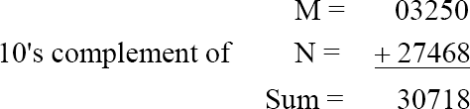
Complements
🞕 Example 1.5
Using 10's complement, subtract 72532 – 3250.
🞕 Example 1.6
Using 10's complement, subtract 3250 – 72532.
There is no end carry.
Therefore, the answer is – (10's complement of 30718) = − 69282.

Slide 30
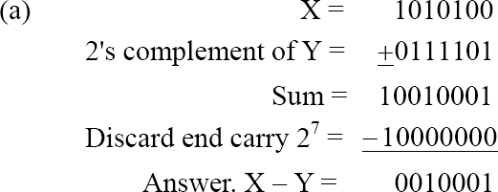
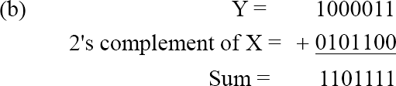
Complements
🞕 Example 1.7
Given the two binary numbers X = 1010100 and Y = 1000011, perform the subtraction (a) X – Y ; and (b) Y − X, by using 2's complement.
There is no end carry. Therefore, the answer is
Y – X = − (2's complement of 1101111) = − 0010001.

Slide 31
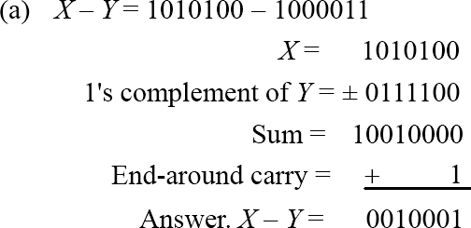
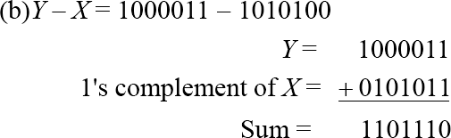
Complements
🞕 Subtraction of unsigned numbers can also be done by means of the (r
1)'s complement. Remember that the (r − 1) 's complement is one less then the r's complement.
🞕 Example 1.8
Repeat Example 1.7, but this time using 1's complement.
There is no end carry, Therefore, the answer is Y – X = − (1's complement of 1101110) = − 0010001.

Slide 32
1.8 Binary Storage and Registers
🞕 Registers
A binary cell is a device that possesses two stable states and is capable of storing
one of the two states.
A register is a group of binary cells. A register with n cells can store any discrete quantity of information that contains n bits.
n cells
2^{n} possible states
🞕 A binary cell
Two stable state
Store one bit of information
Examples: flip-flop circuits, capacitor
🞕 A register
A group of binary cells
AX in x86 CPU
🞕 Register Transfer
A transfer of the information stored in one register to another.
One of the major operations in digital system.

Slide 33
A Digital Computer Example
Memory
Control unit
Datapath
CPU
Inputs: Keyboard,
Outputs: CRT, LCD, modem, speakers
mouse, modem, microphone
Input/Output
Synchronous or Asynchronous?

Slide 34
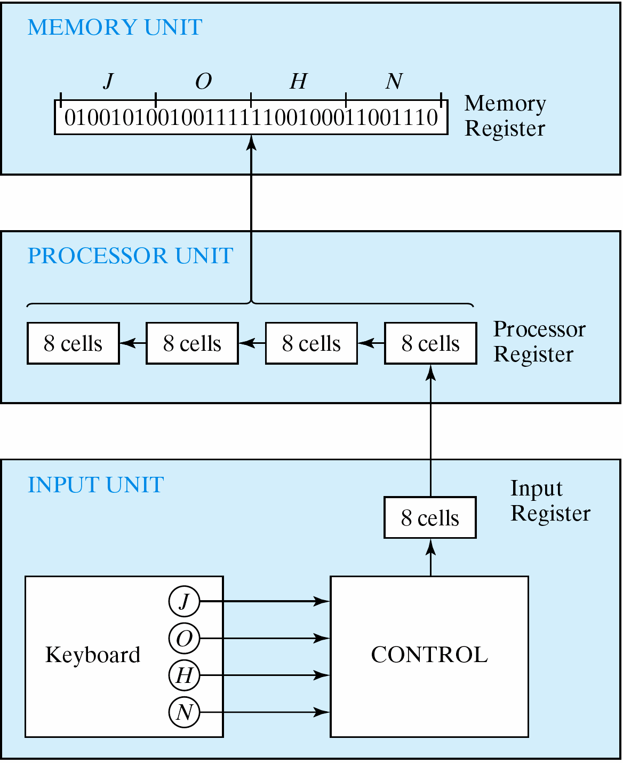
Transfer of information
Figure 1.1 Transfer of information among register

Slide 35
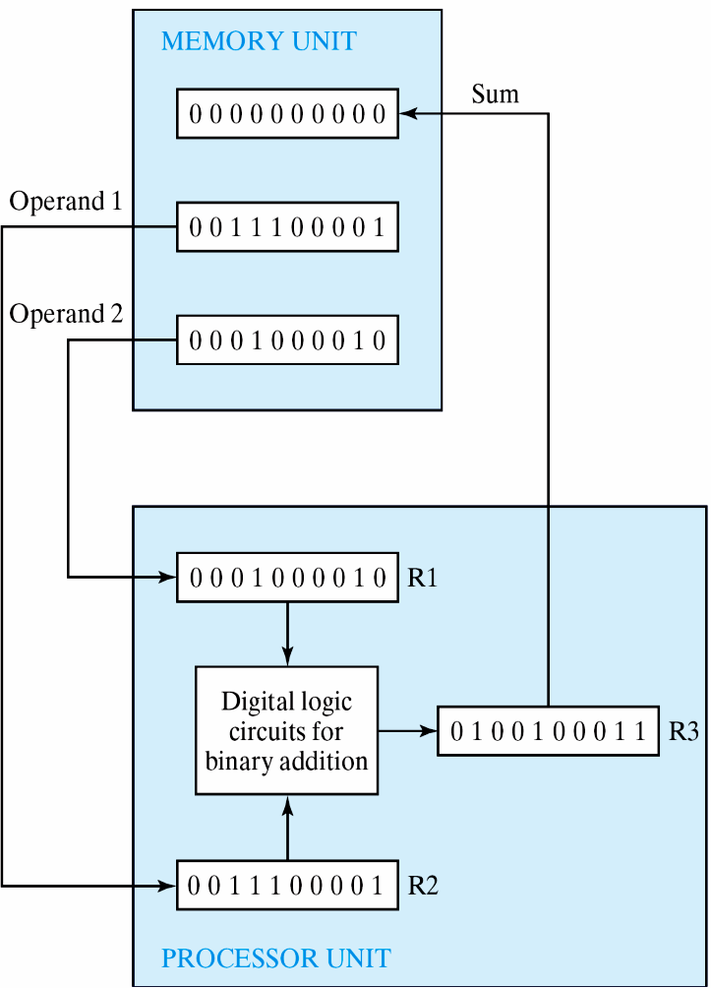
Transfer of information
🞕 The other major component of a digital system
Circuit elements to manipulate
individual bits of information
Load-store machine LD R1;
LD R2;
ADD R3, R2, R1; SD R3;
Figure 1.2 Example of binary information processing

Slide 36
1.9 Binary Logic
🞕 Definition of Binary Logic
Binary logic consists of binary variables and a set of logical operations.
The variables are designated by letters of the alphabet, such as A, B, C, x, y, z, etc, with each variable having two and only two distinct possible values: 1 and 0,
Three basic logical operations: AND, OR, and NOT.

Slide 37
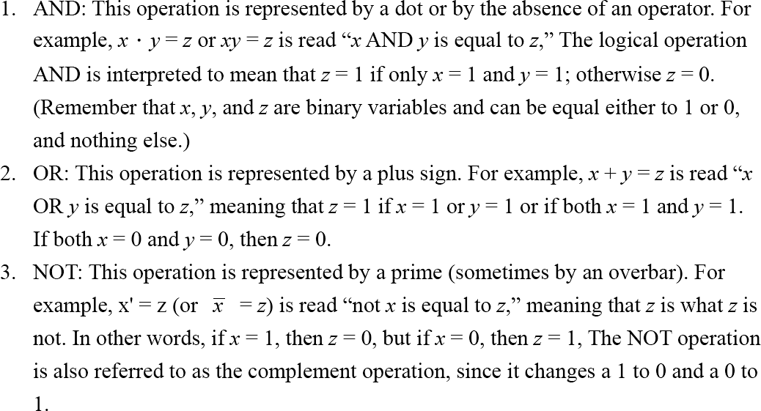
1.9 Binary Logic

Slide 38
Binary Logic
Truth Tables, Boolean Expressions, and Logic Gates
AND OR
NOT
x | y | z
0 | 0 | 0
0 | 1 | 0
1 | 0 | 0
1 | 1 | 1
x | y | z
0 | 0 | 0
0 | 1 | 1
1 | 0 | 1
1 | 1 | 1
x | z
0 | 1
1 | 0
z = x • y = x y
z = x + y
z = x = x’
x
z
x
z
x
z
y
y

Slide 39







Switching Circuits
AND
OR

Slide 40
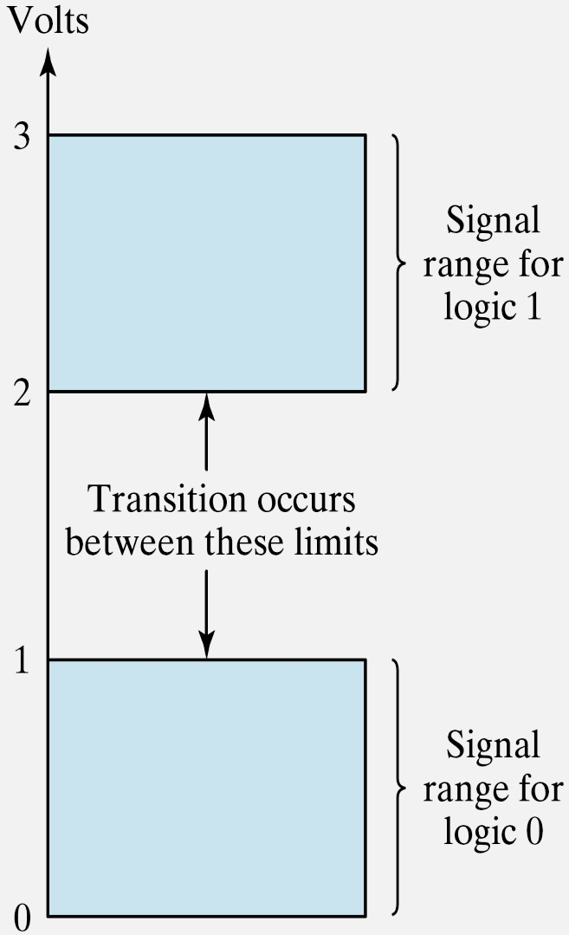
Binary Logic
🞕 Logic gates
Example of binary signals
3
Logic 1
2
Un-define
1
Logic 0
0
Figure 1.3 Example of binary signals

Slide 41
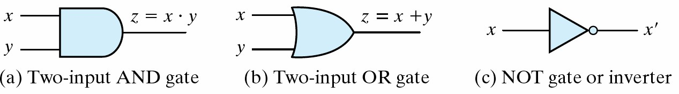
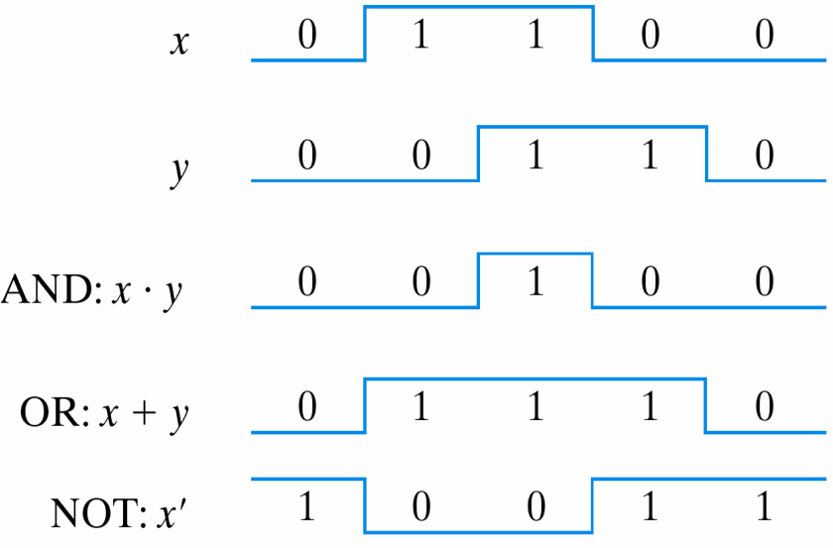
Binary Logic
🞕 Logic gates
Graphic Symbols and Input-Output Signals for Logic gates:
Fig. 1.4 Symbols for digital logic circuits
Fig. 1.5 Input-Output signals for gates

Slide 42
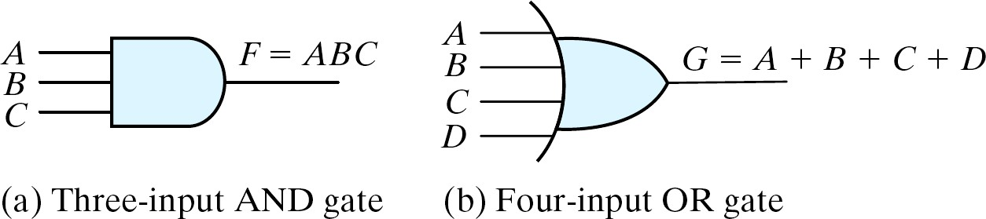
Binary Logic
🞕 Logic gates
Graphic Symbols and Input-Output Signals for Logic gates:
Fig. 1.6
Gates with multiple inputs

